Slide 1

Expert Systems: Smart Help for Tricky Problems
Welcome to the world of Expert Systems. In this presentation, we will explore how computers can mimic the decision-making ability of a human expert to solve complex problems simply and efficiently.

Slide 2

What is an Expert System?
A Super-Smart Digital Helper
Think of an Expert System as a software program that acts like a specialist. It doesn't just process data; it uses reasoning to provide advice or solve problems in specific areas like medicine or finance.
Emulates human expertise
Handles complex logic
Provides reliable "If-Then" solutions

Slide 3



How do Expert Systems Think?
Just like a master chef follows a recipe book, an expert system follows a logical path to reach a conclusion.
Gather Facts
Apply Rules
Reach Answer
The system looks at the current data provided by the user.
It matches those facts against a set of expert rules.
It delivers a logical conclusion or suggestion.
This "reasoning" is what makes it different from a standard search engine.

Slide 4



The Knowledge Base
Where all the wisdom lives
The Knowledge Base is the heart of the system. It is a massive storage of specialized facts and heuristics (rules of thumb) provided by real human experts.
Did you know? Without a high-quality knowledge base, an expert system is like a genius with no memory. It contains the "What" and the "How" of a specific field.

Slide 5
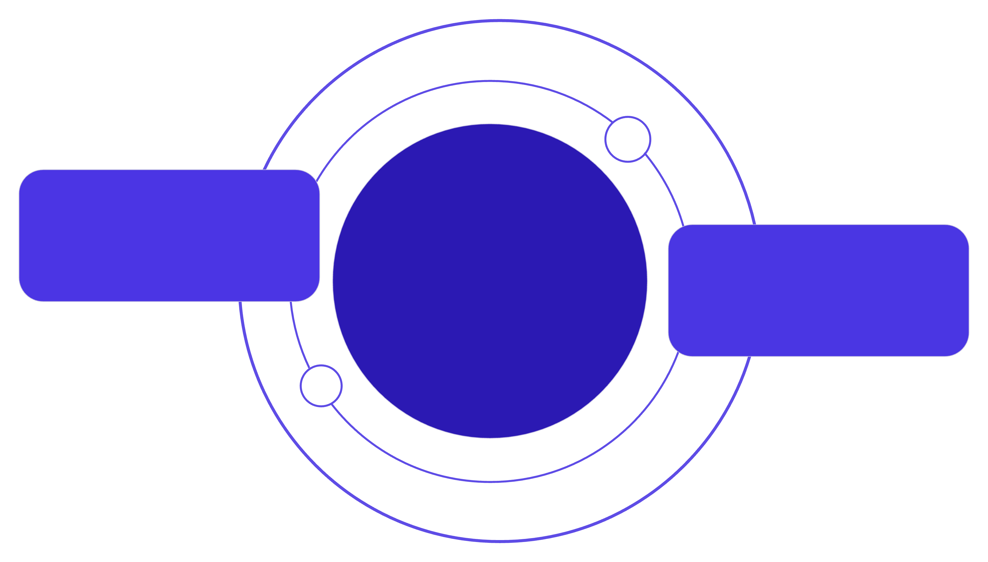
The Inference Engine
The Thinker: Solving the Puzzle
User Interface
Collects inputs and displays results
Inference Engine
Knowledge Base
The brain using forward and backward chaining
Stores facts, rules, and evidence
The Inference Engine is the "brain" that processes the knowledge. It uses two main methods:
Forward Chaining: Starts from facts to reach a goal.
Backward Chaining: Starts with a goal and works back to find supporting facts.

Slide 6

Why use Expert Systems?
The Benefits of Automated Expertise
High Consistency
Available 24/7
Speedy Solutions
Computers don't have "bad days." They give the same answer every time if the facts are the same.
Unlike human experts who need sleep, these systems are always ready to help.
They can scan thousands of rules in seconds to find the right path.

Slide 7






Where do we see them?
Real-World Applications
Healthcare
Finance
Games
Assisting doctors in diagnosing rare diseases based on symptoms.
Reviewing loan applications and detecting fraudulent transactions.
Powering the logic of opponents in complex strategy games.

Slide 8



Building an Expert System
A Quick Look at the Process
Knowledge Acquisition
Knowledge Engineering
Testing & Refinement
Interviewing human experts to gather their secrets and rules.
Translating that human wisdom into code and logic rules.
Checking the system against real cases to ensure accuracy.
The Knowledge Engineer is the bridge between the human expert and the computer.

Slide 9

Challenges and the Future
The Road Ahead
Current Hurdles
The Future
Hard to update manual rules
Combining Expert Systems with Machine Learning so they can learn from new data automatically without human intervention.
Lack of "common sense"
High initial setup cost

Slide 10
Key Takeaways
Expert Systems take the world's most complex knowledge and make it accessible to everyone.
Expertise Scaled
Reliable Logic
Simple & Smart
They bring specialist knowledge to remote areas or busy workplaces.
They provide a structured, error-free way to solve difficult puzzles.
They prove that even the hardest problems can be simplified with the right rules.
Empowering Decisions with Digital Wisdom

