Slide 1
Weather Imaging CubeSat with Telemetry Transmission
Submitted by

Slide 2
Hardware components
Stm32 Controller
Atmega328
Battery
Solar Panels
Camera Module
Magnetometer
Infrared Sensor
Temperature Sensor
OLED
Buzzer
LED’s
PCB Board
Resistors
Capacitors
Transistors
Cables and Connectors
Cubesat Frame
Nuts and Bolts

Slide 3
Abstract
Satellites are launched in orbit for a variety of purposes including communication, GPS, Weather imaging and similar applications. Weather imaging satellites are used to transmit data about weather parameters that can be used for prediction and forecasting systems.
So here we develop a demo weather imaging and parameter transmission satellite to transmit weather data for analysis back to the earth. The satellite delivers following functions:
Record and transmit earth weather imaging data
Sense and transmit infrared radiation levels to detect solar winds
Sense and transmit temperature
Self Charge itself using Solar Power

Slide 4
The system makes use of an STM32 controller along with a solar panel, battery for power supply, a magnetometer, infrared sensor, temperature sensor, a camera and 2.4Ghz rf transmitter to develop the satellite. We here develop a basic Cubesat design without an ACDS stabilizer system with more focus towards weather data gathering and transmission part.
The CUBE SAT body is a cubicle shaped frame made of 4 sides. The 4 parts are merged to develop a cube with mounting holes for the controller, sensors, circuit board, solar panels and battery. The solar panels are used to generate energy that is storec in battery using charge controller and charging circuitry.
The battery charging and auto cutoff is managed by circuitry to avoid overcharging and maintain battery health. The magnetometer is used to check orientation of the cubesat. The sensor transmits orientation data to controller. The Temperature sensor is used to measure the orbital temperature. Infrared sensor is mounted on top to help measure the infrared radiation from the sun and detect solar waves/blasts.

Slide 5
The camera is mounted at the bottom of the cubesat for capturing live footage of the earth from above. This footage along with the sensor data is transmitted by the controller through a 2.4Ghz RF transmitter module with a high gain antenna for max distance transmission. The sensor data is also displayed on an LCD Display for reference.
The transmitted data is now received by a receiving station on the ground. The ground station circuit consists of an LCD display and footage display. The 2.4Ghz receiver is used to receive the signals from cubesat and display all the data for further processing.

Slide 6
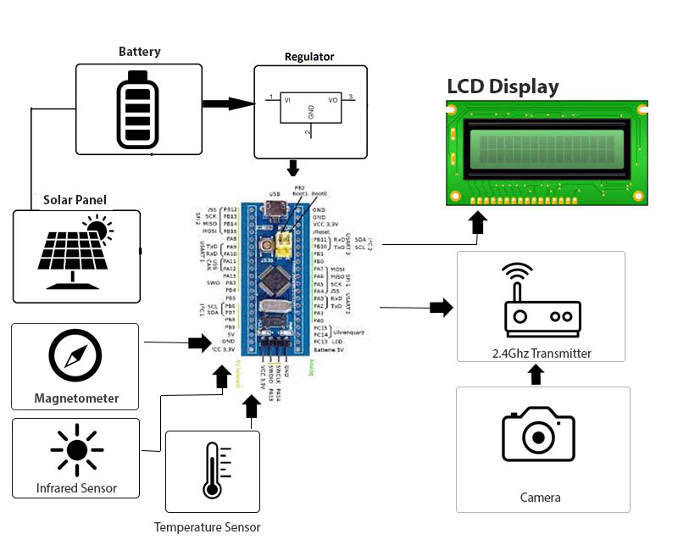
Block Diagram

Slide 7
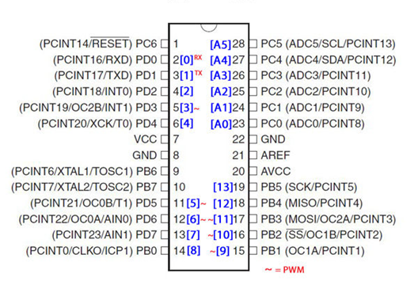
Atmega328
The Atmel ATmega328P is a 32K 8-bit microcontroller based on the AVR architecture. Many instructions are executed in a single clock cycle providing a throughput of almost 20 MIPS at 20MHz. The ATMEGA328-PU comes in an PDIP 28 pin package and is suitable for use on our 28 pin AVR Development Board.

Slide 8
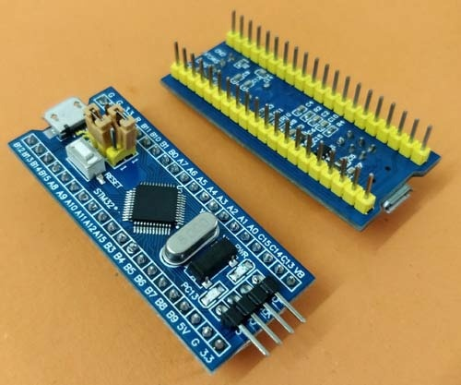
STM32 Controller
The STM32F103C8T6 (also known as ‘STM32’ or ‘Blue Pill”) is a cheap development board based on the ARM Cortex M3 microprocessor.

Slide 9
Naming Convention of STM microcontrollers
Parameter Meaning
STM name of the manufacturer (STMicroelectronics)
32 32 bit ARM architecture
F Foundation
1 Core (ARM Cortex M3)
03 Line (describes peripherals and speed)
C 48 pins
8 64 KB flash memory
T LQFP package (Low Profile Quad Flat Pack)
6 Operating Temperature Range (-40 °C to 85 °C)

Slide 10
Technical Specifications of STM32
Parameter Meaning
Architecture 32 bit ARM Cortex M3
Operating Voltage 2.7V to 3.6V
CPU Frequency 72 MHz
Number of GPIO pins 37
Number of PWM pins 12
Analog Input Pins 10 (12 bit resolution)
I2C Peripherals 2
SPI Peripherals 2
CAN 2.0 Peripheral 1
Timers 3(16-bit), 1
Flash Memory 64KB
RAM 20kB

Slide 11
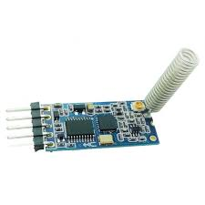
HC12
The HC-12 is a half-duplex wireless serial communication module with 100 channels in the 433.4-473.0 MHz range that is capable of transmitting up to 1 km. This project will begin by using the HC-12 to create a wireless link between two computers and end with a second article that creates a simple wireless GPS tracker.The HC-12 is a half-duplex 20 dBm (100 mW) transmitter paired with a receiver that has -117 dBm (2×10-15 W) sensitivity at 5000 bps.Paired with an external antenna, these transceivers are capable of communicating up to and possibly slightly beyond 1 km in the open and are more than adequate for providing coverage throughout a typical house.

Slide 12
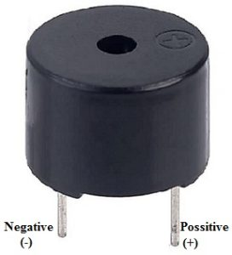
Buzzer
An audio signaling device like a beeper or buzzer may be electromechanical or piezoelectric or mechanical type. The main function of this is to convert the signal from audio to sound. Generally, it is powered through DC voltage and used in timers, alarm devices, printers, alarms, computers, etc. Based on the various designs, it can generate different sounds like alarm, music, bell & siren.

Slide 13
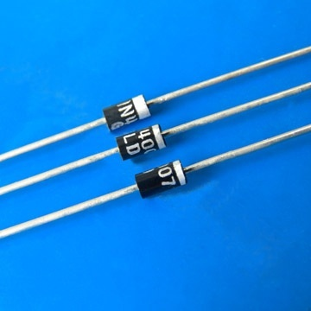
1N4007
Diodes are used to convert AC into DC these are used as half wave rectifier or full wave rectifier. Three points must he kept in mind while using any type of diode.
Maximum forward current capacity
Maximum reverse voltage capacity
Maximum forward voltage capacity

Slide 14
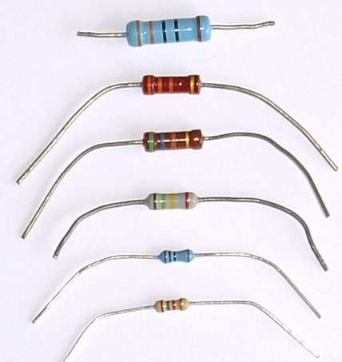
Resistors
A resistor is a two-terminal electronic component designed to oppose an electric current by producing a voltage drop between its terminals in proportion to the current, that is, in accordance with Ohm's law:
V = IR

Slide 15
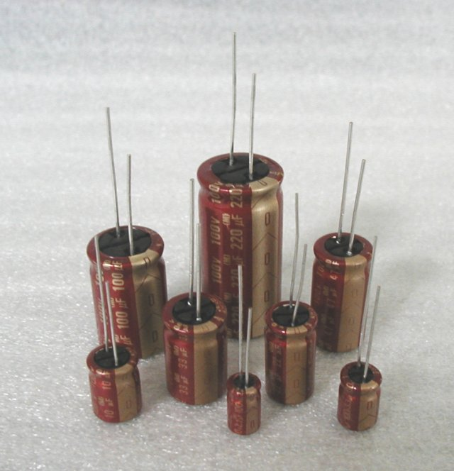
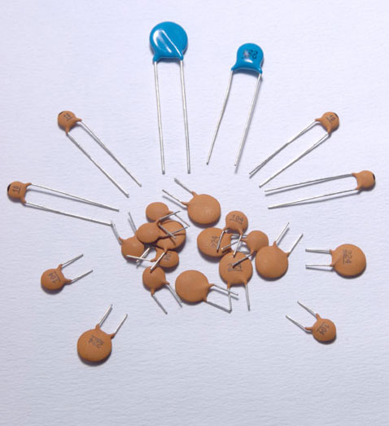
Capacitors
A capacitor or condenser is a passive electronic component consisting of a pair of conductors separated by a dielectric. When a voltage potential difference exists between the conductors, an electric field is present in the dielectric. This field stores energy and produces a mechanical force between the plates. The effect is greatest between wide, flat, parallel, narrowly separated conductors.

Slide 16
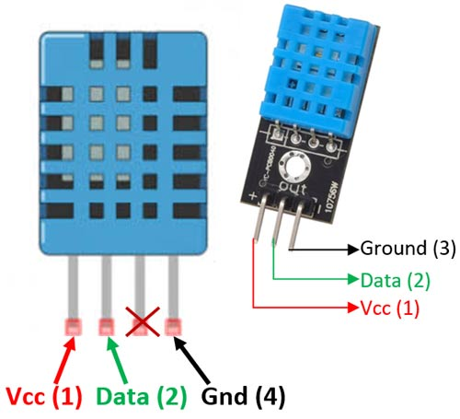
Dht11–temperature And Humidity Sensor
The DHT11 is a commonly used Temperature and humidity sensor that comes with a dedicated NTC to measure temperature and an 8-bit microcontroller to output the values of temperature and humidity as serial data.
The DHT11 is a commonly used Temperature and humidity sensor. The sensor comes with a dedicated NTC to measure temperature and an 8-bit microcontroller to output the values of temperature and humidity as serial data. The sensor is also factory calibrated and hence easy to interface with other microcontrollers.

Slide 17
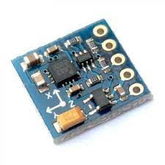
Magnetometer
The HMC5883L is a triple-axis magnetometer compass, which uses I2C for communication. This Module consists of an on-board voltage regulator allowing you to power the module with voltages between 3.3V and 6V.
This HMC5883L Magnetometer Module consists of an HMC5883L Magnetometer IC, Voltage Regulator IC, resistors, and capacitors in an integrated circuit. Different manufacturers use a different voltage regulator IC. Most of the modules use XC6206P332MR (662K) IC.

Slide 18
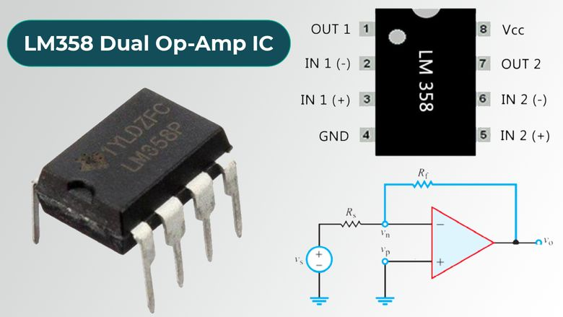
LM 358
LM358 IC is a dual operational amplifier integrated circuit with two Op-Amp powered by a common power supply. It consists of two independent compensated operational amplifiers with low power and high gain frequency.

Slide 19
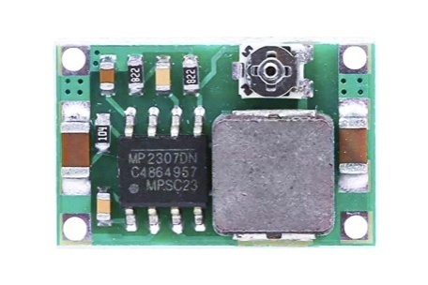
Mini Buck Module
The Mini360 is a small but efficient buck converter module built around the MP2307 from Monolithicpower. This Module is capable of outputting an adjustable DC voltage of 1-17V range, with an input voltage range of 4.75-23V DC. It has a maximum surge current of 3A, while the recommended maximum continuous current is 1.8A. The Output voltage can be adjusted using the onboard potentiometer.

Slide 20
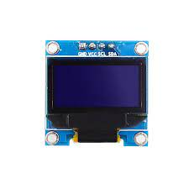
Oled
To start with let us understand what these OLED displays mean. The term OLED stands for “Organic Light emitting diode” it uses the same technology that is used in most of our televisions but has fewer pixels compared to them. It is real fun to have these cool looking display modules to be interfaced with the Microcontrollers since it will make our projects look cool.

Slide 21
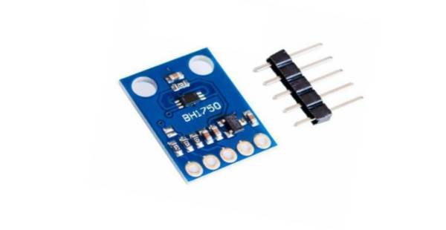
Light Sensor
BH1750 is a digital ambient light sensor that is used commonly used in mobile phones to manipulate the screen brightness based on the environment lighting. This sensor can accurately measure the LUX value of light up to 65535lx.
BH1750 Features
Power Supply: 2.4V-3.6V (typically 3.0V)
Less current consumption: 0.12mA
Measuring Rang: 1-65535lx
Communication: I2C bus
Accuracy: +/-20%
Built in A/D converter for converting analog illuminance in the digital data.
Very small effect of IR radiation
Highly responsive near to human eye.

Slide 22

Solar Panel
Solar PV panels are comprised of many small photovoltaic cells – photovoltaic meaning they can convert sunlight into electricity. These cells are made of semi-conductive materials, most often silicon, a material that can conduct electricity while maintaining the electrical imbalance needed to create an electric field.

Slide 23
Software Requirements
Arduino Integrated Development Environment (IDE) v1
Learn how the Arduino IDE v1 works, such as compiling & uploading sketches, file management, installing dependencies and much more.
The Arduino Integrated Development Environment - or Arduino Software (IDE) - contains a text editor for writing code, a message area, a text console, a toolbar with buttons for common functions and a series of menus. It connects to the Arduino hardware to upload programs and communicate with them.

Slide 24
Writing Sketches
Programs written using Arduino Software (IDE) are called sketches. These sketches are written in the text editor and are saved with the file extension .ino. The editor has features for cutting/pasting and for searching/replacing text. The message area gives feedback while saving and exporting and also displays errors. The console displays text output by the Arduino Software (IDE), including complete error messages and other information. The bottom righthand corner of the window displays the configured board and serial port. The toolbar buttons allow you to verify and upload programs, create, open, and save sketches, and open the serial monitor.

