Slide 1


Introduction to Tourism Trends
Tourism trends are crucial for the travel industry's success. Understanding these trends helps businesses adapt to changing preferences and cater to diverse traveler needs.
Ankit Raj – 20BCS5019
Inderjeet Singh – 20BCS5138
Ridhim Mittal – 20BCS4979

Slide 2
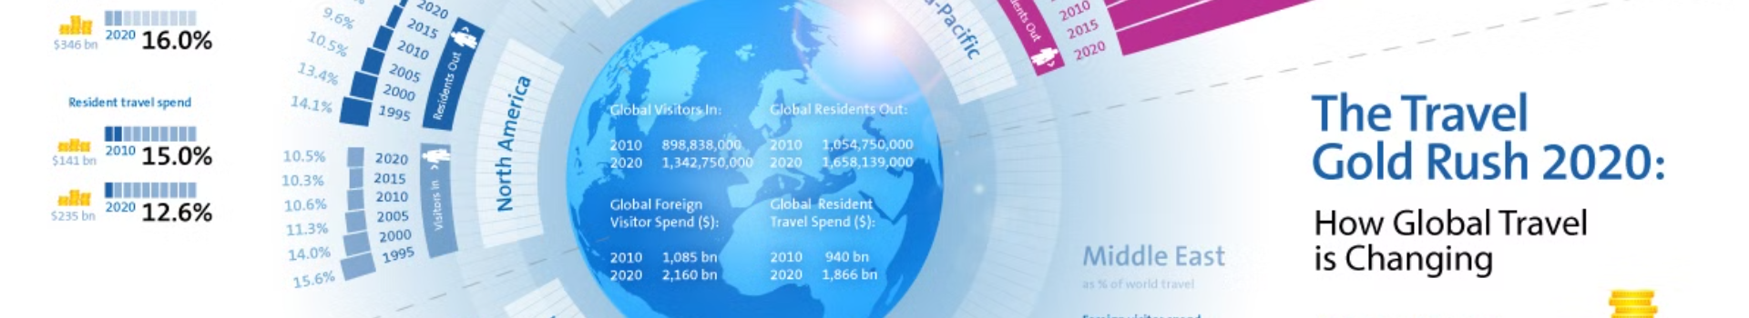
Importance of Predicting Tourism Trends
1
Strategic Decisions
2
Customer Satisfaction
3
Industry Growth
Accurate predictions contribute to the growth and sustainability of the tourism industry.
Predicting tourism trends aids in strategic decision-making for businesses and tourist destinations.
It ensures satisfying and appealing offerings for travelers, enhancing their overall experience.

Slide 3
Data Sources for Predicting Tourism Trends
Online Analytics
Market Research
Government Reports
Utilizing web data and social media insights to understand traveler behavior.
Gathering information on consumer preferences and industry patterns for trend analysis.
Accessing official data on tourist arrivals, spending, and travel patterns for accurate forecasting.

Slide 4
Key Factors Influencing Tourism Trends
Economic Changes
Cultural Shifts
Technological Advancements
Fluctuations in income, exchange rates, and employment significantly impact travel trends.
Changes in cultural and social behaviors influence the choice of travel destinations and activities.
Innovations like online booking platforms and travel apps affect travel patterns and preferences.

Slide 5
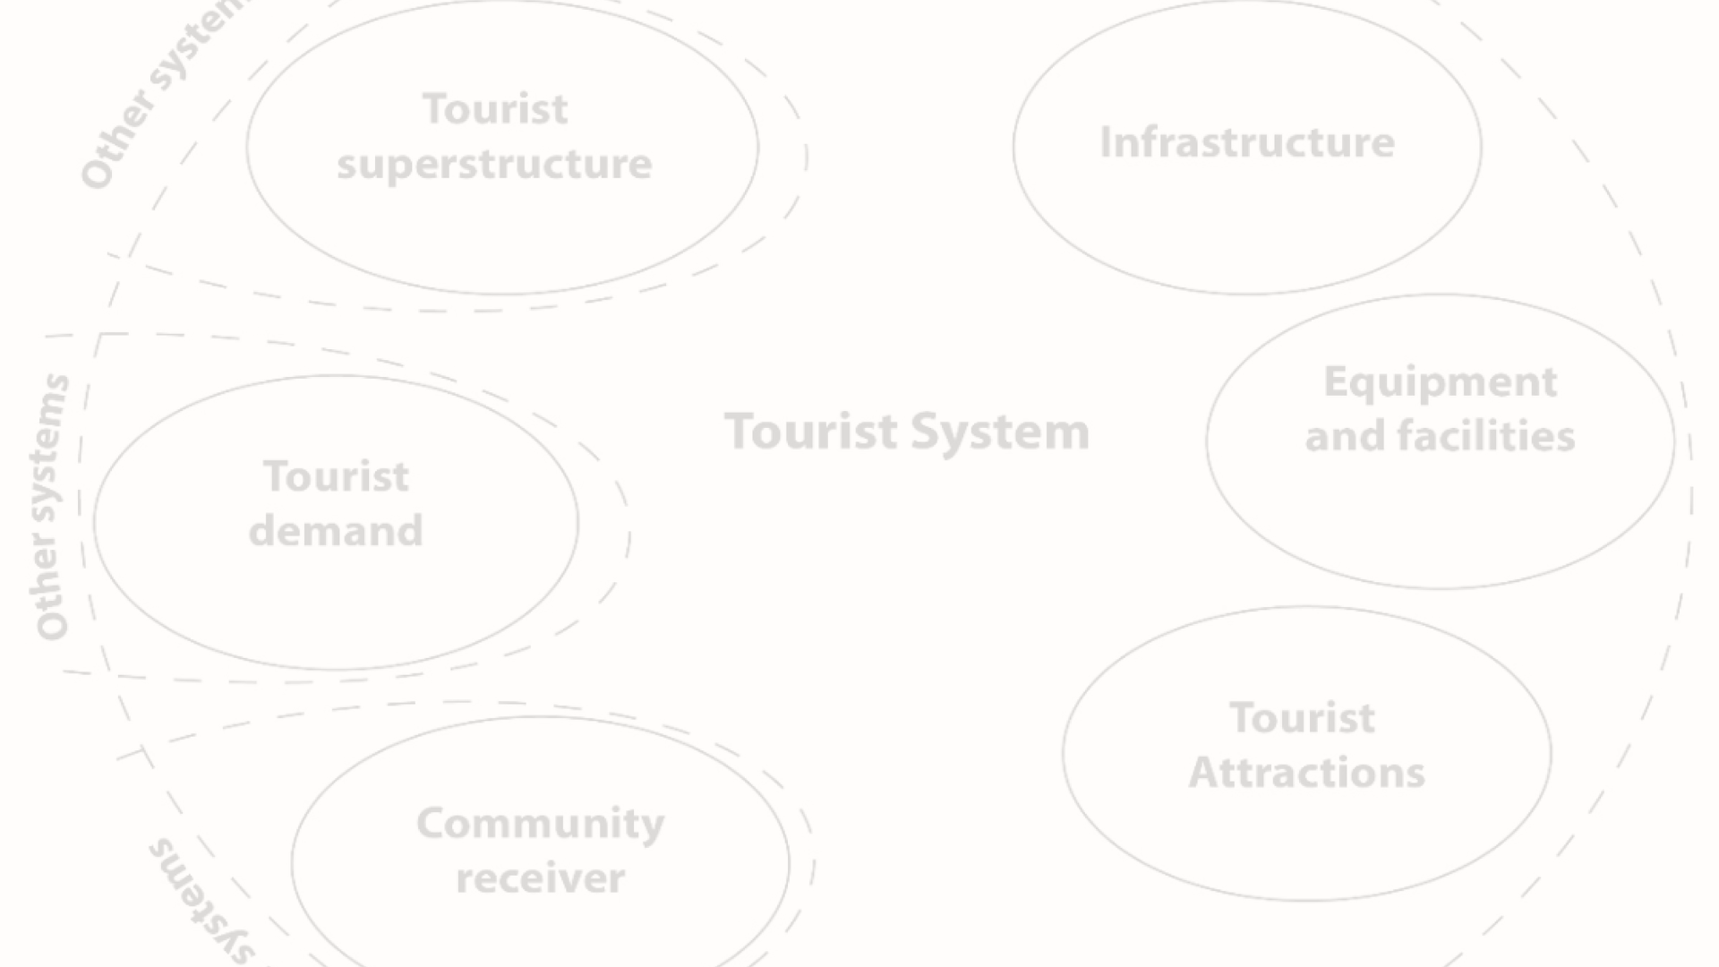



Methods and Models for Predicting Tourism Trends
Data Analysis
Trend Forecasting
Scenario Planning
Utilizing statistical and machine learning models to analyze historical and current travel data.
Applying predictive algorithms to anticipate future travel behaviors and preferences.
Developing models to predict potential tourism outcomes based on different scenarios and variables.

Slide 6
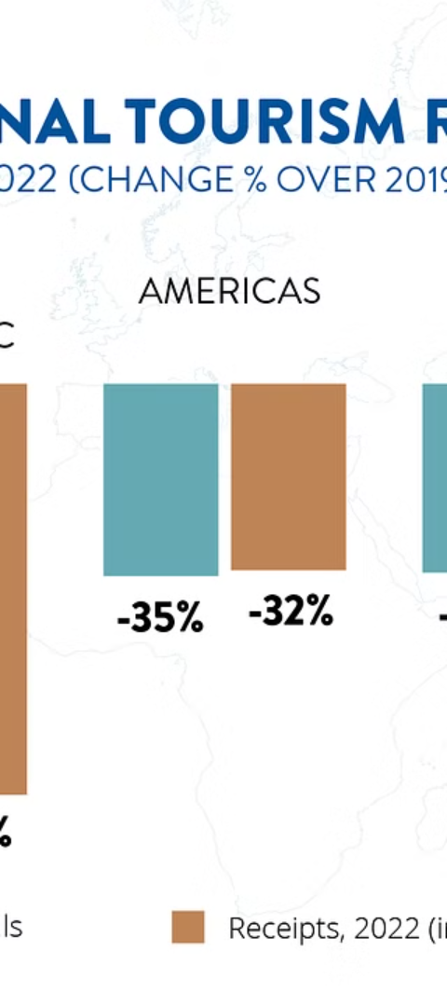
Case Studies of Successful Tourism Trend Predictions
1
Peak Season Travel
Anticipating demand for specific destinations during peak travel periods.
2
Cultural Events Impact
Predicting the influence of cultural events and festivals on tourist footfall.
3
Emerging Market Trends
Identifying new travel trends and capitalizing on emerging market opportunities.

Slide 7
Challenges and Limitations in Predicting Tourism Trends
1
Data Accuracy
2
Unforeseen Events
3
Behavioral Changes
Challenges in obtaining accurate and comprehensive data for precise trend predictions.
Impact of unexpected geopolitical or natural events on travel behavior and patterns.
Difficulty in predicting sudden shifts in consumer preferences and travel habits.

Slide 8



Conclusion and Future Directions
Innovation
Sustainability
Globalization
Pioneering new methodologies for enhanced prediction accuracy and adaptability.
Aligning predictions with sustainable practices for long-term industry development.
Focusing on global trends and cross-cultural influences for comprehensive predictions.

