Slide 1


Hotel Bookings Management System
IGATE is now a part of Capgemini

Slide 2
TEAM MEMBERS
N. Saikiran -150815
E. Sai Preetha -150742
A. Ishwarya -150643
B. Indhu -150646

Slide 3
CONTENTS
OVERVIEW
REQUIREMENT ITEMIZATION
USECASES
ACTORS
TESTCASES
APPLICATION LINK
DEFECTS
TEST CASE ADEQUACY
TEST CASE EFFECTIVENESS
PROJECT STATISTICS
TRACEABALITY MATRIX

Slide 4
OVERVIEW OF THE PROJECT
Project Overview:
To provide a website that can allow a user to search and book available hotel rooms over the internet at any time.
Users can reserve up to any rooms with their own preferences at a time.
Real time information of availability of hotel rooms.

Slide 5
REQUIREMENT ITEMIZATION
Requirements validation is an iterative process which takes place throughout the lifecycle of the project.
During elicitation, analysis and specification you should constantly be questioning and clarifying the data given to you in order to check its validity.
This will ensure that the SRS that you produce is complete, consistent and ready for the formal validation process.
LINK: C:\Users\nkiran\Desktop\Project-Bots with Dots\RVFD.xls

Slide 6
Requirements Validation And Functional Decomposition
Termination
End process
File Handling
Storage of information
Invocation
Start process
Implicit
Efficiency
RVFD
System
Minimum specifications
Explicit
User specified
Query
improvements
Error Handling
consistency
Security
For confidentiality

Slide 7
USE CASES
A use case is a methodology used in system analysis to identify, clarify, and organize system requirements.
The use case is made up of a set of possible sequences of interactions between systems and users in a particular environment and related to a particular goal.
A use case can be thought of as a collection of possible scenarios related to a particular goal, indeed, the use case and goal are sometimes considered to be synonymous.
LINK: Use Cases.docx

Slide 8
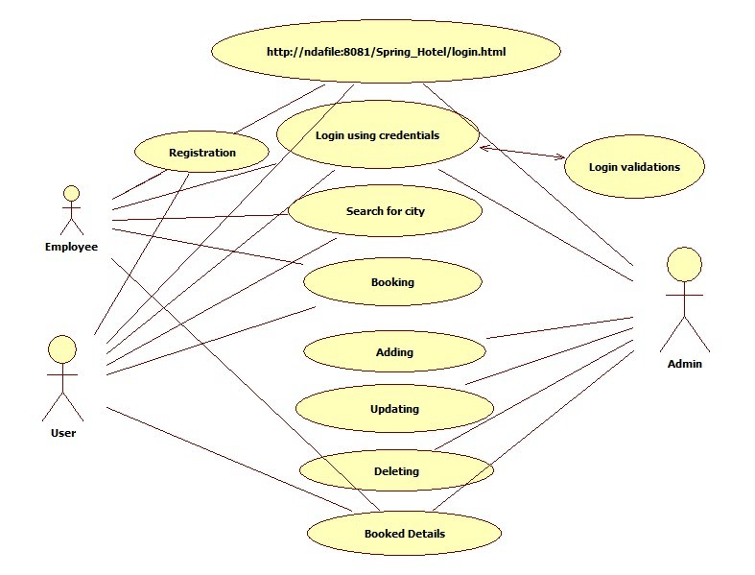
USE CASE DIAGRAM

Slide 9
USE CASE HYPERLINKS
Login:
C:\Users\nkiran\Desktop\Login.html
Functionalities:
C:\Users\nkiran\Desktop\Search hotel.html
C:\Users\nkiran\Desktop\hotels list.html
C:\Users\nkiran\Desktop\Add new hotel.html

Slide 10
ACTORS
Customer/Hotel Employee
Hotel Admin

Slide 11
TEST CASES
A test case is a set of conditions or variables under which a tester will determine whether a system under test satisfies requirements or works correctly.
The process of developing test cases can also help find problems in the requirements or design of an application.

Slide 12
Link : C:\Users\nkiran\Desktop\Project-Bots with Dots\Test Cases.xlsx
TEST CASES
LOGIN
Admin
Perform Room Management
Perform Hotel Management
View Bookings of specific hotel
View bookings for specified date
View guest list of specific hotel
User
Search for hotel rooms
Book hotel rooms

Slide 13
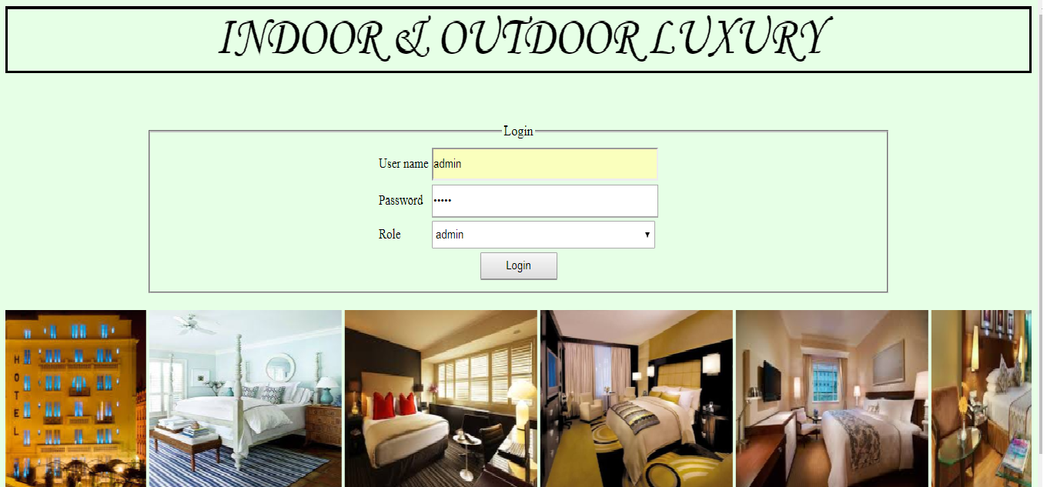
Application link
http://ndafile:8081/Spring_Hotel/login.html

Slide 14
DFDR
A defect is an error or a bug, in the application that causes it to produce an incorrect or unexpected results.
A programmer while designing and building the software can make mistake or error.
These mistakes or errors mean that there are flaws in the software, these are called defects and the report written for logging these defects is called a defect report.
LINK: C:\Users\nkiran\Desktop\Project-Bots with Dots\DFDR.xlsx

Slide 15
DEFECTS FOUND
User
The web application fails to respond on entering valid username and password by user.
The user did not select the city from the drop down list, but on clicking search button it goes to the next page.
The user did not select the arrival date from the drop down list, but on clicking search button it goes to the next page.
No error message is generated even if the user enters the departure date which is before the arrival date.
No error message is generated even if the user enters invalid number of rooms.
No error message is generated even if the user enters invalid number of adults.
No error message is generated even if the user enters invalid number of children.

Slide 16
DEFECTS FOUND
The mobile number field in the Add new hotel page is found to accept numbers more than 10 numbers.
The mail id should be in the correct email format.
The average fare per night field in the Add new hotel page is found to accept negative fare.
The fax no. should be in the correct format.
Admin

Slide 17
Test Case Adequacy
This defines the number of actual test cases created vs estimated test cases at the end of test case preparation phase. It is calculated as
Test Case Adequacy = No. of actual Test cases*100/No. of estimated Test cases estimated
=(55*100)/65
=84.61%

Slide 18
Test Case Effectiveness
This metrics defines the effectiveness of the test cases which is measured in terms of the number of defects found in testing with using the test cases.
Test Case Effectiveness = No. of defects detected using test cases*100)/total no of defects detected in testing
=(11*100)/12
=91.66%

Slide 19
Project Statistics
Number of Test Cases = 55
Number of Test Cases Passed = 08
Number of Test Cases Failed = 47
Number of Defects Logged = 11
Number of Use Cases = 01

Slide 20
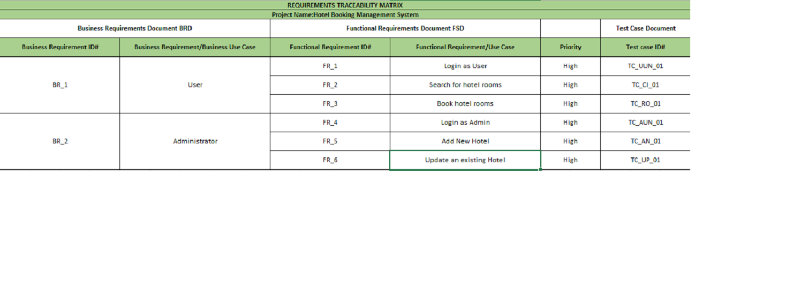
Traceability Matrix

Slide 21
THANK YOU

