Slide 1

Attendance System Using Haar Cascade Classifier
By Cherukupalli Indhu

Slide 2
About me:
I hold both Bachelor of Science and Master of Science degree.
To improve further in Statistics and to apply the methods of Statistics.
My academic journey has equipped me with a robust foundation in quantitative analysis, problem-solving, and critical thinking skills.
Throughout my studies, I specialized in Statistics , gaining expertise in Decision - Making.
I Interested in Analysis field.
Has of know I did not have any experience.
My career aspiration is to become a Data Scientist.
I aim to leverage my academic background and technical skills to extract actionable insights from complex datasets.
As a data scientist, I am eager to tackle real-world challenges, develop innovative solutions, and contribute to data-driven decision-making processes.

Slide 3
Objective :
To develop a real-time face recognition-based attendance system using Haar Cascade Classifier and OpenCV.
Scope :
The project aims to develop a real-time face recognition-based attendance system using Haar Cascade Classifier and OpenCV.
Automating attendance logging with high accuracy and efficiency.
It provides a user-friendly interface for seamless integration into educational and workplace environments, ensuring precise and convenient attendance management.

Slide 4
Technologies and Libraries Used
Programming Language: Python
Libraries:
OpenCV: For image processing and face detection.
Numpy: For handling numerical operations and arrays.
scikit-learn: For machine learning models and label encoding.
Datetime: For regarding DateTimes.

Slide 5
Data Collection and Preprocessing:
Data Collection:
Method of collecting face data using webcam or images.
Storage of collected face data in .npy format.
Preprocessing Steps:
Face Detection: Use a tool to find where faces are in pictures.
Resize: Make all face pictures the same size so the computer can understand them.
Normalize: Change the numbers in the pictures to make them easier for the computer to learn from.
Label: Give each face picture a name or number so the computer knows who each face belongs to.

Slide 6
Model Training:
Loading and Validating Data:
Loading face data from the .npy file.
Ensuring the data is not empty and validating its shape.
Data Preparation:
Flattening face data to create a suitable input for the neural network.
Encoding labels for classification.
Splitting data into training and testing sets.
Model Selection:
Using MLP Classifier from scikit-learn for training a neural network.
Parameters used for model training, such as hidden layer sizes, max iterations, solver, learning rate, etc.

Slide 7
Real-Time Face Recognition:
Webcam Initialization:
Setting up the webcam for real-time face detection.
Handling errors if the webcam is not accessible.
Face Detection and Recognition:
Capturing frames from the webcam.
Converting frames to grayscale and detecting faces.
Extracting and resizing detected faces.
Flattening and reshaping faces for prediction.
Predicting face identities using the trained model.
Drawing rectangles around detected faces and displaying names.

Slide 8
Attendance Logging:
Attendance File Handling:
Creating an attendance file (Face.csv) if it doesn't exist.
Writing attendance records with timestamps.
Recording Attendance:
Ensuring each person's attendance is recorded only once per session.
Writing names and timestamps to the attendance file.

Slide 9
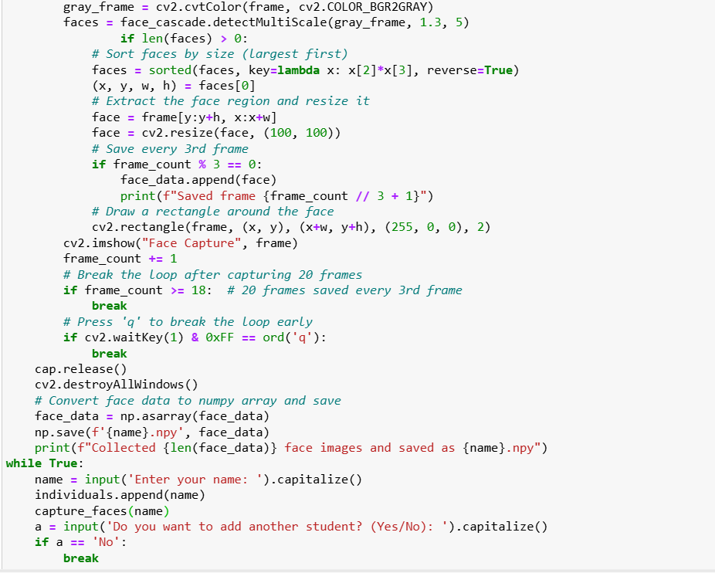
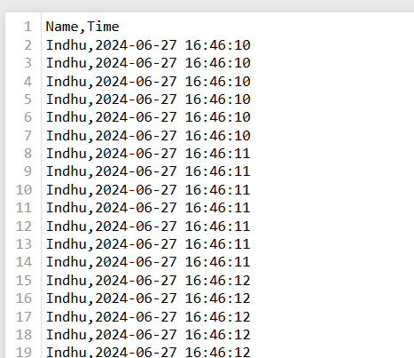
Final Frontend Performance:

Slide 10

THANK YOU

