Slide 1
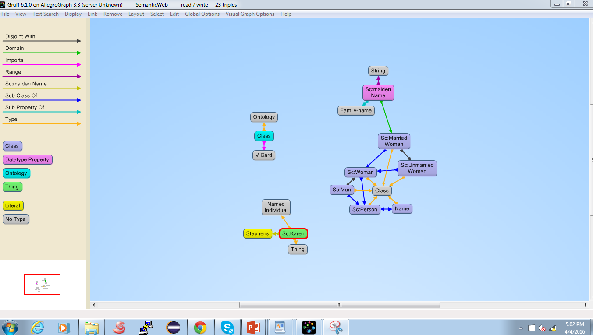
Before Applying RDFS++ Reasoner

Slide 2
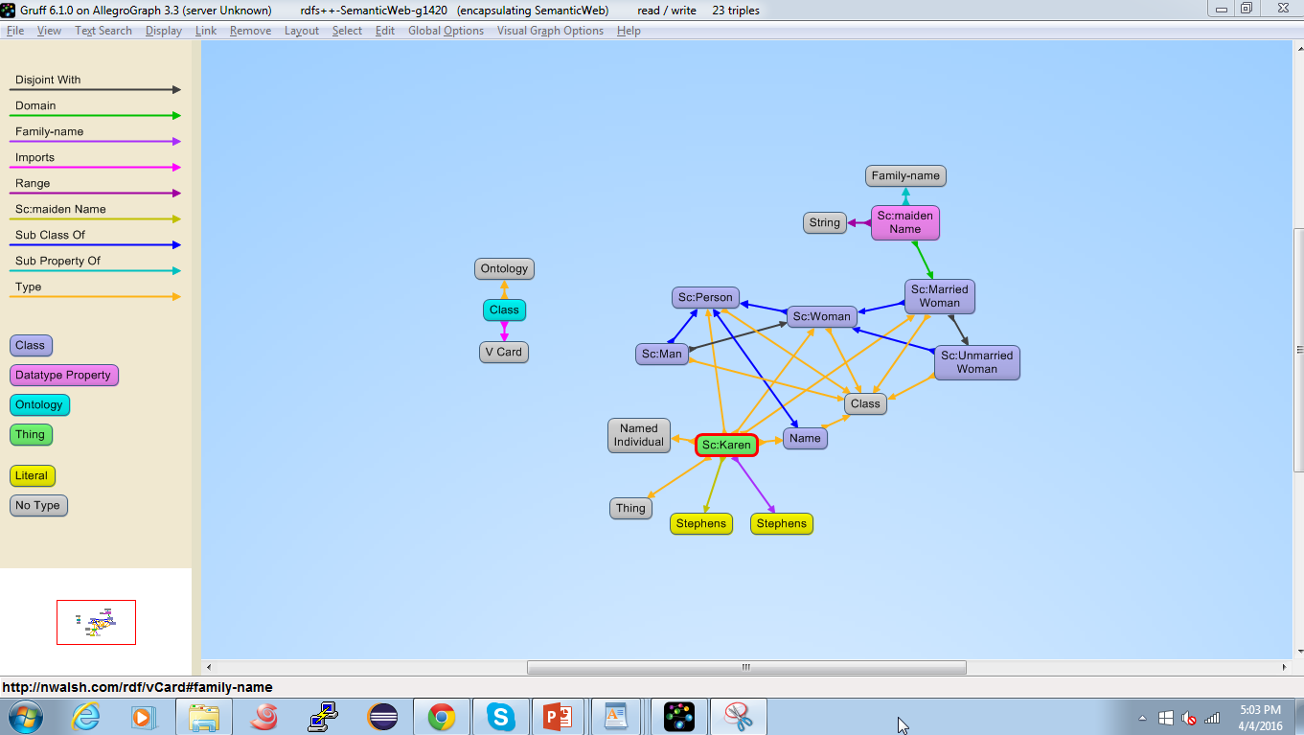
After Applying RDFS++ Reasoner

