Slide 1
Superstore
File created on: 10-09-2025 22:18:52

Slide 2
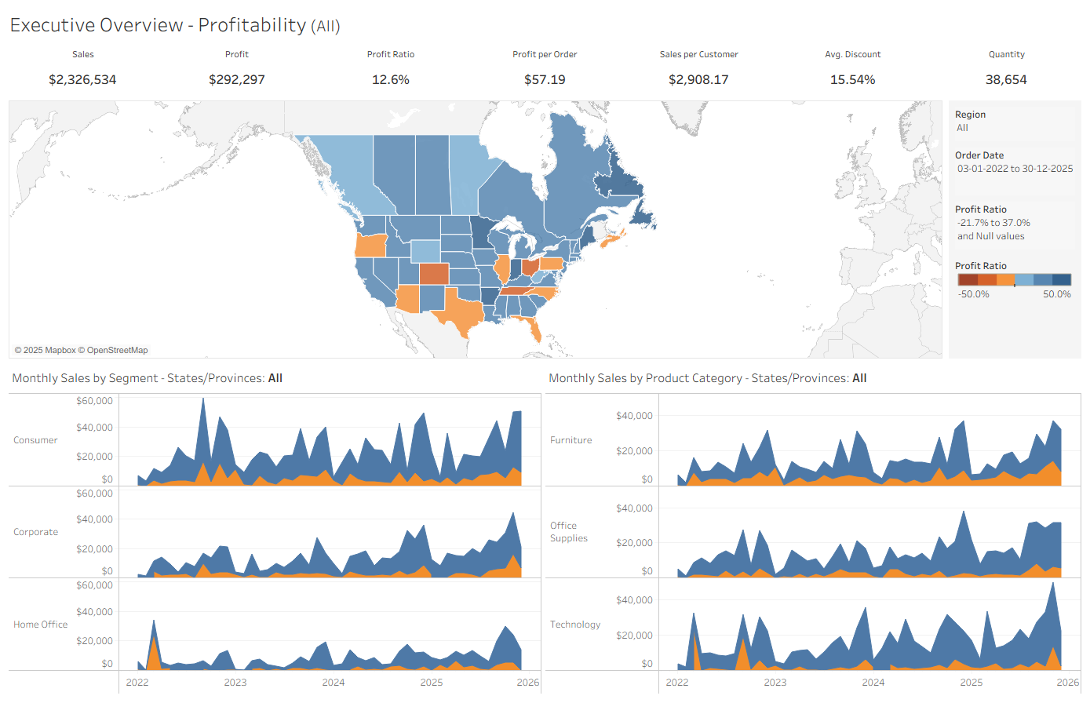

Slide 3
