Slide 1
World Stock Prices Analysis

Slide 2
Introduction
Empirical Analysis is the process of testing a hypothesis using empirical evidence
A Real World Stock Prices dataset is used which updates everyday.
The empirical analysis is performed on this data

Slide 3
Project Overview
The following tests are preformed:
One sample mean test
One sample proportion test
Two sample mean test
Two sample proportion test
Correlation Test
Regression Models
Multi-Regression Models

Slide 4
Dataset
Open
High
Low
Close
Volume
Dividends
Stock Splits
Brand Name
Ticker
Industry Tag
Country

Slide 5
Hypothesis Test

Slide 6
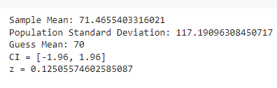
One Sample Mean Test
For dependent variable Close,

Slide 7
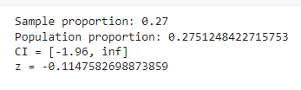
One Sample Proportion Test
For the variable Close,

Slide 8
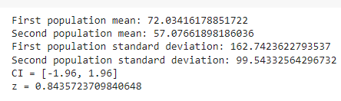
Two Sample Mean Test
For the variable High,

Slide 9
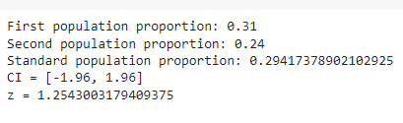
Two Sample Proportion Test
For the variable Low,

Slide 10

Correlation Test
For the variables Country and Close,

Slide 11

Correlation Test
For the variables High and Close,

Slide 12
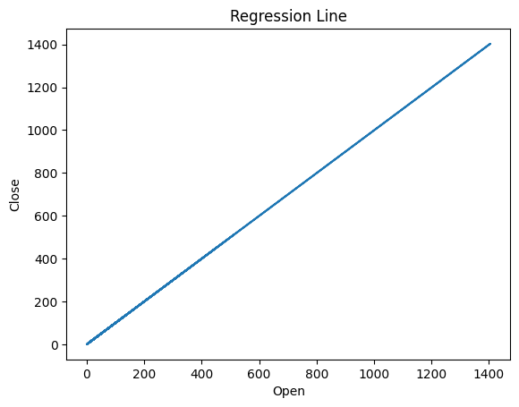
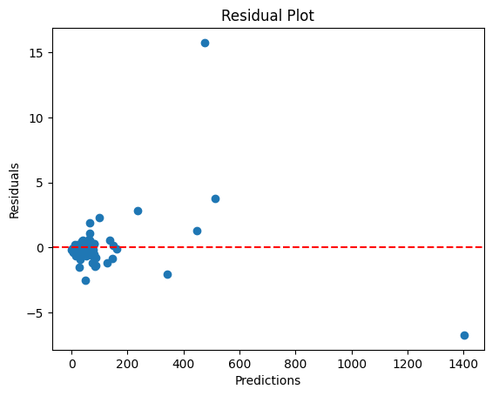
Regression
For the variables Open and Close,

Slide 13
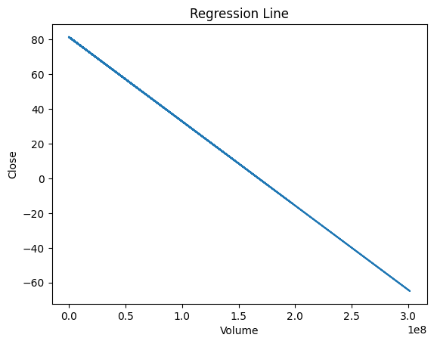
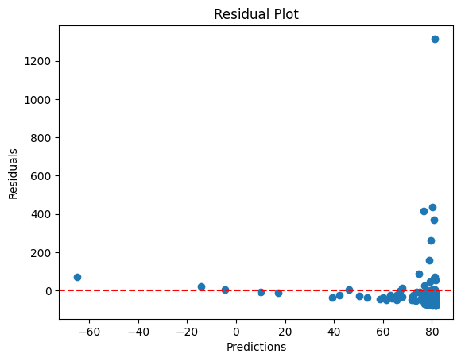
Regression
For the variables Volume and Close,

Slide 14
Multi-Regression
Variables
Open, High and Low
Regression Equation
y=-0.017034891973385768*a + 0.8109676270075653*b + 0.2034552694554999*c + -0.10776348739618413
Adjusted R2 = 0.9999

Slide 15
Thank You

