Slide 1



01 / 20
INDIA NEW ZEALAND BUSINESS COUNCIL
INZBC TEAM
FINAL REPORT
Three specialist lanes. One governed delivery.
BHANU GUPTA · ROSHAN ARYAL · PARAS · 20 AUGUST 2026
Notes:
Open with the final-team framing: this is one delivery, not three disconnected portfolios.
[Sources]
- C:\Users\brett\Downloads\INZBC_Team_Final_Report.docx — consolidated team report and evidence refreshed 20 August 2026.
- https://github.com/India-New-Zealand-Business-Council — organisation repository history.
[/Sources]

Slide 2
THE TEAM RESULT
02 / 20
Three focused workstreams became one governed, evidence-led platform.
192 student-authored PRs · 184 merged · 138 board items
Notes:
State the thesis before explaining the workstreams or technology.
[Sources]
- C:\Users\brett\Downloads\INZBC_Team_Final_Report.docx — consolidated team report and evidence refreshed 20 August 2026.
- https://github.com/India-New-Zealand-Business-Council — organisation repository history.
[/Sources]

Slide 3
CONTENTS
03 / 20
What the evidence proves
01
Mandate + method
Why trust and human authority shaped the build.
02
Delivery + evidence
What shipped, how it connects, and the live record.
03
Team + learning
Why communication and ownership were delivery tools.
04
Handover + decisions
What INZBC must decide to authorise operation.
Notes:
Use the four parts as a narrative arc, not a conventional agenda.
[Sources]
- C:\Users\brett\Downloads\INZBC_Team_Final_Report.docx — consolidated team report and evidence refreshed 20 August 2026.
- https://github.com/India-New-Zealand-Business-Council — organisation repository history.
[/Sources]

Slide 4
CHAPTER 01
04 / 20
01
Built for trust,
not just demos
Accuracy, privacy, named approval and handover were product requirements from the start.
Notes:
Transition from the thesis to the operating constraints that made the project non-trivial.
[Sources]
- C:\Users\brett\Downloads\INZBC_Team_Final_Report.docx — consolidated team report and evidence refreshed 20 August 2026.
- https://github.com/India-New-Zealand-Business-Council — organisation repository history.
[/Sources]

Slide 5
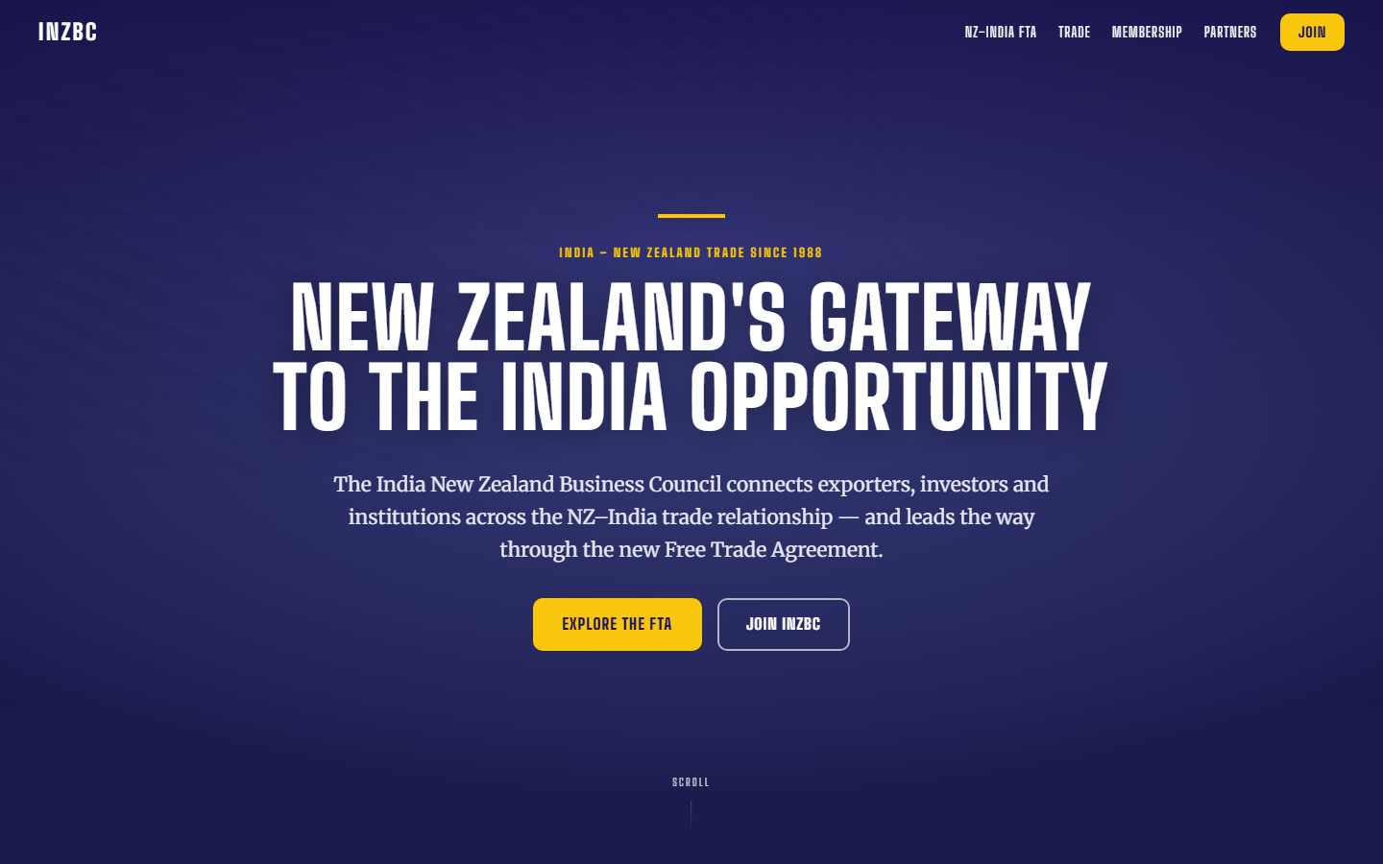
CHAPTER 01
05 / 20
01
Four connected outcomes,
one operating standard
INZBC asked for a SIP review workflow, FTA intelligence, a Communications Assistant and a refreshed public website. Every outcome had to preserve evidence, privacy and human authority.
Trade Intelligence / SIP review
FTA + communications services
Public website + member surfaces
Notes:
Use the public-site concept as evidence of the design lane, not as a claim that every displayed fact is production-approved.
[Sources]
- C:\Users\brett\Downloads\INZBC_Team_Final_Report.docx — project mandate and safeguards.
- C:\Users\brett\Downloads\Evidence_Portfolio_Paras.docx — public-site work and design evidence supplied by Paras.
- C:\Users\brett\inzbc\team_report_work\bhanu-media\image5.png — INZBC public-site concept included in Bhanu's final evidence portfolio.
[/Sources]

Slide 6

THE THESIS
06 / 20
Trust is a chain across every layer.
Sources → contracts → controls → interfaces → named human review
Notes:
Explain that a failure at any layer weakens the whole result.
[Sources]
- C:\Users\brett\Downloads\INZBC_Team_Final_Report.docx — consolidated team report and evidence refreshed 20 August 2026.
- https://github.com/India-New-Zealand-Business-Council — organisation repository history.
[/Sources]

Slide 7
ONE TEAM / THREE LANES
07 / 20
Clear ownership made integration testable
01
02
03
Bhanu Gupta
Roshan Aryal
Paras
Strong ×6 PDR objectives. Platform, security, review, integration and handover.
Intelligence, sources, FTA, collectors, audit and service-side delivery.
Product/UX, SIP + Comms interfaces, member surfaces and the Wix public site.
Notes:
Make the individual strengths explicit while keeping the team result primary.
[Sources]
- C:\Users\brett\Downloads\INZBC_Team_Final_Report.docx — consolidated team report and evidence refreshed 20 August 2026.
- https://github.com/India-New-Zealand-Business-Council — organisation repository history.
[/Sources]

Slide 8
MERGE QUALITY
08 / 20
95.8%
BHANU / 135 PRs
99.3%
ROSHAN / 35 PRs
88.6%
of student-authored PRs merged
PARAS / 22 PRs
86.4%
184 of 192 across Bhanu, Roshan and Paras · live organisation history refreshed 20 August 2026.
Notes:
Calculation: 184 ÷ 192 = 95.8%. Individual rates are 134/135, 31/35 and 19/22.
[Sources]
- C:\Users\brett\Downloads\INZBC_Team_Final_Report.docx — consolidated team report and evidence refreshed 20 August 2026.
- https://github.com/India-New-Zealand-Business-Council — organisation repository history.
[/Sources]

Slide 9
TEAM DELIVERY
09 / 20
The live record shows sustained delivery
01
192
184
138
Student-authored PRs
Merged
ProjectV2 items
Across all four repositories
95.8% of the student set
121 unique student-assigned
Notes:
Keep scopes separate: student-authored PRs, organisation repositories and private-board items are not summed together.
[Sources]
- C:\Users\brett\Downloads\INZBC_Team_Final_Report.docx — consolidated team report and evidence refreshed 20 August 2026.
- https://github.com/India-New-Zealand-Business-Council — organisation repository history.
[/Sources]

Slide 10
CHAPTER 02
10 / 20
02
Delivery that
connects
Contracts, controls and interfaces meet at explicit, testable boundaries.
Notes:
Move from scale to the mechanisms that made the work coherent.
[Sources]
- C:\Users\brett\Downloads\INZBC_Team_Final_Report.docx — consolidated team report and evidence refreshed 20 August 2026.
- https://github.com/India-New-Zealand-Business-Council — organisation repository history.
[/Sources]

Slide 11
CHAPTER 02
11 / 20
One system, built in stages
02
FOUNDATION
INTELLIGENCE
INTERFACES
PUBLIC SITE
NOW
Shared contracts
FTA + sources
SIP + Comms
Wix rebuild
Handover
Schema, APIs, security
Collectors, ranking, audit
Real data, review states
Content, mobile, navigation
Controls + decisions visible
Notes:
This is a capability progression rather than a literal date-by-date project schedule.
[Sources]
- C:\Users\brett\Downloads\INZBC_Team_Final_Report.docx — consolidated team report and evidence refreshed 20 August 2026.
- https://github.com/India-New-Zealand-Business-Council — organisation repository history.
[/Sources]

Slide 12
THE GOVERNED FLOW
12 / 20
Four steps keep trust intact
01
02
03
04
Source evidence
Analyse in contracts
Review by a human
Publish with audit
Dated sources, collectors and approved facts.
FTA services, scoring and generated APIs.
Named approval, QA and refusal paths.
Staff UI, public site and operating record.
Notes:
Describe the cross-lane boundary at each step; no lane silently bypasses the next one.
[Sources]
- C:\Users\brett\Downloads\INZBC_Team_Final_Report.docx — consolidated team report and evidence refreshed 20 August 2026.
- https://github.com/India-New-Zealand-Business-Council — organisation repository history.
[/Sources]

Slide 13
BEFORE AND AFTER
13 / 20
What changed, precisely
STARTING POINT
DELIVERED STATE
Separate specialist lanes
Shared contracts and APIs
Hidden approval assumptions
Named review + audit trail
Board state could drift
Handover gaps made visible
Notes:
The board reconciliation finding is intentionally preserved; the report does not rewrite stale status to make delivery look cleaner.
[Sources]
- C:\Users\brett\Downloads\INZBC_Team_Final_Report.docx — consolidated team report and evidence refreshed 20 August 2026.
- https://github.com/India-New-Zealand-Business-Council — organisation repository history.
[/Sources]

Slide 14
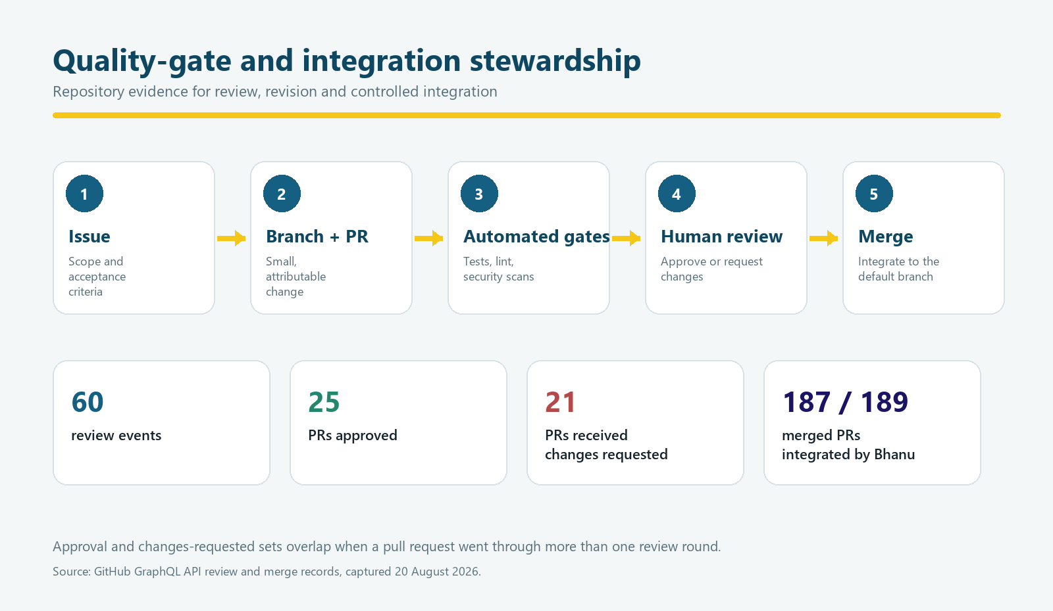
INTEGRATION EVIDENCE
14 / 20
Quality became the integration gate
02
187
Organisation merges
of 189 total · stewarded by Bhanu
60 review events
Strong ×6
Across 45 pull requests and multiple revision rounds.
Bhanu's PDR objectives are fully demonstrated.
Issue → PR → CI → human review → merge
Notes:
Use this slide to connect quantitative activity to the controlled merge process.
[Sources]
- C:\Users\brett\Downloads\INZBC_Team_Final_Report.docx — Bhanu metrics, PDR assessment and integration findings.
- C:\Users\brett\inzbc\team_report_work\bhanu-media\image3.png — evidence graphic generated from refreshed GitHub review and merge records.
- https://github.com/India-New-Zealand-Business-Council — organisation history.
[/Sources]

Slide 15
CHAPTER 03
15 / 20
03
Ownership made
teamwork stronger
Clear lanes reduced collisions; shared quality rules kept the whole system coherent.
Notes:
Introduce the practices that turned specialist ownership into a team outcome.
[Sources]
- C:\Users\brett\Downloads\INZBC_Team_Final_Report.docx — consolidated team report and evidence refreshed 20 August 2026.
- https://github.com/India-New-Zealand-Business-Council — organisation repository history.
[/Sources]

Slide 16

TEAM REFLECTION
”
16 / 20
03
“The strongest team result is that the lanes meet at explicit boundaries.”
Consolidated team report
Final reflection · 20 August 2026
Notes:
This sentence is quoted directly from the consolidated team report.
[Sources]
- C:\Users\brett\Downloads\INZBC_Team_Final_Report.docx — consolidated team report and evidence refreshed 20 August 2026.
- https://github.com/India-New-Zealand-Business-Council — organisation repository history.
[/Sources]

Slide 17
HOW THE TEAM WORKED
17 / 20
Communication was delivery infrastructure
Focused PRs
Clear ownership
Human review
Real systems
Client escalation
Handover
Small, reviewable changes
One accountable lane
No silent publishing
APIs + databases
No guessed facts
Docs + runbooks
Weekly calls, issues, reviews, ADRs and decision packs turned communication into traceable delivery.
Notes:
Bhanu's communication evidence is particularly strong: 141 authored issues, 60 review events, client-decision framing and broad handover documentation.
[Sources]
- C:\Users\brett\Downloads\INZBC_Team_Final_Report.docx — consolidated team report and evidence refreshed 20 August 2026.
- https://github.com/India-New-Zealand-Business-Council — organisation repository history.
[/Sources]

Slide 18
HANDOVER
18 / 20
Three decisions unlock production
DECISION 01
DECISION 02
DECISION 03
Identity boundary
Reviewer + secrets
Operating owner
Confirm login ownership and the Member Jungle boundary.
Name the reviewer; provide OAuth secrets and a rotation policy.
Accept deployment, board reconciliation and long-term support.
INZBC · Go-live gate
INZBC · Before UAT
INZBC + team · Handover
Strong controls are ready for authorised operation.
Notes:
These are client-authority decisions, not unfinished engineering choices the team should guess.
[Sources]
- C:\Users\brett\Downloads\INZBC_Team_Final_Report.docx — consolidated team report and evidence refreshed 20 August 2026.
- https://github.com/India-New-Zealand-Business-Council — organisation repository history.
[/Sources]

Slide 19
CLOSING
19 / 20
Ready for handover
Thank you to INZBC, course supervisors and the team for turning four outcomes into one governed delivery.
INDIA NEW ZEALAND BUSINESS COUNCIL
Notes:
Resolve the opening thesis: the team has a credible path from a controlled implementation to a sustainable service.
[Sources]
- C:\Users\brett\Downloads\INZBC_Team_Final_Report.docx — consolidated team report and evidence refreshed 20 August 2026.
- https://github.com/India-New-Zealand-Business-Council — organisation repository history.
[/Sources]

Slide 20
EVIDENCE TRAIL
20 / 20
Evidence lives in the work
Bhanu · Roshan · Paras
Studio 5 delivery team · INZBC
Four repositories.
One governed delivery.
GITHUB
India-New-Zealand-Business-Council
BOARD
INZBC SIP Platform · ProjectV2 #1
REPORT
Refreshed 20 August 2026
Next: confirm the operating owner, named reviewer and go-live decisions.
Notes:
Close on the action required from INZBC and leave the audience with the evidence locations.
[Sources]
- C:\Users\brett\Downloads\INZBC_Team_Final_Report.docx — final report and evidence index.
- https://github.com/India-New-Zealand-Business-Council
- https://github.com/India-New-Zealand-Business-Council/inzbc
- https://github.com/India-New-Zealand-Business-Council/inzview
- https://github.com/India-New-Zealand-Business-Council/daily-india-nz-news-agent
[/Sources]

