Slide 1
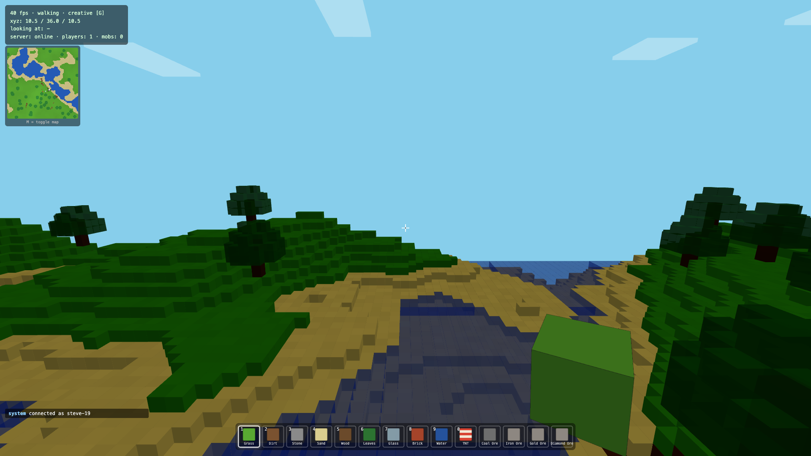
HYDRA MINECRAFT
Every block you place or break is a real Cardano Hydra L2 transaction.
TEAM 0x0D
INDIACODEX 2026
CARDANO · HYDRA

Slide 2
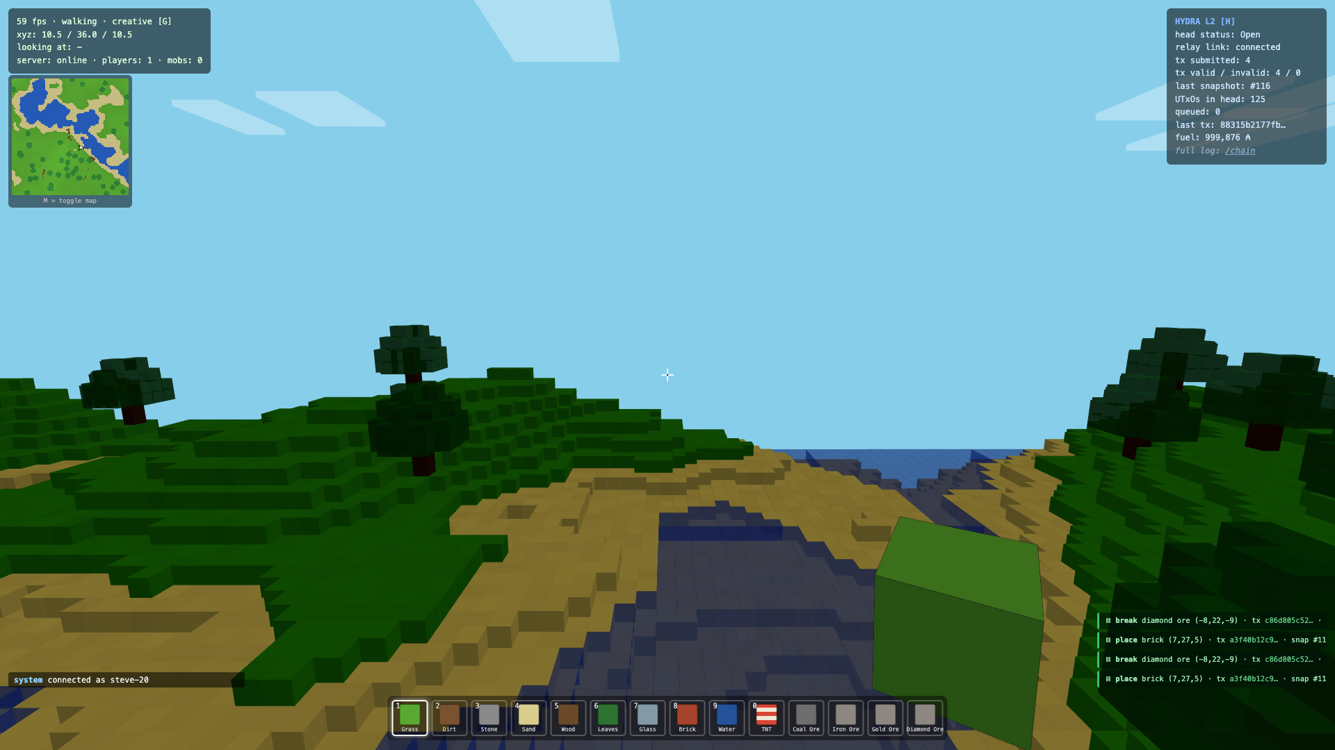
THE IDEA
A playable Minecraft-style voxel world in the browser —
where the save file is a blockchain.
Terrain is a pure function of one seed — so the world isn't stored.
Only the EDITS matter. Each place/break = one tiny on-chain record.
The Hydra head's UTxO set IS the world. Replay it -> exact world.
No wallet. No popups. No fees. No delays. The player never notices.

Slide 3
HOW IT WORKS
Browser → Relay → Hydra head
YOUR BROWSER
RELAY (Node.js)
HYDRA HEAD
Three.js voxel game
place / break a block
applied instantly,
then fire-and-forget
holds an Ed25519 key
server-side — no wallet
builds + signs a zero-
fee tx, submits NewTx
offline head, seeded
UTxO. Inline datum
Constr 0 [x,y,z,type,
action,seq]. Replayable
→
→
On SnapshotConfirmed the relay decodes datums and broadcasts world deltas to every client.
Hydra unreachable? The game keeps running; queued edits land on-chain when it returns.

Slide 4
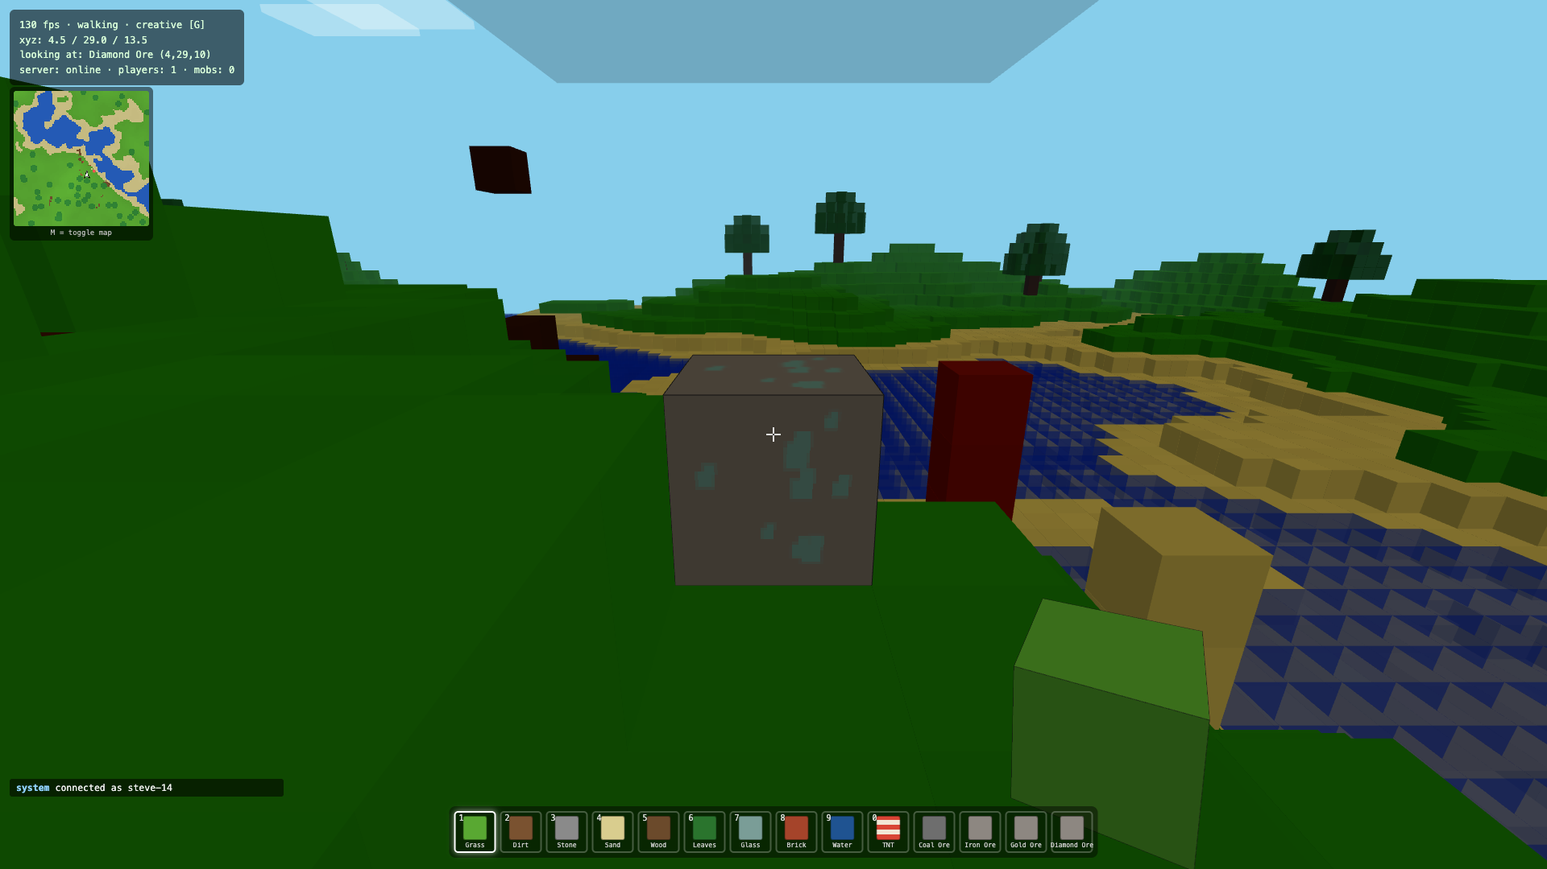
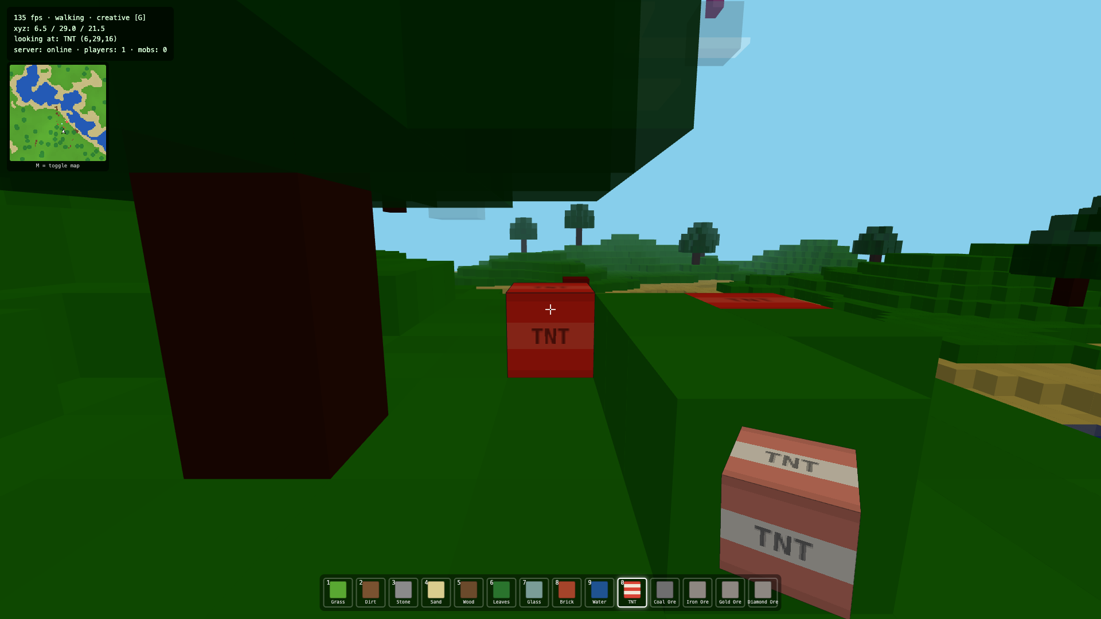
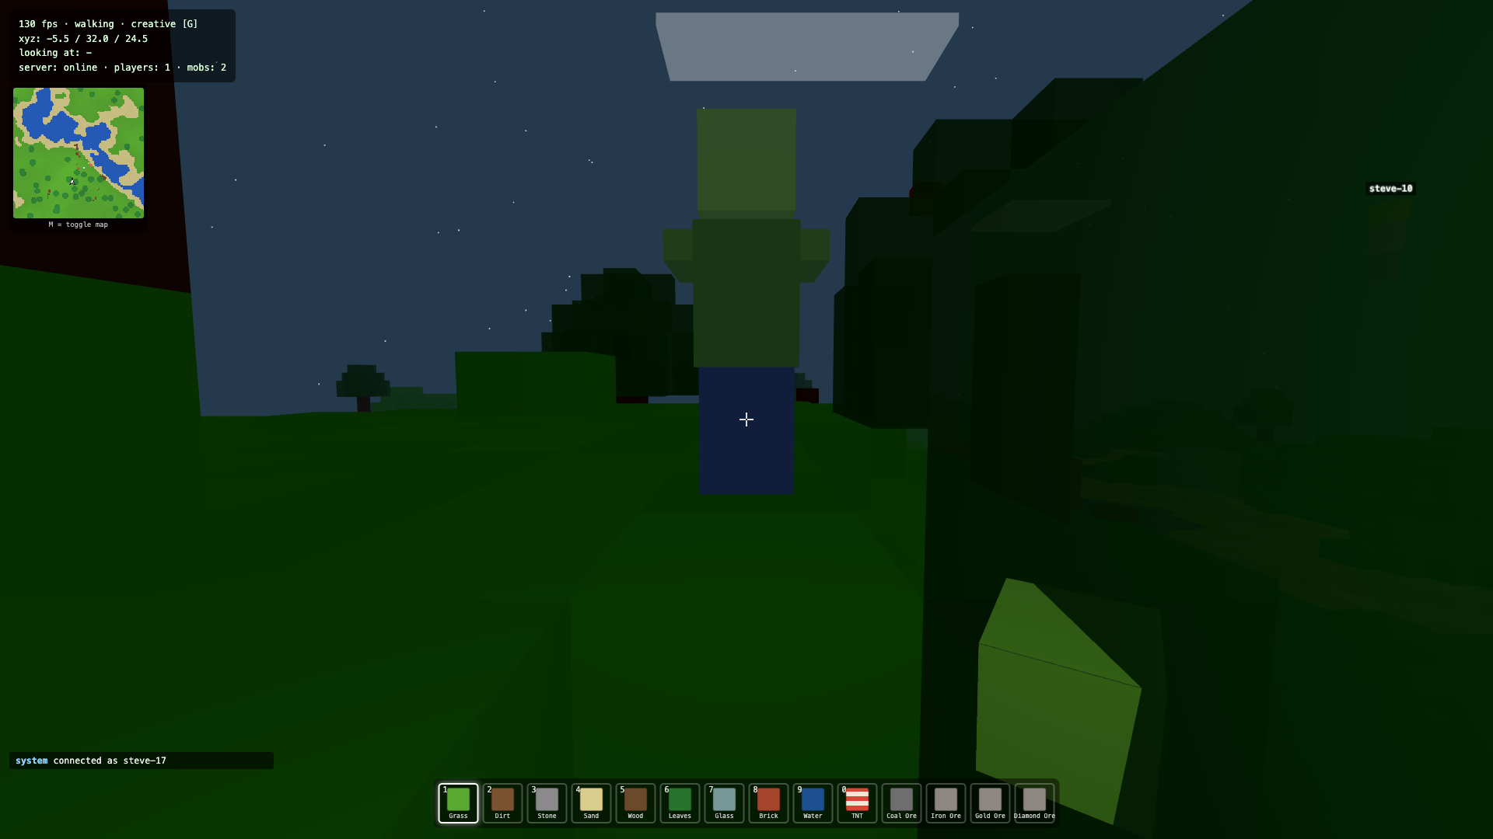
IT'S A REAL GAME
Not a tech demo — a game people actually play
Survival mode — hearts, fall & drowning damage, death + respawn, item drops
TNT + physics — fuses, chain reactions, falling sand — each explosion a tx burst
Mobs & caves — zombies at night, sheep/pigs/cows, ore veins, real mining times
Multiplayer — avatars, chat, minimap, day/night — synced via the relay

Slide 5
ON-CHAIN — THE SMART CONTRACT
The datum is the contract
BlockAction = Constr 0 [
x, y, z : Int -- coordinates
block_type_id : Int -- 0..13
action : Int -- 0 place / 1 break
seq : Int -- replay order
]
Aiken · Plutus V3
block_ledger validator:
• append-only world log
• only head authority
may spend a record
• well-formedness guard
aiken check → 3 PASSED / 0 FAILED
hash 6c433965…
Verified: a 2-TNT chain reaction produced 37 valid L2 transactions, 0 invalid in one blast —
proof, live from the head via GET /chain (real tx hashes + raw datum CBOR).

Slide 6
STACK & STORY
Vanilla, fast, verifiable
FRONT-END
BACK-END
ON-CHAIN
Three.js r158 (CDN)
vanilla JS, no bundler
InstancedMesh voxels
pointer-lock + physics
Node.js relay
Express + ws
cardano-serialization-lib
GET /chain explorer
hydra-node (Docker)
offline head, zero-fee
Aiken / Plutus V3
CBOR inline datums
Built end to end by Claude Fable 5 — from one prompt.
~3,800 lines · 12/12 features · verified in-browser · every claim reproducible.

Slide 7
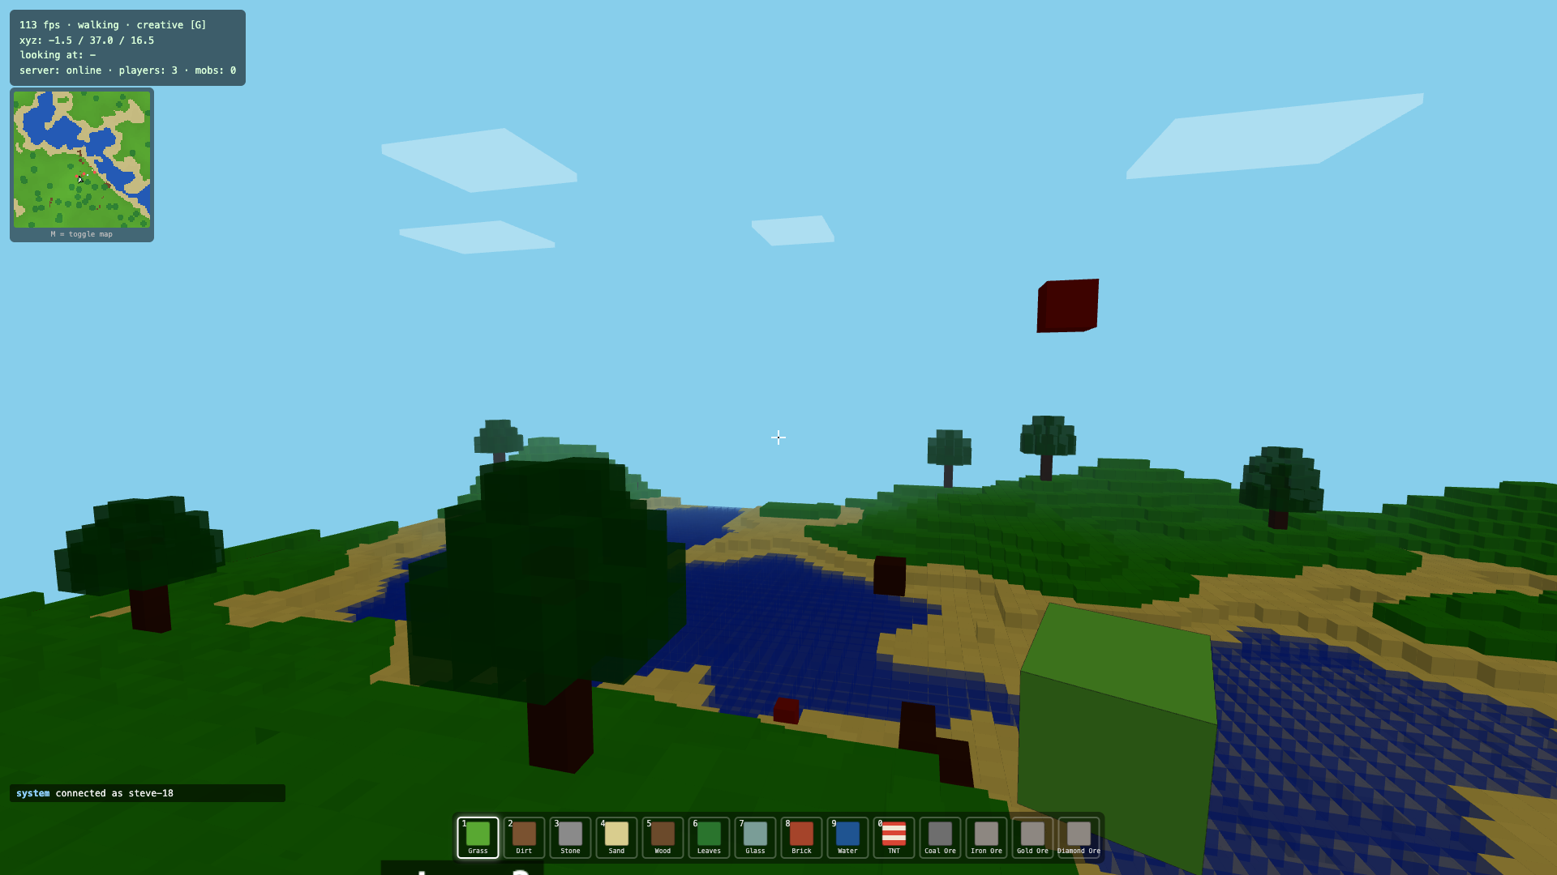
Clone it.
Run it.
Mine on-chain.
A world you can dig — and a ledger that never forgets it.
github.com/nickthelegend/hydra-minecraft
TEAM 0x0D
CARDANO HYDRA L2
▶ DEMO VIDEO IN README

