Slide 1
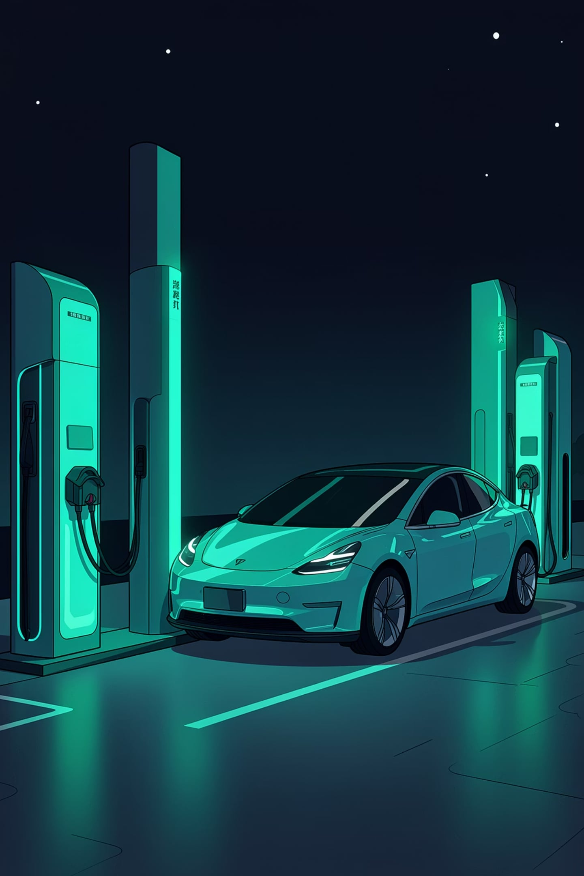
Cardano ChargePass
Decentralized EV Grid Intelligence
Securing the future of EV charging with Gemini AI and Cardano Native Assets.

Slide 2
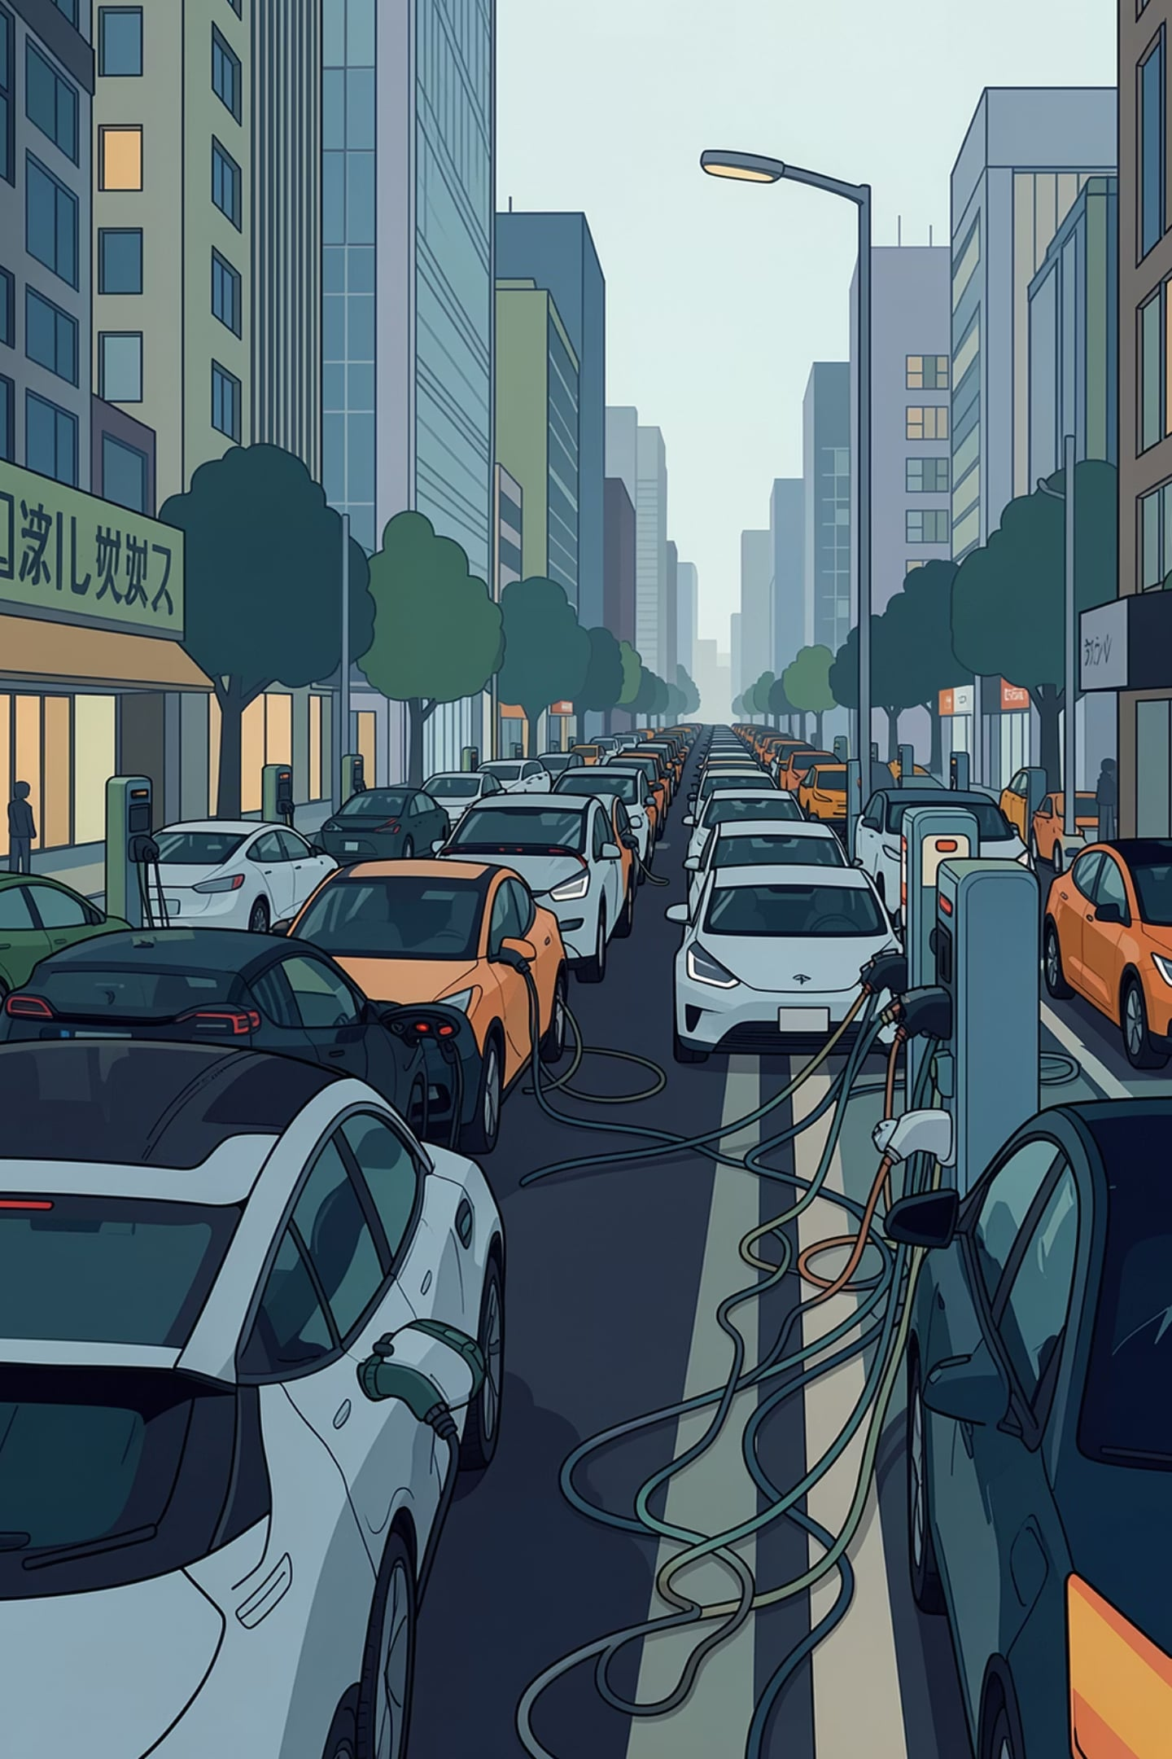



THE PROBLEM
Centralized EV Gridlock
Double-Booking Epidemic
Standard Web2 apps suffer from high-latency database syncs, causing chronic double-bookings and gridlocked charging stations.
Zero Cryptographic Ownership
Drivers lack true ownership of reservations. Centralized authorities can cancel or alter bookings at will — no transparency, no recourse.
Static & Inefficient Routing
Legacy systems ignore live grid load and carbon offset, leading to poor charger utilization and wasted energy.

Slide 3

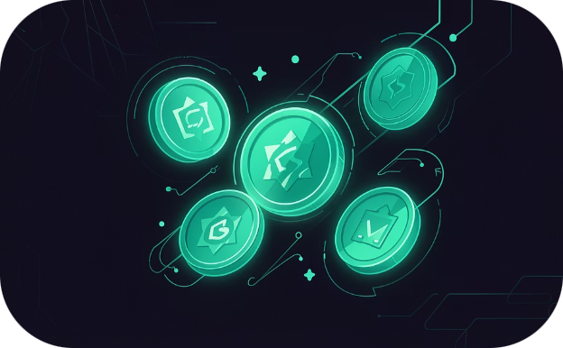
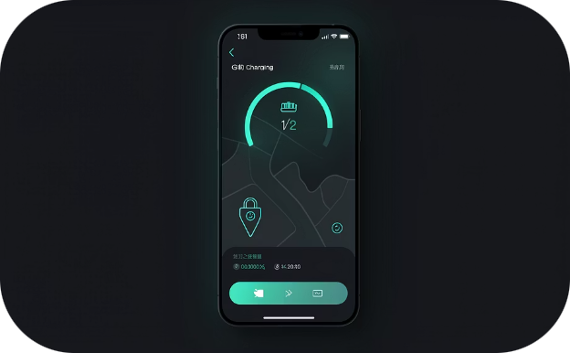
OUR SOLUTION
The ChargePass Ecosystem
ChargePass unifies AI-driven intelligence with blockchain-backed trust — delivering a seamless, secure, and sustainable EV charging experience.
Context-Aware Intelligence
Immutable Reservations
Premium UX
Gemini AI dynamically routes EVs based on real-time metrics — not just distance.
Charging slots become Cardano Native Assets — mathematically secure digital gate passes in your Web3 wallet.
A responsive React + Tailwind CSS interface bridging Web2 convenience with Web3 security.

Slide 4

INTELLIGENCE LAYER
Gemini AI & Node.js Backend
Dynamic Data Ingestion
A high-performance Node.js & Express backend processes user telemetry — Battery %, Vehicle Model, and Destination — in real time.
Advanced AI Prompting
The Gemini AI SDK computes optimal routing by balancing three pillars: Charging Speed, Grid Load Optimization, and Carbon Offset.
Staggered AI Scheduling
The backend structures AI output into three competitive, staggered time slots — Fastest, Eco, and Balanced — for the driver to choose from.

Slide 5



EXECUTION LAYER
Cardano & Lucid: On-Chain Settlement
Client-Side Minting
Lace Wallet Integration
Blockfrost Infrastructure
The frontend uses Lucid Evolution to construct and sign transactions entirely within the browser — no centralized server trust required.
Direct integration with Lace Wallet enables frictionless, decentralized authentication and transaction signing.
High-speed on-chain queries and transaction submissions executed seamlessly via the Blockfrost API on Cardano Preprod testnet.

Slide 6





ARCHITECTURE
System Architecture & Data Flow
User Input
AI Processing
Selection
React UI captures trip details and wallet authentication
Node.js backend queries Gemini AI for optimal chargers
Frontend renders interactive AI recommendations
Transaction
Settlement
Lucid Evolution builds the minting transaction
Lace Wallet signs and broadcasts to Cardano Preprod
From wallet connection to on-chain confirmation, every step is transparent, verifiable, and decentralized — with zero centralized intermediaries in the critical path.

Slide 7
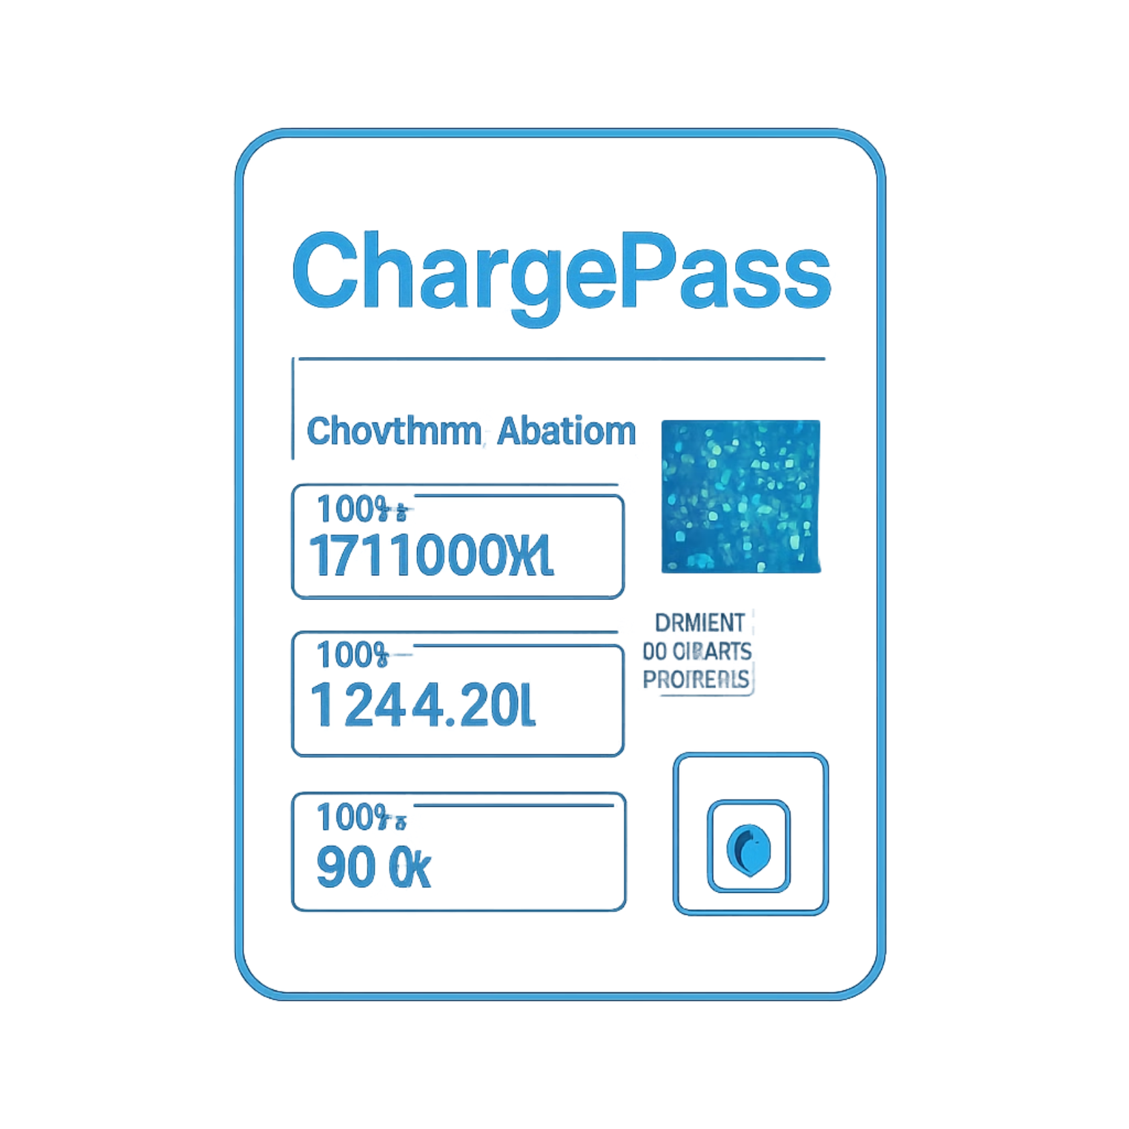

WEB3 ADVANTAGE
Why Native Assets?
By representing charging reservations as Cardano Native Assets, ChargePass eliminates the complexity and risk of traditional smart contract architectures — while delivering instant, trustless verification at the station.
Native Assets are first-class citizens on the Cardano ledger, requiring no separate contract deployment or execution overhead.

Slide 8
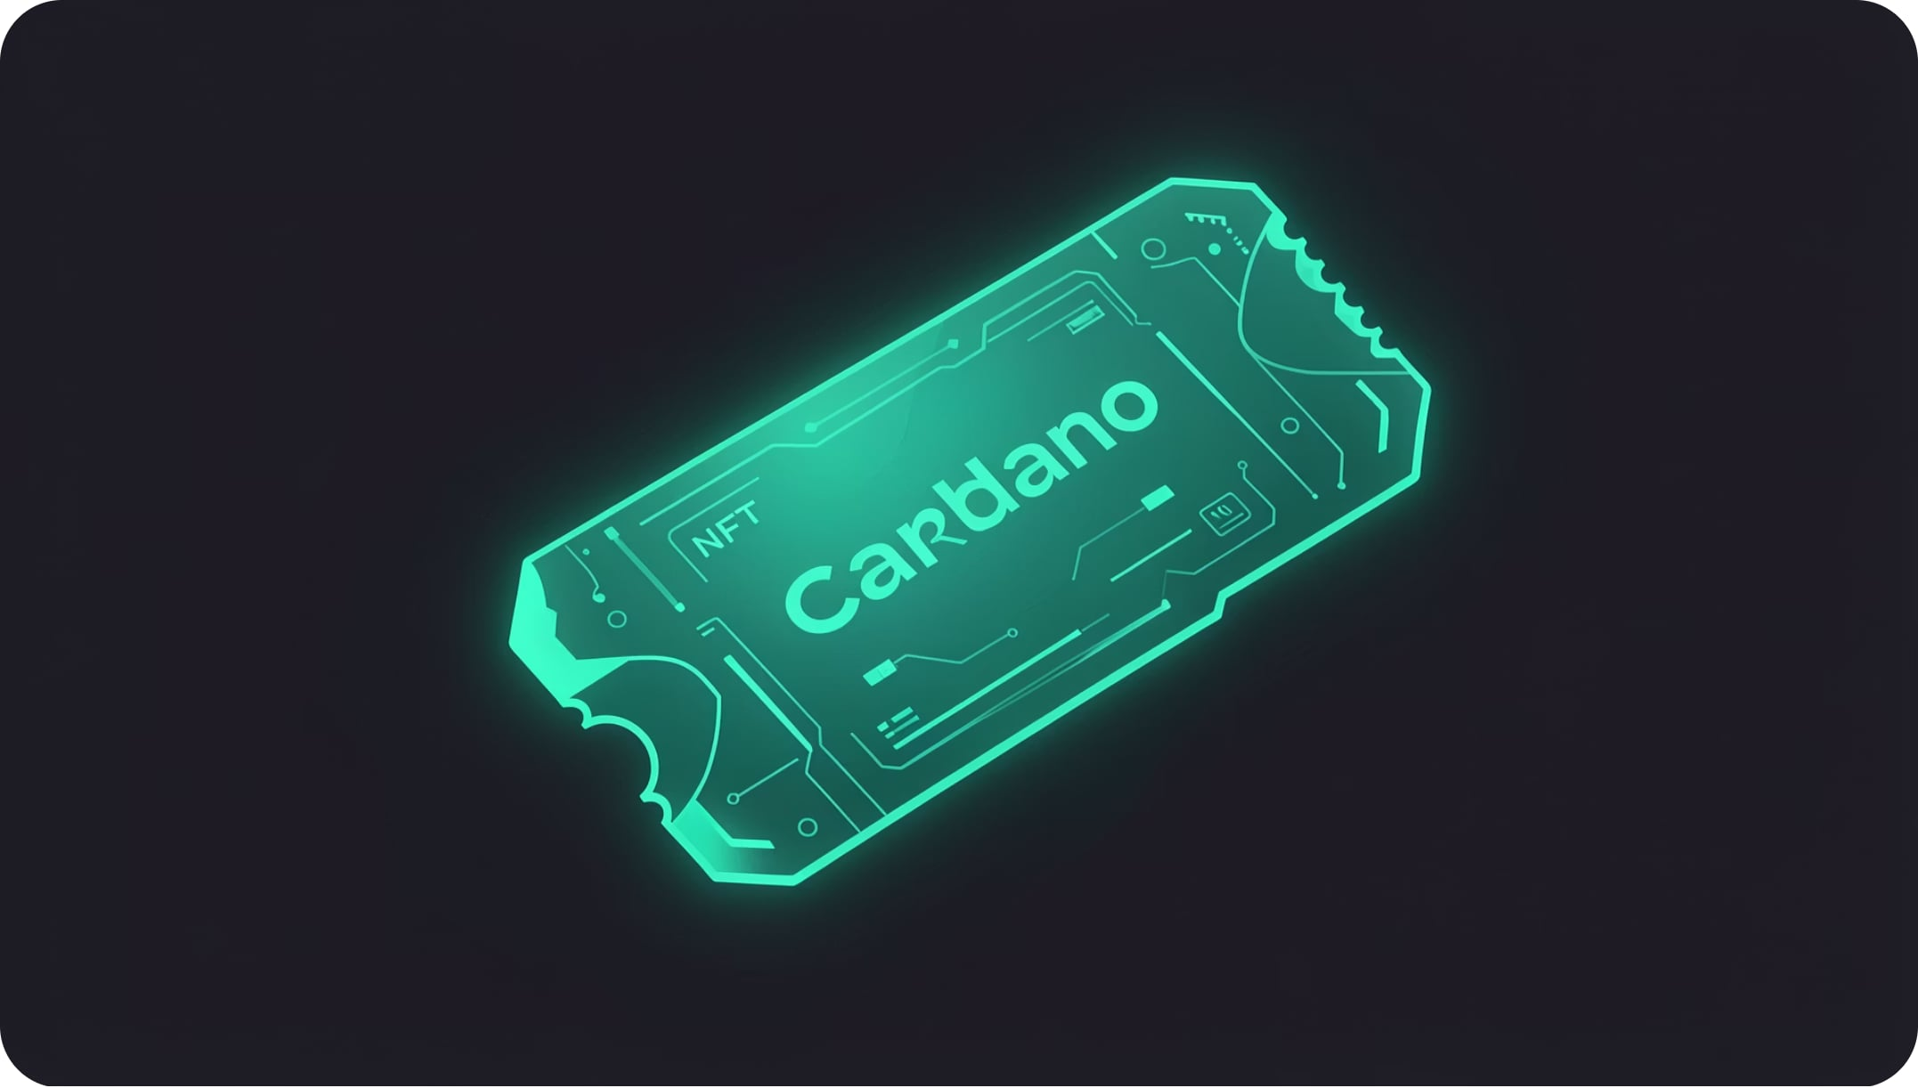
ON-CHAIN METADATA
CIP-25 Immutable Metadata
Permanent On-Chain Storage
ChargePass uses the Cardano CIP-25 NFT metadata standard to embed critical reservation details permanently on-chain — no off-chain dependencies, no mutable databases.
Embedded Payload
Each ChargePass inherently contains: Charger Name, Arrival Time, Pricing, Grid Load, and Carbon Saved.
Tamper-Proof Records
Once minted, neither the user nor the station operator can alter agreed-upon reservation parameters — establishing absolute trust.

Slide 9
LIVE DEMO
End-to-End Walkthrough
01
02
03
Connect Wallet
Input Trip Details
AI Generates Options
User connects Lace Wallet to access the dApp.
Enter destination, battery level, and preferred arrival time.
Gemini AI returns three context-aware options with pricing, grid load, and environmental impact.
04
05
Reserve & Mint
Digital Gate Pass Issued
Select a charger, click "Reserve & Mint," and sign in Lace.
A ChargePass NFT is minted on Cardano Preprod with an on-screen transaction hash and Apple Wallet-style ticket.

Slide 10

ROADMAP
Phase 2: Scalability & Future Vision
CIP-68 Dynamic Datums
Plutus Escrow Contracts
AI Grid Balancing Agents
Upgrade to CIP-68 for real-time on-chain status tracking: Reserved → Charging → Completed — no re-minting required.
Plutus v3 contracts hold ADA in escrow, auto-releasing payment to providers upon verified energy transfer via IoT sensors.
Autonomous AI agents dynamically adjust charging pricing based on real-time city grid demand — optimizing energy distribution at scale.
ChargePass is not just a reservation app — it's the foundational layer for a decentralized, AI-optimized EV energy economy.

