Slide 1
Forge
The AI-native developer platform for Cardano
IndiaCodeX Cardano Hackathon Submission

Slide 2
The Problem
• Cardano has excellent individual tools — Aiken, Lucid Evolution, Mesh, Blockfrost — but no project owns the integration between them.
• Every team hand-assembles its own project structure before writing business logic
• Hand-writes TypeScript types with no compiler-enforced link back to the validator
• Hand-rolls its own deployment-tracking scheme, or skips it entirely
• Has no systematic check for eUTxO-specific bugs like double satisfaction
Forge — IndiaCodeX Cardano Hackathon

Slide 3
The Solution
forge build "Build an escrow smart contract with milestone-based payments"
• One command takes a natural-language request and produces:
• A real, compiled Aiken project — verified against the actual compiler
• A real CIP-57 blueprint
• A typed TypeScript SDK, generated from that blueprint
• A passing test against an in-memory emulator
• A real CIP-19 deployment address and versioned manifest
• All in about ten seconds.
Forge — IndiaCodeX Cardano Hackathon

Slide 4
Why This Is Trustworthy, Not Just Impressive
The language model NEVER writes blockchain logic.
• It has exactly two responsibilities anywhere in the platform:
• 1. Classify intent — which template category matches the description
• 2. Narrate decisions the system already made deterministically
• A separate, deterministic template engine renders every line of Aiken source.
• A low-confidence request is REJECTED outright — never guessed at.
Forge — IndiaCodeX Cardano Hackathon

Slide 5
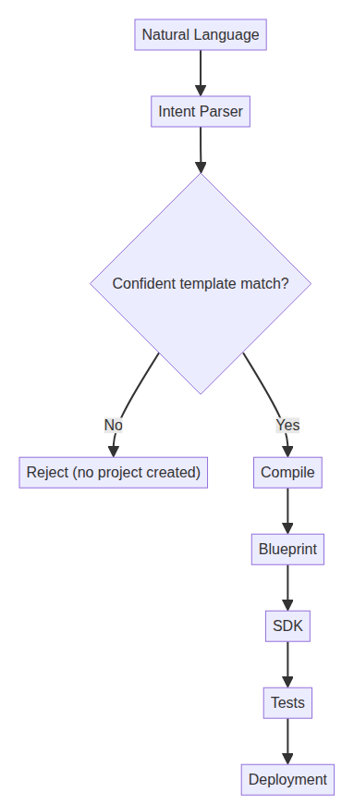
How Forge Works
Forge — IndiaCodeX Cardano Hackathon

Slide 6
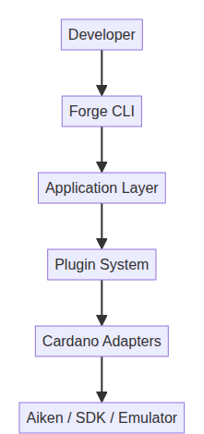
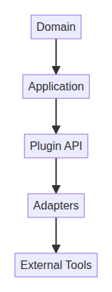
Architecture Overview
Forge — IndiaCodeX Cardano Hackathon

Slide 7
Supported Templates
1. Escrow with Milestone Payments (spend validator)
Use cases: Freelancing · Construction · Project funding
2. NFT Minting with Royalties (mint validator)
Use cases: NFT marketplaces · Creator royalties
3. Token Vesting (spend validator)
Use cases: Employee token vesting · Investor lockups
Forge — IndiaCodeX Cardano Hackathon

Slide 8
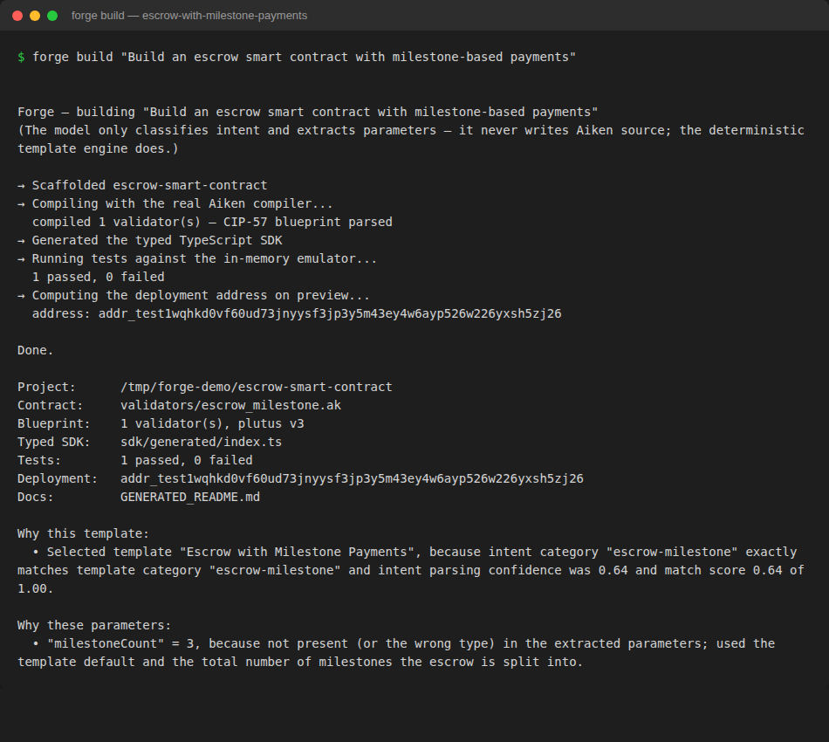
Live Demo — Real, Captured Output
Forge — IndiaCodeX Cardano Hackathon

Slide 9
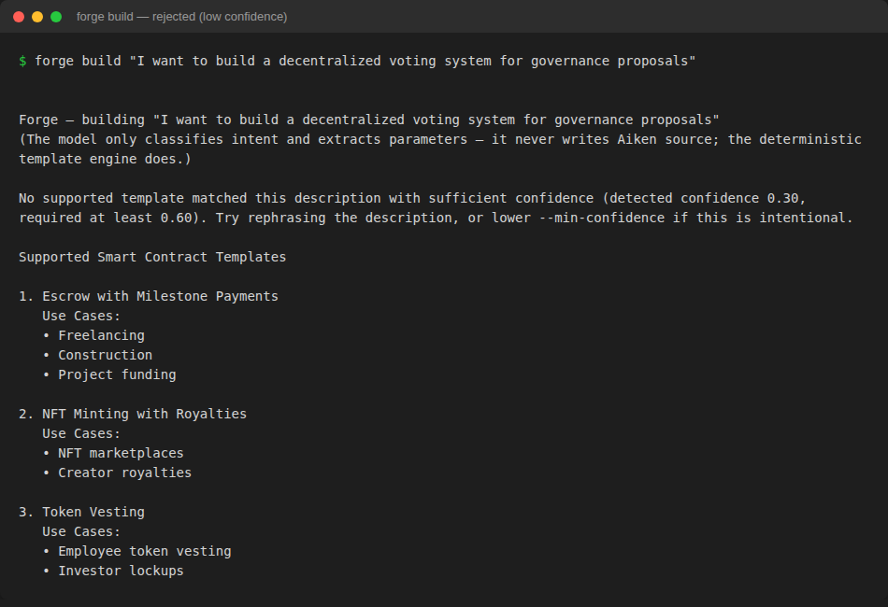
Same Command, Different Real Contracts
Forge — IndiaCodeX Cardano Hackathon

Slide 10
Traditional Development vs. Forge
Traditional Development | Forge
Set up project manually | ✓ Automated
Write boilerplate | ✓ Generated
Configure the compiler | ✓ Automated
Generate a typed SDK | ✓ Automated
Compile the contract | ✓ Automated
Run the emulator | ✓ Automated
Generate deployment artifacts | ✓ Automated
AI assistance | Intent parsing only — never writes contract code
Security model | Deterministic, audited templates — not AI-generated
Forge — IndiaCodeX Cardano Hackathon

Slide 11
What's Real Today vs. Roadmap
• REAL AND VERIFIED TODAY:
• Real Aiken compilation and CIP-57 blueprint parsing (not mocked)
• 3 audited, compiling contract templates (spend + mint validators)
• Confidence-gated template matching — rejects low-confidence guesses
• 150 unit tests + 8 real integration tests, all passing
• ROADMAP, HONESTLY DISCLOSED:
• ai-testgen — the eUTxO vulnerability rule engine (architected, not implemented)
• Real off-chain transaction building (ITxBuilderPort)
• Real local devnet, additional presentation layers (VS Code, web)
Forge — IndiaCodeX Cardano Hackathon

Slide 12
Why This Matters to Cardano
• eUTxO has failure modes no generic tool targets — double satisfaction has no equivalent on account-based chains
• The off-chain SDK matters more here — validators are pure functions, so SDK quality is a disproportionate share of the developer experience
• CIP-57 makes reliable codegen possible today — the machine-readable interface a typed-SDK generator needs
• Cardano hasn't had its "Hardhat moment" yet — Ethereum and Solana each inflected once scaffolding, testing, and deployment were unified
Forge — IndiaCodeX Cardano Hackathon

Slide 13
Thank you
Forge — deterministic templates, real Aiken compilation, AI kept strictly to intent parsing.
docs/JudgePreparation.md for the full FAQ · EXECUTIVE_SUMMARY.md for the one-pager

