Slide 1

ProbX
ACTIVE MARKET
Will active Cardano smart contracts exceed 15,000 by year-end?
A Decentralized Prediction Market on Cardano
YES (65%)1.54 ADA
PREDICT
VERIFY
REWARD
NO (35%)2.86 ADA
Volume: 450,230 ADA • Closes in 14 days

Slide 2
The Problem
Centralized platforms control user funds completely
Market resolutions lack cryptographic transparency
Users are forced to trust opaque intermediaries
Extremely limited community governance participation
High operational and middleman costs reduce payouts

Slide 3
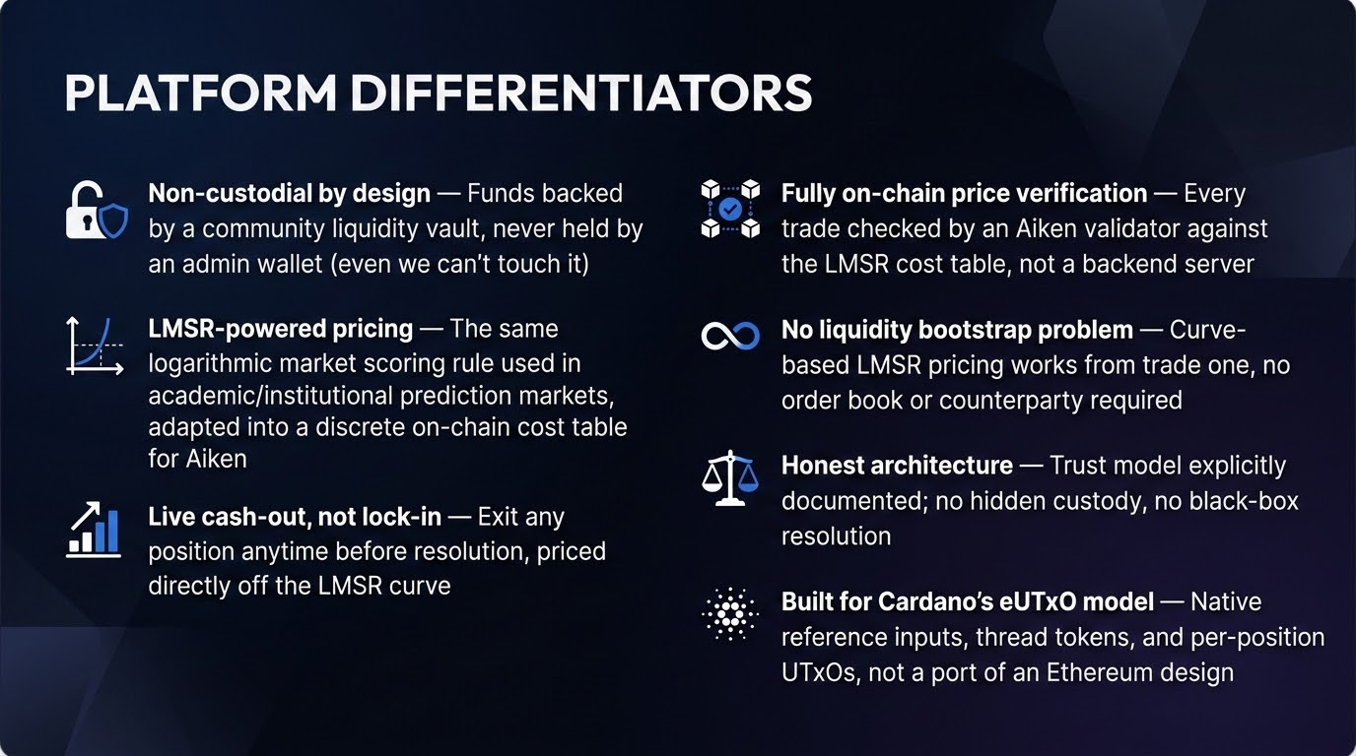

Slide 4




Our Solution
Connect & Create
Trade Positions
Connect your Cardano wallet instantly. Propose and create prediction markets for any verifiable real-world event without permission.
Buy YES or NO outcome positions using ADA. Trade continuously with deep liquidity until the market strictly closes.
Trustless Execution
Automated Rewards
Decentralized oracles cryptographically verify the outcome, ensuring no single entity controls or manipulates the market truth. (Future Scope)
Smart contracts execute automatically, distributing ADA rewards directly to winning wallets with zero intermediary fees.

Slide 5



How PROPHC Works
4. Distribute
2. Trade
Smart contract instantly distributes rewards to winning wallets
User purchases YES/NO shares; ADA is locked in smart contract
1. Setup
3. Resolve
User connects wallet & creates or joins a prediction market
Event ends and Decentralized Oracle verifies the outcome

Slide 6
How Pricing Works (LMSR)
01
Equal Start
The prediction market initializes at a balanced state, with probabilities set strictly at 50% YES / 50% NO.
02
Smooth Shifts
Buying YES pushes the probability up, and buying NO pushes it down. Prices adapt smoothly without wild, single-trade price swings.
03
On-Chain Math
The Aiken validator checks price movements against a precomputed cost table. This achieves maximum efficiency with no floating-point math required on-chain.
04
Softmax Logic
Uses the same mathematical foundation as softmax in Machine Learning, where probability is the normalized exponential of cumulative shares bought.

Slide 7
Future Scope
01 / SECURITY
Robust Trust
Security Audit Third-party smart contract audit + fuzz testing on solvency logic before mainnet.
Any-of-N Keys Remove single-point-of-failure signing for admin/resolver keys.
02 / ORACLES
Decentralization
Oracle Upgrades Replace single resolver key with Charli3 or dispute/staking oracle models.
Monitoring Oracle staleness alerts, reconciler/indexer uptime, and key management via HSM.
03 / PROTOCOL
Scale & Yield
Scale UTxO Redesign beyond single market-UTxO for concurrent trade throughput.
Real Fee Model Protocol fee + LP yield to sustain long-term liquidity incentives.
04 / REGULATORY
Compliance & UX
Compliance Layer KYC/AML, age verification, and geographical jurisdictional restrictions.
Fiat On/Off-Ramp Buy ADA directly with card and cash out seamlessly to bank accounts.

Slide 8
Platform Features
account_balance_wallet
Wallet Integration
CIP-30 wallet support
Secure authentication
Frictionless onboarding
trending_up
Prediction Markets
Create custom markets
Browse active events
Seamlessly trade positions
history_edu
Smart Contracts
Trustless execution
Automatic settlement
Secure on-chain fund locking
visibility
Transparency
Fully on-chain transactions
Publicly verifiable outcomes
Immutable historical records
gavel
Governance
Community-driven improvements
Transparent protocol treasury
Decentralized decision making

Slide 9












System Architecture
Frontend
Wallet Layer
Backend
React + Next.js
Mesh SDK + CIP-8
Node.js + Express
Blockchain
Smart Contracts
Data Layer
Cardano Network
Aiken / Plutus
Blockfrost APIs

Slide 10


Technology Stack
Frontend
Blockchain
Contracts
React
Cardano
Aiken
Next.js
Mesh SDK
Plutus Core
Tailwind CSS
CIP-30 & CIP-8
Node.js Backend
Blockfrost

Slide 11

Smart Contract Workflow
Market Creation & Liquidity Locked
Users Purchase YES/NO Positions
Market Closed (Trading Halts)
Oracle Resolution & Winner Verification
Automatic ADA Distribution

Slide 12
Why Cardano?
alt_routeParallel Execution
Extended UTxO model ensures parallelism and high performance.
tokenNative Assets
Mint custom tokens natively without writing complex smart contracts.
verified_user
Secure, Verified Smart Contracts
Cardano utilizes formal verification techniques to mathematically prove the correctness of smart contracts, providing military-grade security and preventing exploits.
paymentsPredictable Fees
Enjoy low and highly predictable transaction fees on every transfer.
speedHigh Scalability
Optimized core infrastructure built for high global throughput.
calculateDeterministic Costs
Deterministic transactions completely prevent hidden execution costs.
gavelSustainable Governance
On-chain governance architecture ensures decentralized evolution.

Slide 13










Security Model
Wallet Ownership
Digital Signatures
Immutable Chain
Strict cryptographic wallet identity checks
All actions mandate verifiable signatures
Tamper-proof ledger ensures data integrity
Trustless Settlement
Contract Validation
Non-Custodial
Automated payouts without human intervention
Aiken scripts strictly control all UTxO logic
We take absolutely no custody of user assets

Slide 14
Roadmap
Phase 1
•MVP Launch
•Wallet Integration
•Market Creation
Phase 2
•Oracle Integration
•Analytics Dashboard
•On-chain Governance
Phase 3
•Liquidity Pools
•Mobile App Release
•Cross-chain Expansion

Slide 15

Societal Impact
visibility
Transparent Markets
Open, verifiable data feeds ensuring absolute market clarity.
groups
Community Ownership
Decisions and platform governance driven entirely by users.
public
Financial Inclusion
Global access to prediction markets without geographical barriers.
handshake
Trustless Transactions
Smart contracts eliminating counterparty risks and intermediaries.
trending_up
Cardano Adoption
Boosting utility, transactions, and user engagement on Cardano.
gavel
Decentralized Governance
Fair voting protocols for platform upgrades and dispute resolutions.
payments
Fair Reward Distribution
Automated, direct payouts to accurate forecasters instantly.
auto_awesome
The PROBX Vision
Fostering a globally open, decentralized forecasting infrastructure.

Slide 16

hub
Cardano-Powered Core
Built as the premier decentralized prediction market on Cardano, leveraging secure, scalable on-chain settlement.
Future Vision
A decentralized platform empowering anyone, anywhere, to forecast real-world outcomes with absolute integrity.
public
Global & Transparent
Enabling open forecasting across geographical boundaries, ensuring absolute clarity through transparent event data.
handshake
Trustless Disintermediation
Eliminating third-party counterparty risks completely, executing prediction pools securely through automated code.

Slide 17

Market Mechanisms
Order Book
Polymarket / Kalshi
subtitles_off
Counterparty Required
Requires a matching counterparty for every single trade to execute.
trending_down
Liquidity Dependent
Low liquidity directly results in unfilled orders or extremely wide spreads.
dns
Hybrid Infrastructure
Relies on complex matching engines and off-chain infrastructure systems.
gavel
Peer-to-Peer Pricing
Prices depend entirely on actively competing bids and asks in the market.
Curve-Based AMM
ProbX (On-Chain Native)
timeline
Direct Curve Trading
Trade directly against an automated, mathematical pricing curve.
bolt
Guaranteed Liquidity
Constant availability and instant liquidity, even for newly created markets.
layers
Purely On-Chain
Operates on simple, highly secure, fully on-chain smart contract logic.
functions
Deterministic Pricing
Prices are computed programmatically and predictably directly from the curve.

Slide 18
Thank You
ProbX
PREDICT • VERIFY • REWARD

