Slide 1
SENTINEL
Engineering Confidence for Autonomous AI Agents
the Assurance Layer for Masumi
Masumi Hackathon · Release Candidate 1
Notes:
Ten seconds, no more. State your team name and one sentence: "This is Sentinel — the engineering assurance layer for autonomous agents built on Masumi." Don't explain what that means yet — the next slide earns it.

Slide 2
THE PROBLEM
Nobody can prove what an agent actually did
“Why did this payment happen?”
An agent made a Masumi payment. The counterparty disputes it three weeks later.
“Why did the agent make this decision?”
The reasoning lived in a chat log that scrolled away, or was never saved.
“Can you prove this record wasn't altered?”
“Trust our database” is not an answer an auditor accepts.
SENTINEL
2
Notes:
Tell it as a scenario, not a bullet list: "Imagine an autonomous agent renews a subscription through Masumi. The payment gets disputed a month later. Someone asks your team: why did the agent do this, and can you prove it? Today, most teams have nothing but scattered application logs." Land on: "Sentinel exists to make those three questions answerable, deterministically, every time."

Slide 3
WHY EXISTING SOLUTIONS FAIL
Observability isn't assurance
LLM observability platforms
Show a call graph. No portable, independently re-verifiable artifact — the trace lives in their database, trusted because you trust their database.
Blockchain explorers
Show a settled Masumi transaction. No visibility into why the agent decided to make it, or what preceded it.
Generic application logging
Captures whatever a developer thought to log that day. No structural guarantee every nondeterministic boundary was captured.
Masumi itself
Deliberately doesn't solve this. It proves who an agent is and moves the money — a different, engineering-shaped problem.
SENTINEL
3
Notes:
Don't trash-talk the alternatives — name the specific gap each one leaves. "Tracing tools show you a call graph, not a proof. An explorer shows a settled transaction, not the reasoning behind it. And Masumi shouldn't have to solve this either — identity and payments are a full-time job for a protocol. What's missing is a layer whose only job is proving what happened."

Slide 4
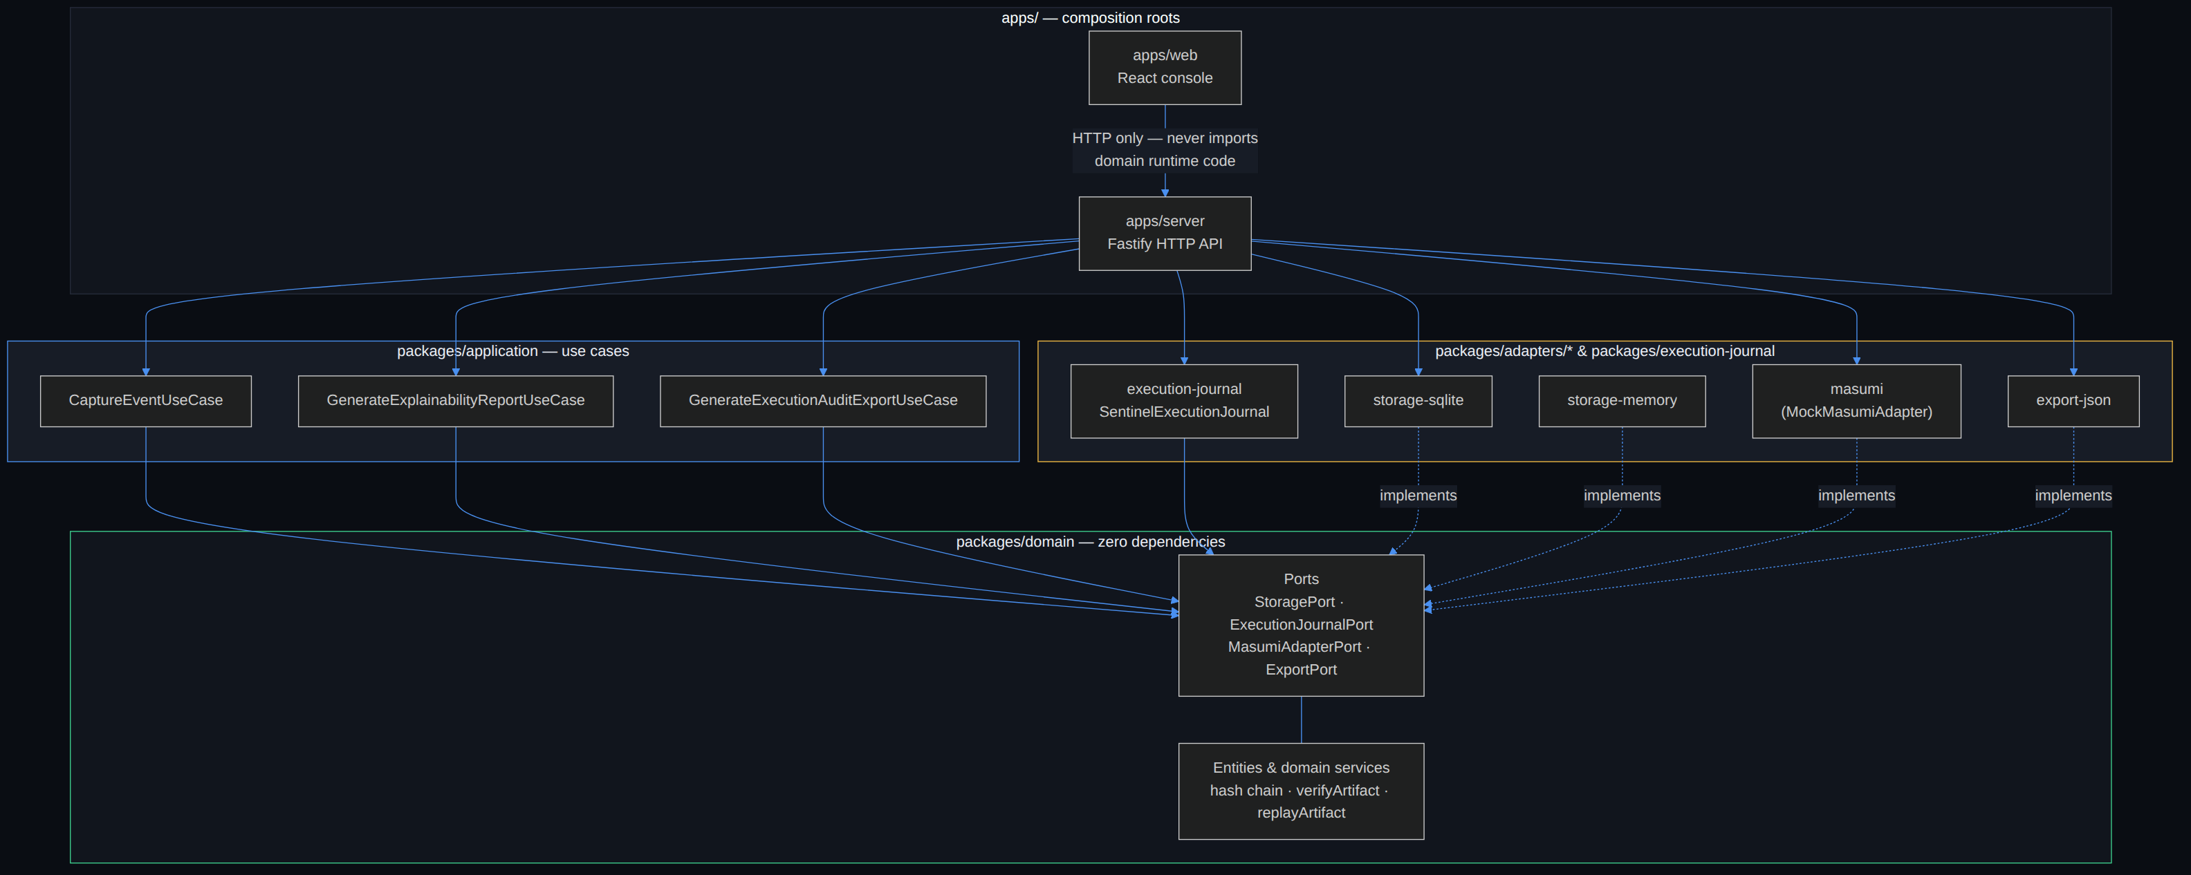
SENTINEL ARCHITECTURE
Clean Architecture, enforced structurally
SENTINEL
4
Notes:
packages/domain has zero dependency on any framework, database, or adapter — verified by grep, not just claimed. Everything the domain needs from the outside world is expressed as a port; adapters implement those ports and are wired together only at the composition root. This is the diagram, not a description of it — it's generated from the actual package.json dependency graph.

Slide 5
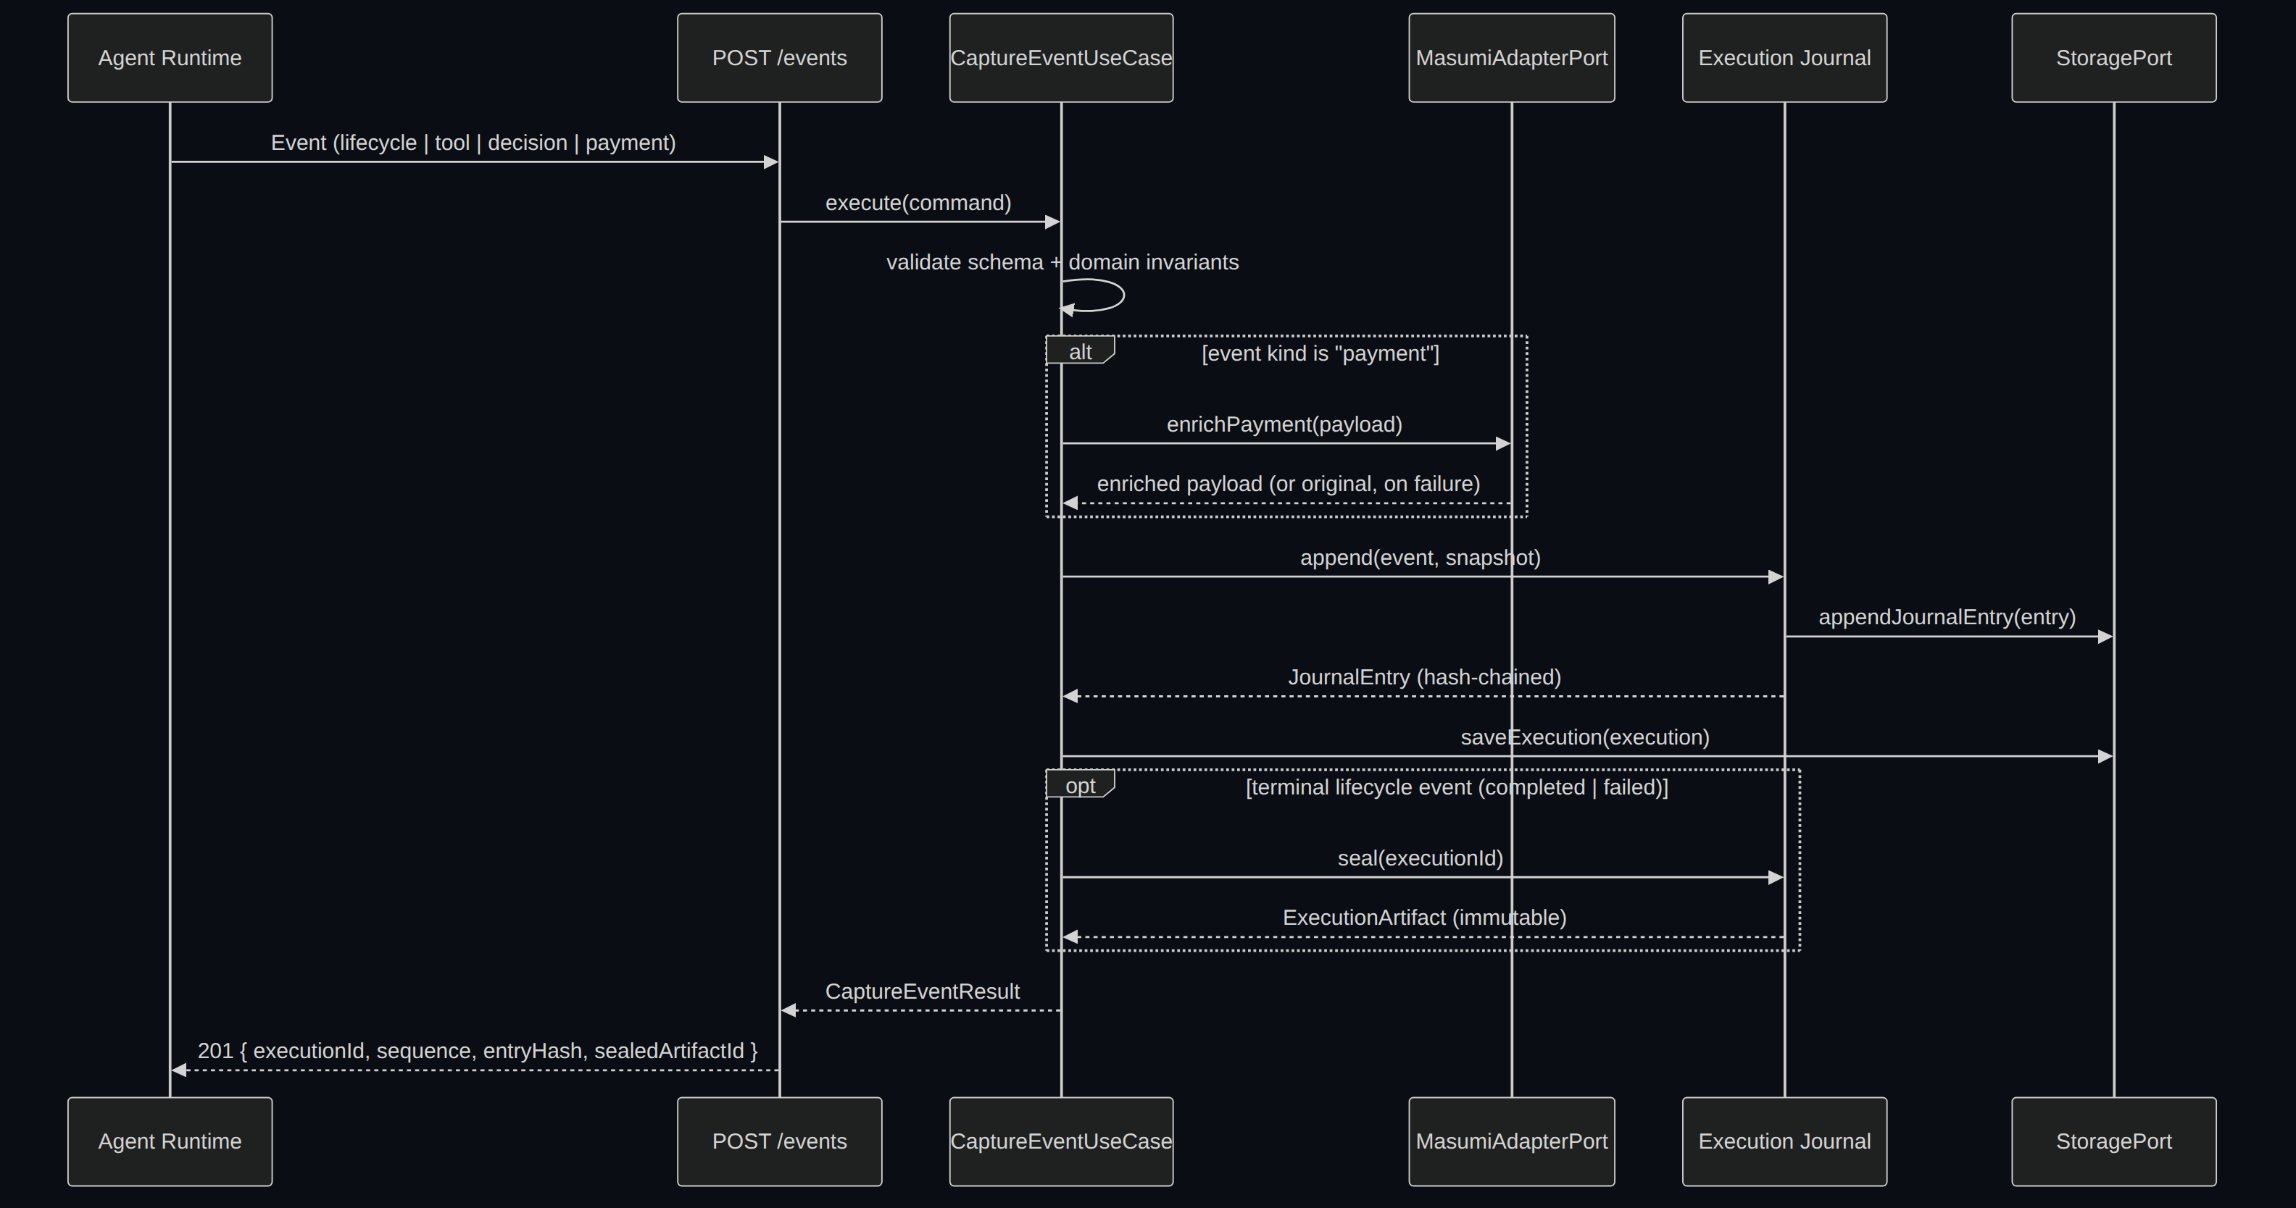
END-TO-END FLOW
One event, from the agent to a hash-chained record
SENTINEL
5
Notes:
Walk it left to right, fast: the agent posts an event, it's validated, a payment event is routed through MasumiAdapterPort live, then it's appended to the hash-chained Journal. A terminal lifecycle event triggers automatic sealing into an immutable artifact — sealing is not a separate call a caller has to remember to make.

Slide 6
CORE COMPONENTS
Six capabilities, one deterministic pipeline
Execution Capture
Execution Journal
Replay Engine
Typed HTTP API validating every event against schema and domain invariants.
Append-only, hash-chained record. No updates, no deletes, ever.
Deterministic reconstruction from recorded Snapshots. Never re-invokes a live system.
Verification Engine
Engineering Explainability
Audit Export
Six independent checks, recomputed from a portable artifact alone.
Deterministic, rule-based narration. No AI, no natural-language generation.
One portable JSON file — sufficient on its own to audit an execution.
SENTINEL
6
Notes:
Move fast through this grid — six words each, don't read every description aloud. The point is the shape: capture, journal, replay, verify, explain, export. Say: "171 tests, nine architecture decisions written down, zero known vulnerabilities."

Slide 7
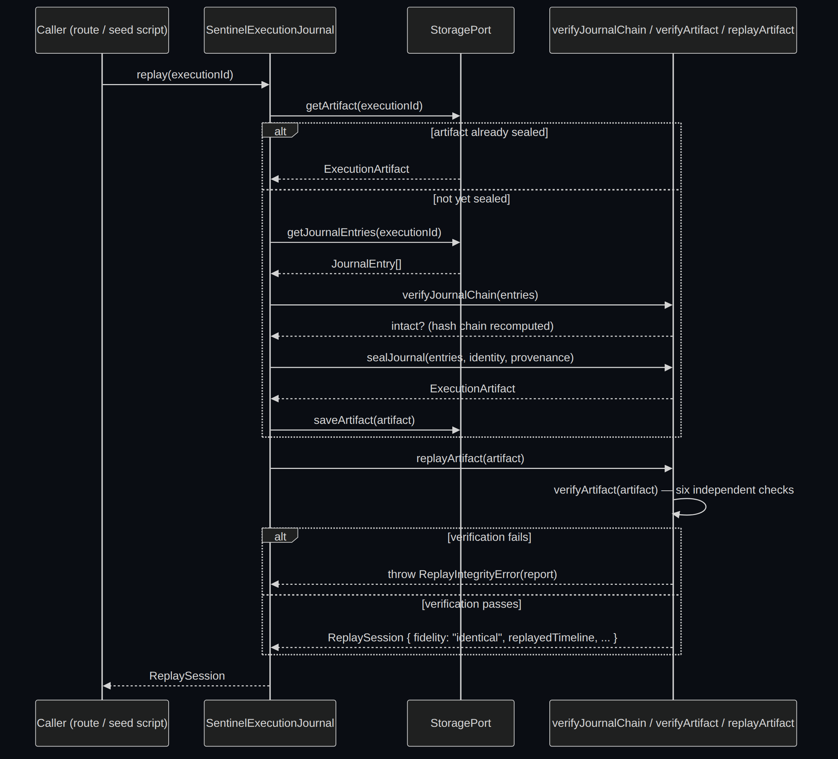
DETERMINISTIC REPLAY
Verify first. Replay never proceeds on unverified data.
SENTINEL
7
Notes:
Two layers of integrity checking gate every replay: journal integrity first (has the live store been altered since write time), then artifact integrity second (does the sealed, portable artifact still hash-verify on its own). Replay refuses to produce a session at all when verification fails — it never operates on data it can't already prove is intact.

Slide 8
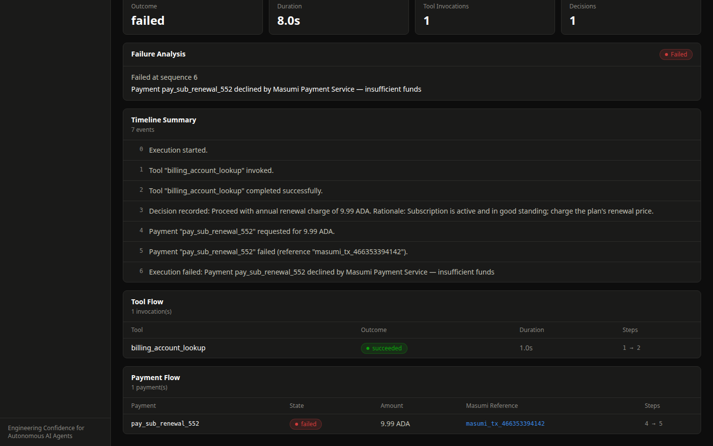
EXPLAINABILITY
The Masumi reference, on a payment that failed
SENTINEL
8
Notes:
This is a live screenshot, not a mockup. This agent's payment was declined — insufficient funds — and Sentinel still knows exactly why, with a real Masumi reference attached during capture. No AI wrote any of this text; it's a template over recorded data, the same output every time for the same input.

Slide 9
ENTERPRISE & OPEN SOURCE VISION
Open core. Enterprise surface.
Commercial surface
— Hosted storage at scale
— Artifact signing and compliance tooling
— Enterprise auth and multi-tenancy
Open core: capture → journal → replay → verify → explain → export (MIT licensed)
SENTINEL
9
Notes:
The goal is maximum adoption of the capture/replay/verify/explain primitive across the Masumi ecosystem — MIT, not AGPL, on purpose. What's commercial sits above the open core: hosted scale, signing, compliance, multi-tenant auth. All named explicitly on the roadmap as 'not built yet,' not hidden.

Slide 10
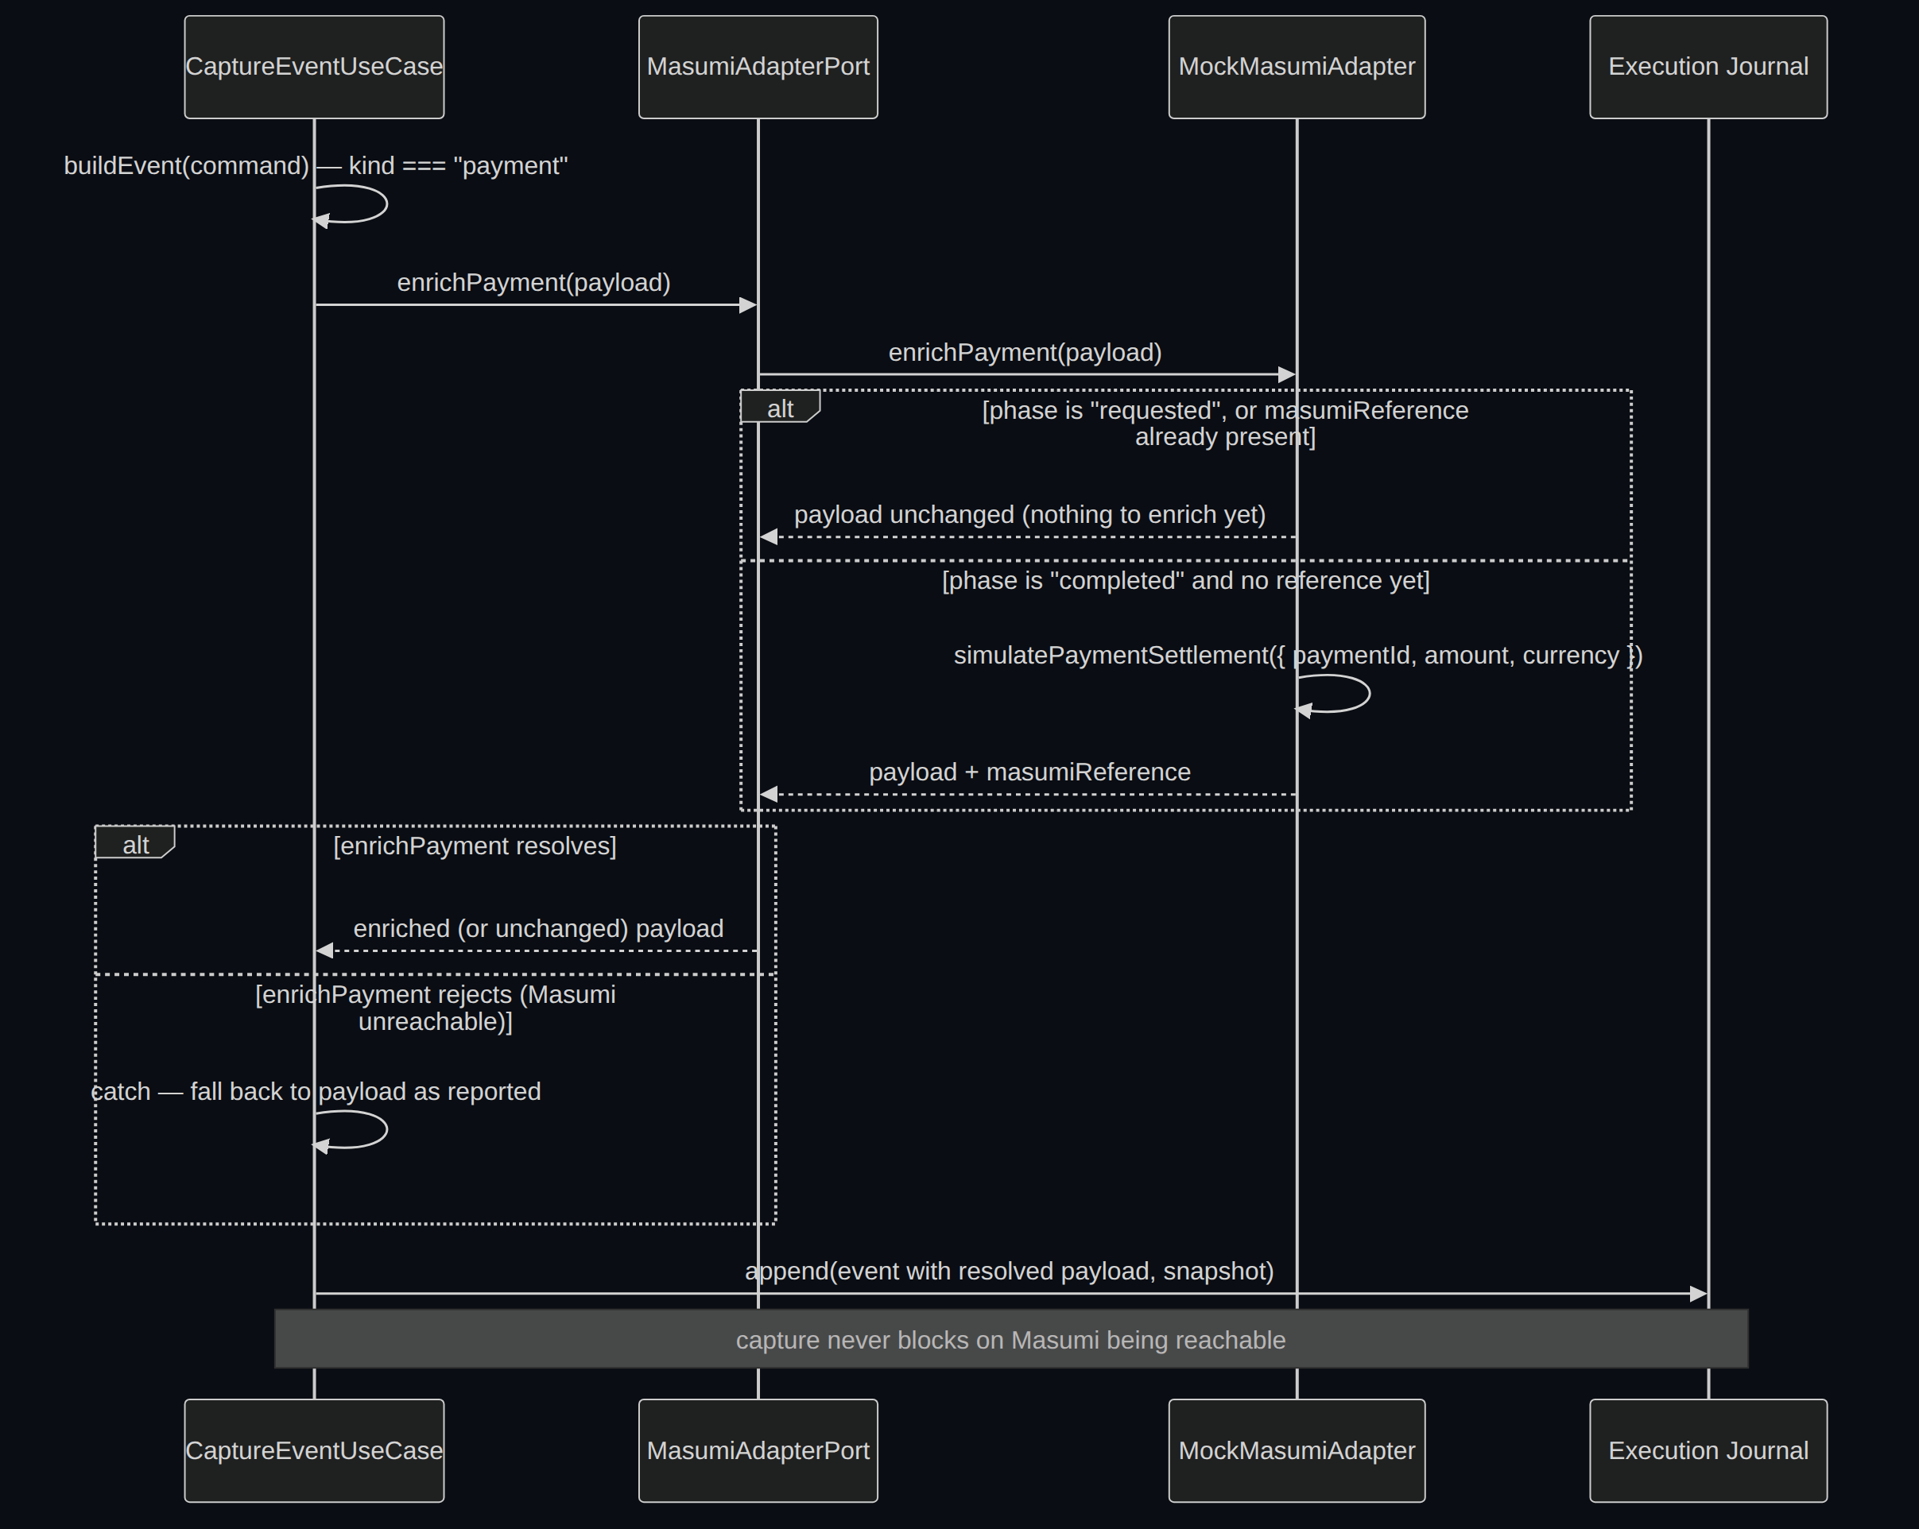
WHY SENTINEL MATTERS TO MASUMI
A live call, every payment — not a mock bolted on
SENTINEL
10
Notes:
MasumiAdapterPort.enrichPayment fires live, during capture, on every payment event — visible in the seed script's own terminal output and in the UI. Today it's backed by a deterministic mock; a real Masumi client is a drop-in replacement behind the same port. If Masumi is unreachable, capture still succeeds — enrichment degrades, the record never does.

Slide 11
ROADMAP
What's real today, what's next
TODAY
NEXT
✓ Live Masumi payment enrichment
✓ Deterministic capture / replay / verify / explain / export
✓ SQLite + in-memory storage, contract-tested
✓ Web console, dark + light theme
✓ 171 tests, 9 ADRs, MIT licensed
→ A real Masumi client behind MasumiAdapterPort
→ Artifact signing for third-party auditability
→ PostgreSQL storage adapter
→ AuthN/AuthZ and multi-tenancy
→ Snapshot redaction policy
SENTINEL
11
Notes:
Judges trust teams that know their own gaps. Say the limitations out loud before anyone has to extract them: no auth yet, no artifact signing yet — both additive, neither requires touching the deterministic core. This is a confidence move, not a confession.

Slide 12
Masumi gave agents the ability to pay.
Sentinel gives them the ability to be trusted.
pnpm install && pnpm demo
Two minutes, one command, judge it yourself.
MIT Licensed · Thank you
Notes:
Land the closing line, then stop talking. Do not fill the silence — let it sit, then invite questions directly rather than a generic thank-you.

