Slide 1
BONDING-CURVE LAUNCHPAD · CARDANO
SNEKPAD
Meme coins, priced by transparent math.
A Cardano meme-coin launchpad where every price is set by a formula anyone can verify — and every graduating token gets a real liquidity pool on Minswap.
PROJECT BRIEFING · JULY 2026

Slide 2
02
The Problem
Meme-token launches are everywhere. Trust in them is not.
1
Blind Buying
Every day people buy tokens with no idea how the price was set, or whether it can be quietly manipulated.
2
Arbitrary Pricing
Pricing on most launch platforms is opaque — buyers don't know what they're really paying for.
3
No Verifiable Math
Existing launchpads work technically, but expose no formula a buyer can check for themselves.
The Problem
SNEKPAD

Slide 3
03
What We Built
Create, buy, and sell meme tokens — priced by a transparent, provable formula.
1
2
3
Create a Token
Buy In
Sell Out
Launch with custom inputs. The bonding-price curve is generated automatically from three parameters.
See exactly why the price is what it is before you buy — transparent, checkable pricing at every step.
Exit at any time. Every action is governed strictly by the same formula, in reverse — nothing hidden.
What We Built
SNEKPAD

Slide 4
04
How Pricing Works
Price rises automatically as more tokens are bought — the same transparent formula for every token.
c
Starting Price
price = m · supply + c
The initial price of the token at launch — set by the creator.
A mathematically transparent, automated linear bonding curve — the same formula the Aiken smart contract enforces on-chain.
m
Price Growth
How fast the price rises as tokens sell. Calculated automatically from the launch inputs.
Off-chain (app) and on-chain (validator) compute this identically — a trade only confirms if both agree.
x
Tokens Sold
The total quantity of tokens purchased from the pool so far.
How Pricing Works
SNEKPAD

Slide 5
05
Setting Up a Token
Three inputs, automated curve math, and a built-in guardrail against impossible configurations.
c
Initial Price
S
Total Supply
R
Target Raise (once fully sold)
AUTOMATIC CALCULATION
BUILT-IN GUARDRAIL
m = 2 × (R − c×S) / S²
R must exceed c × S, or the system flags the configuration before launch.
Price growth is solved for automatically from your three inputs.
Launch parameters also include reserved supply (held back for creator, rewards & liquidity) and sellable supply — the portion actually tradable on the curve.
Setting Up a Token
SNEKPAD

Slide 6
06
Buying & Selling
Every trade is priced fairly, whether you're buying one token or a thousand.
cost = ((price_start + price_end) / 2) × amount
01
02
03
Buying
Selling
The Result
Costs the average price across the whole batch, not the starting price — so bulk buyers can't hide behind stale pricing.
Works the exact same formula in reverse, so there's no exploitable gap between buy and sell logic.
Every trade — big or small, buy or sell — settles under the same consistent, on-chain-verifiable rule.
Buying & Selling
SNEKPAD

Slide 7
07
Why Cardano
Built where the chain's own strengths match what a meme token needs.
1
Native Minting
Tokens mint directly at the ledger level — no bespoke smart contract needed just to create a coin, so launches are fast and cheap.
2
Predictable Fees
Low, stable transaction fees matter for meme tokens, where trades are frequent and often small.
3
A Fast-Growing DeFi Base
Cardano's native DEX ecosystem — led by Minswap — gives graduating tokens a real, liquid home once they outgrow the curve.
Why Cardano
SNEKPAD

Slide 8
08
Graduation: From Curve to Minswap
Tokens trade only on our curve until 80% of the sellable supply is sold — then they graduate to a real liquidity pool.
Bonding Curve
0 → 80% sold
→
Graduation
Gate Triggers
→
Minswap LP
Pool Created
Today: the graduation gate is live in the bonding-curve contract (owner-signed, unlocks at ≥80% sold) and the product already markets this path end-to-end. Wiring the gate to programmatically create the Minswap pool itself is the near-term milestone — see Roadmap.
#1
$124.7M
Minswap is Cardano's largest DEX by TVL and volume
Pump.fun's Q1 2026 platform revenue (Solana)
~25% of all Cardano DeFi TVL runs through it — the natural home for graduated tokens.
The bonding-curve → DEX graduation model is proven at scale; SnekPad brings it to Cardano's eUTXO design, graduating earlier (80% vs. 100%) for tighter liquidity.
Sources: DefiLlama (Minswap TVL/volume), Yellow.com research (Pump.fun Q1 2026 revenue)
Graduation & Minswap
SNEKPAD

Slide 9
09
The Social Farming Engine
Turns every launched coin into a community-growth loop — rewarding real contribution, not just buying.
HOW IT WORKS
THE GUARDRAIL
1
Launchpad emits signed events (buys, sells, LP, graduation) — the engine never reads the chain directly.
AI scores content quality. It never decides payout amounts. A deterministic, creator-configured rule engine turns scores into points — every reward is auditable.
2
A standalone service (independent of the launchpad) ingests, verifies, and de-duplicates every event.
3
Deterministic rules + an AI quality check score community contributions — memes, threads, referrals, education.
STATUS: IN ACTIVE DEVELOPMENT
4
Two ledgers track value: Project Contribution Points (per-project, spends the reward pool) and Reputation (global, non-redeemable, unlocks tiers).
Standalone TypeScript/NestJS service scaffolded with Postgres + Redis, an event-ingestion gateway, and the reward-ledger schema. Not yet wired end-to-end to a live launch or exposed to users.
5
Creators approve AI-suggested campaigns; nothing publishes automatically.
Social Farming Engine
SNEKPAD

Slide 10
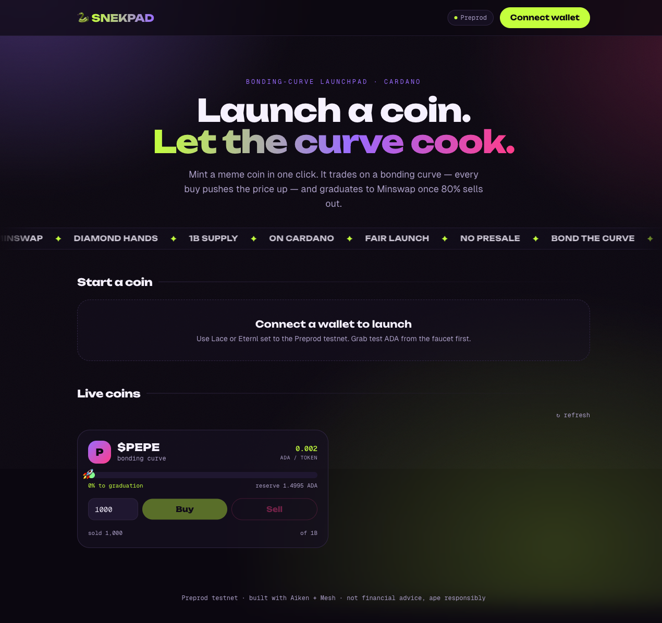
10
Built So Far
Live on Cardano Preprod testnet. Here's exactly what's verified, and what's still in flight.
✓
Token minting — verified on-chain
A real Preprod mint transaction confirmed (CIP-68 policy + supply into the pool).
✓
Bonding-curve validator — built & unit-tested
Aiken contract with passing tests for buy, sell, and rejection of underpayment / tampering.
✓
Graduation gate — implemented
80%-sold threshold enforced on-chain; owner-signed graduation redeemer.
…
Buy / sell trades — on-chain verification in progress
Trade builders are complete in the app; end-to-end confirmed trades on Preprod are the next checkpoint.
…
Minswap pool creation at graduation — not yet wired
Graduation currently releases reserve + tokens to the project owner; automatic LP creation on Minswap is the next milestone (see Roadmap).
Live testnet UI — snekpad.com (Preprod)
Built So Far
SNEKPAD

Slide 11
11
What's Next
From a live pricing engine to full DEX graduation, creator security, and community incentives.
01
On-Chain Trading, Verified
Confirm buy/sell end-to-end on Preprod for every acceptance criterion before moving toward mainnet.
02
Automatic Minswap Graduation
Wire the graduation gate to programmatically create and seed the Minswap liquidity pool — no manual step.
03
Liquidity Locks & Creator Vesting
Anti-rug protection so raised funds and creator allocations can't be pulled or dumped early.
04
AI-Powered Social Farming, Live
Ship the Reward Engine + Trust Engine to production and connect it to real launches.
05
Concurrency at Scale
Move beyond the single-pool-UTXO limit with an order-batching design — the same class of problem Minswap solved for Cardano DEX trading.
What's Next
SNEKPAD

Slide 12
We built the math first.
Because a launchpad you can trust starts with pricing you can prove — and a graduation path onto real Cardano liquidity.
SNEKPAD · Cardano Preprod Testnet · snekpad.com

