Slide 1

INDIA CODEX 2026
CARDANO DAPP
TrustLock
Reclaimable, milestone-gated escrow on Cardano — a smart-contract protocol that removes the unilateral reclaim right at the exact moment a payer has the least incentive to be honest.

Slide 2
CHAPTER 01
THE PROBLEM
The Exploit
A well-documented failure pattern in freelance and gig payments for digital deliverables — UI/UX design, code, creative assets:
01
02
Agreement
Delivery
Client agrees to pay a freelancer for a deliverable, using an escrow-style arrangement to build trust.
Freelancer completes the work and delivers it in full.
03
04
Theft
Ghost & Reclaim
Client reviews, copies, or reuses the deliverable independently.
Client refuses to release payment — or unilaterally reclaims locked funds — leaving the freelancer with neither payment nor recourse.

Slide 3
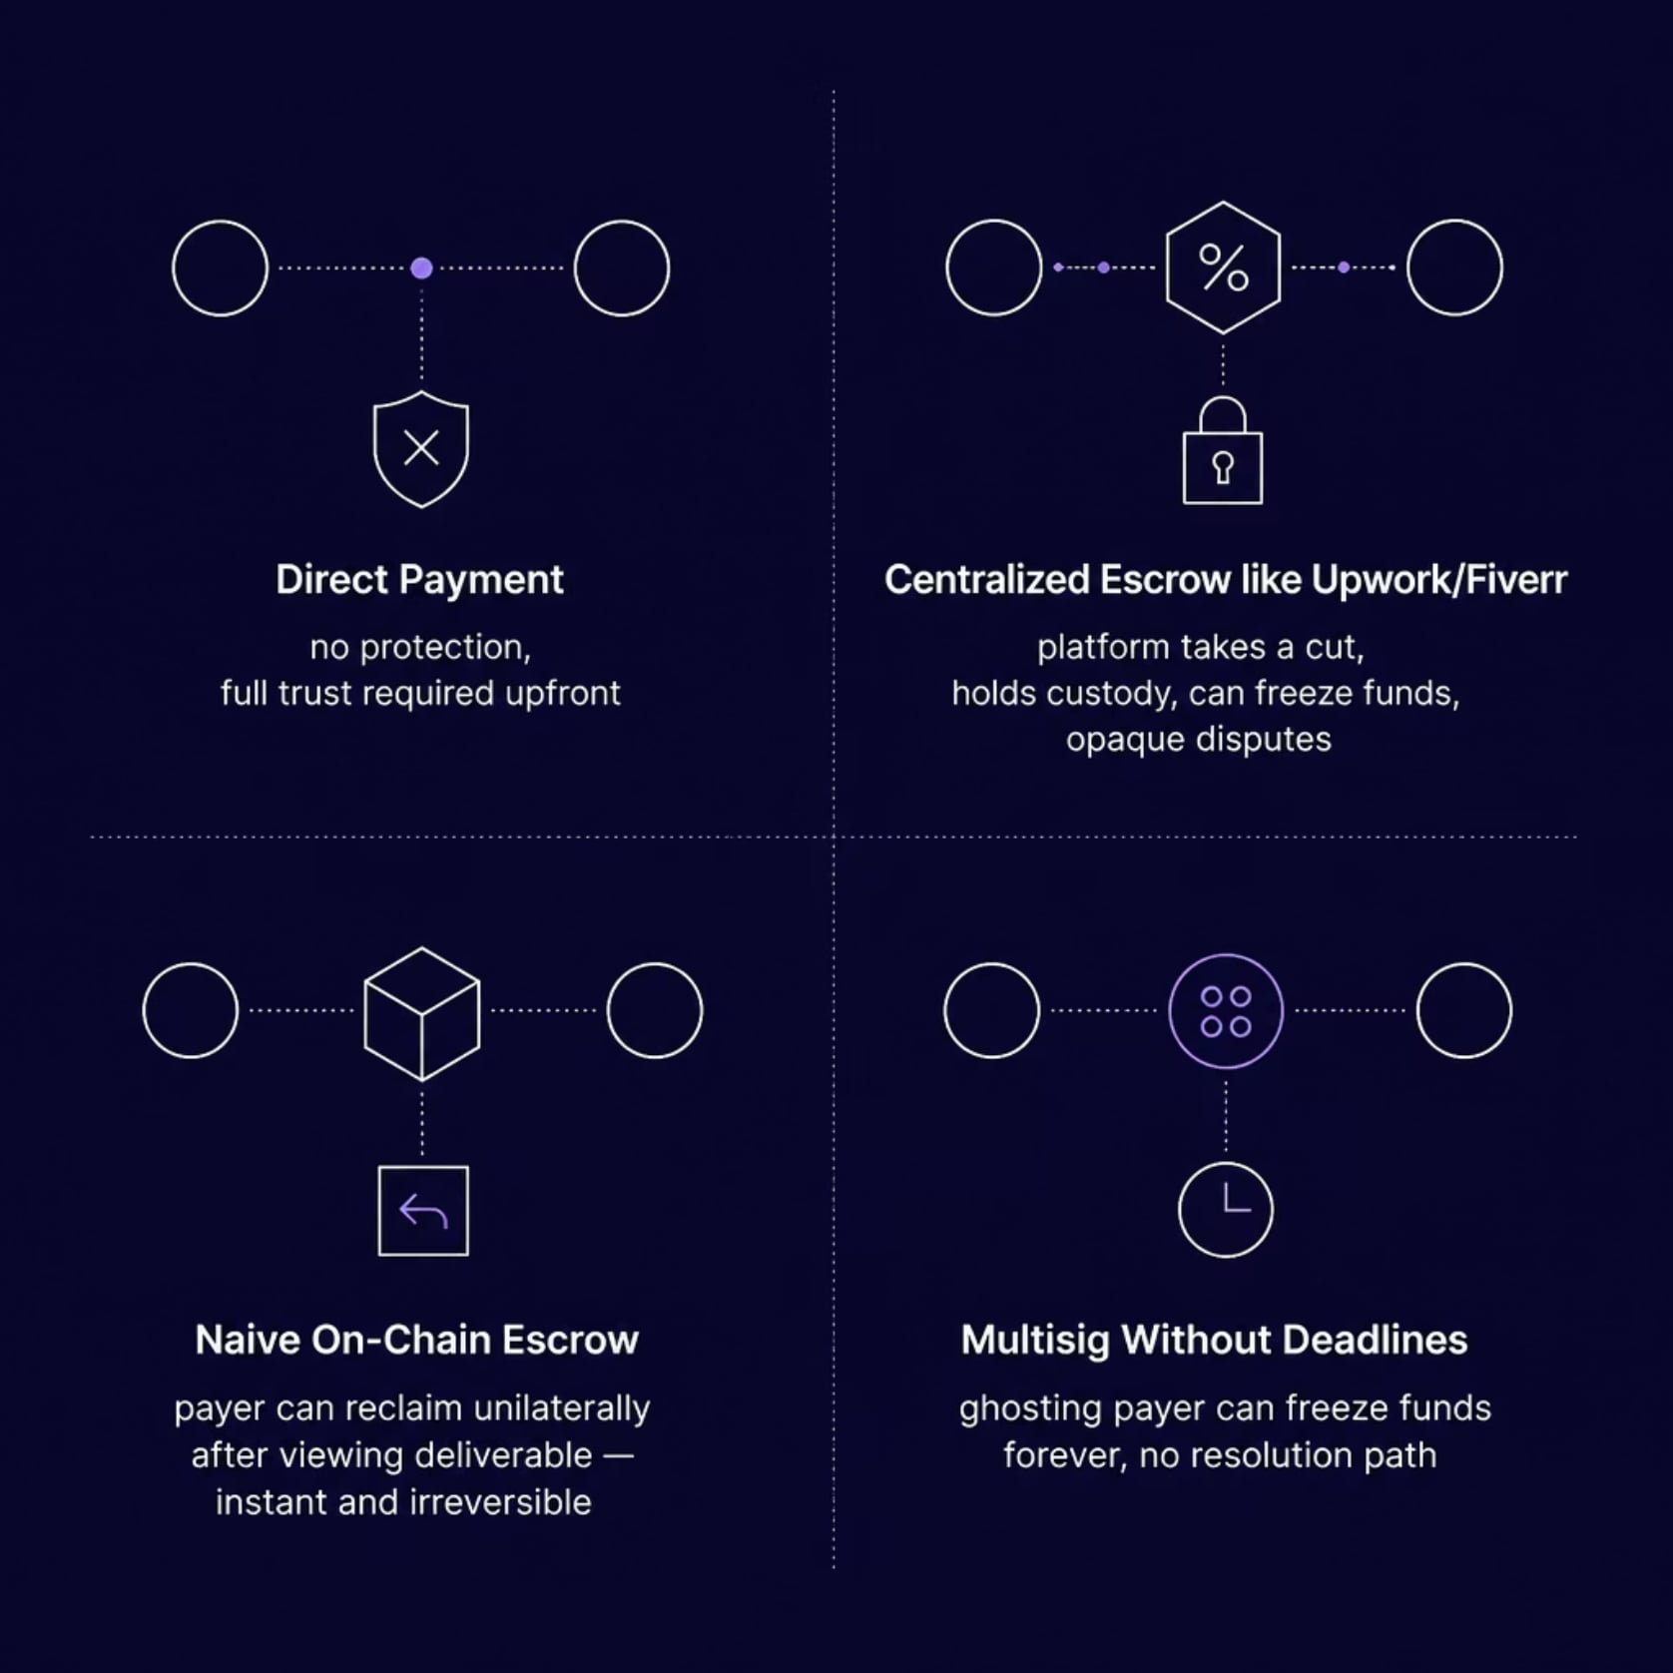
CHAPTER 01
THE PROBLEM
Why Existing Solutions Fall Short
Every current approach to freelance escrow has a critical weakness that fails to protect both parties simultaneously.
Naive on-chain escrow can make the exploit worse — the reclaim is instant, irreversible, and requires no justification.

Slide 4
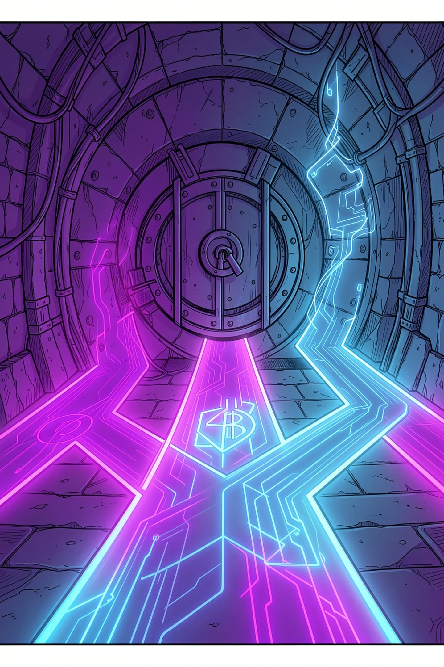
CHAPTER 02
THE SOLUTION
Three-Path Release Policy
TrustLock encodes three spending paths directly into an Aiken validator guarding a script UTXO. Critically, the payer alone can never reclaim funds once a milestone is marked delivered.

Slide 5
CHAPTER 02
THE SOLUTION
The Three Spending Paths
Path A — Timed Auto-Release
Path B — Mutual Refund
Path C — Arbitrated Dispute
Sender and receiver jointly agree to cancel and refund. Requires both signatures — the sender cannot do this alone.
Receiver marks milestone complete. A 48–72 hour countdown begins. If the sender raises no dispute, the receiver claims funds after the deadline. Silence defaults to payment.
If the sender disputes within the window, a neutral arbiter reviews evidence and signs off. The only path by which a sender can recover funds after delivery.

Slide 6

CHAPTER 03
ARCHITECTURE
System Architecture
Arbiter Wallet
Client Wallet
Dispute resolution signer
Locks ADA and datum
High-Level Flow
Client locks ADA at the TrustLock script address, embedding datum with sender, receiver, arbiter key hashes, deadline slot, and milestone status.
Receiver submits a transaction marking the milestone as delivered, starting the dispute window.
If no dispute before deadline, receiver claims via Path A.
If sender disputes, arbiter co-signs a Path C resolution.
If both agree to cancel before delivery, either proposes a Path B mutual refund.
Freelancer Wallet
TrustLock System Flow
Next.js Frontend
Receives funds on success
Mesh SDK interface
TrustLock Aiken Validator
Cardano Node & Blockfrost
On-chain script enforcement
Chain access and APIs

Slide 7
CHAPTER 03
ARCHITECTURE
Smart Contract Design
Redeemer
Required Signers
Validator Conditions
ReceiverClaim
receiver
milestone_delivered == true AND current_slot > deadline_slot AND dispute_raised == false
MutualRefund
sender AND receiver
Always valid with both signatures present
ArbiterResolve
disputing party AND arbiter
dispute_raised == true AND arbiter signature present
MarkDelivered
receiver
Updates milestone_delivered = true, sets deadline_slot (state-transition, no fund release)
RaiseDispute
sender
Only valid if current_slot <= deadline_slot; sets dispute_raised = true
State-transition redeemers re-lock the UTXO at the same script address with updated datum — using Cardano's continuing-output pattern to carry state forward.

Slide 8






CHAPTER 04
TECHNOLOGY
Technology Stack
On-Chain Logic
Off-Chain TX Building
Aiken validator implementing the three spending paths.
Mesh SDK for wallet connection, transaction construction, and datum/redeemer handling.
Frontend
Chain Data & Indexing
Next.js + TypeScript + Tailwind CSS for client and freelancer dashboards.
Blockfrost API for UTXO queries, datum inspection, and tx submission.
Wallets
Network (MVP)
Eternl, Nami, Lace (CIP-30 compliant).
Cardano Preprod Testnet — safe, cost-free environment for demo and iteration.

Slide 9
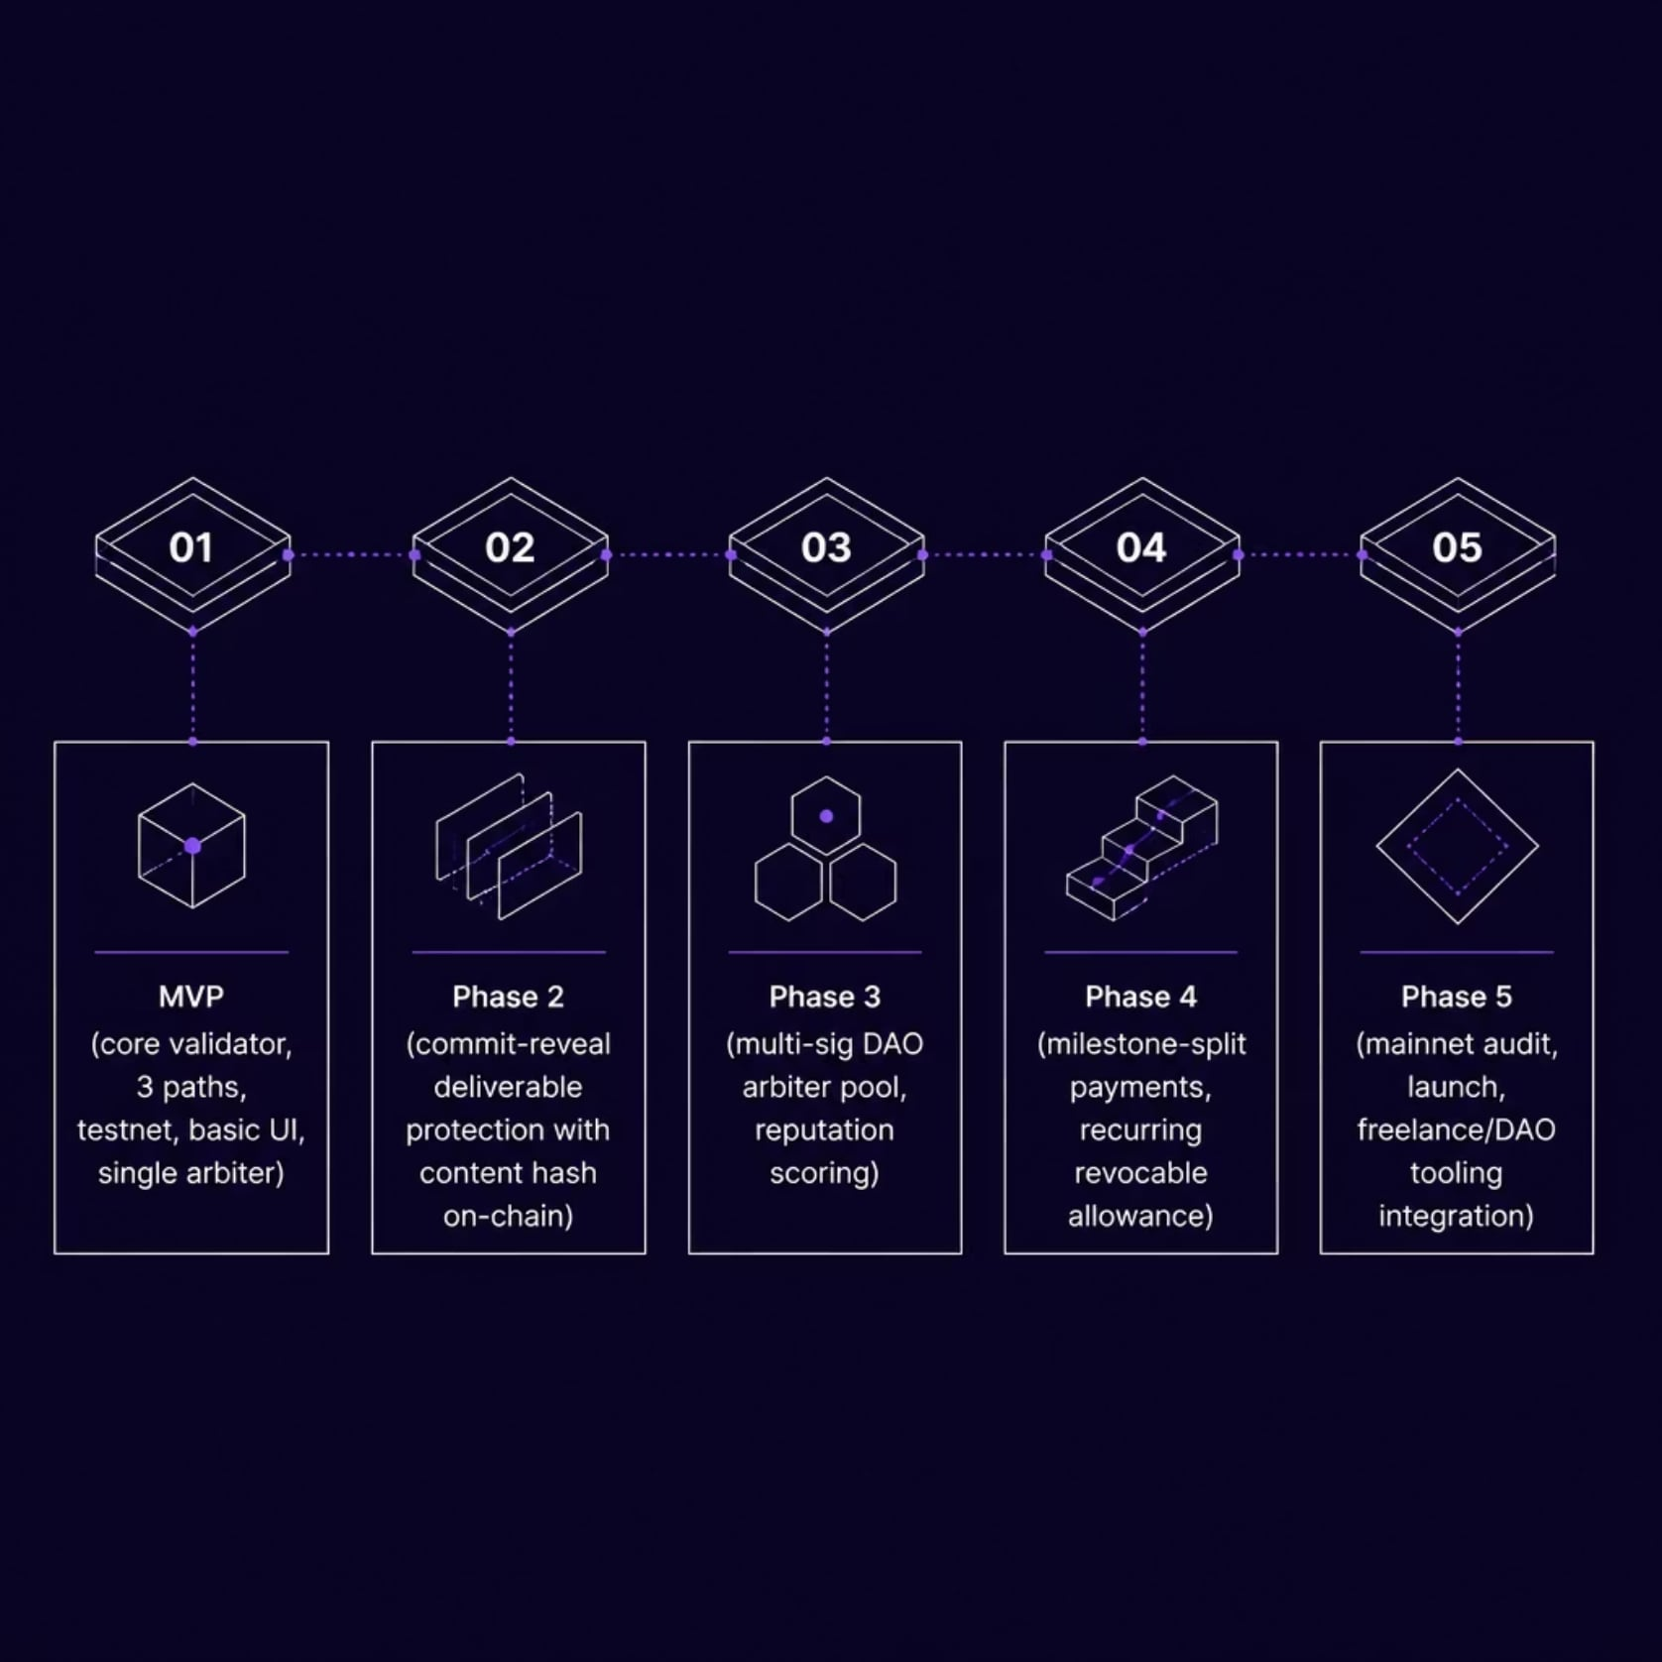
CHAPTER 05
ROADMAP
Why Cardano & What's Next
Why This Fits Cardano
The eUTXO model makes state (datum) explicit and auditable at every step — every spending path is a deterministic, statically verifiable branch.
Aiken's lightweight tooling makes a three-path validator fast to write, test, and audit.
Deterministic fees and predictable finality make time-locked auto-release reliable.
Generalizes to Cardano's own Catalyst-style milestone funding.

Slide 10

SUMMARY
A Narrowly-Scoped, Genuinely Reusable Primitive
TrustLock is not generic "blockchain escrow." It is a concrete fix for the exploit where a payer copies delivered work and then withholds payment — using UTXO datum state and time-locked validator branches native to Cardano's eUTXO model.
Small Enough to Build
The three-path validator is compact enough to build, test, and demo within a hackathon timeframe.
Genuinely Reusable
A reusable primitive for freelance payments, milestone-based grants, and conditional donations on Cardano.

