Slide 1
MIDNIGHT COMPASS
Ecosystem Compatibility
Intelligence for Midnight
Compass ingests real release data from the Midnight ecosystem and computes,
deterministically, which versions actually work together — before a broken build tells you.
Real finding, discovered automatically: Midnight's own official reference template is
currently incompatible with the current midnight-js SDK release.
Midnight Compass
1
Notes:
This is Midnight Compass — a compatibility intelligence engine for the Midnight ecosystem, not a concept. Everything in this deck is generated from the real, working repository: real screenshots, real test counts, and one real finding we're about to walk through. Compass reads actual release and dependency metadata from Midnight's GitHub repositories and computes, deterministically, which combinations of releases are known to work together.

Slide 2
THE PROBLEM
Midnight is not one artifact.
― Protocol the base layer everything else builds on
― Compact compiler its own release cadence, its own version scheme
― SDK packages midnight-js and friends, versioned independently
― Node & wallet runtime and API surface, evolving on their own schedule
― Reference templates example apps every new developer starts from
Nothing today records
which combinations of these independently-released
components actually work together.
Teams find out when a build fails — usually well
after the change has already shipped.
Midnight Compass
2
Notes:
Midnight ships as a constellation of independently versioned components, each maintained by different teams on different release cadences. An application depends on a specific combination of compiler version, SDK version, runtime version, and wallet API all agreeing with each other. Nothing today records that agreement — so the discovery mechanism is a broken build, a failed proof generation, or a red CI run, usually after the change has already shipped.

Slide 3
WHY MIDNIGHT NEEDS THIS
The pain is already real — and already happening.
TODAY: manual and tribal
THE COST
― Changelogs read individually, by hand
― Versions pinned by trial and error
― Breaking changes discovered empirically
― Tribal knowledge held by core maintainers, repeated in support channels
― New developers hit friction in their first hour
― Reference templates silently go stale
― Maintainers ship breaking changes without knowing who it affects
― Manual coordination is a cost that grows faster than the ecosystem
This cost is paid disproportionately by the newest, least-connected teams — exactly the ones an ecosystem needs to retain.
Midnight Compass
3
Notes:
Existing tooling doesn't solve this because it operates one layer too low. A dependency bot compares a package.json range against a registry's latest version — it has no model of cross-repository, cross-versioning-scheme compatibility, and it has no visibility into facts that aren't in a manifest at all, like the Compact language version embedded as text inside a GitHub release name. The result: the ecosystem's compatibility knowledge lives in people's heads, not in a system.

Slide 4
OUR SOLUTION
Compass: a deterministic compatibility engine
― Compatibility Matrix which releases are known to work together, computed from real data
― Upgrade Advisor is a specific upgrade safe, and who else in the ecosystem does it affect
― Breaking Change Analyzer what changed between two points in time, and who depends on what broke
― GitHub Action posts the same finding as a pull-request comment, before merge
― Static Dashboard & CLI the same engine, two more ways to ask it a question
No AI. No heuristics. No guessing. Every verdict cites the specific evidence it was derived from.
Midnight Compass
4
Notes:
Compass is one engine exposed through five capabilities, all computed from the same deterministic core. Every one of these is implemented and tested today, not on a roadmap. The design choice that matters most: no machine learning, no probabilistic guessing — every compatibility verdict is a reproducible conclusion computed from declared metadata and cited evidence. Ask the same question twice, get the same answer, and trace it back to why.

Slide 5
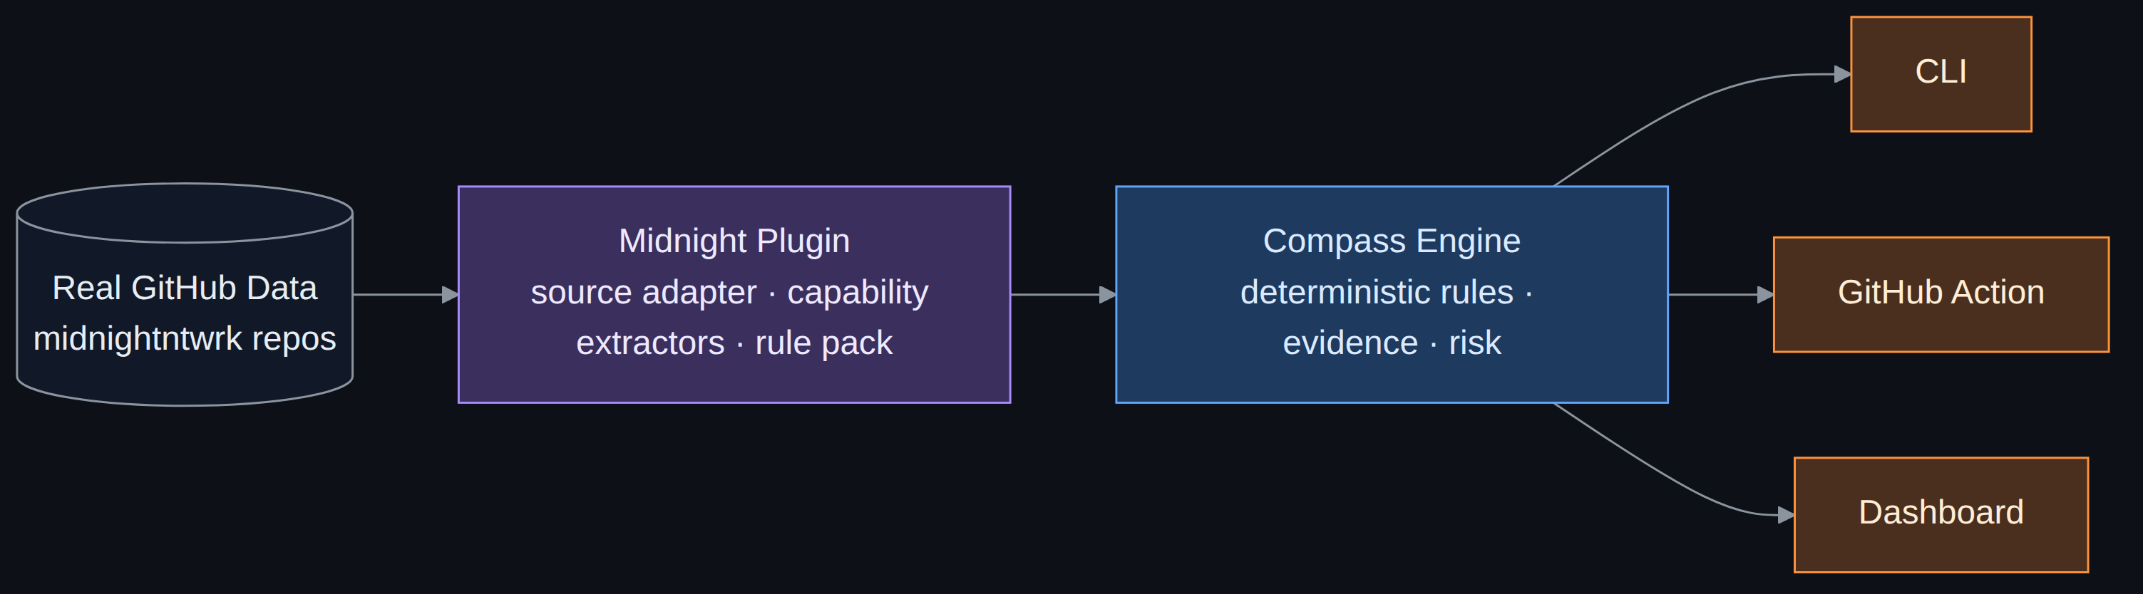
ARCHITECTURE
One engine. Three consumers. Zero duplicated logic.
The engine has never heard of Midnight — every Midnight-specific fact enters through one plugin.
The CLI, GitHub Action, and dashboard all call the same use cases and render through the same layer,
so they cannot disagree about a finding. This boundary is enforced in CI, not left to convention.
Midnight Compass
5
Notes:
Clean, layered architecture. A framework-independent domain core models components, releases, and compatibility relationships with zero knowledge of Midnight. The Midnight plugin is the only piece that knows the ecosystem exists, populating the model through three explicit extension points: a source adapter, capability extractors, and a rule pack. Every consumer — CLI, Action, dashboard — calls the same application-layer use cases and renders through the same shared formatting layer. A dependency-cruiser check runs in CI and fails the build if this inward-only dependency rule is ever violated — this is enforced, not just documented.

Slide 6
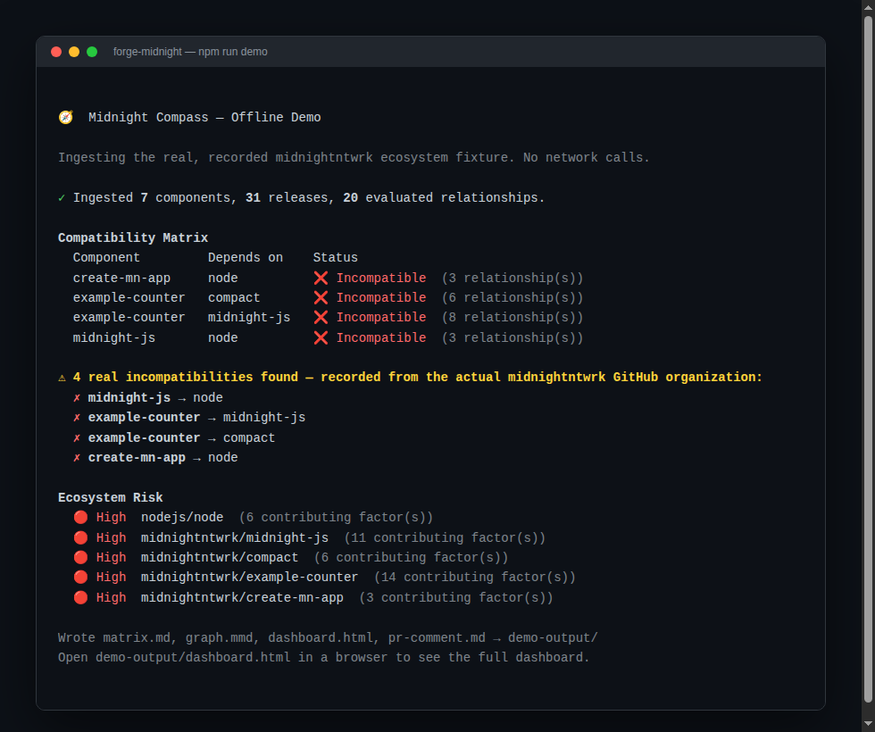
LIVE COMPATIBILITY ENGINE
Runs anywhere. Zero network. Real data.
Midnight Compass
6
Notes:
This is the actual terminal output of `npm run demo` — the project's offline demo. It replays a real, recorded snapshot of the Midnight ecosystem through the exact same engine that live mode uses, with zero network calls and zero GitHub API rate-limit risk. Seven real components, thirty-one real releases, twenty evaluated relationships, four real incompatibilities — computed in under two seconds. This is also the recommended way to demo Compass live, because it never depends on the room's Wi-Fi or GitHub's API being available.

Slide 7
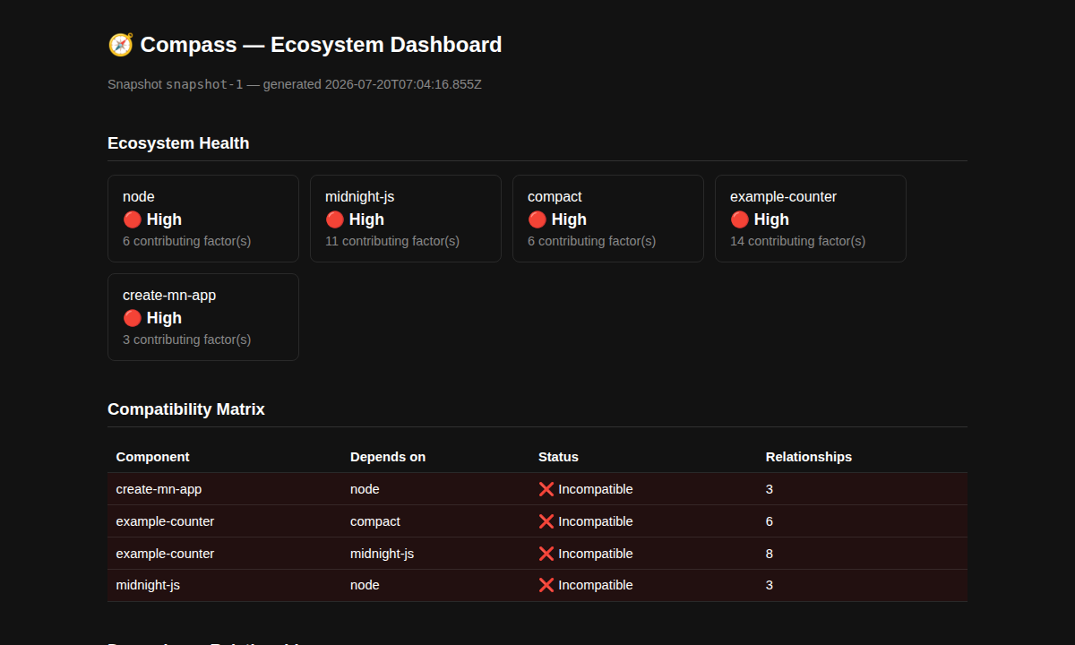
REAL FINDINGS
example-counter is broken against midnight-js.
Midnight's own official reference
template declares:
@midnight-ntwrk/midnight-js: ^4.0.4
Current tracked SDK release:
5.0.0-beta.6
Caught from the components' own declared
metadata — zero hand-written rules for this
specific pair.
Midnight Compass
7
Notes:
This is not a simulated finding for the pitch. This is the actual, current state of the real Midnight GitHub organization, discovered by Compass parsing example-counter's real package.json and comparing its declared dependency range against the SDK's actual tracked release. Nobody wrote a rule specific to this pair — the declared constraint itself is evaluated directly as a compatibility signal. That's the single most concrete piece of evidence this project has: the ecosystem's own official example app disagreeing with the ecosystem's own official SDK, caught automatically.

Slide 8
DEVELOPER WORKFLOW
Three surfaces. One engine underneath.
CLI
GitHub Action
Dashboard
forge-midnight matrix
forge-midnight compatibility
forge-midnight dashboard
on: pull_request
→ posts a compatibility
report as a PR comment
forge-midnight dashboard
→ self-contained HTML
file, zero JS, zero server
Run locally, before ever opening a PR.
Fails the check on a real incompatibility.
Open it in any browser, anywhere.
All three call the same core/application use cases and render through the same interfaces/reporting layer.
Midnight Compass
8
Notes:
A developer has three equally real ways to ask Compass a question: the forge-midnight CLI locally, the GitHub Action automatically on every pull request, or the static dashboard for a browsable overview. None of these three duplicate any compatibility logic — they are thin translation layers over the same use cases, formatted through the same shared rendering functions. A bug in one is, structurally, a bug in all three at once, which means it gets caught fast.

Slide 9
ENGINEERING QUALITY
Not a demo. A tested engineering artifact.
411+
95%+
12
0
tests passing
line coverage
ADRs recording
real decisions
architecture
violations
― Deterministic and evidence-mandatory same inputs always produce the same answer; absence of evidence resolves to ‘unverified,’ never ‘compatible’
― Clean Architecture, CI-enforced a dependency-cruiser check fails the build if inward-only boundaries are ever violated
― Real fixtures, not mocks tests replay data recorded once from the real GitHub API, including an end-to-end golden-snapshot test
― Disclosed, not hidden, limitations ADR 0012 documents that the Action ingests fresh per run rather than querying a pre-warmed snapshot — written down, not shipped around
Midnight Compass
9
Notes:
These numbers are real, verified by running the project's own CI pipeline: build, lint, dependency boundary check, and the full test suite with coverage. Four hundred eleven tests, ninety-five percent line coverage, zero architecture violations, twelve architecture decision records. The last bullet is the one worth dwelling on: ADR 0012 is the project documenting its own current limitation — the GitHub Action doesn't yet meet the CI latency budget the architecture originally targeted, and that's written down in the repository instead of quietly ignored. That's the strongest signal that the rest of the documentation describes what the code actually does.

Slide 10
BUSINESS VALUE & OPEN SOURCE POTENTIAL
Who this serves — built to be ecosystem-owned
― Application & contract developers know if an upgrade is safe before attempting it
― Midnight core maintainers know what breaks downstream before shipping a change
― Template & example maintainers know when reference code has silently gone stale
― Enterprise adopters a defensible, evidenced answer to ‘how do we manage upgrade risk’
Apache-2.0
Licensed permissively on purpose: Compass is
built to become ecosystem-owned infrastructure,
not a single vendor's product.
The plugin architecture that lets one Midnight
team own the Midnight-specific plugin is the same
mechanism that would let a second team extend
coverage — without ever touching the engine.
Midnight Compass
10
Notes:
Four concrete audiences, each already served by a shipped capability, not a persona slide for its own sake. On licensing: Apache-2.0 was chosen deliberately so this can become infrastructure the Midnight ecosystem owns collectively, the way a foundation-backed project should be licensed, rather than a single company's product. The plugin architecture is the technical mechanism behind that: the engine's contributor surface is a stable set of ports, so ecosystem coverage can grow without ever touching the core.

Slide 11
FUTURE ROADMAP
What's next — honestly scoped
― Scheduled ingestion service a persistent, periodically-refreshed snapshot the Action queries instead of ingesting fresh every run
― Hosted Query API & live dashboard the same rendering layer, fed by live API responses instead of a locally-generated snapshot
― Broader ecosystem source coverage new repositories are one entry in a declarative registry, not a redesign
― Ecosystem Observability Release Health and Ecosystem Risk views for maintainers and adoption reviewers
Every item above is additive on top of the existing ports — none require re-architecting the engine that ships today.
Midnight Compass
11
Notes:
This roadmap is taken directly from the project's own docs/roadmap.md, not invented for this deck. The sequencing principle behind it: nothing gets built on a layer that hasn't already been proven. The compatibility matrix and CI check came before the upgrade advisor and breaking-change detection; a hosted dashboard is deliberately sequenced after the CLI and Action are proven, since its entire value is derivative of the engine underneath being trustworthy. Every future item is a new caller or a new adapter behind an existing port — not a change to the engine's own contract.

Slide 12
TRY IT YOURSELF
30 seconds. Zero network.
npm install && npm run build
npm run demo
Real, recorded Midnight ecosystem
data. The same engine live mode uses.
No GitHub API, no rate limits, works
in any judging room.
Deterministic. Evidence-cited. 411+ tests. One real, currently-open incompatibility
found in Midnight's own reference template — automatically, before anyone else did.
Midnight Compass
12
Notes:
Closing. The call to action is literal, not rhetorical: run npm run demo right now, on this machine, with no network connection, and you will see the same real finding this deck has been showing you. That's the whole pitch — this isn't a concept deck for something that might work, it's a working engine that already found a real problem in the real ecosystem, built on an architecture that's enforced by CI rather than promised in a README. Thank you.

