Slide 1
부트스트랩(bootstrap) 5.1
영문 https://getbootstrap.com/
한글https://getbootstrap.kr/docs/5.1/getting-started/introduction/
https://getbootstrap.kr/

Slide 2
부트스트랩(bootstrap) 4.6
https://getbootstrap.com/docs/4.6/getting-started/introduction/
http://bootstrapk.com/css/ <- 한글
WebContent/bootstrap-4.6.0-dist/css/bootstrap.min.css 만듬
<head> 부분에 복사
<meta name="viewport" content="width=device-width, initial-scale=1, shrink-to-fit=no">
<link rel="stylesheet" href="../bootstrap-4.6.0-dist/css/bootstrap.min.css">
</body> 위 부분에 복사
<script src="../bootstrap-4.6.0-dist/jquery/jquery-3.5.1.js"></script>
<script src="../bootstrap-4.6.0-dist/js/bootstrap.bundle.min.js"></script>

Slide 3
부트스트랩(bootstrap) 4.6
https://getbootstrap.com/docs/4.6/getting-started/introduction/
http://bootstrapk.com/css/ <- 한글
<head> 부분에 복사
<meta name="viewport" content="width=device-width, initial-scale=1, shrink-to-fit=no">
<link rel="stylesheet" href="https://cdn.jsdelivr.net/npm/bootstrap@4.6.0/dist/css/bootstrap.min.css" integrity="sha384-B0vP5xmATw1+K9KRQjQERJvTumQW0nPEzvF6L/Z6nronJ3oUOFUFpCjEUQouq2+l" crossorigin="anonymous">
</body> 위 부분에 복사
<script src="https://code.jquery.com/jquery-3.5.1.slim.min.js" integrity="sha384-DfXdz2htPH0lsSSs5nCTpuj/zy4C+OGpamoFVy38MVBnE+IbbVYUew+OrCXaRkfj" crossorigin="anonymous"></script>
<script src="https://cdn.jsdelivr.net/npm/bootstrap@4.6.0/dist/js/bootstrap.bundle.min.js" integrity="sha384-Piv4xVNRyMGpqkS2by6br4gNJ7DXjqk09RmUpJ8jgGtD7zP9yug3goQfGII0yAns" crossorigin="anonymous"></script>

Slide 4
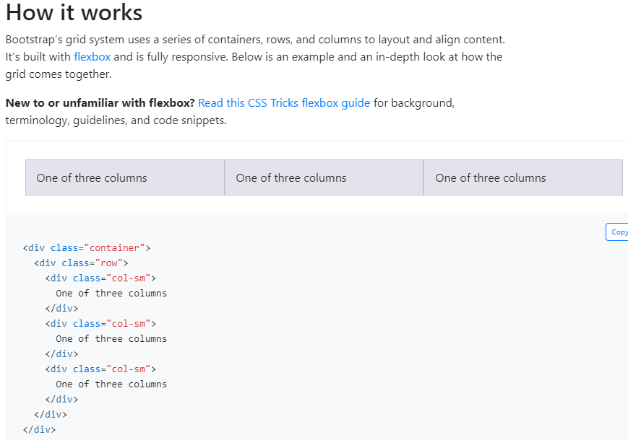
Grid How it works

Slide 5
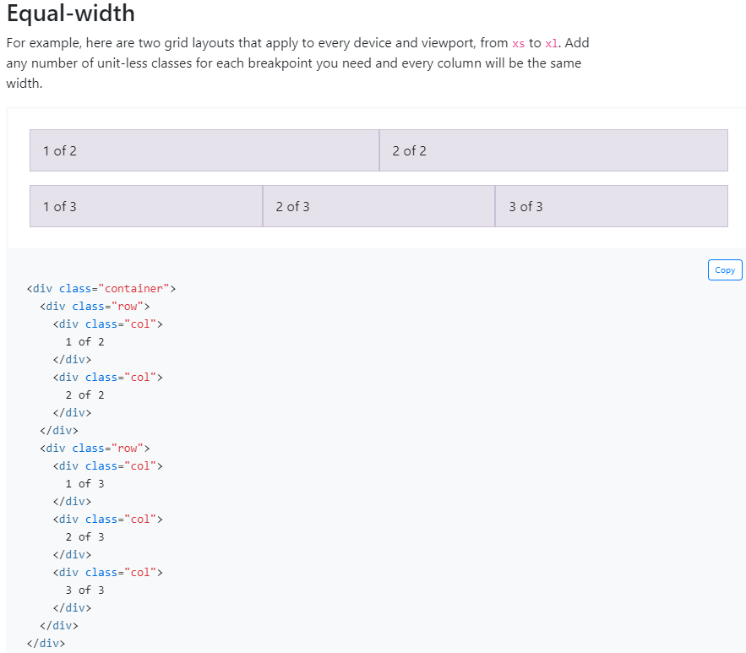
Equal-width

Slide 6
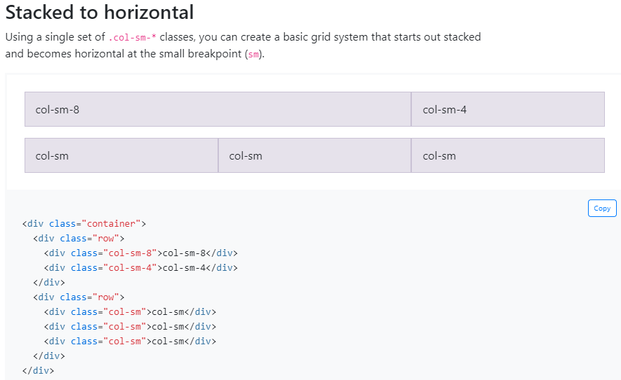
Stacked to horizontal

Slide 7
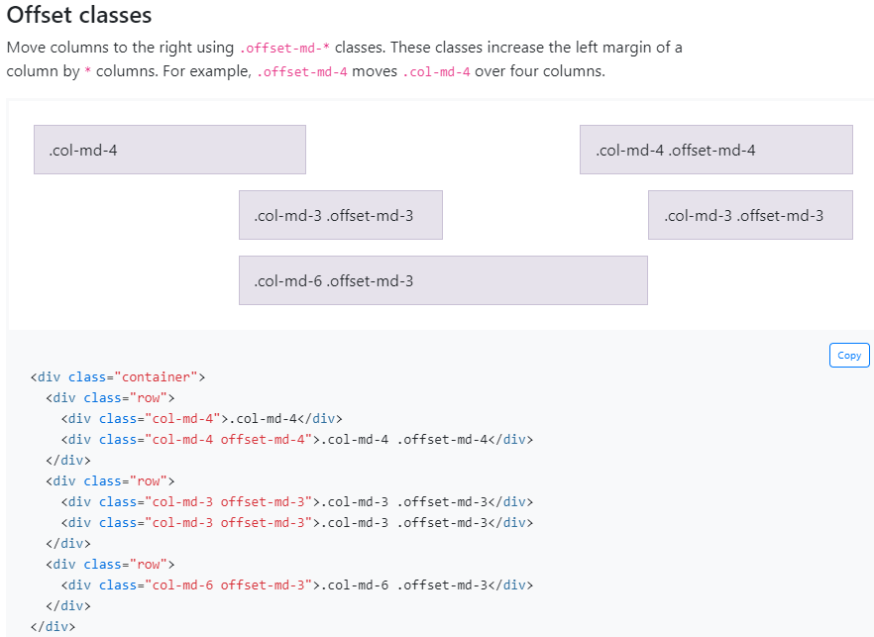
Offset classes

Slide 8
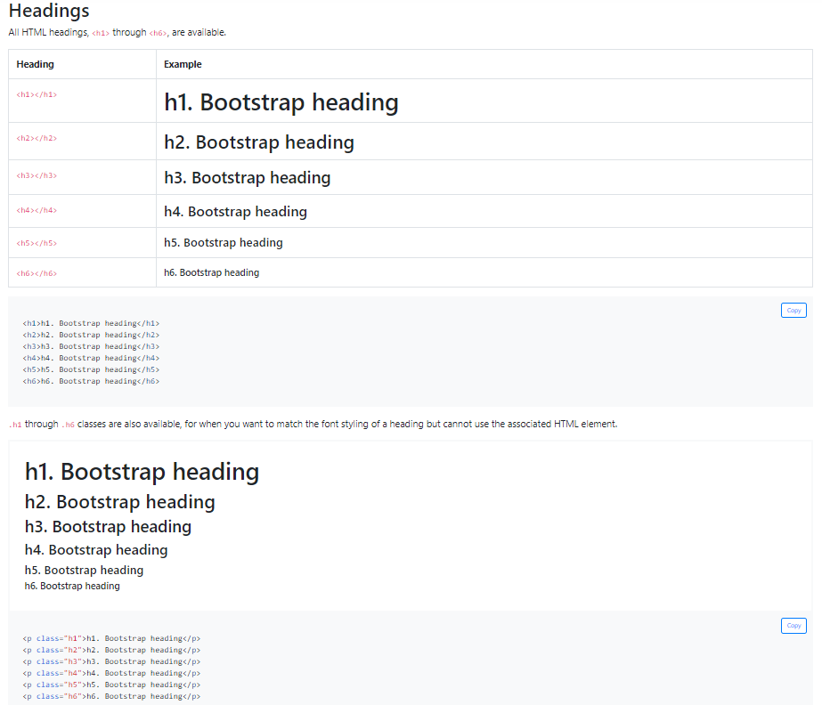
Headings

Slide 9
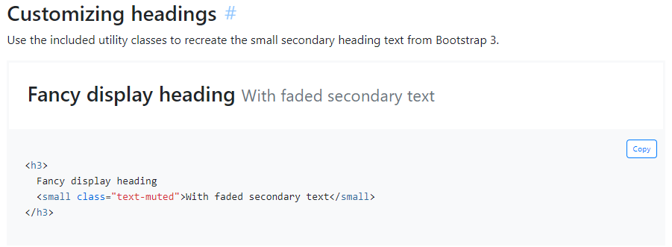
Customizing headings

Slide 10
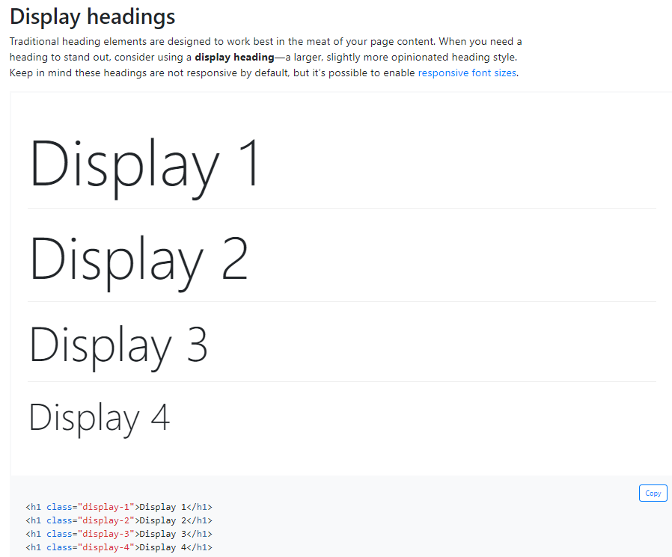
Display headings

Slide 11
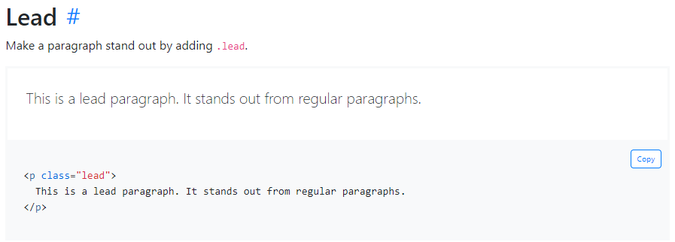
Lead

Slide 12
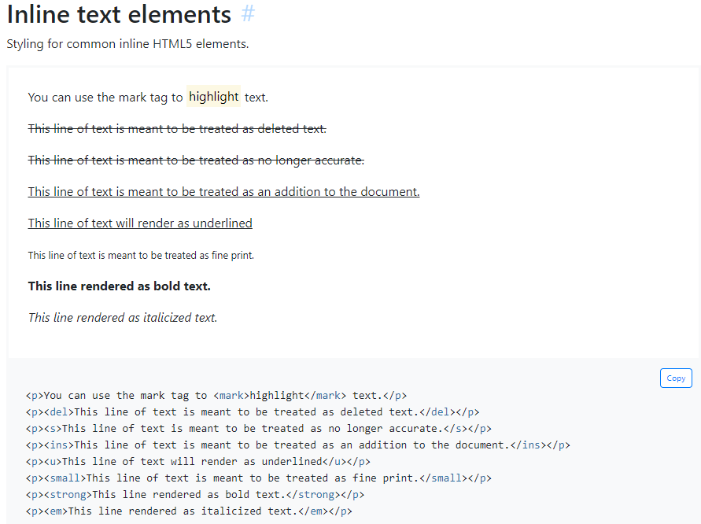
Inline text elements

Slide 13
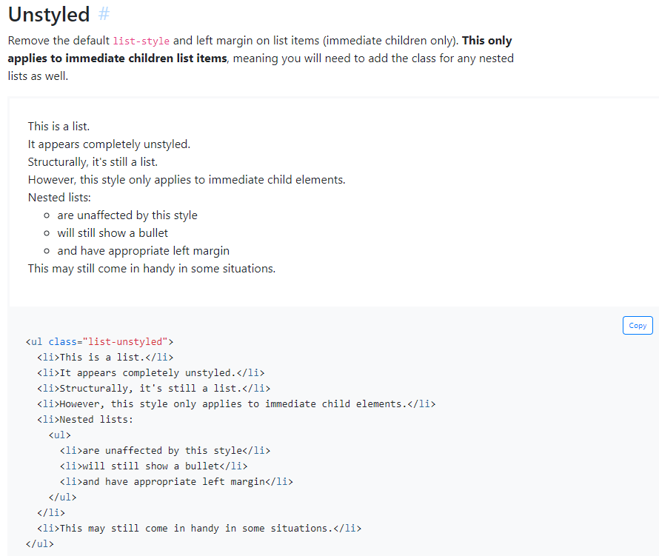
Unstyled

Slide 14
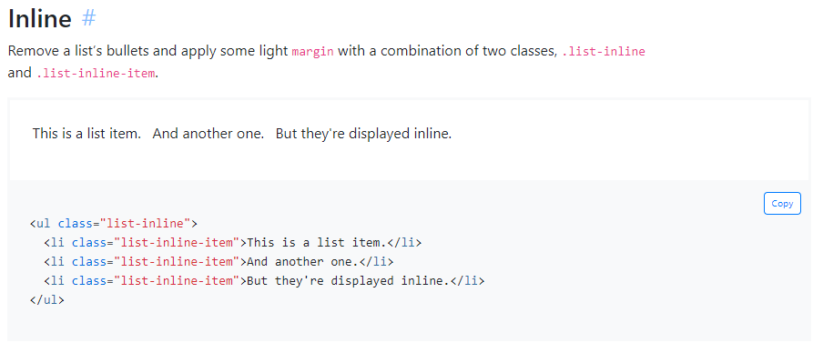
lists Inline

Slide 15
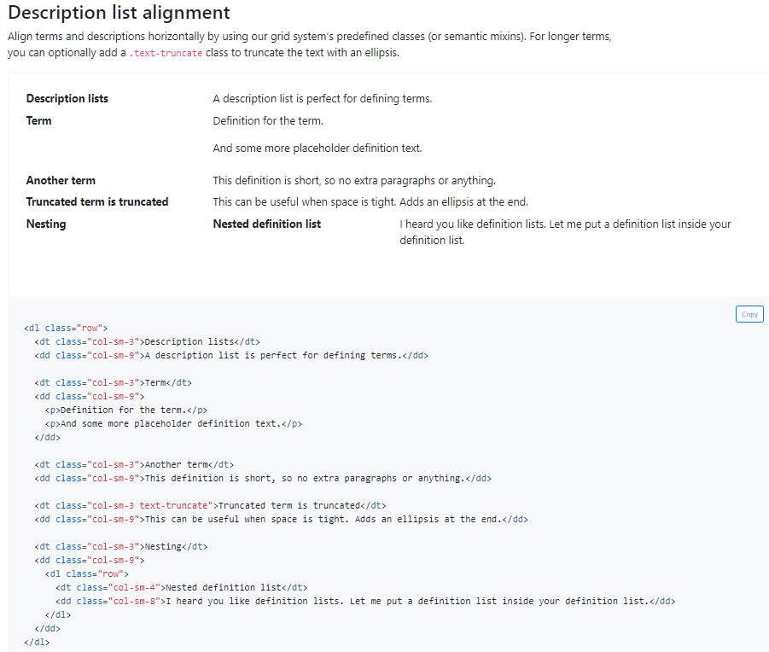
Description list alignment

Slide 16
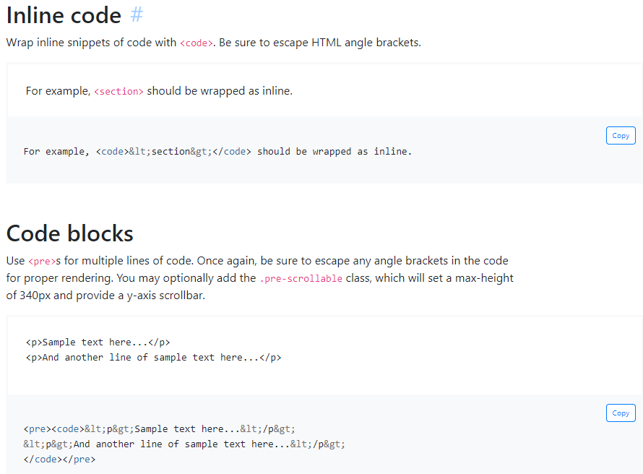
Inline code
Code blocks

Slide 17
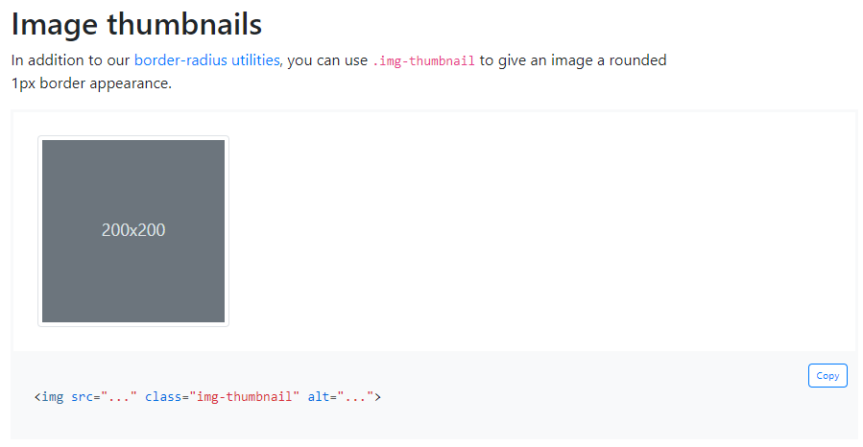
Image thumbnails

Slide 18
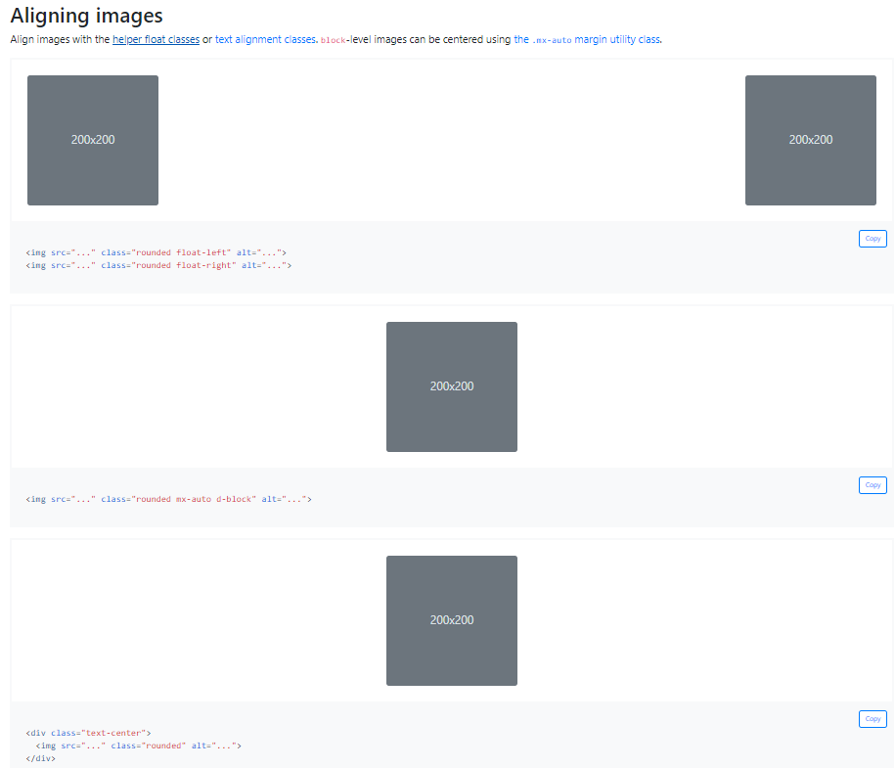
Aligning images

Slide 19
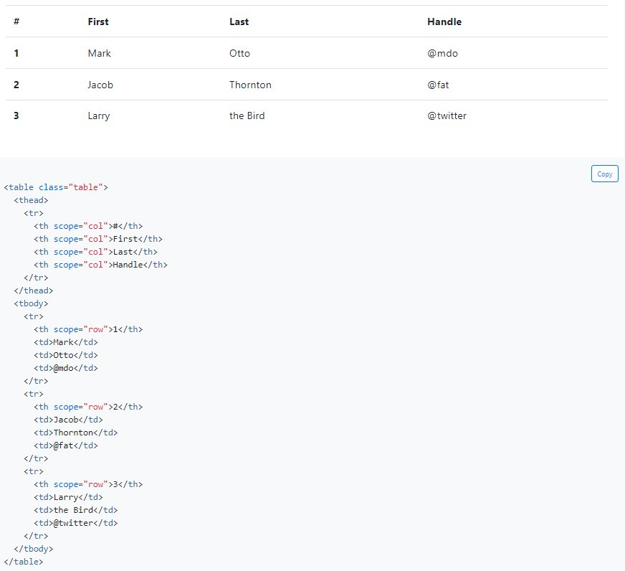

Tables

Slide 20
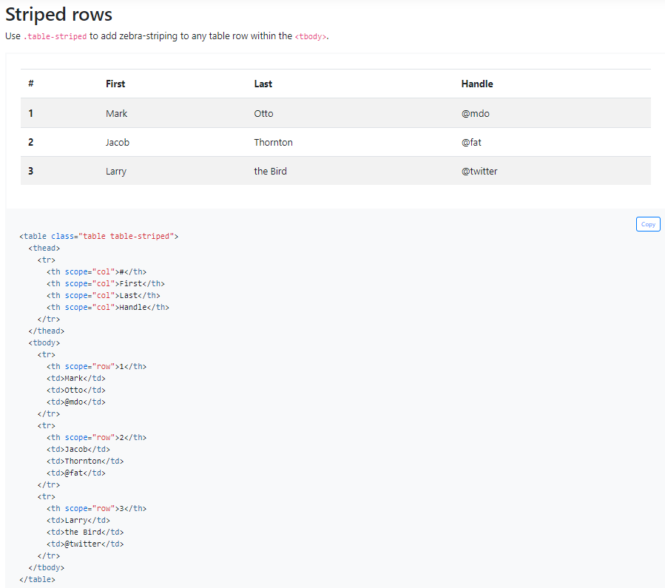
Striped rows

Slide 21
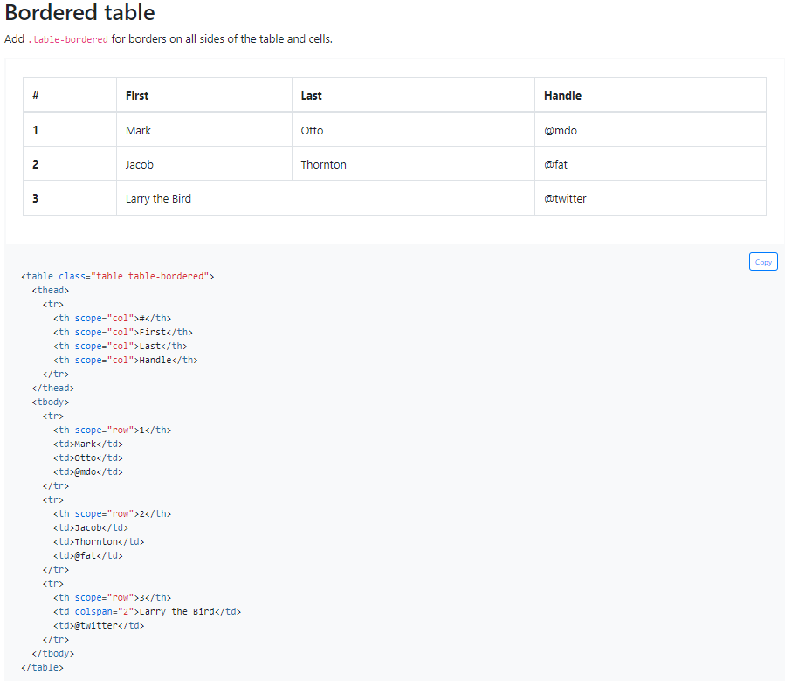
Bordered table

Slide 22
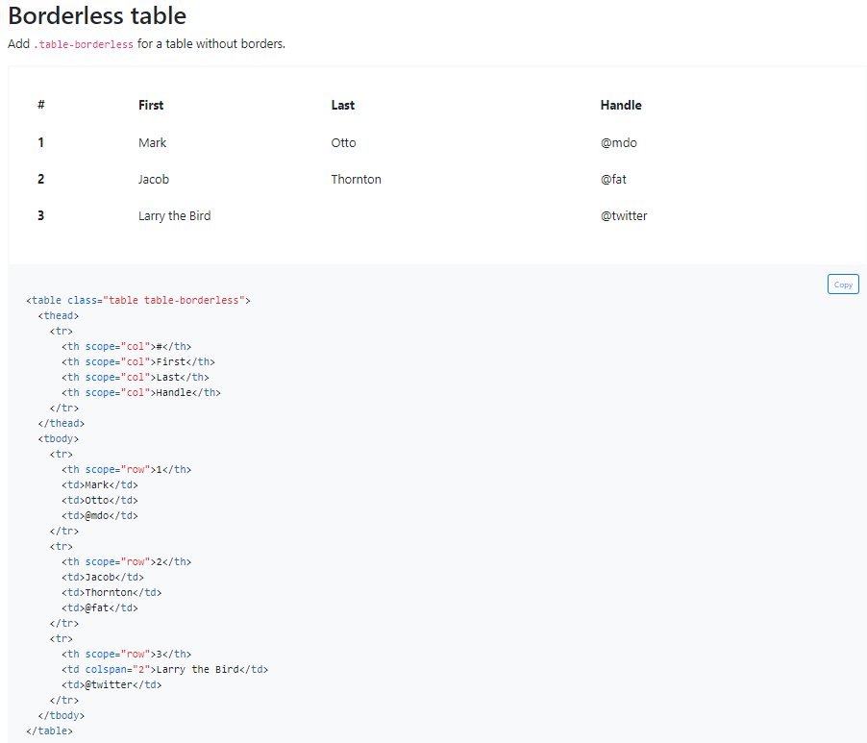
Borderless table

Slide 23
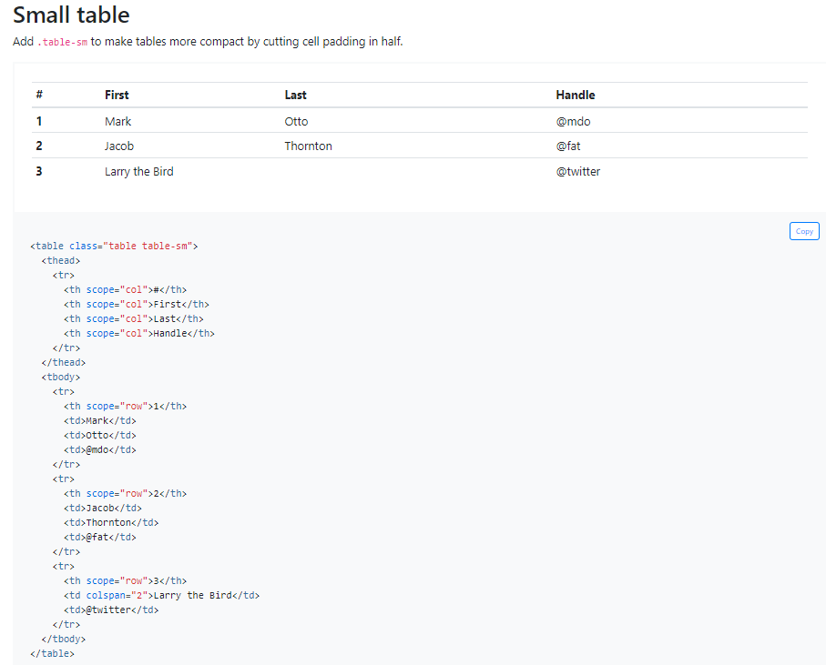
Small table

Slide 24
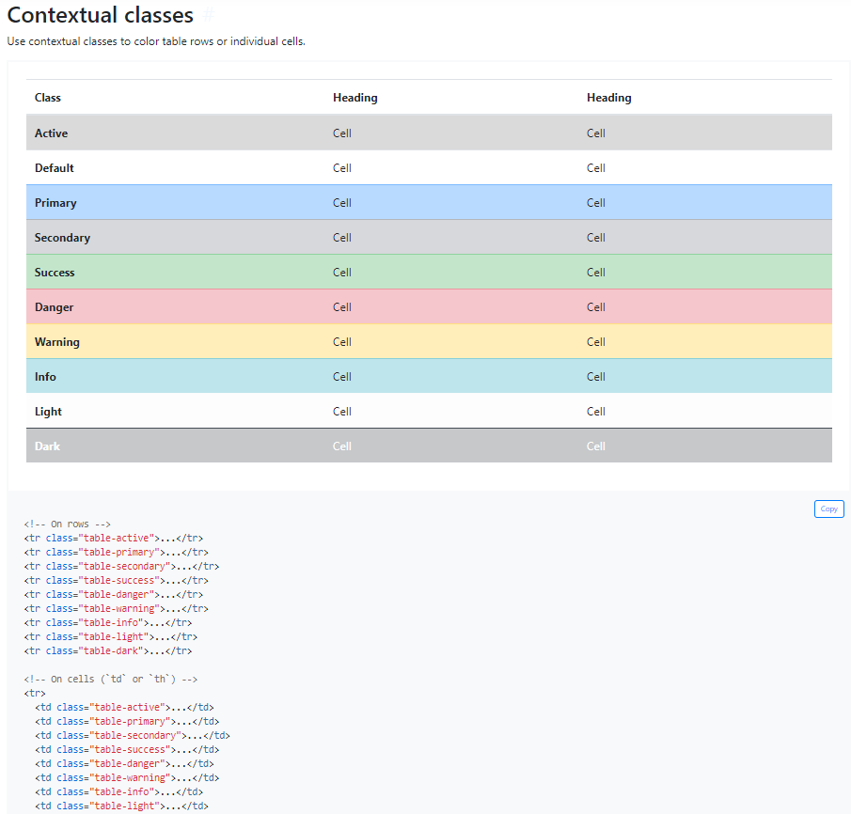
Tables Contextual classes

Slide 25
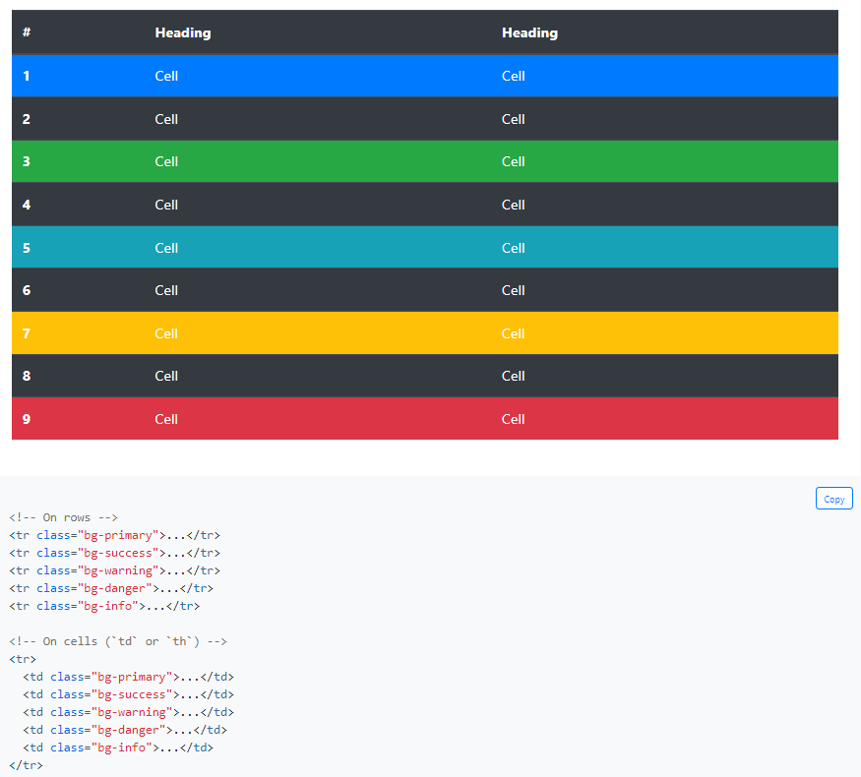

Tables Contextual classes

Slide 26
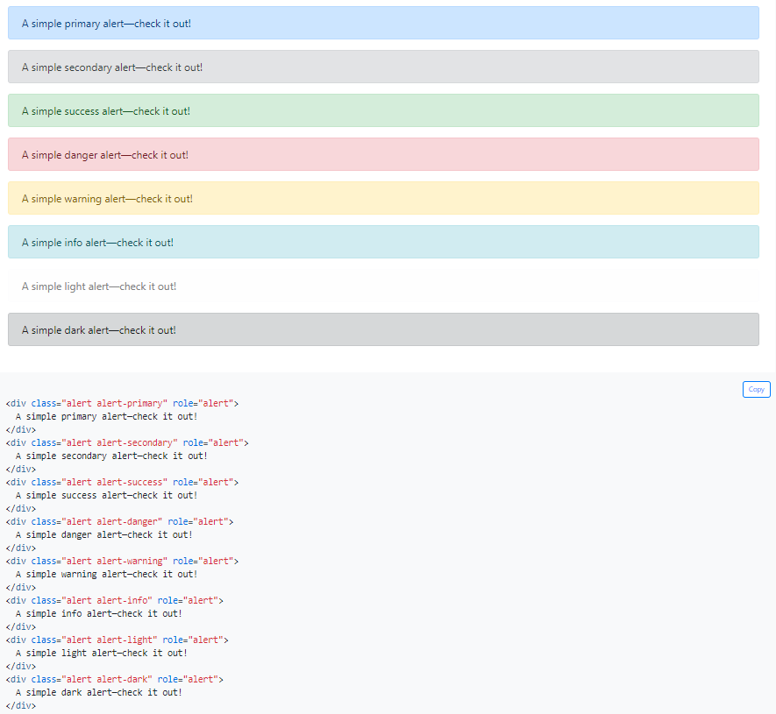

Alerts

Slide 27
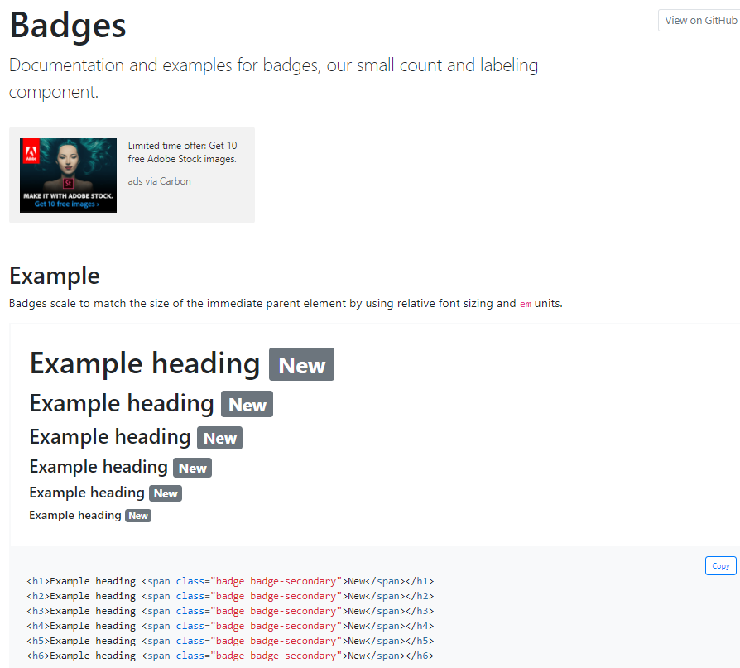
Badges

Slide 28
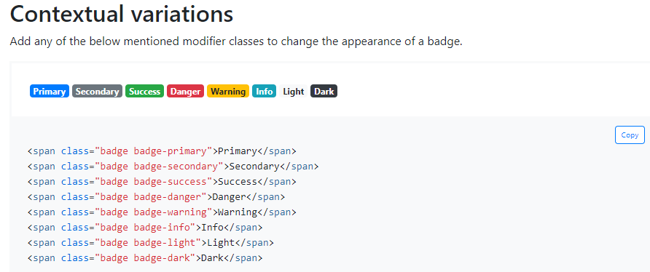
Contextual variations

Slide 29
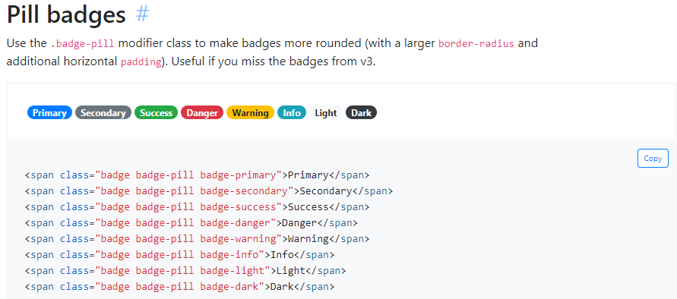
Pill badges

Slide 30
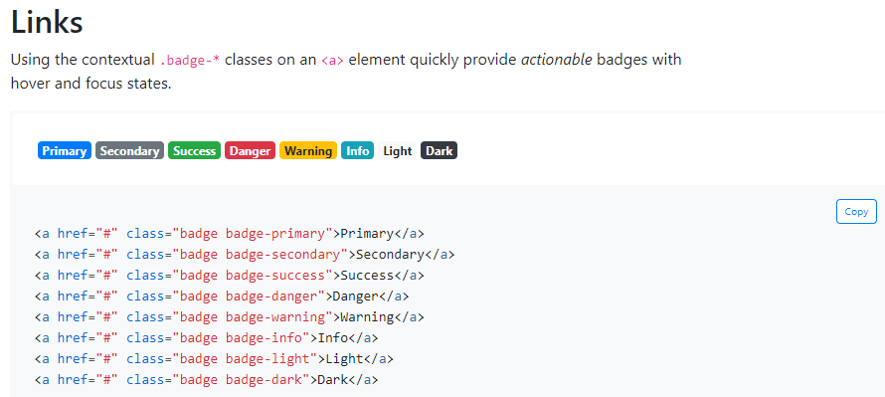
Badges Links

Slide 31
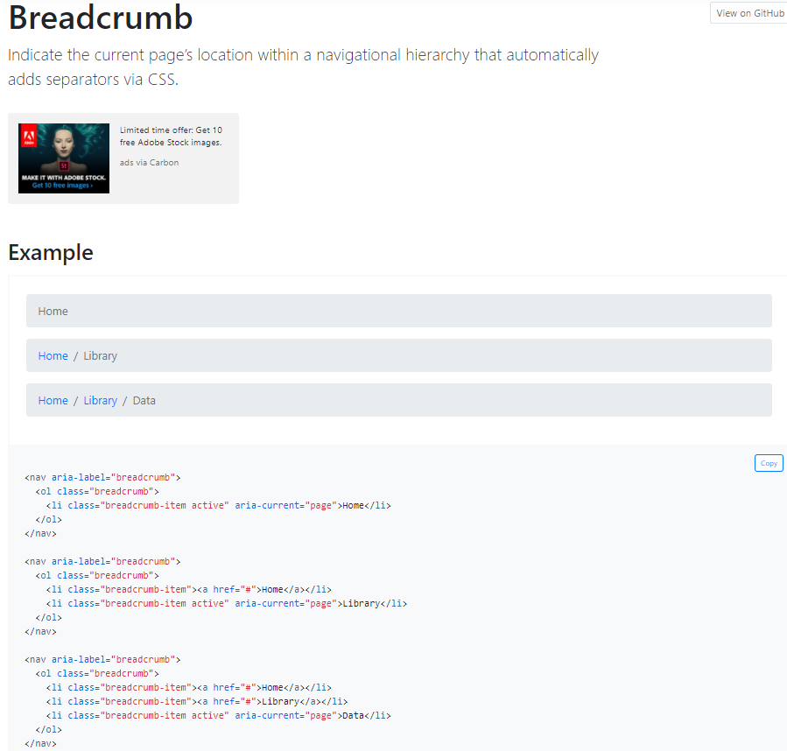
Breadcrumb

Slide 32
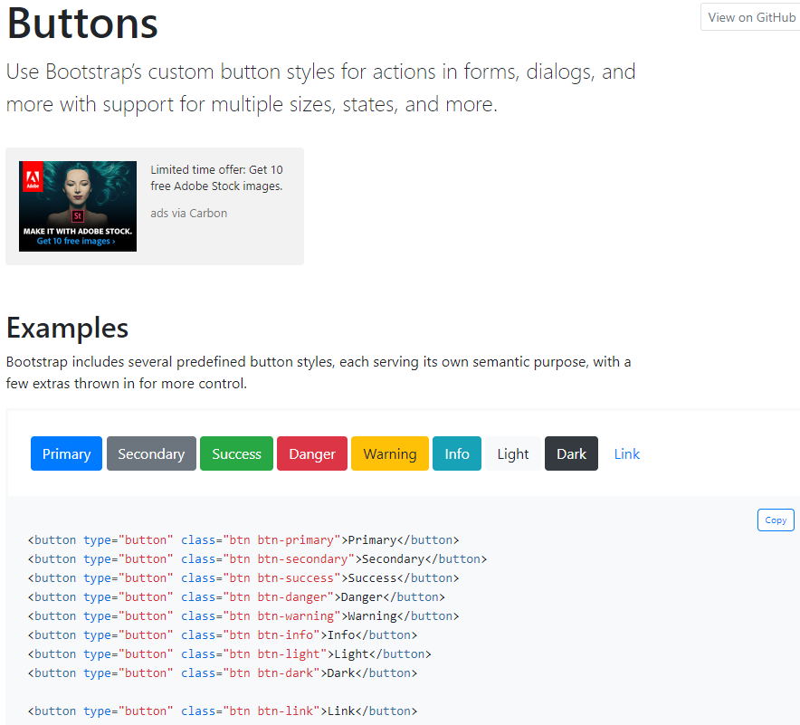
Buttons

Slide 33
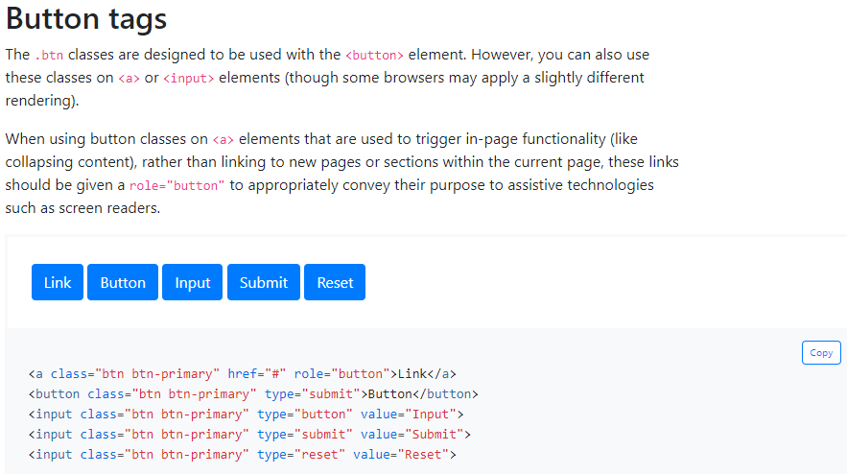
Button tags

Slide 34
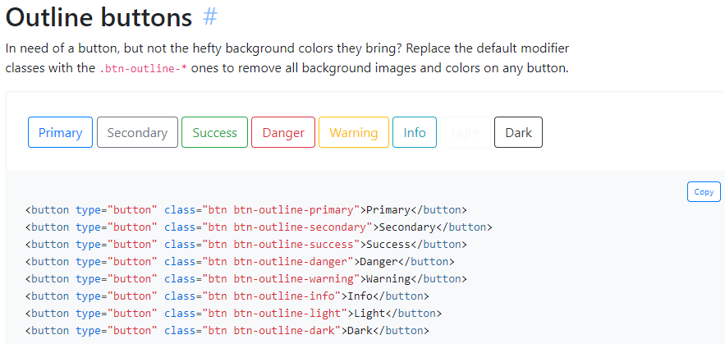
Outline buttons

Slide 35
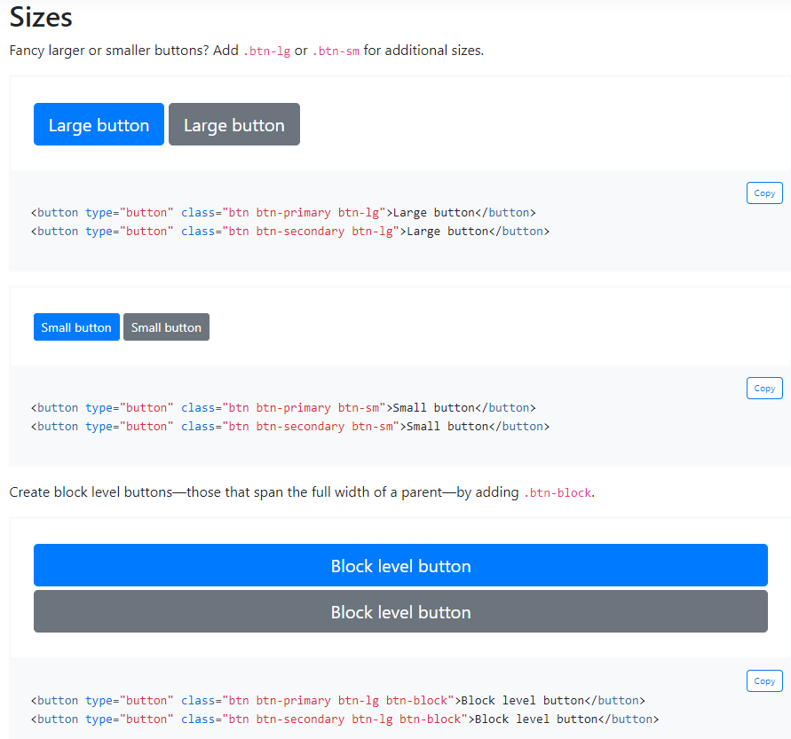
Buttons Sizes

Slide 36

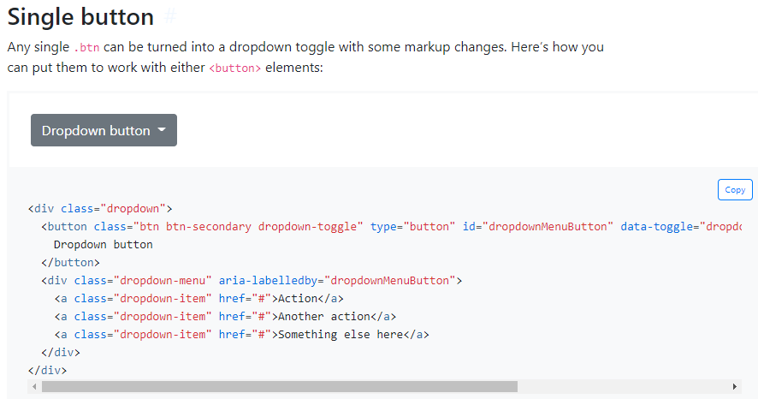
Single button

Slide 37
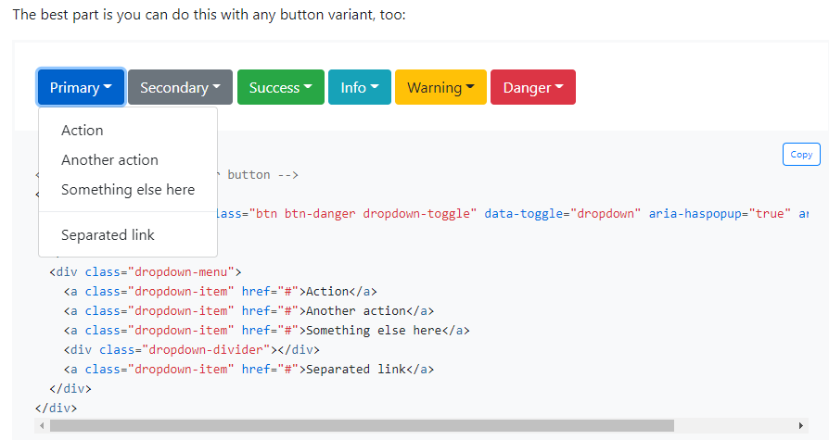
Single button

Slide 38
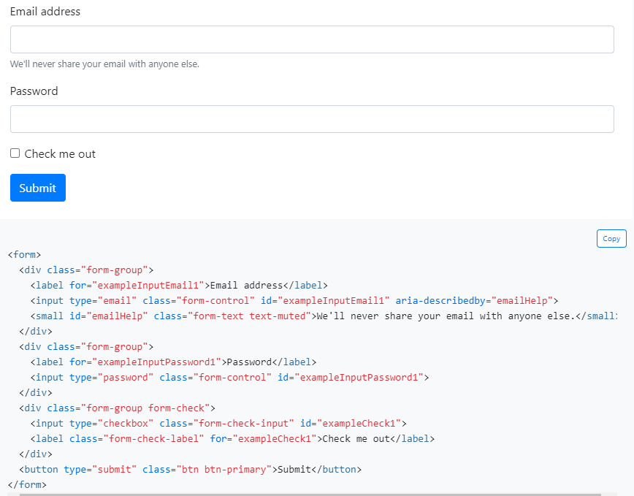

Forms

Slide 39
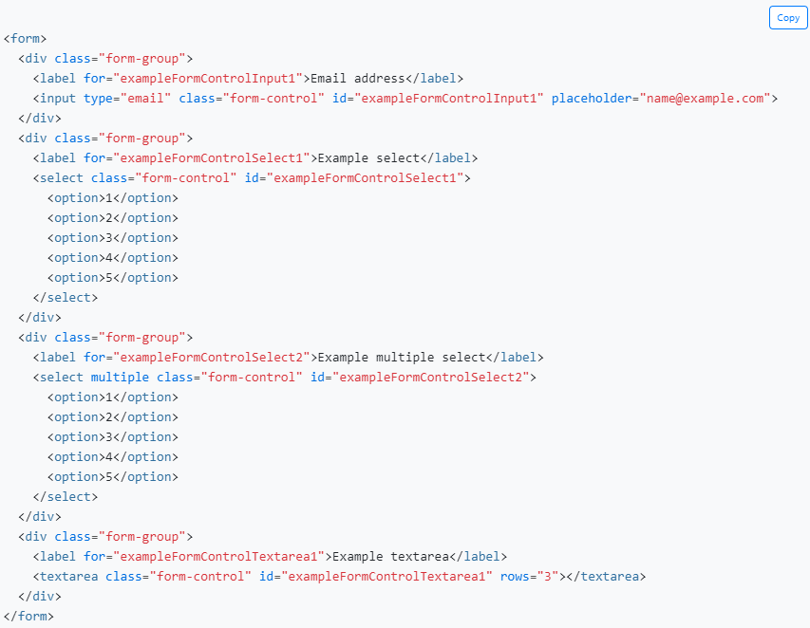
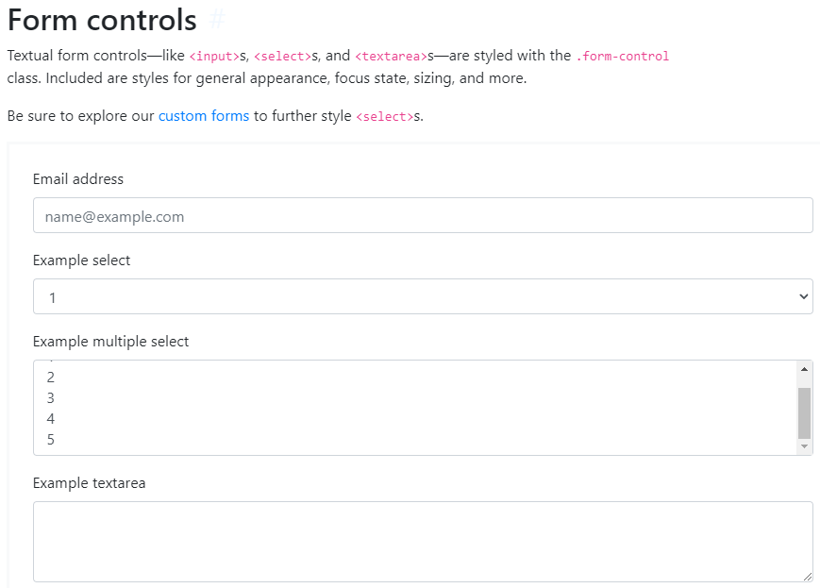
Form controls

Slide 40
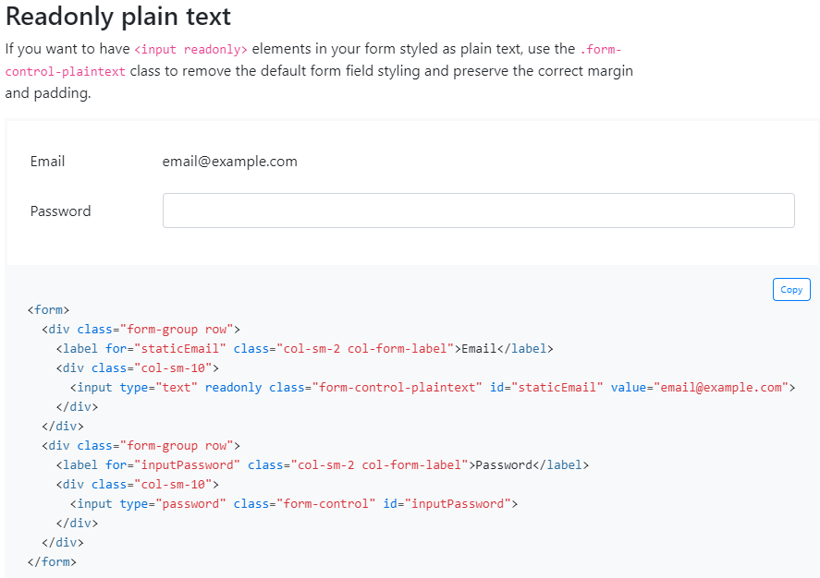
Readonly plain text

Slide 41
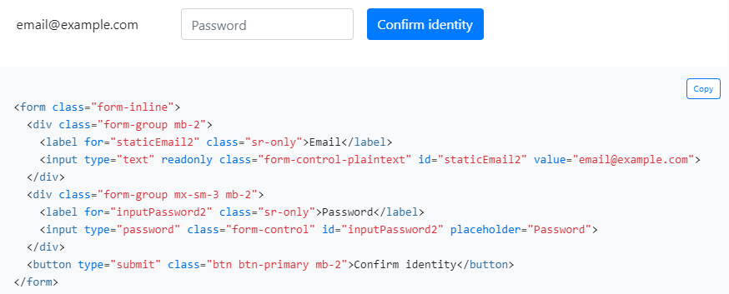
Readonly plain text

Slide 42
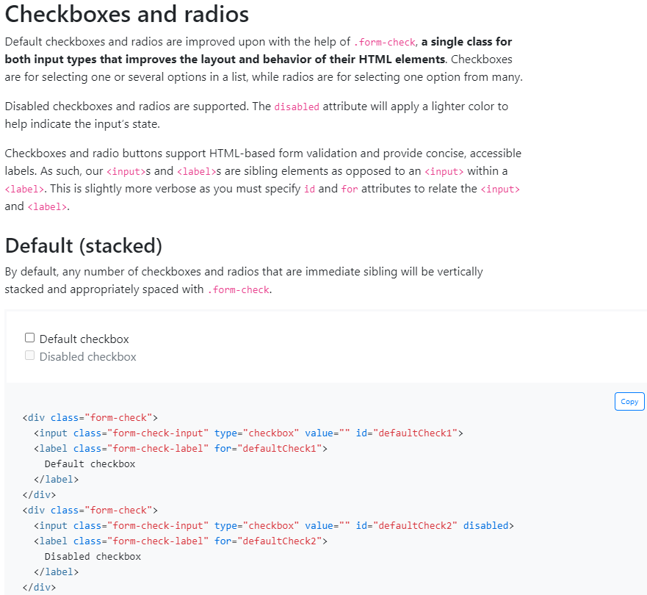
Forms Checkboxes and radios

Slide 43
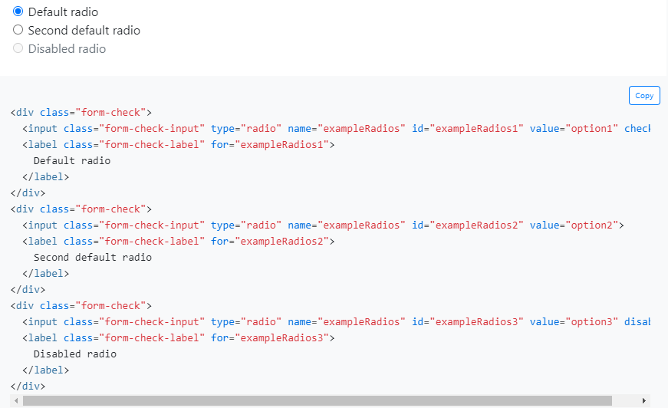
Forms Checkboxes and radios

Slide 44
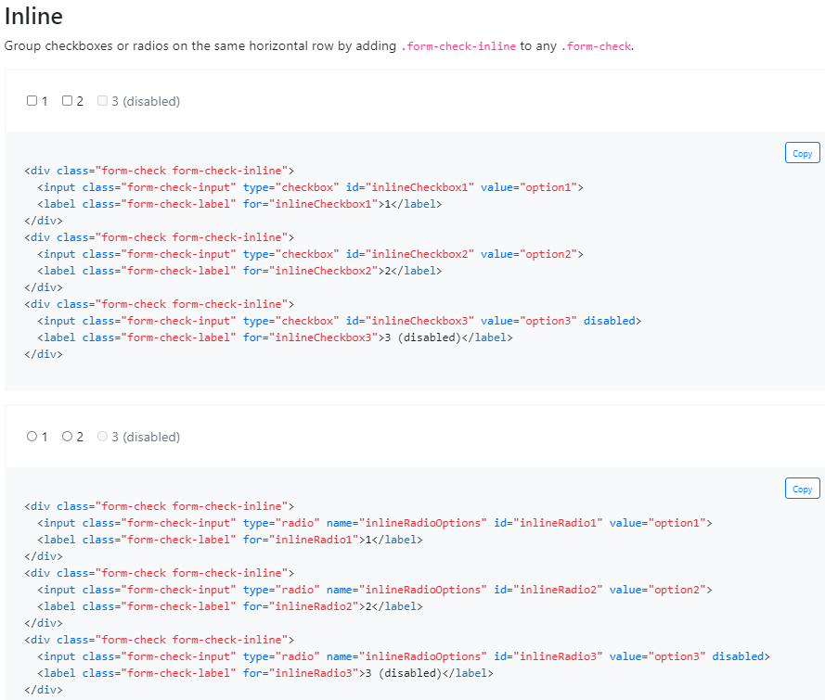
Checkboxes and radios Inline

Slide 45
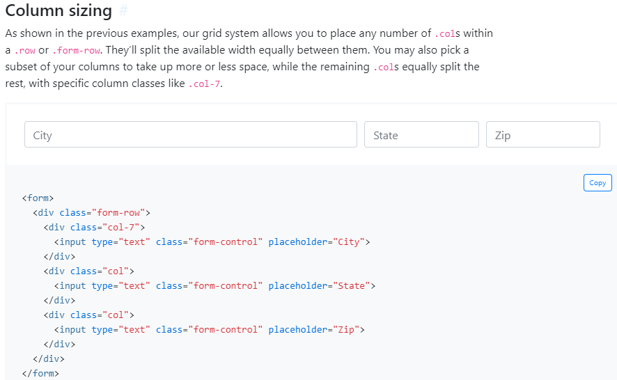
Column sizing

Slide 46
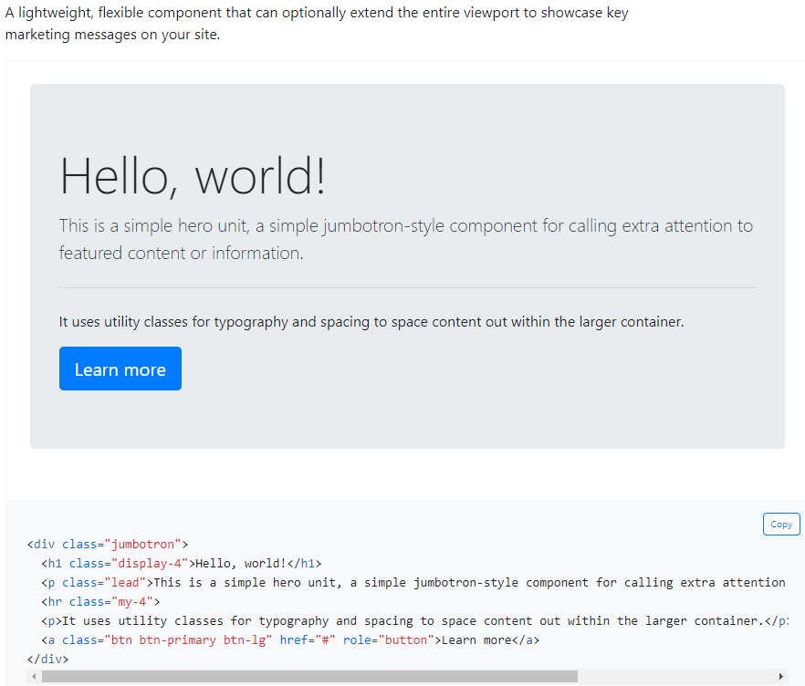

Jumbotron

Slide 47
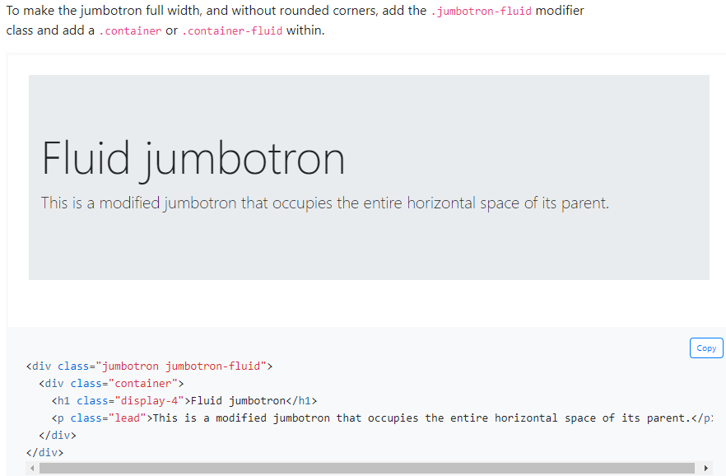
Jumbotron

Slide 48

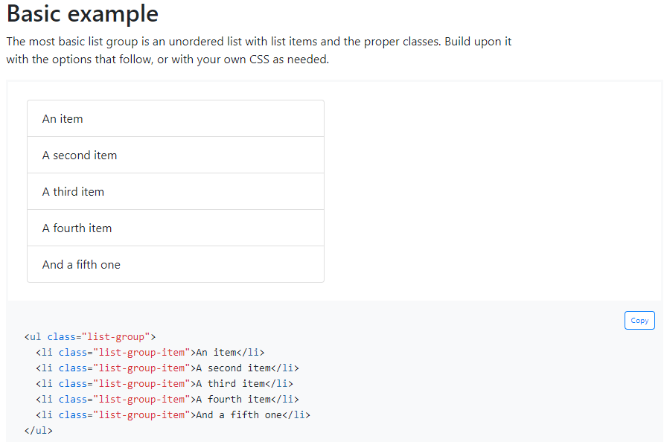
Basic example

Slide 49
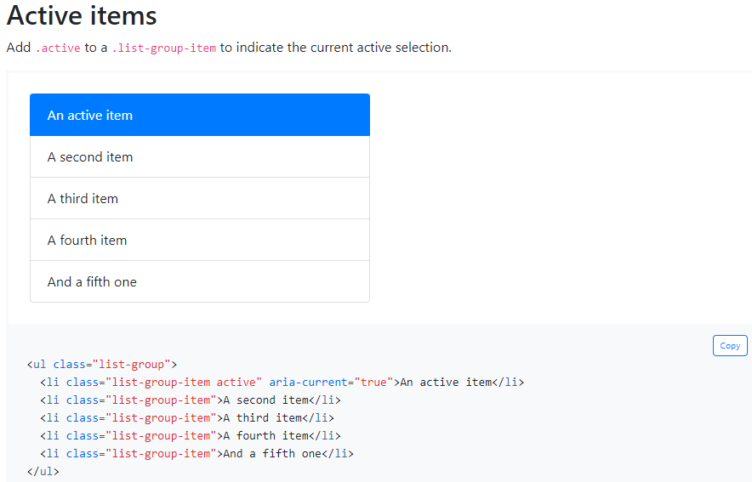
Active items

Slide 50
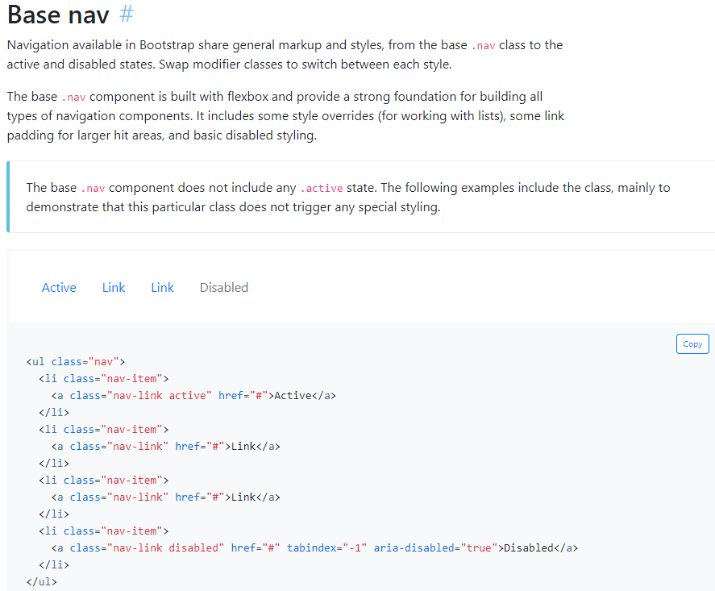
Base nav

Slide 51
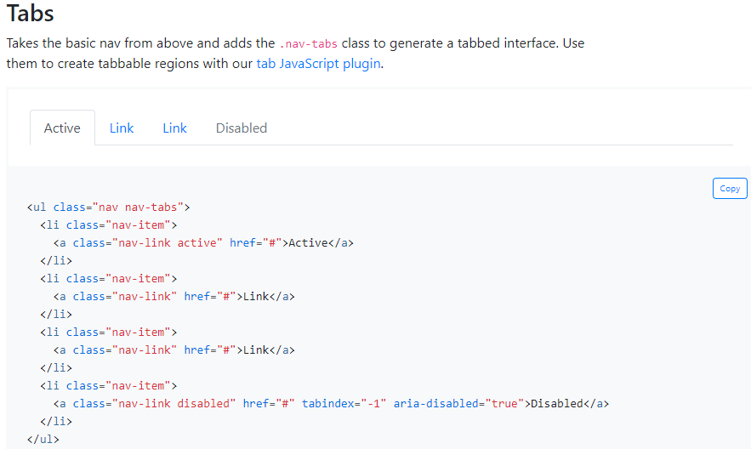
Navs Tabs

Slide 52
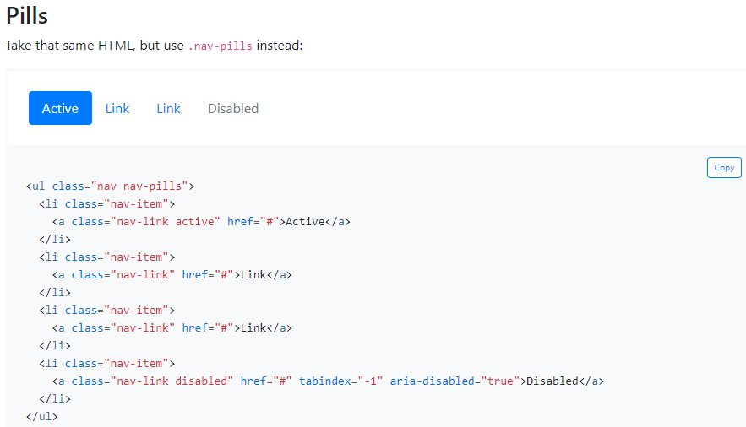
Navs Pills

Slide 53

Using dropdowns

Slide 54

Forms Select menu

Slide 55

Example with list-group

Slide 56


Growing spinner

Slide 57


Toasts Basic

Slide 58

Border color

Slide 59

Border-radius

Slide 60

Colors Color

Slide 61

Background color

Slide 62


Text alignment

Slide 63

Font weight and italics

Slide 64

Vertical alignment

