Slide 1
OSINT Pingala
Helping Police tap the untapped

Slide 2

Created with intensive research
We spent 36 Hours included with intensive research and hard work to prepare a promising solution for the police department
The tool helps Police to investigate the didital world

Slide 3
Google
Face Recognition

Slide 4
Broad Network

Slide 5
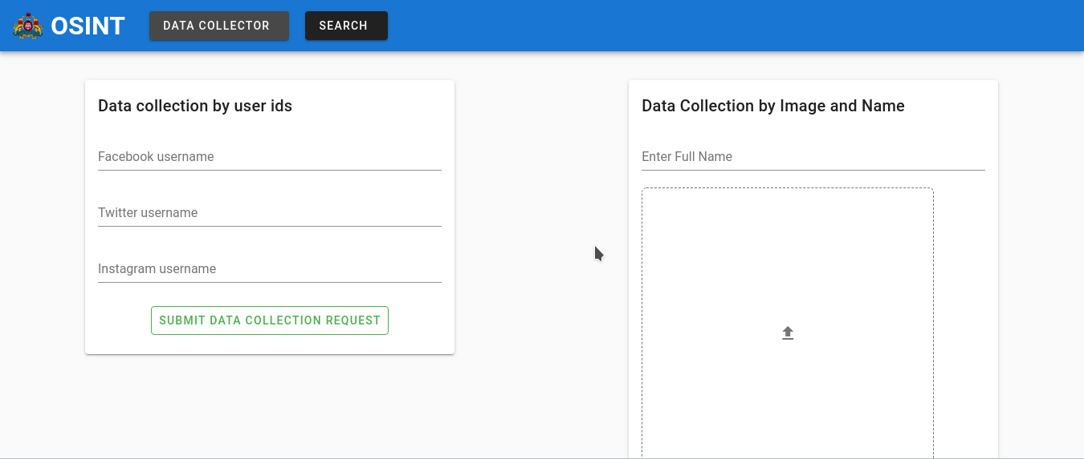

Slide 6
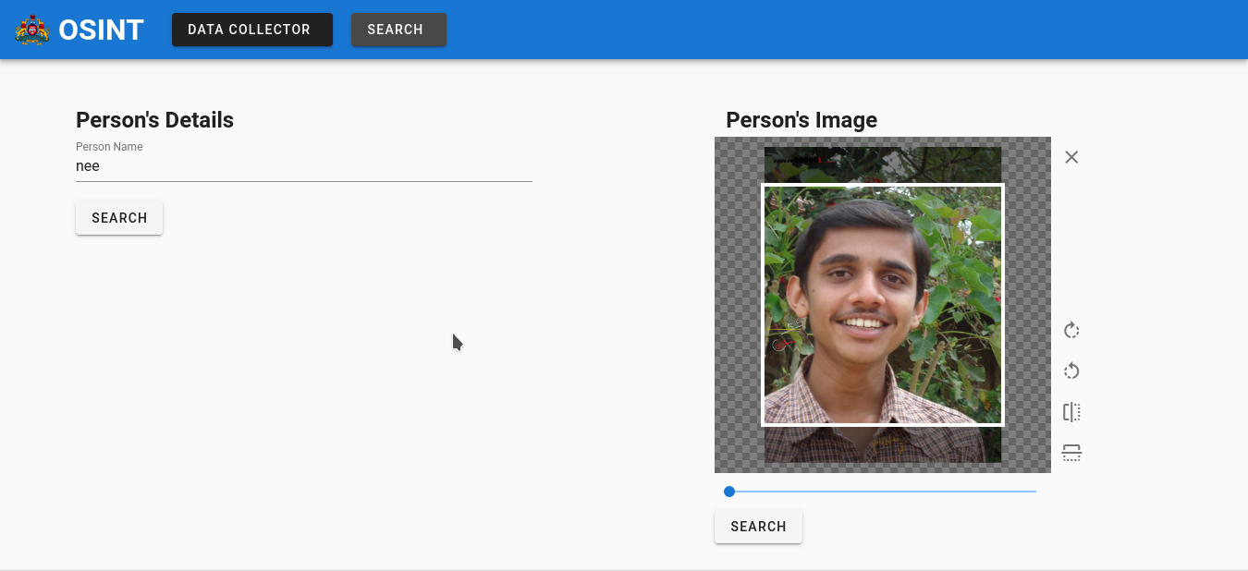

Slide 7
