Slide 1
OSINT
Samarth G Vasist | Anind Kiran | Taran Singhania | Sumukh Aithal K

Slide 2
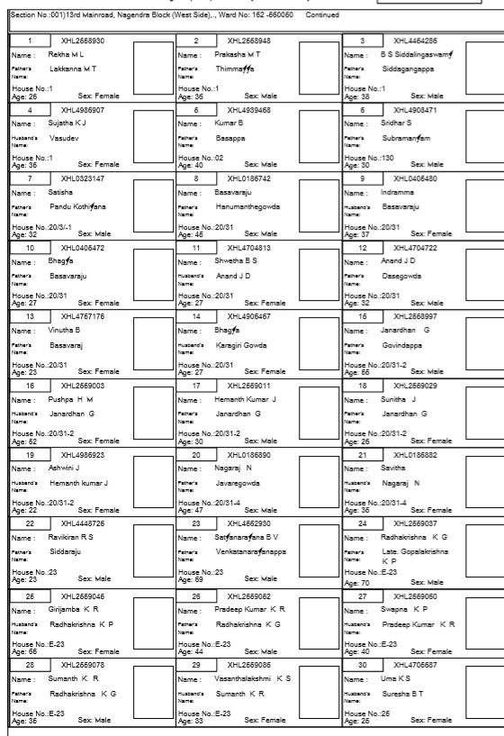
Electoral Roll data collection

Slide 3
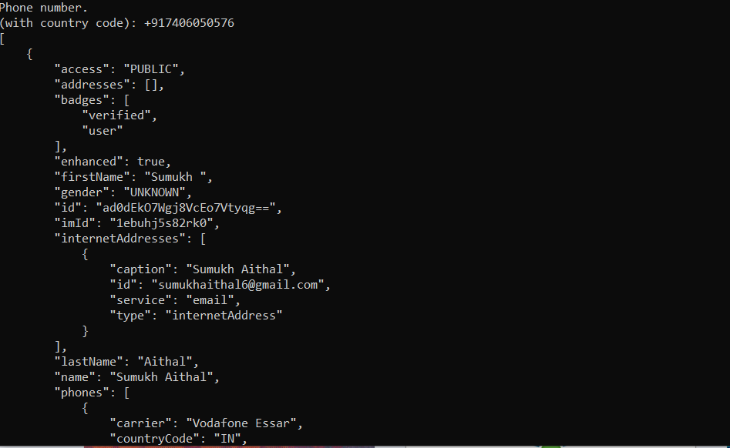
Truecaller

Slide 4
Web Scraping – twitter / facebook
Scraped data from social media sites – facebook and twitter

Slide 5
Google Scraper , Meta Search
Scraps from different search engines based on the keywords

Slide 6
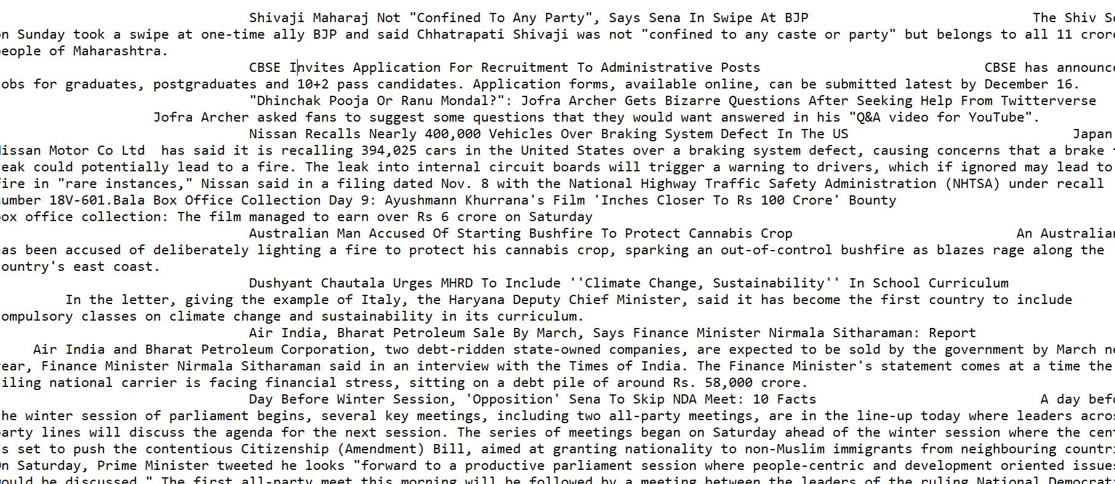
News/ Crime

Slide 7
Search By Image
Reverse image search from the person’s photo and also compare it with the person’s social media accounts

Slide 8
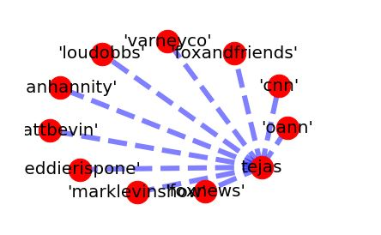
Social Mapping / Graphs

Slide 9
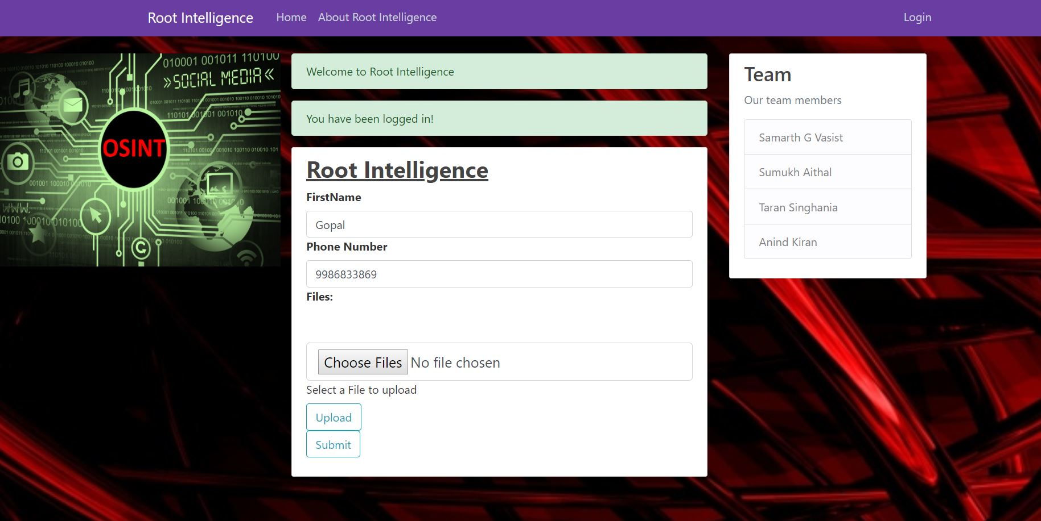

Slide 10
