Slide 1
Global Warming: A Planet in Peril
The Earth’s temperature is rising at an alarming rate, impacting every ecosystem and community.

Slide 2
Fossil Fuel EmissionsDeforestationIndustrial Activities
Rising Sea LevelsExtreme WeatherLoss of Biodiversity
The Drivers and Consequences
Primary Causes
Devastating Effects
Source: IPCC Sixth Assessment Report

Slide 3
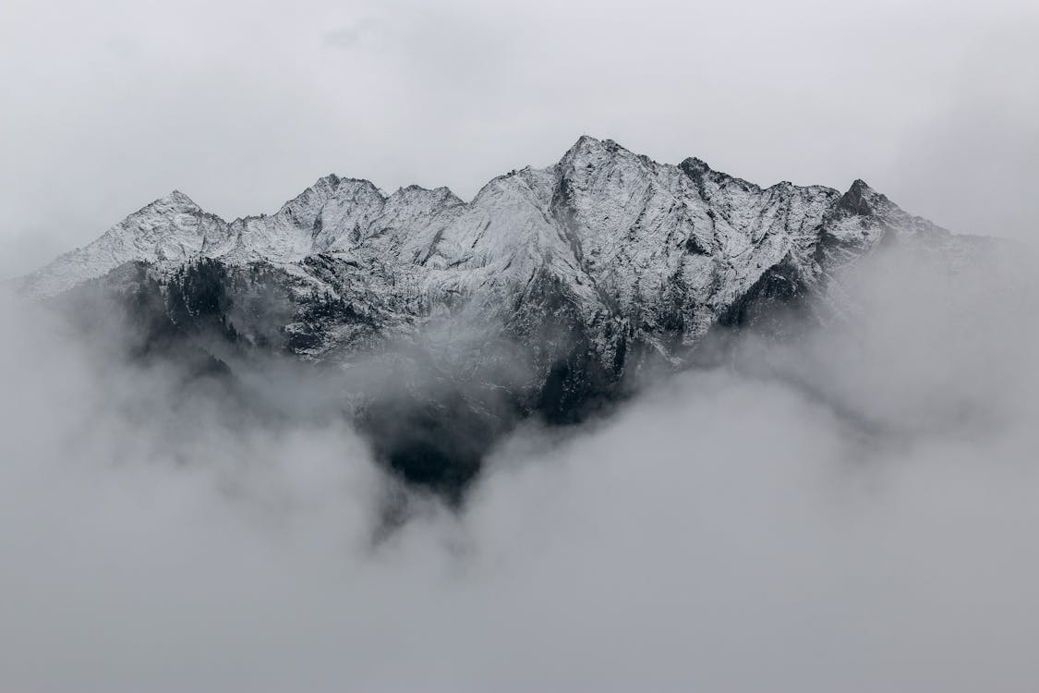
Transition to renewable energyPromote sustainable agricultureConserve our forestsSupport climate-friendly policies
Pathways to a Sustainable Future
We have the solutions. Let's act now for a healthier planet!

