Slide 1
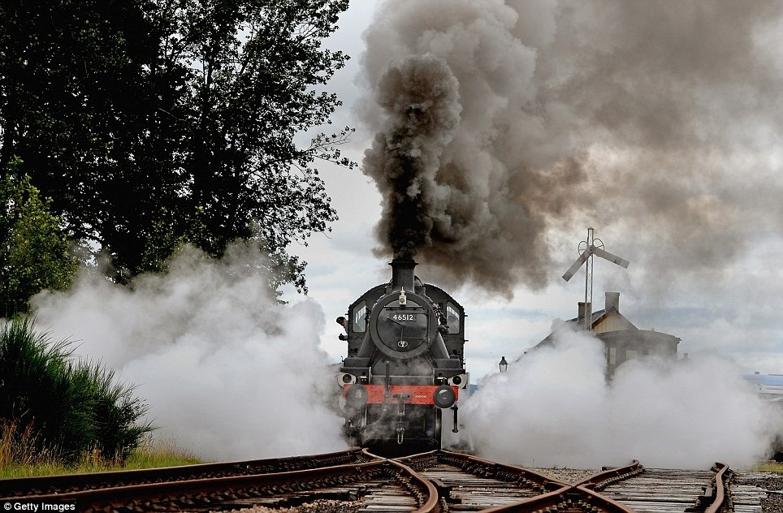
steam
Bill Gallmeister
Magnus Stensmo
July 19, 2016
CONFIDENTIAL

Slide 2
Steam: a Data Science Platform for BUILDING and SCALING Smart Data Products
A collaborative environment that brings data scientists, DevOps, and developers together by providing an end-to-end workflow for operationalizing models
Improve:
Collaboration between Data Scientists: model library, leaderboard, and comparisons
Resource Utilization: Cluster management and usage monitoring
Deployment of chosen models
Let Data Scientists be Data Scientists!

Slide 3
Steam Alpha available NOW
ElasticML for Cluster management
Deployment automation: REST API, bulk, in-app
Model library
http://www.h2o.ai/steam
Steam Beta: 8/10
Project-based model collaboration
Model leaderboard and comparison
Roadmap
Simplified model creation
ElasticML Cluster usage monitoring
ElasticML Additional Cluster management and Deployment options
Enhanced Model Leaderboard and Visualizations

Slide 4
Demo

Slide 5
Join us for the Journey!

