Slide 1
SPARKLING WATER 2.0 PREVIEW
Tom Kraljevic
tomk@h2o.ai
H2O Open Tour 2016, New York City
July 19, 2016

Slide 2
DISTRIBUTED SPARKLING TEAM
Michal - Mt. View, CA
Kuba - Prague, CZ
Mateusz – Tokyo, JP

Slide 3
INTRO TO SPARKLING WATER
Sparkling water brings H2O’s world class modeling algorithms seamlessly to Spark users
Transparent availability in Spark workflows
Access MLlib and H2O algorithms side-by-side from a single Scala or Python driver program

Slide 4
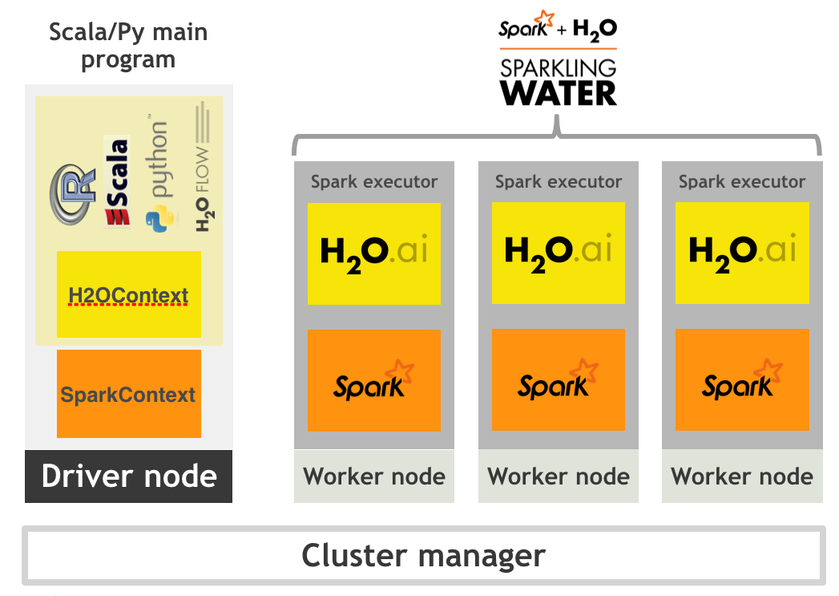

Slide 5
SCALA CODE EXAMPLE
// Perform Spark SQL Join on both tables
val bigTable = sqlContext.sql(
"""SELECT
|f.Year,f.Month,f.DayofMonth,
|f.CRSDepTime,f.CRSArrTime,f.CRSElapsedTime,
|f.UniqueCarrier,f.FlightNum,f.TailNum,
|f.Origin,f.Distance,
|w.TmaxF,w.TminF,w.TmeanF,w.PrcpIn,w.SnowIn,w.CDD,w.HDD,w.GDD,
|f.IsDepDelayed
|FROM FlightsToORD f
|JOIN WeatherORD w
|ON f.Year=w.Year AND f.Month=w.Month AND f.DayofMonth=w.Day""".stripMargin)
// Train H2O Deep Learning model
val trainFrame:H2OFrame = bigTable
trainFrame.replace(19, trainFrame.vec("IsDepDelayed").toCategoricalVec)
trainFrame.update()
val dlParams = new DeepLearningParameters()
dlParams._epochs = 100
dlParams._train = trainFrame
dlParams._response_column = 'IsDepDelayed
dlParams._variable_importances = true
val dl = new DeepLearning(dlParams, Key.make("dlModel.hex"))
val dlModel = dl.trainModel.get

Slide 6
NEW FOR SPARKLING WATER 2.0
Enabling first pure MLlib algorithm from the H2O Flow Web UI
SVM
Providing cluster stability during Spark HA events
(Optionally) separating the Spark and H2O clusters as two separate jobs

Slide 7

H2O ALGORITHM FROM FLOW
H2O Algorithm API Call
H2O Flow Web UI
REST API TCP Port 54321
REST API Facade
REST API Adapter Impl
H2O Algorithm Impl
Sparkling Water

Slide 8
PURE MLLIB ALGORITHM FROM FLOW
MLlib SVM Algorithm API Call
H2O Flow Web UI
REST API TCP Port 54321
REST API Facade
REST API Adapter Impl
Mllib Impl
Spark
Sparkling Water

Slide 9
SPARKLING WATER PRE-2.0
Sparkling Water Cluster
Spark
Worker
JVM
Spark
Executor
JVM
H₂O
Spark
Master
JVM
Spark
Worker
JVM
Spark
Executor
JVM
Sparkling App
jar file
spark-submit
H₂O
Spark
Worker
JVM
Spark
Executor
JVM
H₂O

Slide 10
SPARKLING WATER 2.0 (OPTIONAL)
H2O Cluster
Sparkling Water Cluster
Spark
Worker
JVM
Spark
Executor
JVM
H₂O
H₂O
Spark
Master
JVM
Spark
Worker
JVM
Spark
Executor
JVM
Sparkling App
jar file
spark-submit
H₂O
Spark
Worker
JVM
Spark
Executor
JVM
H₂O

Slide 11
WHEN?
Dependent on the release of Spark 2.0
So… Not a concrete answer…
BUT… First hand-held preview trial will start Aug. 1
Also: keep aware of the numbering scheme
The things I just talked about will likely also be available in (for example) Sparkling Water 1.6.x

Slide 12
Q & A
Thanks for attending!
Send follow up questions to:
h2ostream
(H2O Open Source Community Forum)

