Slide 1
WAYS TO PRODUCTIONIZE H2O
Tom Kraljevic
tomk@h2o.ai
H2O Open Tour 2016, New York City
July 19, 2016

Slide 2
WHERE TO FIND THE SLIDES
They’re in GitHub…
h2oai/h2o-meetups/tree/master/2016_07_19_H2O_Open_Tour_NYC_Prod

Slide 3
DEFINING “IN PRODUCTION”?
Removal would impact value to the business
Dollars
Time

Slide 4
OUTLINE
Motivation
Productionizing Model Building
Training
Productionizing Model Use
Scoring aka Predicting
Q & A

Slide 5
TYPICAL DEPLOYMENT APPROACH
Training
Scoring
Data
Data
Feature
Engineering
Feature
Engineering
Build
Model
Use Model
Export Model
Prediction

Slide 6
PRODUCTIONIZING MODEL BUILDING (TRAINING)

Slide 7
H2O TRAINING DIMENSIONS
Where does the data live?
Hadoop
HDFS, Hive
S3 / AWS
Database
Local drive (laptop, desktop, server)
How big is the data?
Fits in memory of one host? (Or not)
“Too small”?
How often should models be re-trained?
Daily? Weekly? Monthly? Quarterly?
Where will model training happen?
Hadoop YARN job
EC2 instances
Bare metal cluster
A really big server
Laptop
Resource requirements (how many nodes?)
CPUs
Memory
Time to build a model

Slide 8
H2O TRAINING SIZING BEST PRACTICE
For a novice getting started with a decent sized dataset:
Size total cluster memory to 4x on-disk data size (data for model training, not “total data”)
Use nodes of at least 10 GB, preferably larger
Use a small number of big nodes
e.g. 8 nodes x 30 GB each
For a YARN environment, you will have to adjust default settings to start big containers
Definitely DO NOT use 200 nodes x 1 GB each
Caution: Hadoop MapReduce veterans often start this way!
1 GB is way too small for any workload!

Slide 9
H2O TRAINING SIZING BEST PRACTICE
Start
With This
Raw data CSV
H2O Nodes
For the
Experts
Raw data CSV
H2O Nodes

Slide 10
H2O USER PROVISIONING BEST PRACTICE
Individual H2O jobs (aka application instances, aka clusters) are not multi-tenant
Think of YARN as providing multi-tenancy and H2O as a single job
H2O instance per interactive user, or per batch job
Steam product from H2O.ai simplifies management of H2O clusters

Slide 11

H2O USER PROVISIONING BEST PRACTICE
1 User per
H2O Instance
Recommended
Not
Recommended
Shared Group
H2O Instance

Slide 12
H2O MONITORING BEST PRACTICE
Monitor your H2O instance’s resource utilization
Watch the Water Meter in the Flow Web UI to see:
If your hardware cluster is already being slammed before H2O even starts doing anything
If your H2O instance is using CPU when you expect it to
Look at H2O log files for detailed memory utilization information (advanced)

Slide 13
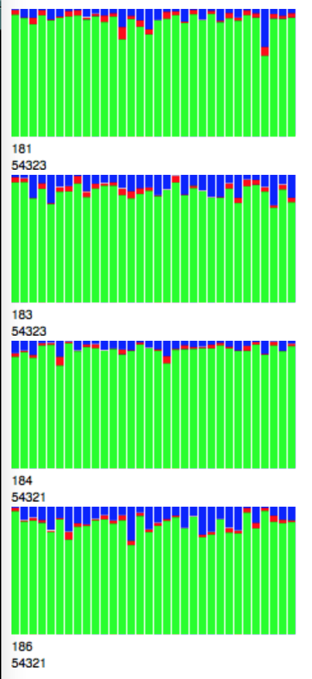
H2O MONITORING BEST PRACTICE
CPU Monitoring
Memory Monitoring (advanced)
yarn logs -applicationId application_1457562501251_2398
07-18 20:18:03.364 172.16.2.184:54321 31423 main INFO: ----- H2O started -----
07-18 20:18:03.430 172.16.2.184:54321 31423 main INFO: Build git branch: rel-turchin
07-18 20:18:03.430 172.16.2.184:54321 31423 main INFO: Build git hash: c09d9da94e7c61eb7ef4573f9f5029e0ca501469
07-18 20:18:03.430 172.16.2.184:54321 31423 main INFO: Build git describe: jenkins-rel-turchin-3
07-18 20:18:03.431 172.16.2.184:54321 31423 main INFO: Build project version: 3.8.2.3
07-18 20:18:03.431 172.16.2.184:54321 31423 main INFO: Built by: 'jenkins'
07-18 20:18:03.431 172.16.2.184:54321 31423 main INFO: Built on: '2016-04-25 13:07:53'
07-18 20:18:03.431 172.16.2.184:54321 31423 main INFO: Java availableProcessors: 32
07-18 20:18:03.431 172.16.2.184:54321 31423 main INFO: Java heap totalMemory: 39.45 GB
07-18 20:18:03.431 172.16.2.184:54321 31423 main INFO: Java heap maxMemory: 39.45 GB
07-18 20:18:03.431 172.16.2.184:54321 31423 main INFO: Java version: Java 1.7.0_67 (from Oracle Corporation)
07-18 20:18:03.431 172.16.2.184:54321 31423 main INFO: JVM launch parameters: [-XX:NewRatio=8, -Djava.net.preferIPv4Stack=true, -Dhdp.version=2.2.6.3-1, -Xms40g, -Xmx40g, -XX:PermSize=256m, -verbose:gc, -XX:+PrintGCDetails, -XX:+PrintGCTimeStamps, -Dlog4j.defaultInitOverride=true,
-Djava.io.tmpdir=/opt2/hdp/yarn/local/usercache/tomk/appcache/application_1457562501251_2398/container_e13_1457562501251_2398_01_000005/tmp,
-Dlog4j.configuration=container-log4j.properties, -Dyarn.app.container.log.dir=/opt2/hdp/yarn/log/application_1457562501251_2398/container_e13_1457562501251_2398_01_000005, -Dyarn.app.container.log.filesize=0, -Dhadoop.root.logger=INFO,CLA]
07-18 20:18:03.431 172.16.2.184:54321 31423 main INFO: OS version: Linux 3.13.0-61-generic (amd64)
07-18 20:18:03.431 172.16.2.184:54321 31423 main INFO: Machine physical memory: 251.89 GB
07-18 20:18:03.431 172.16.2.184:54321 31423 main INFO: X-h2o-cluster-id: 1468898282070
07-18 20:18:03.431 172.16.2.184:54321 31423 main INFO: User name: 'tomk’
07-18 20:18:03.432 172.16.2.184:54321 31423 main INFO: Possible IP Address: br2 (br2), 172.16.2.184
07-18 20:18:03.432 172.16.2.184:54321 31423 main INFO: Possible IP Address: lo (lo), 127.0.0.1
07-18 20:18:03.432 172.16.2.184:54321 31423 main INFO: Internal communication uses port: 54322
07-18 20:18:03.432 172.16.2.184:54321 31423 main INFO: Listening for HTTP and REST traffic on http://172.16.2.184:54321/
07-18 20:29:58.542 172.16.2.184:54321 31423 FJ-1-15 INFO: Frame distribution summary:
07-18 20:29:58.542 172.16.2.184:54321 31423 FJ-1-15 INFO: Size Number of Rows Number of Chunks per Column Number of Chunks
07-18 20:29:58.542 172.16.2.184:54321 31423 FJ-1-15 INFO: 172.16.2.181:54323 918.6 MB 29811120.000000 131.000000 4061.000000
07-18 20:29:58.542 172.16.2.184:54321 31423 FJ-1-15 INFO: 172.16.2.183:54323 883.7 MB 29023380.000000 127.000000 3937.000000
07-18 20:29:58.542 172.16.2.184:54321 31423 FJ-1-15 INFO: 172.16.2.184:54321 919.5 MB 28959996.000000 127.000000 3937.000000
07-18 20:29:58.542 172.16.2.184:54321 31423 FJ-1-15 INFO: 172.16.2.186:54321 925.5 MB 28900760.000000 127.000000 3937.000000
07-18 20:29:58.542 172.16.2.184:54321 31423 FJ-1-15 INFO: mean 911.8 MB 29173814.000000 128.000000 3968.000000
07-18 20:29:58.542 172.16.2.184:54321 31423 FJ-1-15 INFO: min 883.7 MB 28900760.000000 127.000000 3937.000000
07-18 20:29:58.542 172.16.2.184:54321 31423 FJ-1-15 INFO: max 925.5 MB 29811120.000000 131.000000 4061.000000
07-18 20:29:58.542 172.16.2.184:54321 31423 FJ-1-15 INFO: stddev 16.5 MB 370495.062500 1.732051 53.693577
07-18 20:29:58.542 172.16.2.184:54321 31423 FJ-1-15 INFO: total 3.56 GB 116695256.000000 512.000000 15872.000000
792.586: [GC [PSYoungGen: 2353508K->1553406K(3107328K)] 6945343K->6408429K(40390144K), 0.1256170 secs] [Times: user=2.19 sys=0.53, real=0.12 secs]
793.632: [GC [PSYoungGen: 3107117K->1553392K(3107328K)] 7962139K->7350065K(40390144K), 0.1929720 secs] [Times: user=2.61 sys=1.67, real=0.20 secs]
794.524: [GC [PSYoungGen: 3106455K->1221115K(3107328K)] 8903127K->8571453K(40390144K), 0.1658980 secs] [Times: user=2.92 sys=0.77, real=0.17 secs]
795.501: [GC [PSYoungGen: 2774868K->1496653K(3107328K)] 10125206K->9965740K(40390144K), 0.1611300 secs] [Times: user=2.81 sys=0.82, real=0.16 secs]
796.684: [GC [PSYoungGen: 3050216K->986551K(3107328K)] 11519302K->10546313K(40390144K), 0.1470070 secs] [Times: user=2.03 sys=1.27, real=0.15 secs]
797.983: [GC [PSYoungGen: 2540021K->781681K(3107328K)] 12099782K->11006879K(40390144K), 0.1154810 secs] [Times: user=1.38 sys=1.21, real=0.12 secs]

Slide 14
ADDITONAL YARN BEST PRACTICES
Limiting memory occurs “naturally”
No CPU usage limit by default, but you can use:
YARN cgroups
H2O –nthreads startup option
Use node labels to direct container placement
Capacity and Fair schedulers are both fine
Many people provision YARN queues to manage resource use for teams
You must disable preemption for H2O jobs

Slide 15
PRODUCTIONIZING MODEL USE (SCORING AKA PREDICTING)

Slide 16
HIGH-LEVEL H2O DIMENSIONS
In-H2O
POJO
Batch
Many rows at once
think Frames of data
R / Python / Scala
script driving H2O
Script
Real-time
One row at a time
Java / Scala
embedded or as a service
Application

Slide 17
OTHER INDEPENDENT DIMENSIONS
Choice A
Choice B
On-premise
Data Science
Micro-service with REST API
Model only
Train and predict together
Pre-calculated
Cloud
Computer Science
Embedded
Model + Feature engineering
Train and predict separately
Calculate live

Slide 18
DATA ENVIRONMENTS
Hive
Databases
Oracle, MS SQL, SQLite, etc.
Cloud databases (Amazon RDS)
Teradata
Bare flat files
Hadoop HDFS
Amazon S3
Storm spout
Spark stream
Apache Apex

Slide 19
MODEL ENVIRONMENTS
Laptop / Desktop
Hadoop
Standalone cluster
Steam
Cloud (e.g. EC2)
Cloud endpoint (e.g. AWS Lambda)
Storm bolt
Spark stream
Apache Apex
Hive UDF
POJO called from R

Slide 20
KEY PARAMETERS
Model training
Frequency
Cost (memory, CPU, time)
Prediction SLA
Throughput
Latency
Availability
Security

Slide 21
EXAMPLE DESIGN PATTERNS
In-H2O
POJO
Driven from Flow/R/Python/Scala
Often launching on Hadoop
Embedding H2O (droplet)
JUnit test
Craigslist app (Sparkling Water)
App-consumer-loan (Jetty servlet)
App-malicious-domain (AWS lambda)
POJO from R (jar file)
Journals.ai desktop app (SQlite DB)
Storm bolt
Hive UDF
Steam from H2O.ai (REST API)

Slide 22
WALKTHROUGH FOR 5 DESIGN PATTERNS
Batch In-H2O
Steam
AWS Lambda
Hive UDF
Pre-calculated DB

Slide 23
PURE BATCH H2O DESIGN PATTERN
Training and scoring data lives in data lake
Entire process driven by R
Training occurs periodically
Scoring occurs frequently

Slide 24
PURE BATCH H2O DESIGN PATTERN
Training
Scoring
Data in Hadoop
New Scoring Data
H2O Cluster
H2O Cluster
Load Binary Model
Build Model
Score Model
Binary Model
Predictions

Slide 25
STEAM DESIGN PATTERN
Training data lives in Hadoop
POJO models are deployed as a service with a REST API

Slide 26

STEAM DESIGN PATTERN (TRAINING)
Steam
User 1
H₂O
H₂O
User 2
H₂O
H₂O

Slide 27
STEAM DESIGN PATTERN (SCORING)
Feature Lookup
Database
Steam
New Request
Application
Feature Eng
Python
REST API
Steam Scoring Service
Prediction
Score
POJO Model

Slide 28
AWS LAMBDA DESIGN PATTERN
Training data lives in data lake
Scoring data arrives via API call
Real-time POJO scoring in AWS Lambda

Slide 29
MOTIVATION FOR AWS LAMDA
USE CASE | REQUIREMENTS | TECHNOLOGY
Feature engineering | Use of Python for DataSci Code re-use for training and production Speed | Jython
Machine Learning Prediction | High model accuracy Real-time environment | H2O Generated POJO Model
Deployment to Production | Easy handoff to Ops Speed to deployment Built-in scalability No infrastructure management | AWS Lambda

Slide 30



AWS LAMBDA DESIGN PATTERN (SCORING)
{
"domain”: "plzdonthackmekthxbye”
}
Lambda
domain name
HTTPS POST
JavaScript App
Lambda
Function
Handler
Jython
Feature Munging
H2O Model POJO Prediction
JSON
with prediction
REST endpoint
{
"label": 1,
"class0Prob": 0.002564083122440164,
"class1Prob": 0.9974359168775598,
"intercept": -14.94132841574946,
"length": 29.841565204329598,
"entropy": 11.178560649883826,
"proVowels": -1.7679609134401084,
"numWords": -18.347249579636706
}
String length
Shannon Entropy
Number of English words
Proportion of vowels

Slide 31
HIVE UDF DESIGN PATTERN
Training data lives in Hive
Scoring data lives in Hive
Batch POJO scoring
Models built infrequently
Scoring occurs daily
Strict SLA to complete the batch job

Slide 32
HIVE UDF DEPLOYMENT
HIVE
Training Data
Scoring Data
Hive UDF
H₂O POJO
Build
Model
Export POJO

Slide 33
HIVE UDF (TRAINING)
HIVE
Training Data
Prepare training data
Data may be stored in unreadable format!
Export to read _part files for H₂O
Launch H₂O
Build models
Export models as POJOs
Build
Model

Slide 34
HIVE UDF (SCORING)
Create Hive UDF
Extend GenerUDF class
initialize(): initialize H₂O models
evaluate(): loop through models & score
Build JAR file
Hive
Load JARs, define UDF, set columns
ADD JAR localjars/h2o-genmodel.jar; ADD JAR target/ScoreData-1.0-SNAPSHOT.jar;
CREATE TEMPORARY FUNCTION fn AS …
set hivevar:scoredatacolnames=C1,C2…
Score!
select fn(${scoredatacolnames}) from TABLE
HIVE
Scoring Data
Hive UDF
H₂O POJO

Slide 35
JOURNALS.AI DESIGN PATTERN
Driven by R
Training & scoring on bare metal servers
Scores pre-calculated and stored in a database (e.g. MS SQL, SQLite)
Application with domain-specific UI built on top of the database
Flexible deployment (laptop, server, cloud, etc.)

Slide 36
JOURNALS.AI PRODUCTIONIZED
Training
App Deployment
Data
Feature Engineering
Interact with Application
Build Model
Scoring
Database
Export Database
Use Model

Slide 37
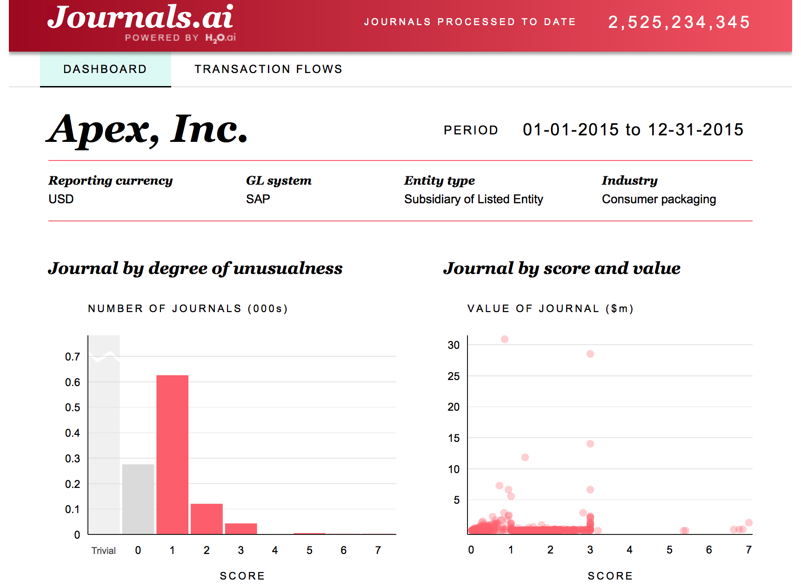

Slide 38
Q & A
Thanks for attending!
Slides in github:
h2oai/h2o-meetups/tree/master/2016_07_19_H2O_Open_Tour_NYC_Prod
Send follow up questions to:
Tom Kraljevic
tomk@h2o.ai

Slide 39
FEATURE ENGINEERING

Slide 40
FEATURE ENGINEERING
For a model in production to make predictions, it needs access to the same features that were trained on
Often there is a need to build the same features in both training and production environments

Slide 41
FEATURE ENGINEERING DIMENSIONS
Language: R / Python / Java / Scala
Code re-use for train and prod: Yes / No
Prod is batch / interactive
Latency SLA
Throughput SLA
Live lookups: Yes / No

Slide 42
FEATURE ENGINEERING RECIPIES
Think like a pipeline
Function call to transform a row
Column Name/Value map in -> map out
Transformation microservice
Storm feature engineering bolt
Jython
Live Python interpreter

Slide 43
FEATURE ENGINEERING STEPS
Database lookup
Imputation
Sanity checks (e.g. age is positive)
Unknown categorical level check
Creating new features

