Slide 1


Computer Organization & Architecture
Chapter 5
Internal Memory

Slide 2
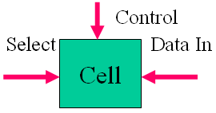
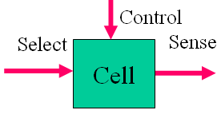
5.1 Semiconductor Memory
Organisation
  Basic element of semi. memory is cell，which stores a digital bit；
  Cell Properties:
    Two states：1 or 0
    Can be set by write operation（ at least once ）
    Sensed by read operation
  Cell writing & Reading operation Fig.

Slide 3
Ch.5-5.1
RAM (random-access memory): access data by address
  Misnamed as all semiconductor memory is random access
  Read/Write: time is the same
  Volatile: DC supplies
  Temporary storage
  Static or dynamic

Slide 4
Ch.5-5.1
Dynamic RAM
  Bits stored as charge in capacitors
  Charges leak：2ms duration
  Need refreshing even when powered
  Simpler construction
  Smaller per bit
  Less expensive and low power consumption
  Need refresh circuits
  Slower
  Main memory
  Essentially analogue
    Level of charge determines value

Slide 5
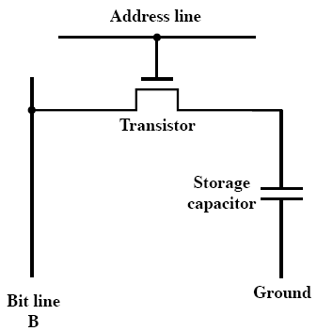
Ch.5-5.1
Dynamic RAM Structure

Slide 6
Ch.5-5.1
DRAM Operation
  Address line active when bit read or written
    Transistor switch closed (current flows)
  Write
    Voltage to bit line
      High for 1 low for 0
    Then signal address line
      Transfers charge to capacitor
  Read
    Address line selected
      transistor turns on
    Charge from capacitor fed via bit line to sense amplifier
      Compares with reference value to determine 0 or 1
    Capacitor charge must be restored

Slide 7
Ch.5-5.1
Static RAM
  Bits stored as flip-flop logic gate
  No refreshing needed when powered
  More complex construction
  Larger per bit: 6 MOS (Metal-oxide semiconductor)
  More expensive
  Does not need refresh circuits
  Faster
  Cache
  Digital
    Uses flip-flops

Slide 8
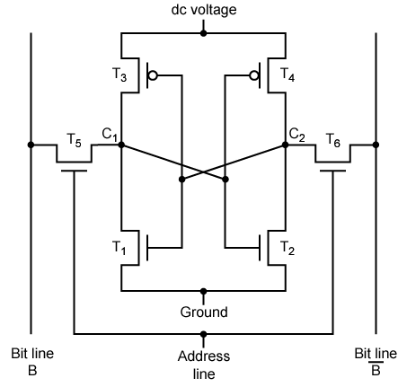
Ch.5-5.1
Stating RAM Structure

Slide 9
Ch.5-5.1
Static RAM Operation
  Transistor arrangement gives stable logic state
  State 1
    C₁ high, C₂ low
    T₁ T₄ off, T₂ T₃ on
  State 0
    C₂ high, C₁ low
    T₂ T₃ off, T₁ T₄ on
  Address line transistors T₅ T₆ is switch
  Write – apply value to B & compliment to B
  Read – value is on line B

Slide 10
Ch.5-5.1
SRAM v DRAM
  Both volatile
    Power needed to preserve data
  Dynamic cell
    Simpler to build, smaller
    More dense
    Less expensive
    Needs refresh
    Larger memory units
  Static
    Faster
    Cache

Slide 11
Ch.5-5.1
Read Only Memory (ROM)
  Permanent storage
  Read-only, can not be written
  Data wired into the chip while making
    A MOS means “1”, no MOS means “0”
  When a bit is error, the whole chip is useless
  Applications:
    Microprogramming
    Library subroutines
    Systems programs (BIOS)
    Function tables

Slide 12
Ch.5-5.1
PROM—programmable ROM
  Original chip produced, it can be written into only once by “programming”
  Special Equipment is required to program
  Writing process is performed electronically by: supplier or customer
    Fuse fired means 0, otherwise, means 1
  Flexibility & convenience

Slide 13
Ch.5-5.1
Read “mostly” Memory
  Read is more frequent than write, nonvolatile applications
    EPROM
    EEPROM
    Flash memory
  Erasable Programmable ROM (EPROM)
    Read and write electronically
    Initializing chip in ultraviolet radiation
    20 minutes to write, multiple updating
    expensive
  Electronically EPROM (EEPROM)
    No need erasing prior contents，acting as disk
    Write is longer than read
    More expensive than EPROM
    Less dense

Slide 14
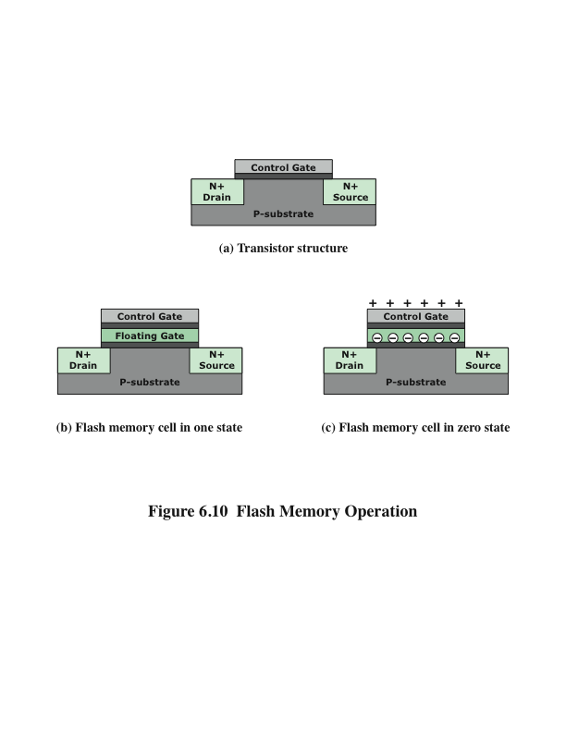
  Flash Memory
    A type of semiconductor memory is used both for internal memory and external memory applications
    Price, function is between EPROM~EEPROM
    Erase by blocks, no needing erasing whole chip

Slide 15
Flash memory
Two distinctive types of flash memory
  NOR
    The basic unit of access is a bit
    Provides high-speed random access
    Used for microcontrollers where the amount of program code is relatively small and a certain amount of application data does not vary
  NAND
    The basic unit is 16 or 32 bits
    Reads and writes in small blocks
    Does not provide a random-access external address bus so the data must be read on a block-wise basis
NAND memory is better suited for external memory, such as USB flash drives, memory cards, and in what are known as solid-state disks (SSDs)

Slide 16
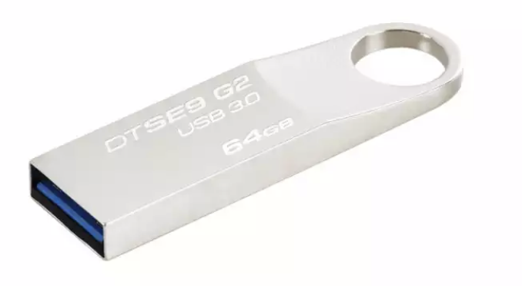
Ch.5-5.1
Modern Flash
  U disk: flash memory chip, 8G~64G
  Structure:
    USB port
    main control chip
    flash chip
    PCB board
    shell

Slide 17
Ch.5-5.1
More about U disk
  Early USB1.1
    Hundreds of KB/s
    Recently, USB2.0
    A few of MB/s
  At present, USB3.0
    5Gb/s

Slide 18
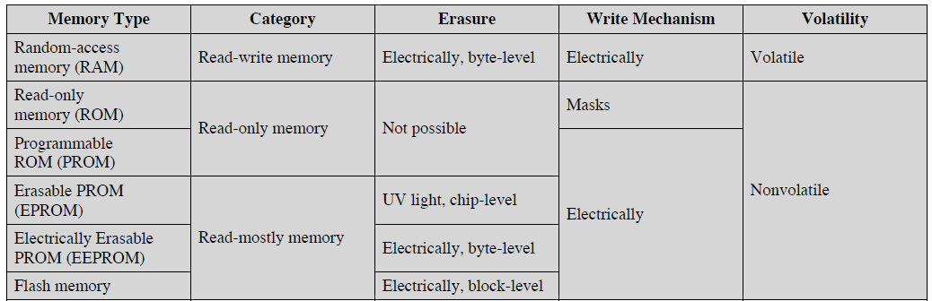
Ch.5-5.1
Summary for Semiconductor Memory

Slide 19
Ch.5-5.1
Chip Logic - how to organize memory cells
  Packaged chip
  Array of Cells
    Word or cell
  Key design issue：
    Word length：data bits read or written each
  Organization modes：
    Physical arrangement of the cells in the array is the same as the logical arrangement
      e.g.：16Mbit=1M×16bit, 4M ×4bit or 2M ×8bit
    Cell/word
      e.g.：16Mbit=16M ×1bit
    Others

Slide 20
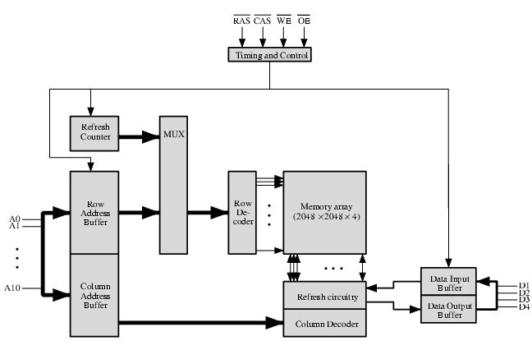
Ch.5-5.1
Typical 16M-bit DRAM (4M x 4)

Slide 21
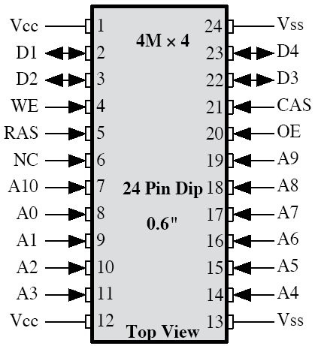
Ch.5-5.1
Specification for Fig5.4
  Typical structure of 16M DRAM: 4x2048x2048 array, 4bits/word
  Multiplexing 11 address lines, address bits= 22, Save on pins;
  RAS: Row address selection
  CAS: Column address selection
  WE: Write enable
  OE: Output enable
  Refreshing row by row
    No operations while refreshing
    Refresh before reading or writing

Slide 22
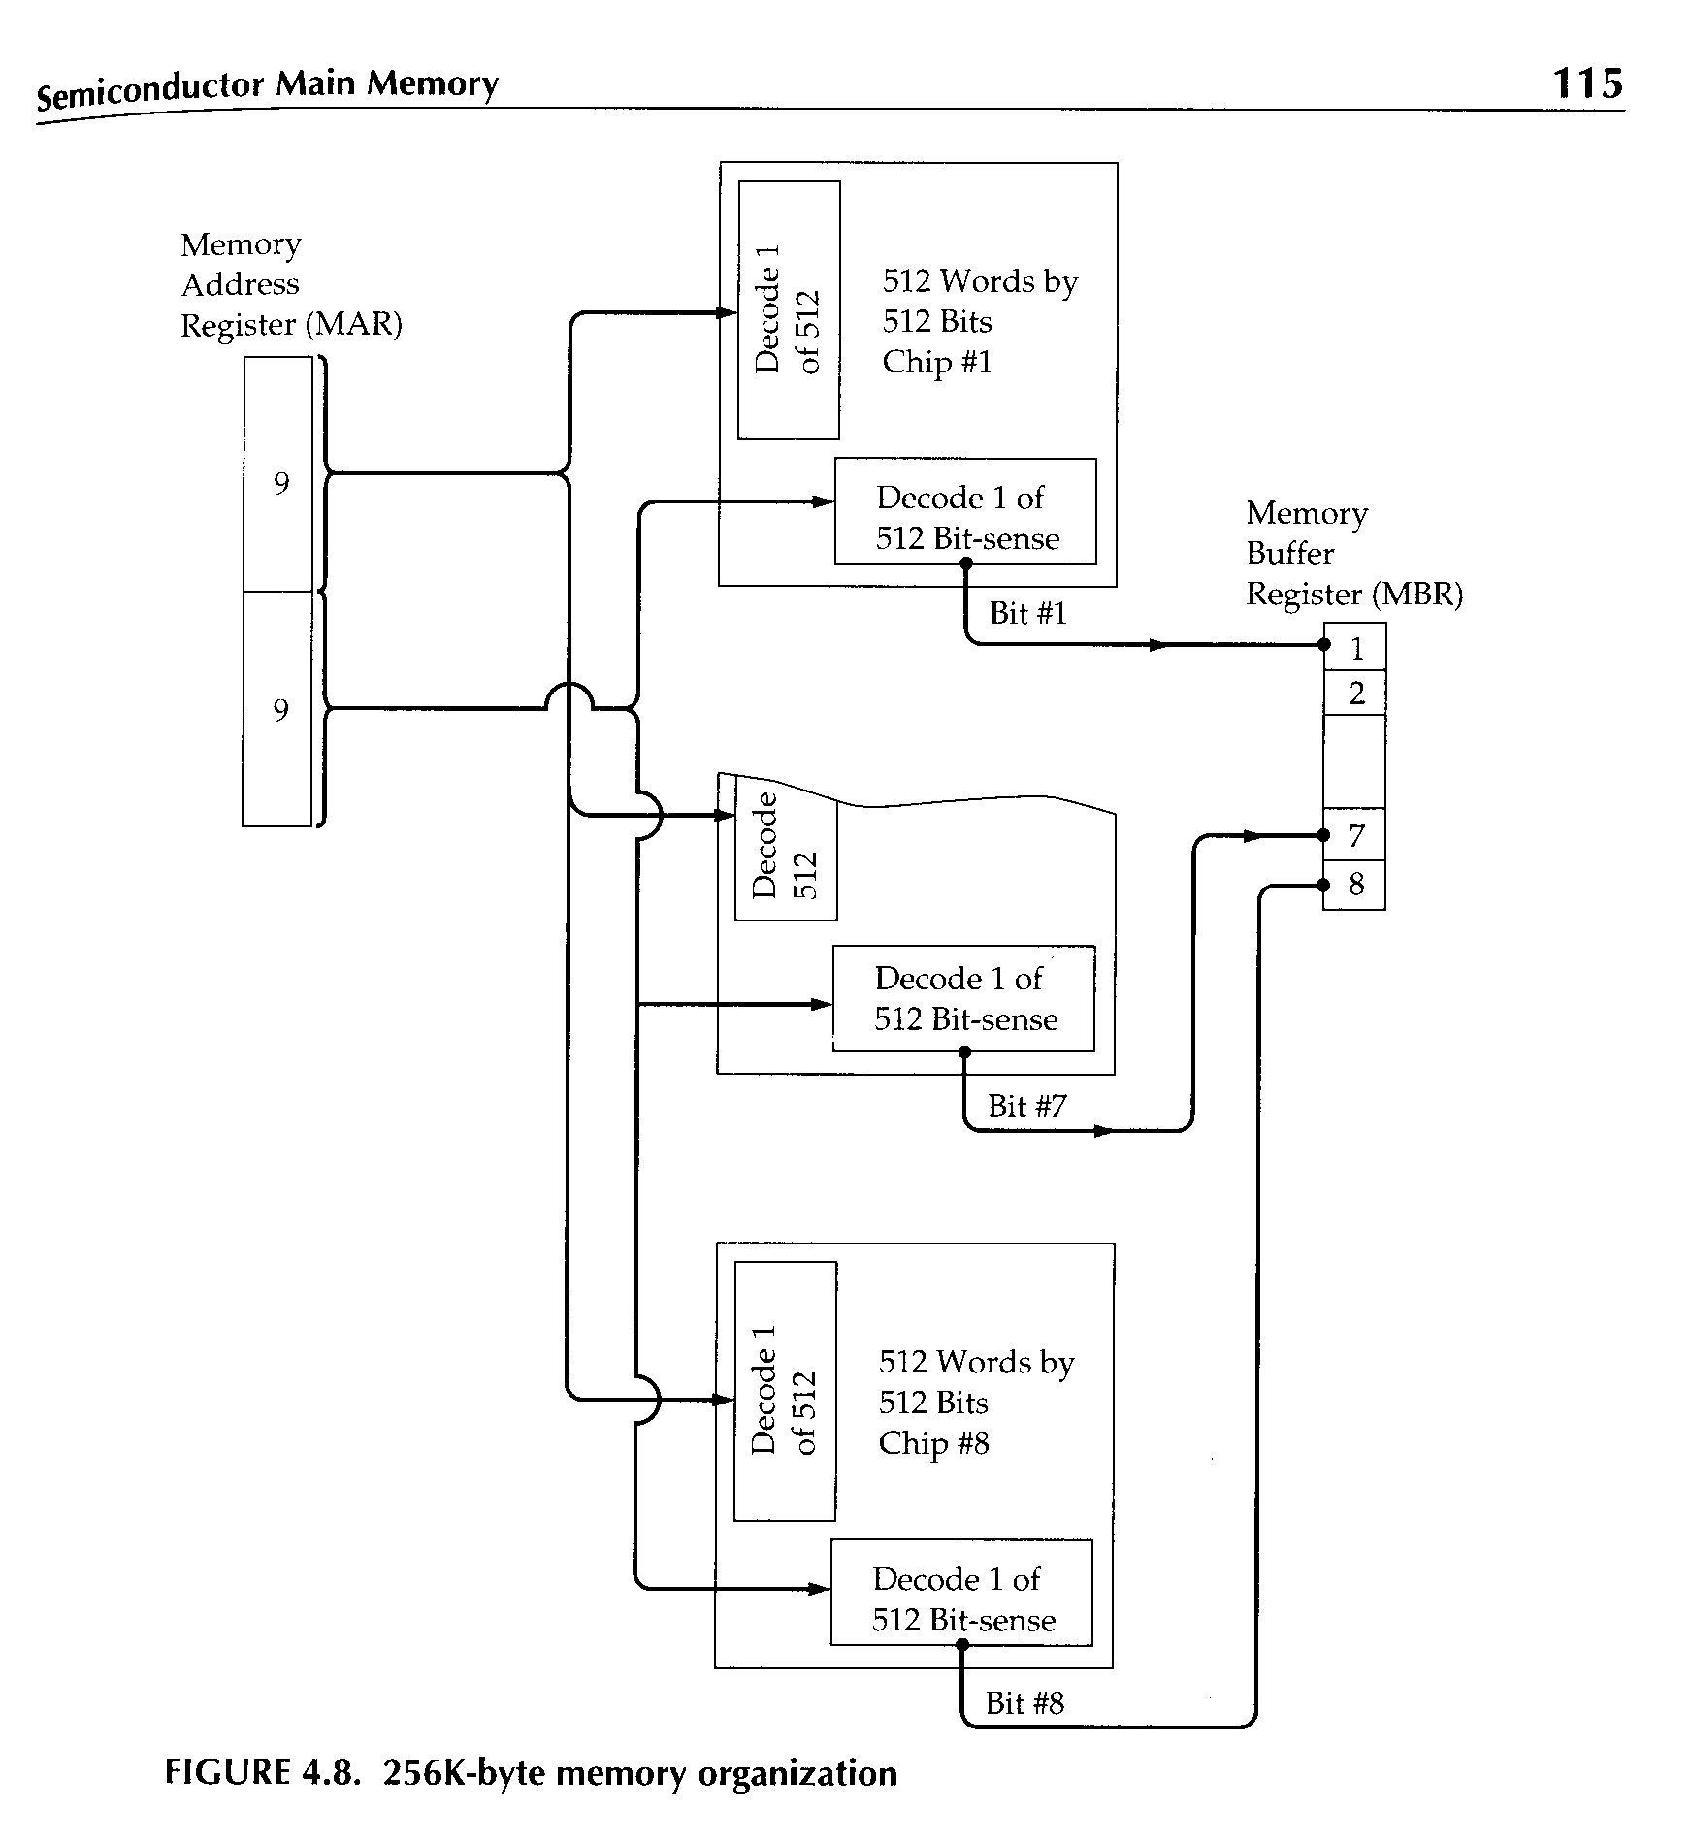
Ch.5-5.1
Module Organization - a simple example

Slide 23
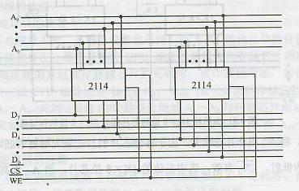
Ch.5-5.1
Module Organization- word length extension
    1K×4 → 1K×8

Slide 24
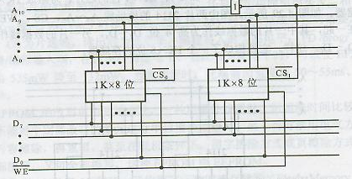
Ch.5-5.1
Module Organization - word number extension
    1K ×8→ 2K ×8

Slide 25
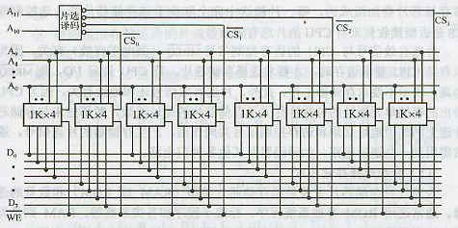
Ch.5-5.1
Module Organization- word length and number extension
    1K×4 → 4K×8

Slide 26
Ch.5-5.1
Connection of CPU and Memory
  Connection of address lines
    Address lines of CPU are usually more than memory’s
    Low bits ←→ low bits
    High bits of CPU used for CS
  Connection of data lines
    Data lines of CPU must equal data bits of memory, if necessary, the chip bit is enlarged
  Connection command line
    Read/write lines are directly connected to that of memory
    CS is connected to MREQ and high address bits of CPU
    Logic circuit may be used, such as decoder
  Correctly select types of chip and number
    ROM used for system area
    Ram used for user area

Slide 27
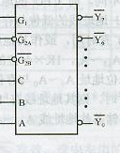

Ch.5-5.1
An Example of CPU-Memory
Suppose CPU has 16 address lines, 8 data lines. MREQ is used for access memory control, WR is read/write control. Now, we have following chips:
  1K×4 RAM;4K ×8 RAM; 8K ×8 RAM;
  2K ×8 ROM; 4K ×8 ROM; 8K ×8 ROM;
  74LS138 decoder and all kinds of gates, as figure.
  Please draw the diagram of CPU connecting memory, conditions:
  1. 6000H~67FFH is system area; 6800H~6BFFH is user area;
  2. select reasonable chips, how many chips used, respectively？

Slide 28
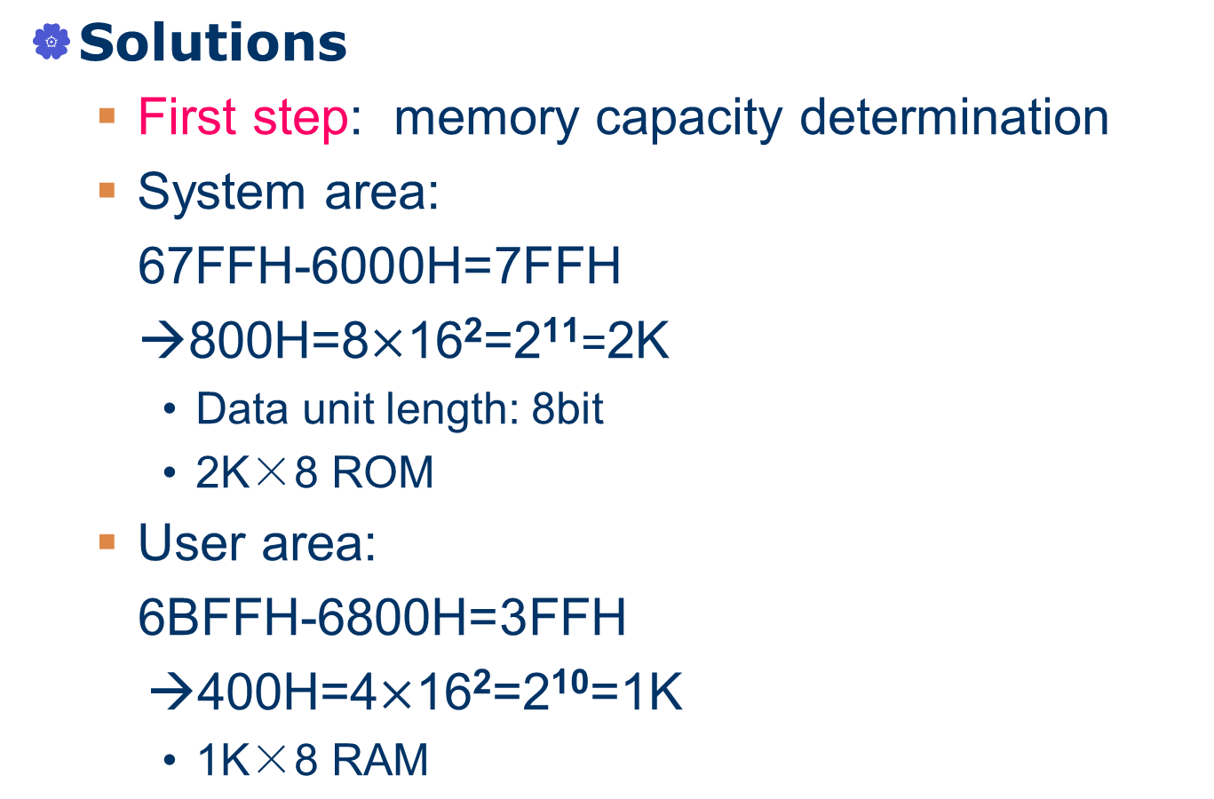
Ch.5-5.1

Slide 29
Ch.5-5.1
  Second step: select chips
    One 2K×8 ROM
    Two 1K ×4 RAM (parallel connection)
  Third step: allocate CPU address lines
    A0~A10 of CPU connect addresses of ROM
    A0~A9 connect two chips of RAM address lines
    Left high bits and MREQ are used for chip selection

Slide 30
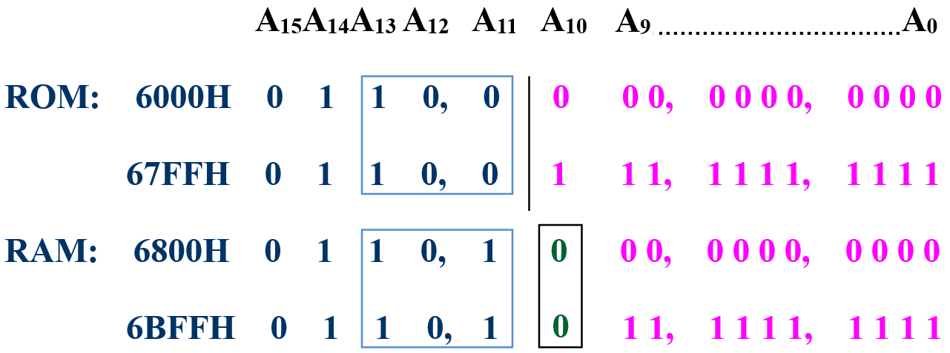
Ch.5-5.1

Slide 31
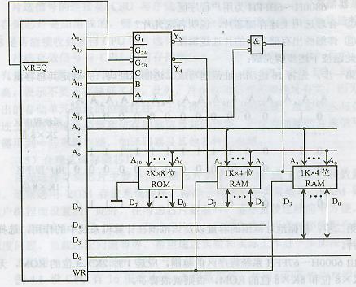
Ch.5-5.1

Slide 32
5.2 Error Correction
Hard Failure
    Permanent defect
Soft Error
  Random, non-destructive
  No permanent damage to memory
  Detected using Hamming error correcting code

Slide 33
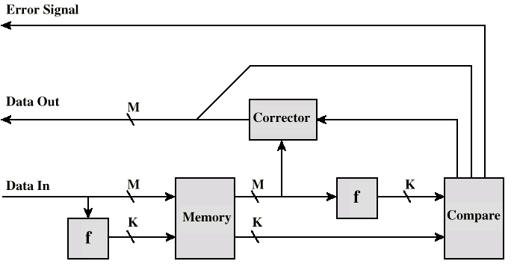
Ch.5-5.2
Error Correcting Code Function

Slide 34
5.3 Advanced DRAM Organizaition
Newer RAM Technology
  Basic DRAM keeps same since first RAM chips
  Enhanced DRAM
    Contains small SRAM as well
    SRAM holds last line read
  Cache DRAM
    Larger SRAM component
    Used as cache or serial buffer

Slide 35
  Synchronous DRAM (SDRAM)
    Access is synchronized with an external clock
    Address is presented to RAM
    RAM finds data (CPU waits in conventional DRAM)
    Since SDRAM moves data in time with system clock, CPU knows when data will be ready
    CPU does not have to wait, it can do something else，because of latch
    Burst mode allows SDRAM to set up stream of data and fire it out in block

Slide 36
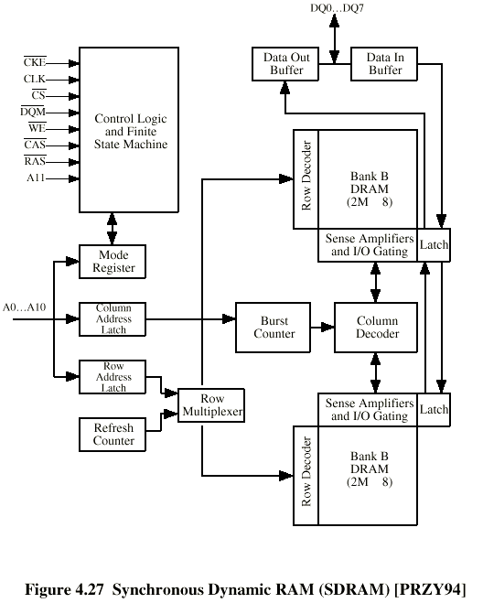
SDRAM Organization

Slide 37
  RAMBUS
    Adopted by Intel for Pentium & Itanium
    Main competitor to SDRAM
    Vertical package – all pins on one side
    Data exchange over 28 wires < 12cm long
    Bus addresses up to 320 RDRAM chips at 1.6Gbps
    Asynchronous block protocol
      480ns access time
      Then 1.6 Gbps

Slide 38
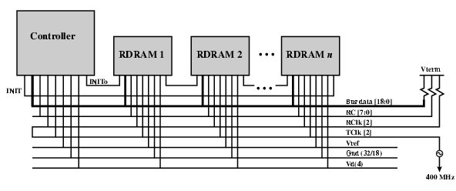
  RAMBUS Diagram
RC: address and control lines
RClk, TClk: clock
Vref: reference voltage line
Vd: power lines
Vterm: terminator

Slide 39
  DDR SDRAM
    SDRAM can only send data once per clock
    Double-data-rate SDRAM can send data twice per clock cycle
      Rising edge and falling edge
    DDR4
      DDR V4
      Introduced in 2011
      enlarging the prefetch buffer (small cache)

Slide 40
  Cache DRAM
    Mitsubishi
    Integrates small SRAM cache (16 kb) onto generic DRAM chip
    Used as true cache
      64-bit lines
      Effective for ordinary random access
    To support serial access of block of data
      E.g. refresh bit-mapped screen
        CDRAM can prefetch data from DRAM into SRAM buffer
        Subsequent accesses solely to SRAM

Slide 41
Vocabulary
MO(magneto-optical disk):磁光盘
Data-In/Sense Terminal:数据输入/输出端
RAS(row address select):行地址选择
CAS(column address select):列地址选择
Module:模块
Flash memory: 快闪存储器
Hard failure: 硬件故障
Soft error: 软件故障

Slide 42
Vocabulary
Error correction ：差错校验/纠错
Hamming error-correction code:海明差错校验码
Parity bit：校验位
Syndrome word:错误字
Reliability：可靠性
Latch：锁存器
Volatile memory: 易失性存储器

Slide 43
Key Points
  Differences between SRAM and DRAM?
  Comparing EPROM and Flash memory!
  What is SDRAM? what applications need it?
  Parallel DRAM techniques

Slide 44
Homework
1 Explain following concepts:
  SRAM, DRAM, SDRAM, EEPROM
2 compare SRAM to DRAM
3 Which advanced methods can be used to improve accessing main memory?

Slide 45
4某CPU有16条地址线和8条数据线。从0000H到9FFF地址已有40KB内存，现在要求在40KB地址空间之后再增加8KB SRAM。如用4K×8位SRAM芯片来扩容，假设CPU有地址总线，数据总线，控制信号为R/W（读写允许）以及MREQ（当存储器进行读写操作时，该信号只是地址总线上的地址是有效的），SRAM有地址线，数据线，R/W和片选CS信号端，试设计CPU与该8KB SRAM的连接图，可选用如图所示的各种逻辑门及3-8译码器。

