Slide 1


Computer System and Application
Computer Organization & Architecture
Chapter 18
Multicore Computers

Slide 2
Why multi-core?
Multicore
  Combines two or more processors on a single piece of silicon(die)
  Also called chip multiprocessor: CMP
  Each processor in chip is called “core”
Each core consists of all of the components of an independent processor
  Registers, superscalar,CU,multi-level caches
Necessity of multicore
  Requirements of power consumption and heat dissipation of CPU
  Parallelism requirements
  Requirements of application software
  Requirement of Moore’law

Slide 3
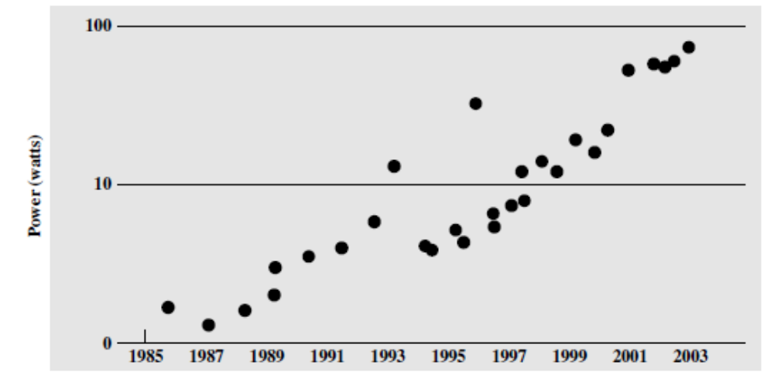
Power Dissipation
Power dissipation
  Power requirements have grown exponentially as chip density and clock frequency have risen,.
  User cost increasing and heat dissipation problem

Slide 4
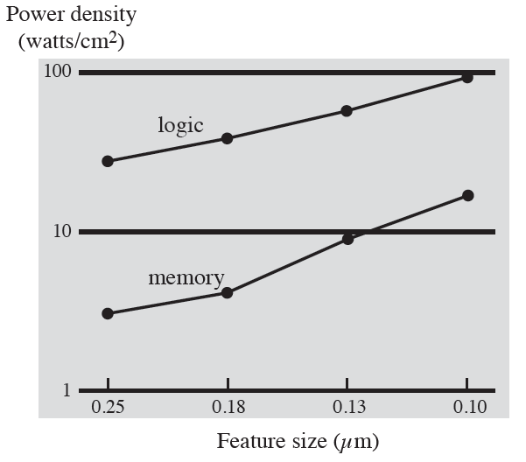
Heat Dissipation Problem
Heat is a function of several factors, two of which are processor density and clock speed: direct proportion
  In traditional architectures, heat generated by each new generation of processors has increased at a greater rate than clock speed
  Liquid heat dissipation is required in high end CPU
  Chip density and clock frequency cannot increase continuously

Slide 5
Heat Dissipation Problem
Pollack ‘rule
  Performance increase is roughly proportional to square root of increase in complexity
  Double the logic in a processor core, only 40% more performance
Dissipation requires low chip density and clock
Multicore is the only selection
  One high speed core changes to multiple low speed cores
  Maintaining performance and reducing density and frequency

Slide 6
Parallelism Requirement
Parallelism progressing before multicore
  Pipelining → superscalar → SMT
SMT: Simultaneous Multithreading
  Multiple threads share superscalar resources
With width and depth increase of superscalar, more logic is required to manage hazards and to stage instruction resources
  Diminishing returns
  Complexity limits the number of threads and resource utilization
  CPU ILP approaches its limit
Increasing ILP and no increasing the complexity, increasing the number of cores is the unique selection

Slide 7
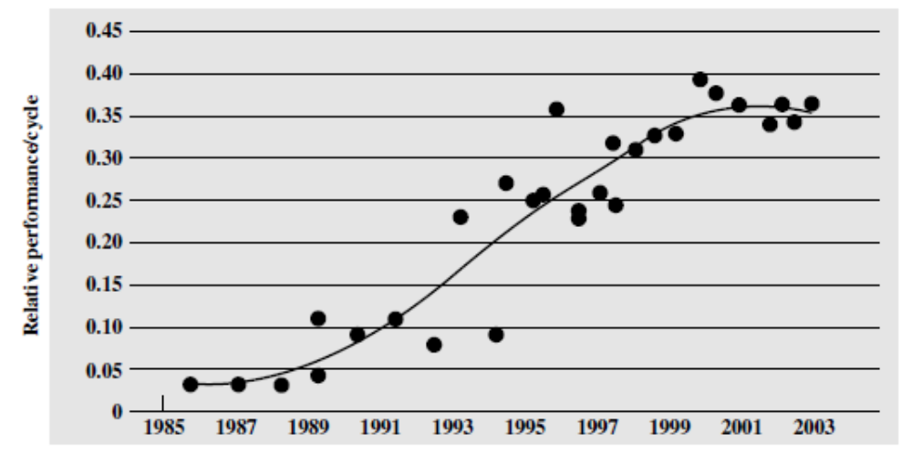
CPU performance VS. ILP
Before 80s, There is a flat region
Beginning about 2000, a new flat region appears
  Reaching the limits of effective exploitation of instruction-level parallelism

Slide 8
Application Software Requirement
Most of application softwares need multithread
  Network software
  Server software
  Multithreaded native applications
  Multiprocess applications
  Java and virtualization applications
  …
When an application needs too many threads, Hyper-threading and SMT can not meet the requirement
  Multicore or parallel processing computer is needed

Slide 9
Summary for Necessity of Multicore
Limitation factors
  Clock frequency of CPU
  Power consume
  Heat dissipation
  Superscalar complexity
Multithread application driving
  Multithreaded applications need high ILP
Moore’ law driving
  In single core CPU, Moore’ law approaches to failure
  Moore’ law drives CPU towards multicore
So, CPU developing route
  Superscalar → hyper thread → SMT → multicore → manycore

Slide 10
From SMT to Multicore
For some applications, ILP is not enough
  Large database, science computing and web applications need higher parallelism, but traditional ILP only provides 3-6 instructions/cycle
  TLP is needed for multi-threaded applications
TLP: thread-level parallelism
  A thread is an independent process or program segment with its own instructions and data
  Each thread has all the state (instructions, data, PC, register state, and so on) necessary to allow it to execute
  TLP is explicit parallel operations, multiple threads are executed in parallel
When a tread stalls, instructions of other threads can be scheduled to execute
  Reducing CPU idle

Slide 11
Normal Multithread Architecture
Multithreading allows multiple threads to share CPU in an overlapping fashion
  CPU maintains an independent thread state for each thread
    A separate register file, a separate PC, and a separate page table
    Shared memory
  Thread switching hardware is also needed
    Thread switching time:0.1~10 cycles
    Process switching time: 100s~ 1000s cycles
Multithread supporting
  Fine-grained Multithreading
    Switching between threads on each instruction, interleaving in a round-robin fashion
  Coarse-grained Multithreading
    Switching threads only on costly stalls
  Hybrid threading
    Selective use of fine-grained threading for some systems and single threading for other systems

Slide 12
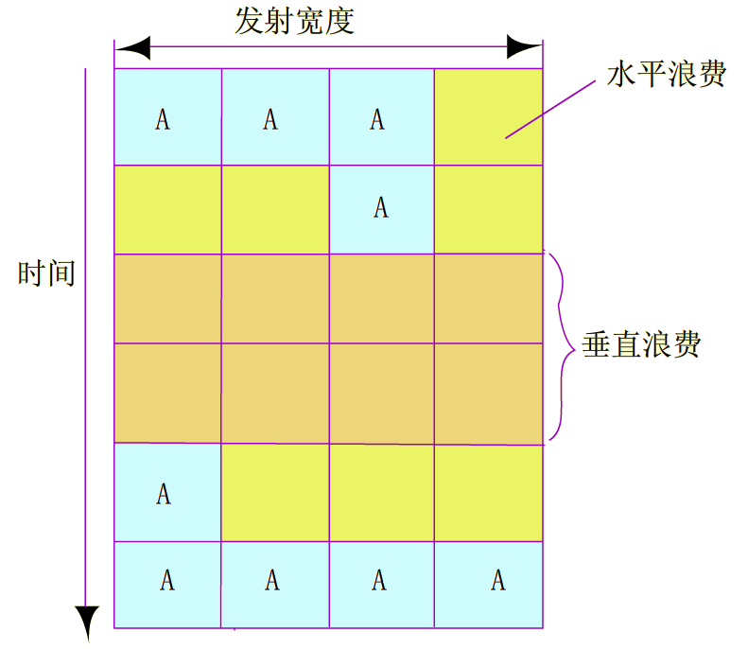
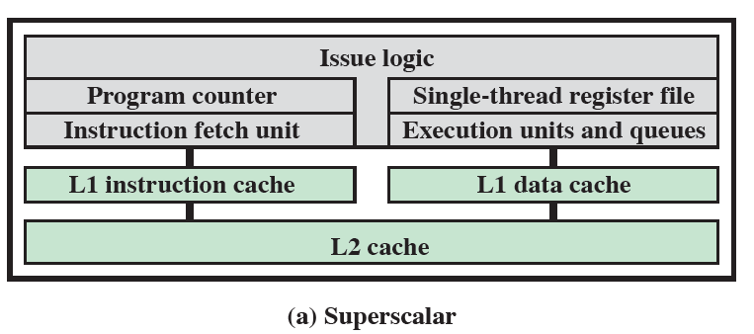
超标量处理机的水平浪费和垂直浪费

Slide 13
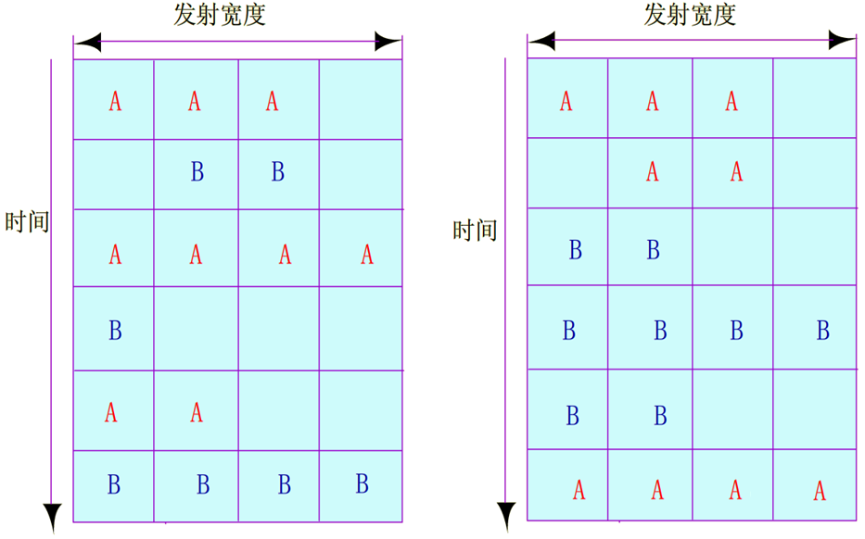
（a）细粒度多线程 （b）粗粒度多线程

Slide 14
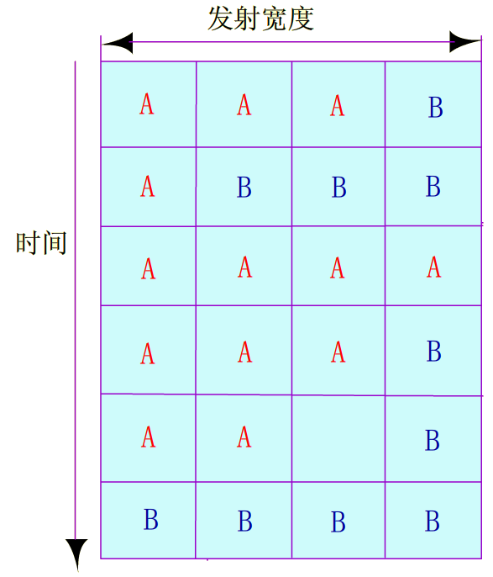
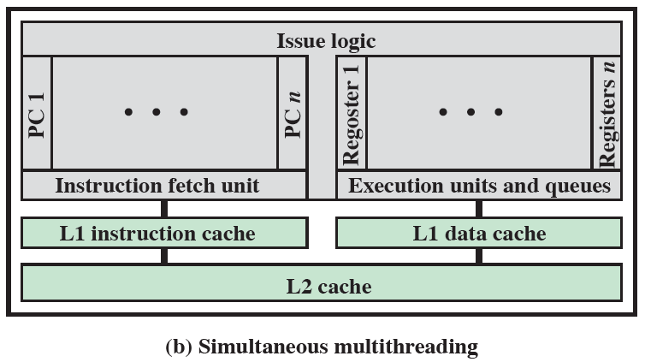
SMT处理机的指令执行

Slide 15
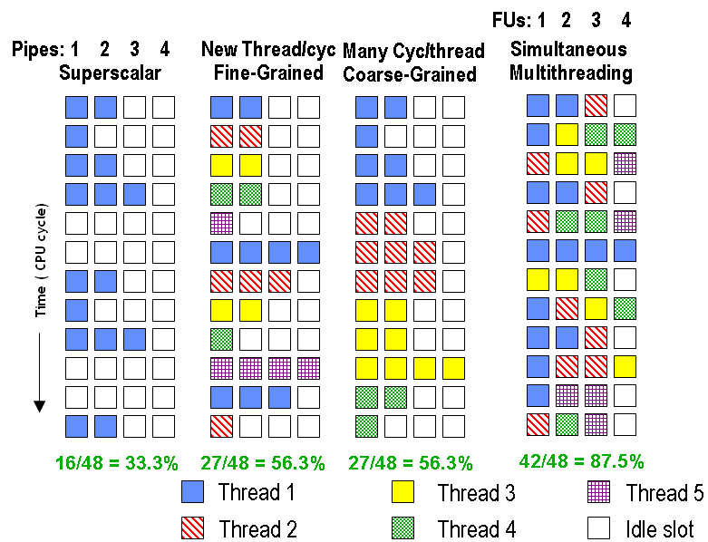
SMT Architecture
SMT: Simultaneous multithreading
  Multiple threads are executed in a cycle
  Exploiting TLP&ILP
Fine-grained Multithreading
  One thread are executed in a cycle
Coarse-grained Multithreading
  One thread are executed in several cycles

Slide 16
SMT CPU Design Problems
Most SMT select fine-grained multithreading
  Allocating priority to multiple threads
  Maintaining performance of high priority thread
SMT CPU is more complex than normal superscalar
  Increasing the associativity of the L1 I-cache and TLB
  Adding per-thread load and store queues
  Increasing the size of the L2 and L3 caches
  Adding separate instruction prefetch and buffering
  Increasing the number of virtual registers
  Increasing the size of several issue queues
  Core will become larger
SMT has low performance/cost
  Power5 has only 1.2 of speedup, no broadly used
  Multicore is the better method supporting TLP

Slide 17
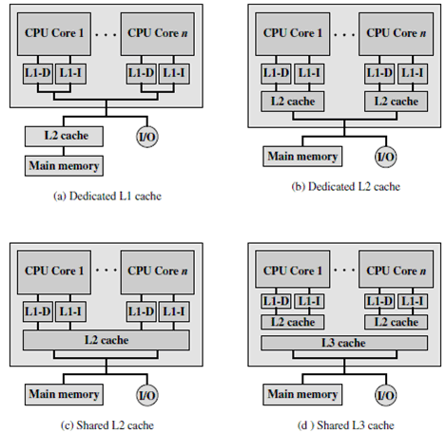
Multicore Architectures
Multicore: multiple computing cores are integrated in a CPU chip
Organization
  The number of cores
  The number of cache levels
  Capacity of shared cache
  Interconnection
Multiple organization modes
  See the fig.

Slide 18
Advantages of Using Shared L2 Cache
Constructive interference can reduce overall miss rates
  A thread on one core accessing a main memory location results in a block transferred to shared cache
  If a thread on another core soon accesses the same memory block, it will hit
Data shared by multiple cores is not replicated at the shared cache level
The amount of shared cache allocated to each core is dynamic
  Threads with a less locality can employ more cache
Inter core communication is easy via shared cache
Shared L2 cache confines the cache coherency problem to the L1 cache level

Slide 19
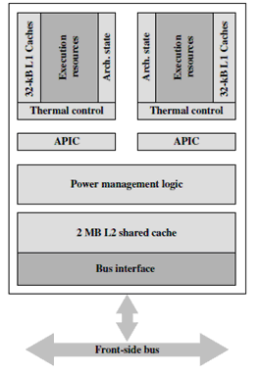
Intel x86 Multicore: Core Duo
From 2005, a new multicore CPU was released every two years
  65nm,45nm,32nm,22nm→8nm
Core Duo is low-end multicore CPU
  2 x86 superscalar cores
  Shared L2 cache and private L1 I-cache and D-cache
  Thermal control units: temperature in a core exceeds a threshold, reduces the clock rate
  APIC: Advanced Programmable Interrupt Controller
  Power management logic: reducing power consumption, increasing battery life
  Bus interface: connect to main memory, I/O controllers, and other processor chips

Slide 20
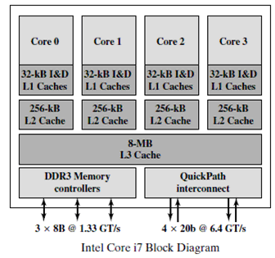
Intel Core i7
The Intel Core i7, introduced in November of 2008, implements four x86 SMT processors
  Each core has two dedicated L1caches and one dedicated L2 cache, and a shared L3 cache
  Prefetching for cache
  Two forms of external communications :DDR3 memory controller and QuickPath Interconnect
  DDR3 controller is used for access main memory,32GB/s
  QPI: for Intel cores and chipsets, dual-way bandwidth:25.6GB/s
  Used for server

Slide 21
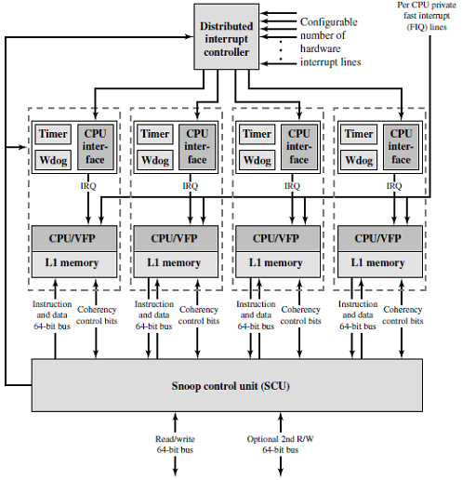
ARM11 MPCore
The ARM11 MPCore is a multicore product based on the ARM11 CPU family
  Configured with up to four processors(cores)
  L1 I and D caches
Organization
  See the fig.

Slide 22
Organization of ARM11 MPCore
DIC: Distributed interrupt controller
  Handles interrupt and communication
  Supporting unicast,multicast and broadcast
Timer
  Private timer that can generate interrupts
Watchdog
  Issues warning alerts in the event of software failures
CPU interface
  Handles interrupt response
CPU: core
VFP: Vector floating-point unit
  Coprocessor
SCU: Snoop control unit
  Responsible for maintaining coherency among L1 data caches

Slide 23
Cache Coherence in ARM11 MPCore
L1 cache coherency scheme is based on the MESI protocol
  MESI state migration is optimized
Three types of optimization
  Direct data intervention
  Duplicated tag RAMs
  Migratory lines
Direct data intervention
  Copying clean data from one cache to another rather than from access to the shared L2 cache

Slide 24
Continue
Duplicated tag RAMs
  Tags are also implemented as a separate block of RAM
  Check for data availability before sending coherency commands to the relevant cores
  Coherency commands are sent only to cores that must update their coherent data cache
  Reduce the power consumption and performance impact from snooping
Migratory lines
  Moving dirty data from one CPU to another without writing to L2 and reading the data back in from external memory
  If one processor has a modified line, and another processor reads then writes to it, the SCU will automatically move the cache line directly to an invalid state rather than expending energy moving it first into the shared state

Slide 25
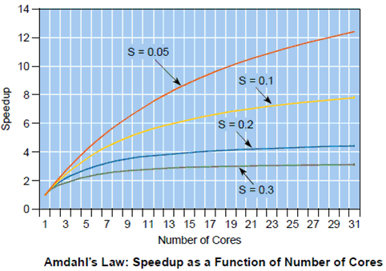
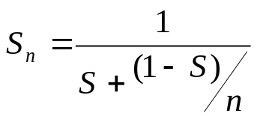
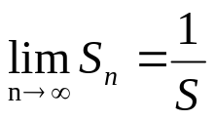
Theoretical Basis for Parallel Programming
Multicore requires executing multiple tasks in parallel to reduce the whole program execution time
  An application program must be divided into multiple tasks and each implemented as a thread
Amdahl’s Law
  A program typically consists of sequential part and parallel part
  Less sequential part, larger speedup

Slide 26
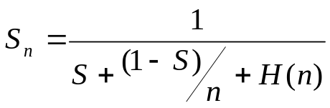
Amdahl’s Law with Thread Overhead
Define total overhead of threads as H(n) , then
  H(n): OS scheduling overhead+thread synchronization and communication overhead
H(n) must be kept to a minimum
  H(n) will offset some returns from parallelization
  If H(n) is large enough, S_{n}<1
  Unreasonable parallelization is worse than sequential execution
  This is very common in poorly architected multi-threaded applications
Conclusions from Amdahl’s Law
  For an application, increasing of speedup becomes smaller and smaller with increasing the number of cores
  Efficiently improving speedup can not depend on unlimitedly increasing the number of cores
  Reducing sequential part of application and increasing parallel part as possible as

Slide 27
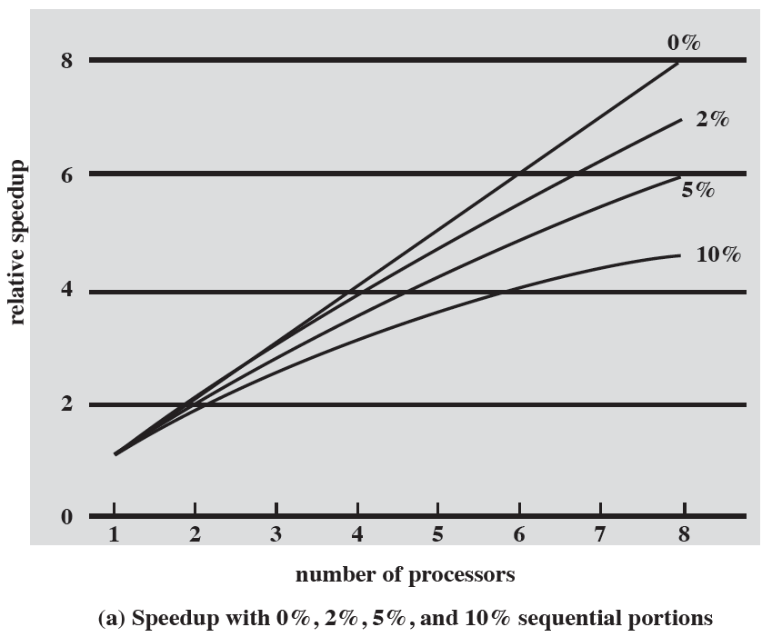
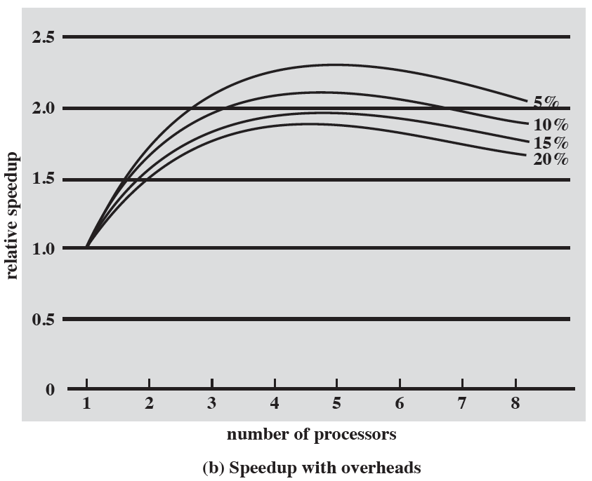
Performance effect of multiple cores

Slide 28
Effective Applications for Multicore Processors
Multi-threaded native applications
  Characterized by having a small number of highly threaded processes
  Lotus Domino, Siebel CRM (Customer Relationship Manager)
Multi-process applications
  Characterized by the presence of many single-threaded processes
  Oracle, SAP, PeopleSoft
Java applications
  Java Virtual Machine is a multi-threaded process that provides scheduling and memory management for Java applications
  Sun’s Java Application Server, BEA’s Weblogic, IBM Websphere, Tomcat
Multi-instance applications
  One application running multiple times
  If multiple application instances require some degree of isolation, virtualization technology can be used to provide each of them with its own separate and secure environment
Notes:
In addition to general-purpose server software, a number of classes of applications benefit directly from the ability to scale throughput with the number of cores. [MCDO06] lists the following examples:
Multithreaded native applications: Multithreaded applications are characterized by having a small number of highly threaded processes. Examples of threaded applications include Lotus Domino or Siebel CRM (Customer Relationship Manager).
Multiprocess applications: Multiprocess applications are characterized by the presence of many single-threaded processes. Examples of multi-process applications include the Oracle database, SAP, and PeopleSoft.
Java applications: Java applications embrace threading in a fundamental way. Not only does the Java language greatly facilitate multithreaded applications, but the Java Virtual Machine is a multithreaded process that provides scheduling and memory management for Java applications. Java applications that can benefit directly from multicore resources include application servers such as Sun’s Java Application Server, BEA’s Weblogic, IBM’s Websphere, and the open-source Tomcat application server. All applications that use a Java 2 Platform, Enterprise Edition (J2EE platform) application server can immediately benefit from multicore technology.
• Multi-instance applications: Even if an individual application does not scale to take advantage of a large number of threads, it is still possible to gain from multicore architecture by running multiple instances of the application in parallel. If multiple application instances require some degree of isolation, virtualization technology (for the hardware of the operating system) can be used to provide each of them with its own separate and secure environment.

Slide 29
Review Points
Multicore computer
  Why multicore？
  TLP and SMT architecture
  Multicore organization contents and main modes
  Software on multicore

Slide 30
Recommendation Readings
ARM08a ARM Limited. Cortex-A8 Technical Reference Manual. ARM DDI 0344E,2008. www.arm.com
FOG08b Fog,A. The Microarchitecture of Intel and AMD CPUs. Copenhagen University College of Engineering, 2008. http://www.agner.org/optimize/
HINT01 Hinton, G., et al. “The Microarchitecture of the Pentium 4 Processor.” Intel Technology Journal, Q1 2001. http://developer.intel.com/technology/itj/

