Slide 1


Computer Organization & Architecture
Chapter 8
Operating System Support

Slide 2
8.1 Operating system overview
Objectives and Functions
  The operating System (OS) is the software that controls the execution of program and manages the computer’s resources
  An interface between the user and computer hardware
  Functions: resource management, interface
    Memory, CPU, device, file, interface management
  Objectives:
    Convenience: Making the computer easier to use
    Efficiency: Allowing better use of computer resources

Slide 3
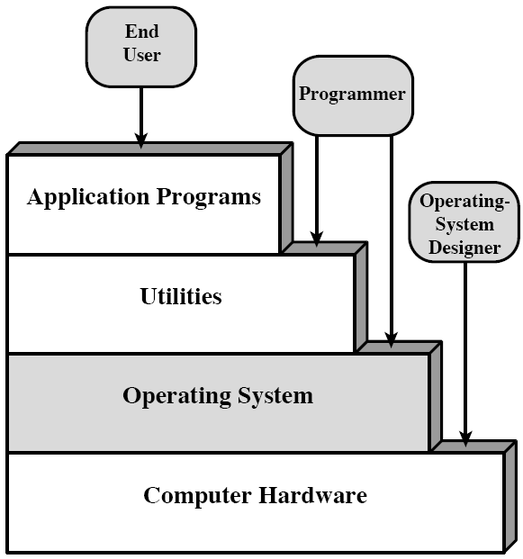
Layers and Views of a Computer System

Slide 4
Operating System Services
  Program creation
    Utilities are accessible through OS
  Program execution
    A number of tasks needed in the execution of a program are masked by OS
  Access to I/O devices
  Controlled access to files
  System access
    Protect resources, resolve conflicts
  Error detection and response
  Accounting

Slide 5
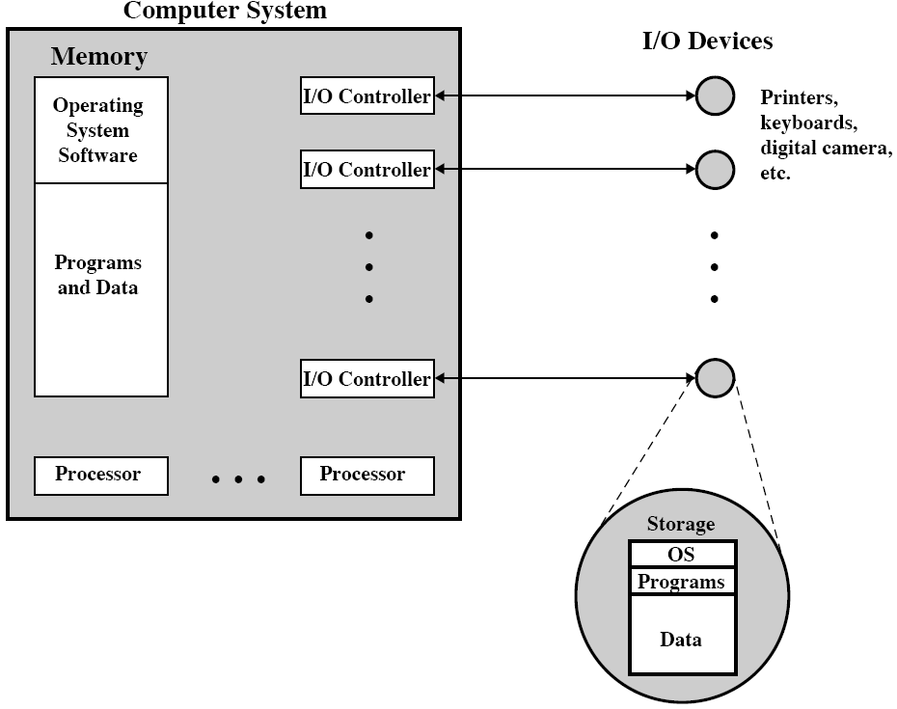
OS as a Resource Manager

Slide 6
Types of O/S
  Interactive
    User directly interacts with the O/S through a keyboard/terminal
  Batch
    User programs are collected together (“off line”) and submitted to the O/S in a batch by an operator
    Print-out results of the program execution is returned to the user
    This type of O/S is not typical of current machines

Slide 7
  Single program (Uni-programming)
    Work only one program at a time
  Multiprogramming / time sharing
    An O/S is said to be multiprogramming if it supports the simultaneous execution of more than 1 job
    Time sharing is the term for multiprogramming when applied to an interactive system

Slide 8
Multiprogramming / time sharing
  A queue of pending jobs is maintained
  Current job is swapped out when it is idled waiting for I/O and other devices
  Next pending job is started
  Either requires much more sophistication than a typical batch O/S
      Memory management
      Scheduling

Slide 9
Early Systems
  Late 1940s to mid 1950s
  No Operating System
  Programs interact directly with hardware
  Two main problems:
    Scheduling
    Setup time

Slide 10
Simple Batch Systems
  Resident Monitor program
  Users submit jobs to operator
  Operator batches jobs
  Monitor controls sequence of events to process batch
  When one job is finished, control returns to Monitor which reads next job
  Monitor handles scheduling

Slide 11
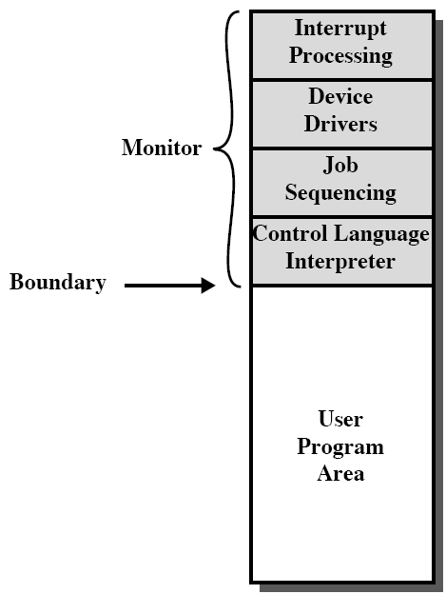
Memory Layout for Resident Monitor

Slide 12
Job Control Language
  Instructions to Monitor
  Usually denoted by $
  e.g.
    $JOB
    $FTN
    ... Some Fortran instructions
    $LOAD
    $RUN
    ... Some data
    $END

Slide 13
Desirable Hardware Features
  Memory protection
    To protect the Monitor
    An error will be presented if a user program tries to access protected memory
  Timer
    To prevent a job monopolizing the system
  Privileged instructions
    Only executed by Monitor, otherwise, an error will occur
    e.g. I/O, must be through monitor
  Interrupts
    Allows for relinquishing and regaining control

Slide 14
Multi-programmed Batch Systems
  Even with the automatic job sequence provided by a simple batch operating system, CPU is often idle.
    Waiting for I/O, because I/O devices very slow
  When one program is waiting for I/O, the other can use the CPU
    Enough memory for resident monitor and multiple user programs (see Fig.8.5)
    This process is referred to as multi-programming or multitasking
    Modern operating system

Slide 15
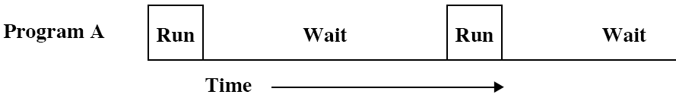
Single Program

Slide 16
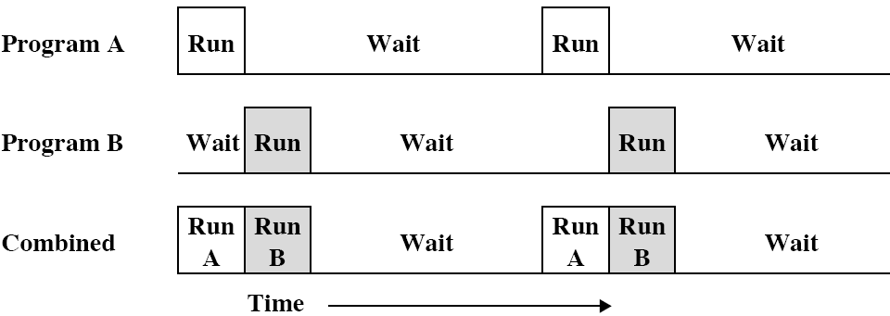
Multi-Programming with Two Programs

Slide 17
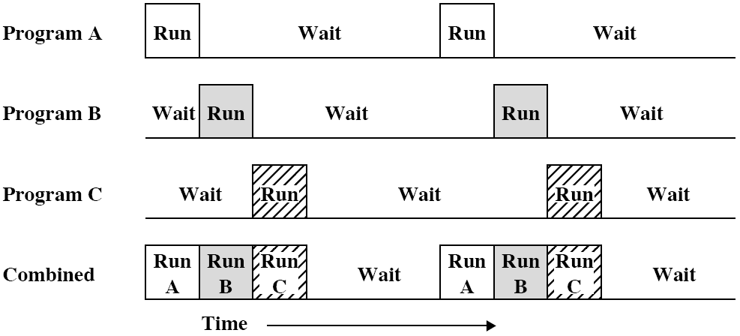
Multi-Programming with three Programs

Slide 18
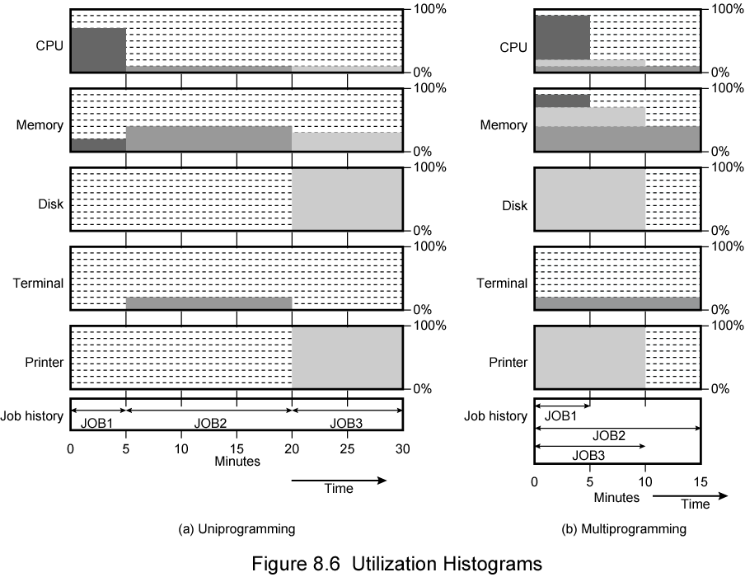
Utilization

Slide 19
Time Sharing Systems
  Allow users to interact directly with the computer in minimized respond time
    i.e. Interactive
  Multi-programming allows a number of users to interact with the computer
  Time sharing: multiple users use CPU in round robin mode, each time, a user consumes only a time slot
Both batch multiprogramming and time sharing use multiprogramming

Slide 20
8.2 Scheduling
Key to multi-programming
Four types of scheduling
  Long term
  Medium term
  Short term
  I/O
Process
  A program in execution
  The “animated spirit” of a program
  Entity to which a processor is assigned

Slide 21
Long Term Scheduling
  Determines which programs are admitted for processing
    i.e. controls the degree of multi-programming
  Once submitted, a job becomes a process for the short term scheduler
  or it becomes a swapped out job for the medium term scheduler

Slide 22
Medium Term Scheduling
  Part of the swapping function (later…)
  Usually based on the need to manage multi-programming
  If no virtual memory, memory management is also an issue

Slide 23
Short Term Scheduler
  runs frequently
  Dispatcher
  Fine grained decisions of which job to execute next
    i.e. which job actually gets to use the processor in the next time slot

Slide 24
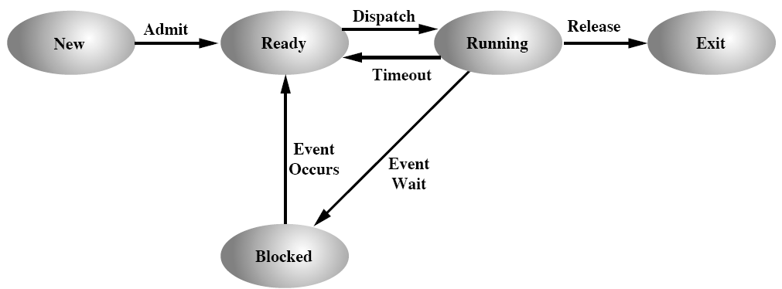
Process States
located in memory
short term scheduler
located in disk
Long term scheduler
located in memory or disk
medium term scheduler

Slide 25
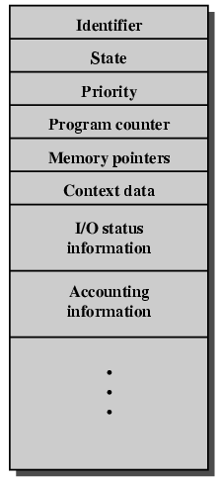
Process Control Block (PCB)
  Identifier
  State
  Priority
  Program counter
  Memory pointers
  Context data
  I/O status
    I/O Request
    I/O devices
    a list of file assigned to this process
  Accounting information
    CPU time used
    time limits
    account, etc.

Slide 26
Scheduling techniques
  An example for scheduling
    kernel of OS is resident
    Each process occupies a block of memory

Slide 27
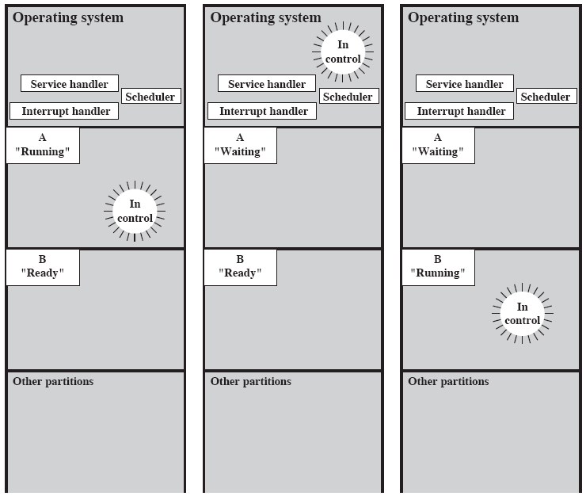

Slide 28
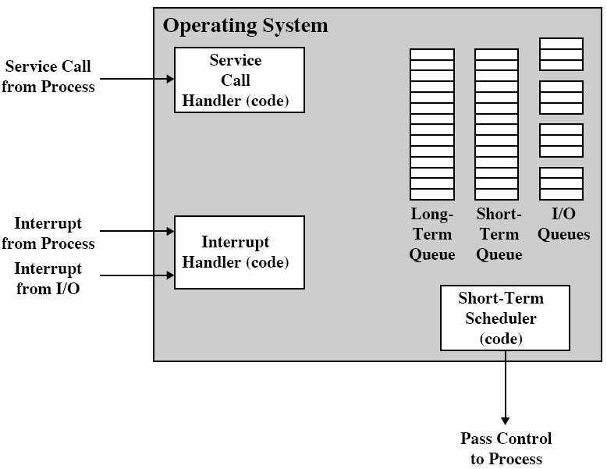
Key Elements of O/S involved in schedule

Slide 29
Long-term queue: a list of jobs waiting to use the system
Short term queue: a list of all processes in the ready state.
  Any one of these process could use the processor next
I/O queue: a list of all processes waiting to use each I/O device
All queues are managed by OS ?????

Slide 30
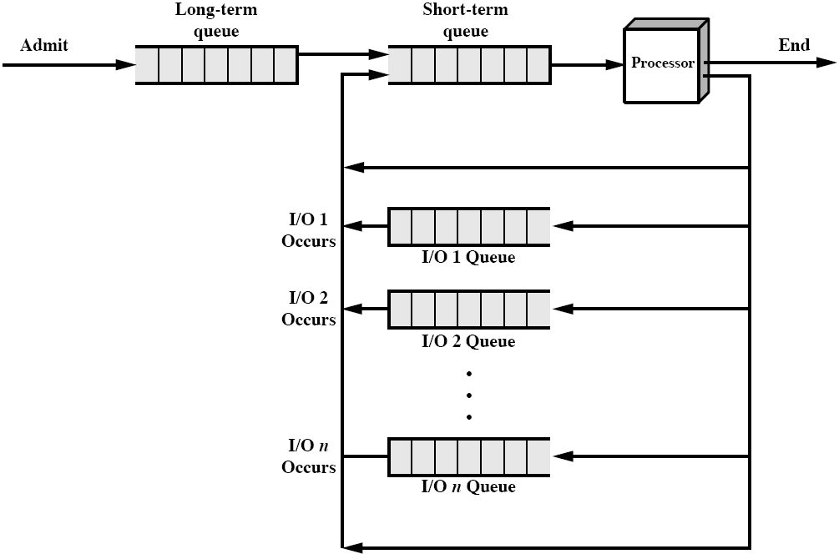
Process Scheduling

Slide 31
8.3 Memory management
Uni-program
  Memory split into two
  One for Operating System (monitor)
  One for currently executing program
Multi-program
  “User” part is sub-divided and shared among active processes
  The task of subdivision is carried out dynamically by OS – memory management

Slide 32
Swapping
  Problem: I/O is so slow compared with CPU that even in multi-programming system, CPU can be idle most of the time
  Solutions:
    Increase main memory
      Expensive
      Leads to larger programs
    Swapping

Slide 33
What is Swapping?
  Long term queue of processes stored on disk
  Processes “swapped” in as space becomes available
  As a process completes it is moved out of main memory
  If none of the processes in memory are ready (i.e. all I/O blocked)
    Swap out a blocked process to intermediate queue
    Swap in a process from intermediate queue or a new process from long-term queue
    But swapping is an I/O process … (the fastest I/O)
    Intermediate queue is a list of existing processes that have been temporarily kicked out of memory

Slide 34
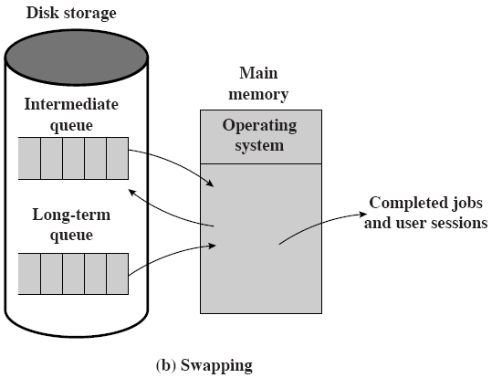
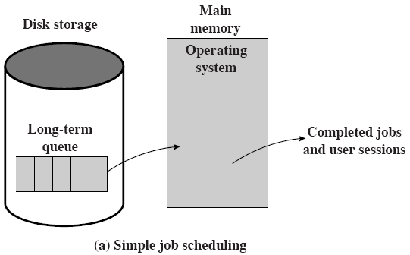
Use of swapping

Slide 35
Memory Partitioning
  Splitting memory into sections allocated to processes (including Operating System)
  Fixed-sized partitions
    May not be equal size
    Process is fitted into smallest hole that will take it (best fit)
    Some wasted memory
    Leads to variable sized partitions (dynamic partition)

Slide 36
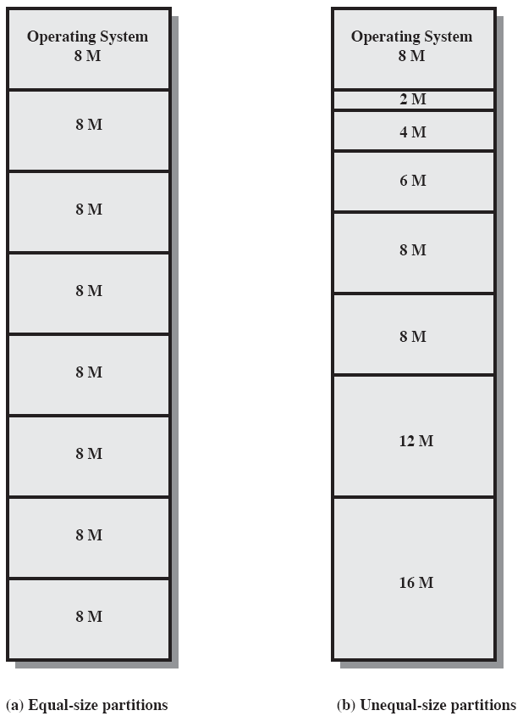

Slide 37
Dynamic Partitions
  Allocate exactly the required memory to a process
  This leads to a hole at the end of memory, too small to use
    Only one small hole - less waste
  When all processes are blocked, swap out a process and bring in another

Slide 38
  New process may be smaller than swapped out process
  Another hole
  Eventually have lots of holes (fragmentation)
  Solutions:
    Coalesce - Join adjacent holes into one large hole
    Compaction - From time to time go through memory and move all hole into one free block (c.f. disk de-fragmentation)

Slide 39
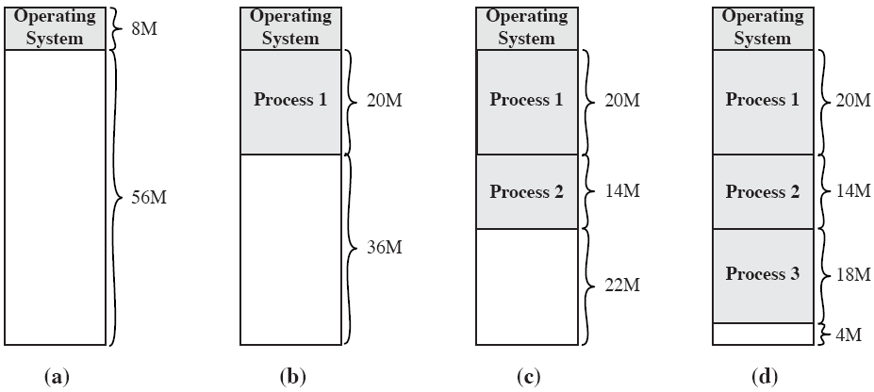
The effect of dynamic partitioning

Slide 40
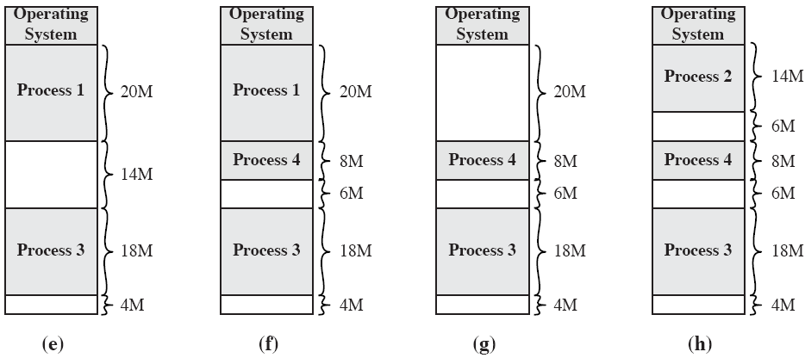

Slide 41
Address Variation
  No guarantee that process will be loaded into the same place in memory
  Instructions contain addresses
    Locations of data
    Addresses for instructions (branching)
  Logical address - relative to beginning of program
  Physical address - actual location in memory (this time)
  base address - starting location of the process
  Automatic conversion using base address
    Logical address + base address = Physical address

Slide 42
Paging
  Split memory into equal sized, small chunks -page frames
  Split programs (processes) into equal sized small chunks - pages
  Allocate the required number page frames to a process
  Operating System maintains list of free frames
  A process does not require contiguous page frames
  Use page table to keep track

Slide 43
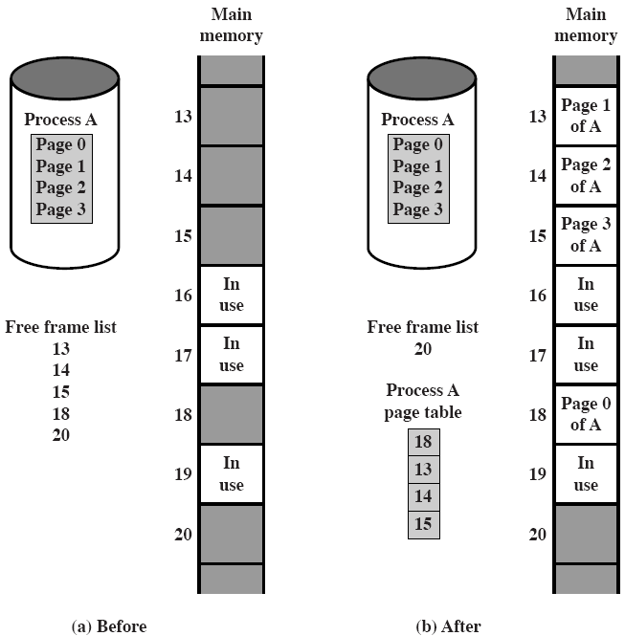
Allocation of Free Frames

Slide 44
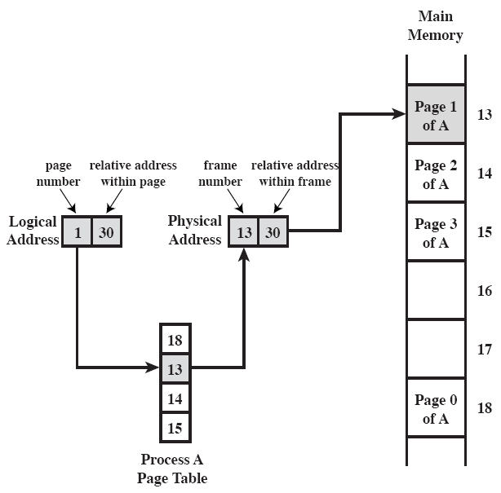
Logical and Physical Addresses - Paging

Slide 45
Virtual Memory
  Demand paging
    Do not require all pages of a process in memory
    Bring in pages as required
    At any time, only a few pages of any given process are in memory, many processes can be in memory
    A process may be larger than all of memory
  Page fault
    Required page is not in memory
    Operating System must swap in required page
    May need to swap out a page to make space
    Select page to throw out based on recent history

Slide 46
Thrashing
  Too many processes in too little memory
  Operating System spends all its time swapping
  Little or no real work is done
  Disk light is on all the time
  Solutions
    Good page replacement algorithms
    Reduce number of processes running
    Fit more memory

Slide 47
Bonus
  We do not need all of a process in memory for it to run
  We can swap in pages as required
  So - we can now run processes that are bigger than total memory available!
  Main memory is called real memory
  User/programmer feels much bigger memory - virtual memory

Slide 48
Page Table Structure
  Page table is variable length, depending on the size of the process, it cannot be in registers
  In most systems, one-level page table/process is used
  With very large page table, the table may be paged and stored in virtual memory, some processors make use of a two-level scheme to organize large page table
  When a process is running, at least a part of its pages must be in real memory
  Inverted page table structure is just a two-level page table

Slide 49
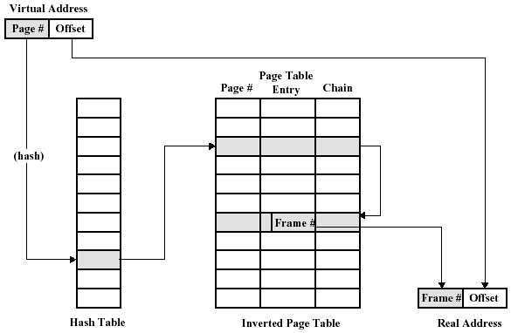
Inverted page table structure

Slide 50
Translation Lookaside Buffer
  Every virtual memory reference causes two physical memory access
    Fetch page table entry
    Fetch data
  Use special cache for page table
    TLB

Slide 51
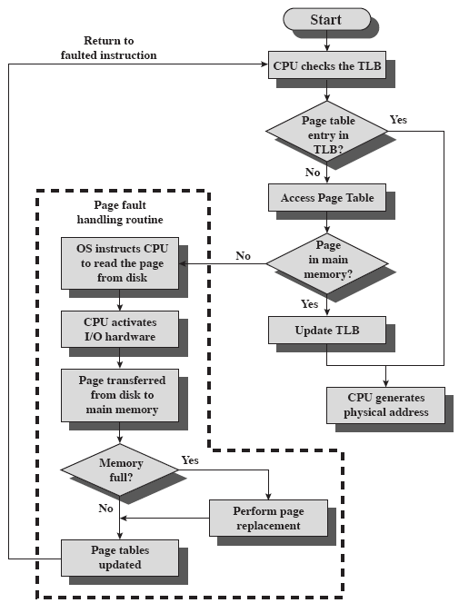
Operation of Paging and TLB

Slide 52
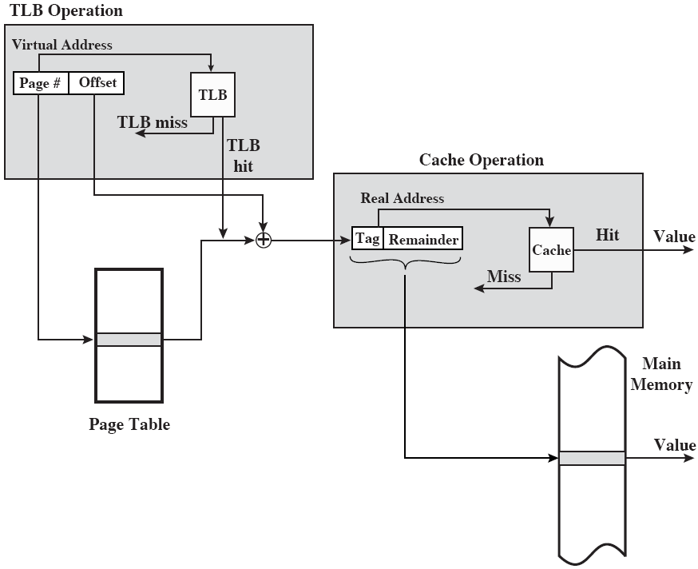
TLB and Cache Operation

Slide 53
Segmentation
  Segmentation is a set of correlative program and data
  Typically, a segmentation may be a subroutine, a table, a tree and so on, called by another or shared by many users
  Memory can be viewed as consisting of many segments, segment length is variable
    Program segments & data segments
    Access and usage rights attached to segments
  Paging is not (usually) visible to the programmer
  Segmentation is visible to the programmer
  Usually different segments allocated to program and data

Slide 54
Advantages of Segmentation
  Simplifies handling of growing data structures
  Allows programs to be altered and recompiled independently, without re-linking and re-loading
  Lends itself to sharing among processes
  Lends itself to protection

Slide 55
Segmented-memory System
  Memory management based on segmentation partition called Segmented-memory System
  A segment table is needed to specify the location of a segment in main
  A segment may be divided into pages
  Segment-page memory management

Slide 56
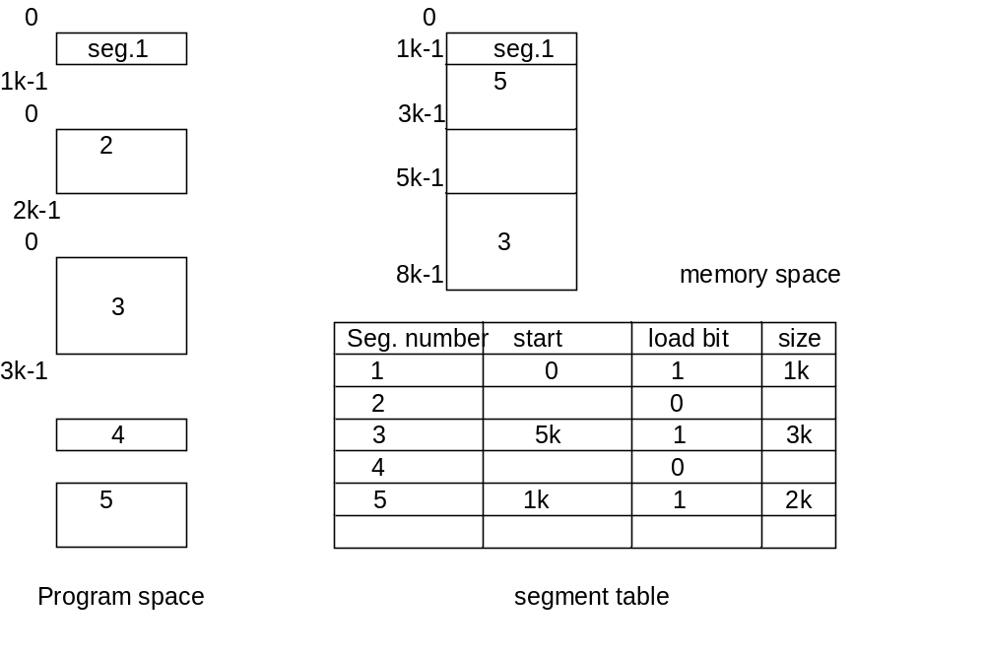
Segmented-memory Management Based on Segment Table
0
2k-1

Slide 57
8.4 Pentium II
Address Space
  Both segmentation and paging mechanisms are optional
4 combination modes:
  Unsegmented unpaged memory
  Unsegmented paged memory
  Segmented unpaged memory
  Segmented paged memory

Slide 58
PII Memory Management
– Segmentation
  Virtual address (logical address) 48bits:
  With unsegmented memory, virtual memory:
    2³²=4GB
  With segmented memory, virtual memory:
    2⁴⁶=64TB
  Physical address: 32bits, max: 4GB

Slide 59
PII Memory Management
-- paging
  Paging mechanism is a two-level table
    The first is a page directory up to 1k entries
      1024 page groups
    The second is a page table
      Up to 1k entries
      Each corresponds to a 4-KB page
  When 4-MB pages are used, there is only one level of table

Slide 60
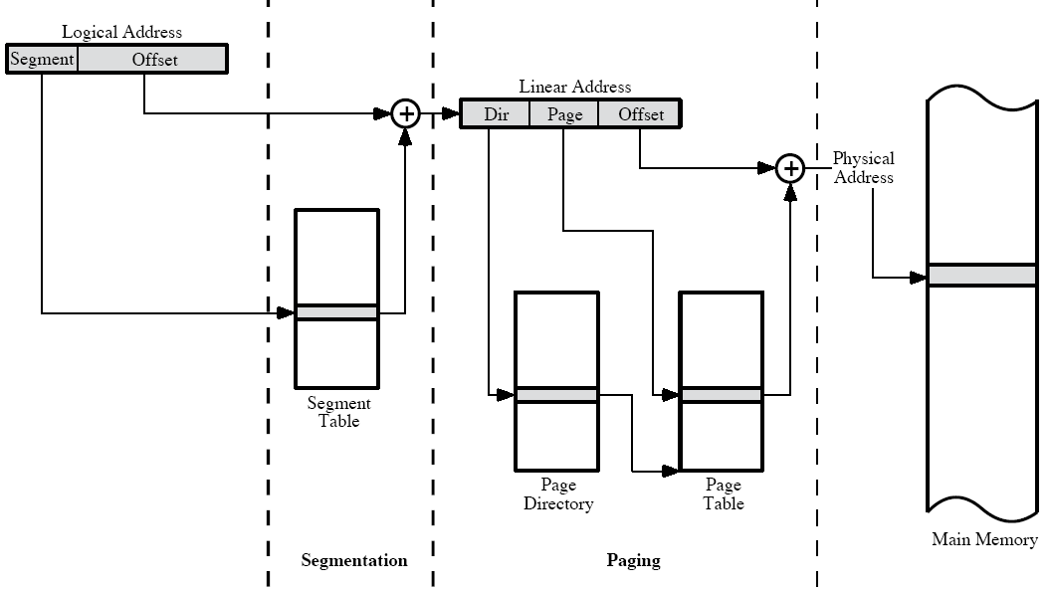
PII Memory Address Translation

Slide 61
Vocabulary
Batch system: 批处理系统
Job control language (JCL): 作业控制语言
kernel: 内核
Memory protection: 存储器保护
Multitasking: 多任务
nucleus: 核，核心
Privileged instruction: 特权指令
Resident monitor: 常驻的监控程序

Slide 62
Vocabulary
segmentation: 分段
swapping: 交换
thrashing: 抖动
Time-sharing system: 分时系统
Translation lookaside buffer (TLB): 转换后援缓冲器
Utility: 实用程序

Slide 63
Key Points
What are the functions of OS?
Which services do the OS provide?
Process scheduling
  State transition
  PCB
Virtual memory principle
  Swap, page, segment
  Pentium II virtual memory

Slide 64
Homework
pp273
  8.4
  The following sequence of virtual page number is encountered in the course of execution on a computer with virtual memory:
  3 4 2 6 4 7 1 3 2 6 3 5 1 2 3
  Assume that a least recently used page replacement policy is adopted. Plot a graph of page hit ratio (fraction of page references in which the page is in main memory) as a function of main-memory page capacity n for 1<= n<=8. Assume that main memory is initially empty.

