Slide 1


Computer Organization & Architecture
Chapter 6
External Memory

Slide 2
Types of External Memory
  Magnetic Disk
    Hard disk &floppy disk
    RAID (redundant array of independent Disks)
    Removable hard disk
  Optical
    CD-ROM
    CD-Writable (WORM)
    CD-R/W
    DVD: digital video disk
  Magnetic Tape

Slide 3
6.1 Magnetic Disk
Metal or plastic disk coated with magnetizable material (iron oxide…rust)
  Record data according to polarity
  Head: conducting coil
  While Reading/writing, head is fixed, disk rotates
Substrate used to be aluminium
Now glass
  Improved surface uniformity
    Increases reliability
  Reduction in surface defects
    Reduced read/write errors
  Lower flight heights (See later)
  Better stiffness
  Better shock/damage resistance

Slide 4
Read and Write Mechanisms
  Recording & retrieval via conductive coil called a head
    May be single read/write head or separate ones
  During read/write, head is stationary, platter rotates
  Write: electricity flowing through a coil produces magnetic field
    Current through coil produces magnetic field
    Positive and negative current gives different pulse signal to produce different magnetic area on the disk, representing 0 or 1 respectively.
    Magnetic pattern recorded on surface below

Slide 5
  Read (traditional)
    Magnetic field moving relative to coil produces current
    Different polarity produces the current with different direction
    Coil is the same for read and write
  Read (contemporary)
    Separate read head, close to write head
    Partially shielded magneto resistive (MR) sensor
    Electrical resistance depends on direction of magnetic field
    High frequency operation
      Higher storage density and speed

Slide 6
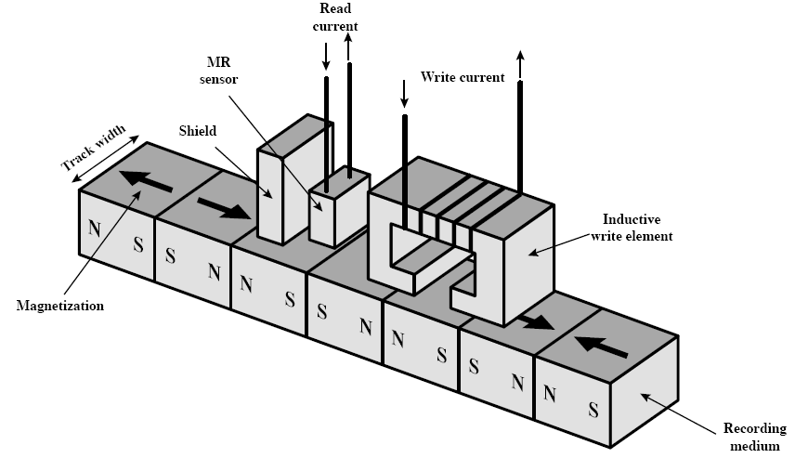
Inductive Write MR Read

Slide 7
Types of Disk
  Range of packaging
    Floppy
    hard disk
    Removable hard disk

Slide 8
Data Organization and Formatting
  Concentric rings or tracks
    A ring is a track, each track is the same width as the head
    Gaps between tracks, prevent data interference
    Reduce gap to increase capacity
    Same number of bits per track (variable packing density)
      Simplify circuit
      Data density increases gradually from outer to inner
      Constant angular velocity
  Tracks divided into sectors
    10~100 sectors/track
    Intra-track/inter-record gap
  Minimum block size is one sector
  May have more than one sector per block

Slide 9
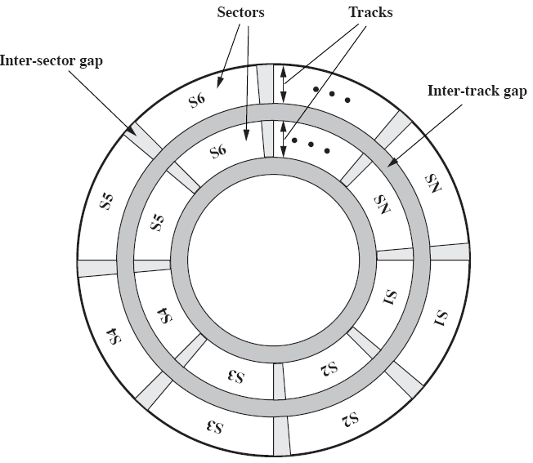
Disk Data Layout

Slide 10
Disk Velocity
  Bit near centre of rotating disk passes fixed point slower than bit on outside of disk
  Increase spacing between bits in different tracks
  Rotate disk at constant angular velocity (CAV)
    Gives pie shaped sectors and concentric tracks
    Individual tracks and sectors addressable
    Move head to given track and wait for given sector
    Waste of space on outer tracks
      Lower data density
  Can use zones to increase capacity
    Each zone has fixed bits per track
    More complex circuitry

Slide 11
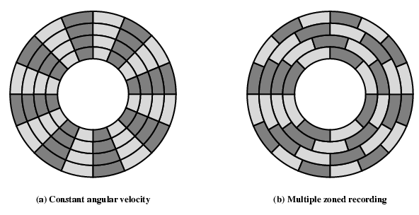
Disk Layout Methods Diagram
CAV

Slide 12
Control data in Sector
  How to locate the sector ?
    Control data recorded on the disk
  Extra data (Control data) is put into sector by formatting the disk
  Format disk
    Additional information not available to user
    Marks tracks and sectors

Slide 13
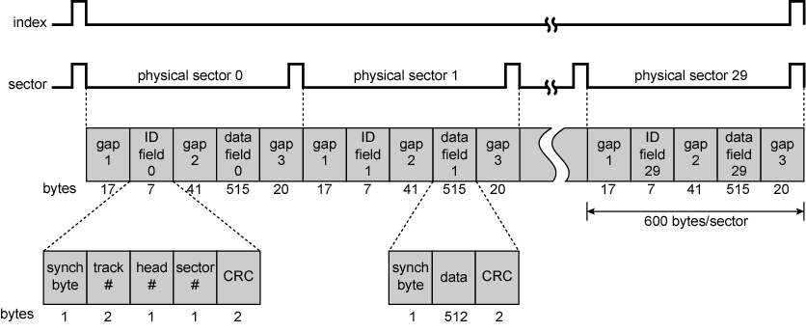
Winchester Disk Format Seagate ST506

Slide 14
Physical characteristics
-- Fixed/Movable Head Disk
  Fixed head
    One read write head per track
    Heads mounted on fixed rigid arm
  Movable head
    One read-write head per side
    Mounted on a movable arm
    The arm can be extended or retracted

Slide 15
Physical characteristics
-- Removable or Not
  Removable disk
    Can be removed from drive and replaced with another disk
    Provides unlimited storage capacity
    Easy data transfer between systems
  Nonremovable disk
    Permanently mounted in the drive

Slide 16
Physical characteristics
-- double, single-sided & multiple platter
  Double sided disk
  Single sided disk, e.g. floppy disk
  multiple platter：1inch between two platter, each surface has a read-write head, also called disk pack, e.g. hard disk
    One head per side
    Heads are joined and aligned
    Aligned tracks on each platter form cylinders
    Data is striped by cylinder -- which reduces head movement and Increases speed (transfer rate)

Slide 17
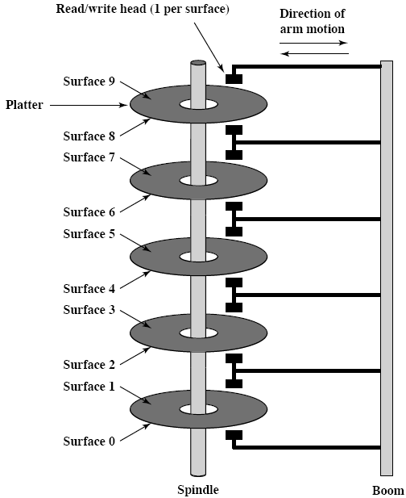
Multiple Platters

Slide 18
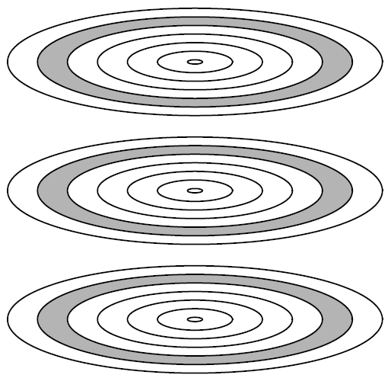
Tracks and Cylinders

Slide 19
Physical characteristics
-- head mechanism
  Contact: the head is just on the disk surface, e.g. floppy disk
  fixed gap: an air gap between the head and the surface, e.g. hard disk
  aerodynamic gap: the narrower the head is, the narrower the track is, the greater the data density is, the closer it must be to the platter surface, and the greater error prone
    For Winchester disk, when disk is motionless, the head rests on the platter surface lightly. While disk spinning, the air pressure generating by spinning is enough to make the head rise above the surface.

Slide 20
Floppy Disk
  8”, 5.25”, 3.5”
  Small capacity
    Up to 1.44Mbyte (2.88M never popular)
  Slow
  Universal
  Cheap
  Obsolete?

Slide 21
Winchester Hard Disk
  Developed by IBM in Winchester (USA)
  Sealed unit
  One or more platters (disks)
  Heads fly on boundary layer of air as disk spins
  Very small head to disk gap
  Getting more robust
  Universal
  Cheap
  Fastest external storage
  Getting larger all the time
    500 Gigabyte now easily available

Slide 22
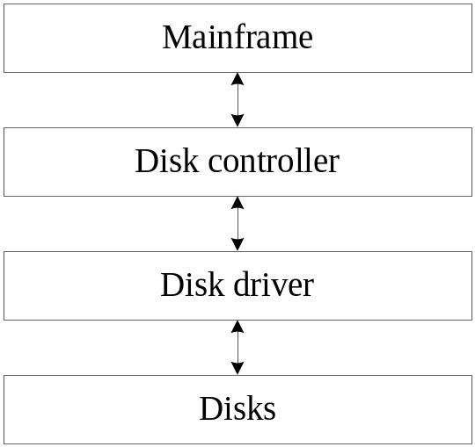
Organization of Disk System
For hard disk, floppy disk, optic disk, a disk system is composed of:
  Disk driver
  Disk controller: I/O interface including Cache memory (2-16MB). Typical disk interfaces:
    IDE (integrated driver electronics): for PC
    SCSI (Small Computer System Interface): for server
  Disks

Slide 23
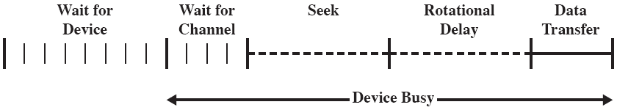
Disk Performance Parameters
  Disk I/O operation depends on
    Computer system
    O.S
    I/O mechanism
    Disk controller hardware
  Timing of a disk I/O:

Slide 24
Parameter(1): multi-cpu system
  Time of waiting for device
    In multi-process system, when a process requests I/O, the I/O task will be queued to wait for device idle.
  Time of waiting for channel
    If I/O channel is busy, wait until it idle
  The two parts of time are uncertain

Slide 25
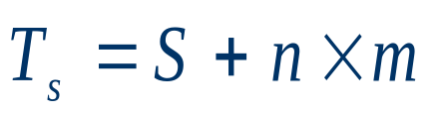
Parameter(2): seek time
  Seek time
    Locate disk header to track of accessing data
  It is uncertain, including
    Time of starting header arm
    Time of accelerating and traversing tracks
      Traversal time is not linear function of the number of tracks
  Estimation formula:
    T_{s}: seek time; S: starting time; n: traversal tracks;
    m: constant related to disk driver

Slide 26
Parameter(3): Rotational delay
  Hard disks typically rotational speed:
    PC: 7200 rpm (round per minute)
      One revolution per 8.4 ms
      Average rotational delay is 4.2ms
    Server: 15000rpm
    Laptop: 5400rpm
  Floppy disk typically rotate at 300~600rpm
    Average delay is 100~200ms

Slide 27
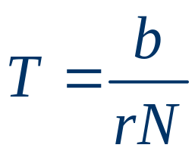
Parameter(4): Transfer time
  Transfer time depends on two factors:
    Number of bytes to be transferred
    Rotation speed of the disk
  Formula:
    T: transfer time;
    b: Number of bytes to be transferred
    N: Number of bytes on a track
    r: Rotation speed, in revolution per second

Slide 28
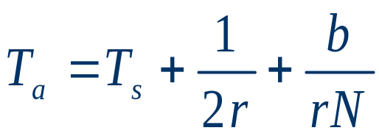
Parameter(5): access time
  Access time: summation of seek time, rotate delay and transfer time
  Average access time T_{a}:
    T_{s}: average seek time

Slide 29
An Example
A disk with rotation speed of 15000 rpm, average seek time of 4ms, 512B/sector, 500sectors/track, suppose that we wish to read a file consisting of 2500 sectors for a total of 1.28MB, estimate the total time for access.
Case 1: sequence organization
Case 2: data random distribution

Slide 30
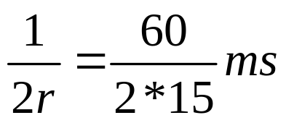
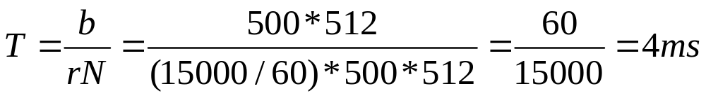
Solution to case 1
Case 1:sequential organization:
  Time to read 1st track:
    Average seek: 4 ms
    Average rotational delay:
    2 ms
    Time to read a track:
    4 ms
    total: 10 ms

Slide 31
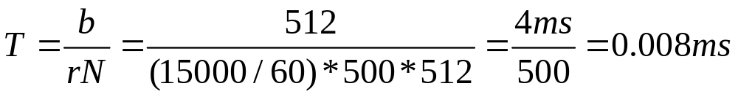
Solution to case 2
Case 2: data random distribution:
  Time to read 1st track:
    Average seek: 4 ms
    Average rotational delay:
    2 ms
    Time to read a sector :
    0.008 ms
    total: 2500 x 6.008 = 15s

Slide 32
6.2 RAID: Redundant Array of Independent Disks
Operation independently and in parallel
As long as the data required resides on separate disks, a single or multiple I/O requests can be executed in parallel
For multiple-disk database, RAID industry standard has been passed
6 or 7 levels in common use, not a hierarchy, just for different applications
  Set of physical disks viewed as single logical drive by O/S
  Data distributed across physical drives
  Can use redundant capacity to store parity information

Slide 33
Solution to case 1
Case 1:sequential organization:
  For left tracks, seek is no long needed, time for reading a track:
    2+4=6 ms
  Total time:
    10+4(2+4)=34 ms

Slide 34
RAID 0
  No redundancy
  Data striped across all disks
  Round Robin striping
  Increase speed
    Multiple data requests probably not on same disk
    Disks seek in parallel
    A set of data is likely to be striped across multiple disks
  Applications
    High data transfer capacity
    High I/O request

Slide 35
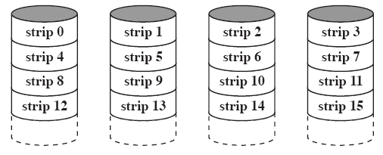
RAID 0 (non-redundant)

Slide 36
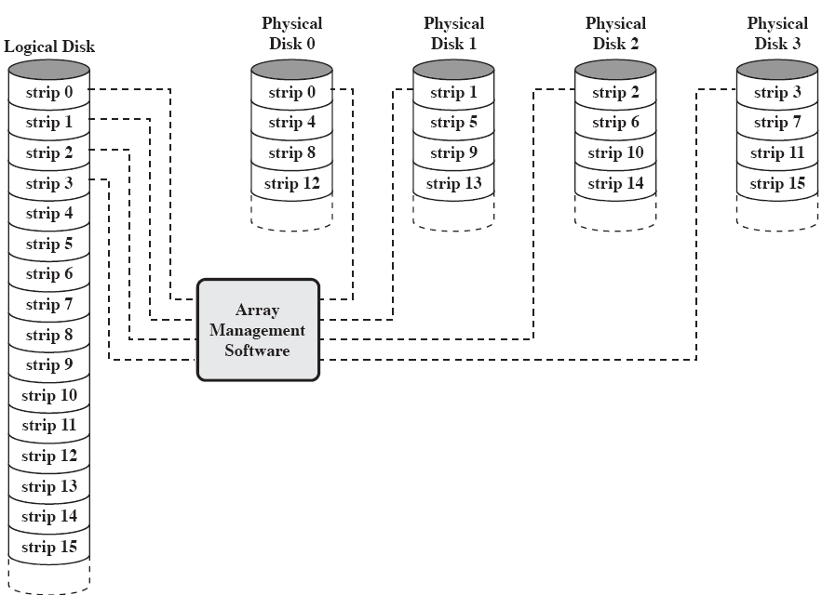
Data Mapping for a RAID level 0 Array

Slide 37
RAID 1
  Data is striped across disks
  2 copies of each stripe on separate disks
  Mirrored Disks
  Read from either, write to both in parallel
  advantages
    Recovery is simple, error-tolerance is very good
    In a transaction-oriented environment, if read request rate is very high, the performance of RAID1 can approach double of that of RAID 0
  Expensive (2 copies of hardware disk )
  Applications
    Storing system software, data highly critical files

Slide 38
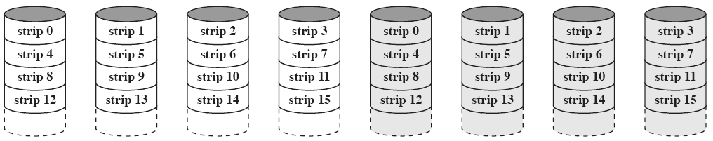
RAID 1 (mirrored)

Slide 39
RAID 2 (not implemented)
  Disks are synchronized
    At any time, head must be in the same location of all disks
  Very small stripes
    Often single byte/word
  Error correction calculated across corresponding bits on disks(4 strips need 3 correction strips)
  Multiple parity disks store Hamming code error correction in corresponding positions
  access in parallel, data together with parity
  Lots of redundancy

Slide 40
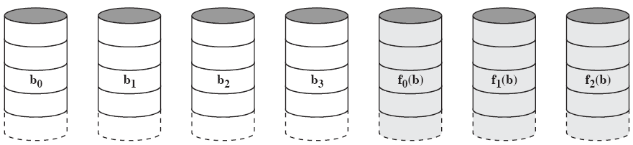
RAID 2 (redundancy through Hamming code)

Slide 41
RAID 3
  Similar to RAID 2
  Only one redundant disk, no matter how large the array
  Data on failed drive can be reconstructed from surviving data and parity info
    E.g. 5 disks array, X₀~X₃ for data, X₄ for parity
    X₄ (i) = X₃ (i) ⊕ X₂ (i) ⊕ X₁ (i) ⊕ X₀ (i)
    If X₀ is damaged, two sides of above equation Xor
      X₄ (i) ⊕ X₀ (i)
    X₀ (i) = X₄ (i) ⊕ X₃ (i) ⊕ X₂ (i) ⊕ X₁ (i)
  Very high transfer rates
  Only one I/O request can be executed at a time

Slide 42
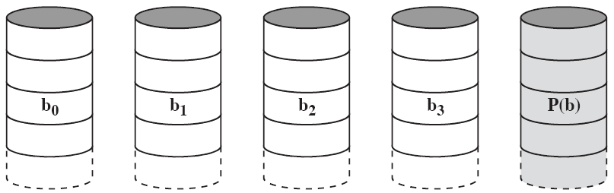
RAID 3 (bit-interleaved parity)

Slide 43
RAID 4
  Similar to RAID 2, but larger stripes
  Each disk operates independently (independent access technique)
  Good for high I/O request rate
  Bit by bit parity calculated across stripes on each disk
  Parity stored on parity disk
  Write penalty

Slide 44
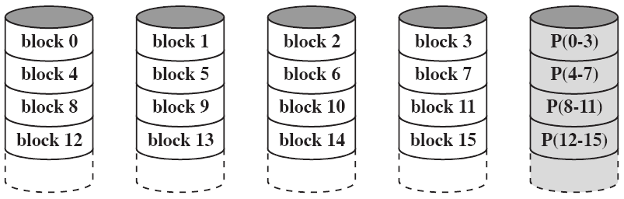
RAID 4 (block-level parity)

Slide 45
Example for write penalty
Consider an array of 5 drives in which X₀~X₃ contain data and X₄ contains the parity. Suppose that a write occurs on a strip on disk X₁.
Initially, for each bit, we have the following relationship:
  X₄(i)=X₃(i) ⊕X₂(i) ⊕X₁(i) ⊕X₀(i)
after the update,
  X₄’(i)=X₃(i) ⊕X₂(i) ⊕X₁’(i) ⊕X₀(i) (read 3,write 2)
  = X₃(i) ⊕X₂(i) ⊕X₁’(i) ⊕X₀(i) ⊕ X₁(i) ⊕X₁(i)
  = X₄(i) ⊕X₁(i) ⊕X₁’(i) (read 2,write 2)
Conclusion:
  When an I/O write request of small size is performed, a write penalty occurs in RAID4
  Parity disk may become a bottleneck

Slide 46
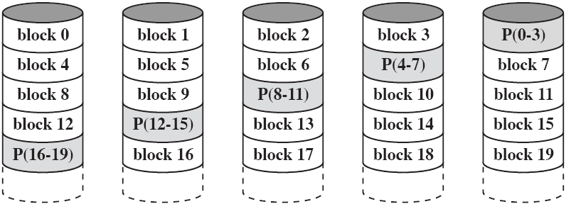
RAID 5
  Like RAID 4
  Parity striped across all disks
  Round robin allocation for parity stripe
  Avoids RAID 4 bottleneck at parity disk
  Commonly used in network servers

Slide 47
RAID 6
  A high reliable RAID proposed by Berkeley researchers
  Two different parity calculations, stored in separate strips on different disks
  P and Q are two different data check algorithms, one is exclusive-or and the other is an independent data check algorithm
  Advantage:
    extremely high data availability, even if two strips fail the data can be regenerated
  Disadvantage: write penalty

Slide 48
RAID 6
  A high reliable RAID proposed by Berkeley researchers
  Two different parity calculations, stored in separate strips on different disks
  P and Q are two different data check algorithms, one is exclusive-or and the other is an independent data check algorithm
  Advantage:
    extremely high data availability, even if two strips fail the data can be regenerated
  Disadvantage: write penalty

Slide 49
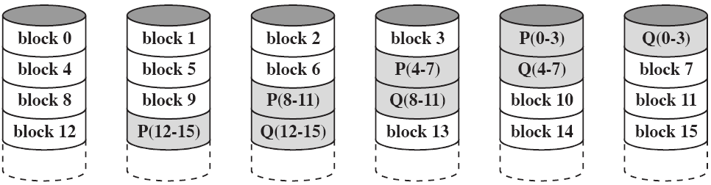
RAID 6 (dual redundancy)

Slide 50
6.3 Solid State Drives
A solid state drive (SSD) is a memory device made with solid state components that can be used as a replacement to a hard disk drive (HDD)
  The term solid state refers to electronic circuitry built with semiconductors
The SSDs now use a type of semiconductor memory --flash memory
SSDs have the following advantages over HDDs:
  High-performance input/output operations per second (IOPS)
  Durability
  Longer lifespan
  Lower power consumption
  Quieter and cooler running capabilities
  Lower access times and latency rates

Slide 51
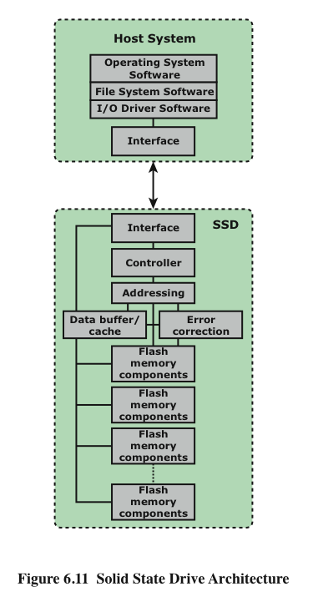
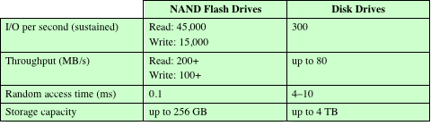

Slide 52
6.3 Solid State Drives
Two practical issues peculiar to SSDs
  SDD performance has a tendency to slow down as the device is used
    The entire block must be read from the flash memory and placed in a RAM buffer
    Before the block can be written back to flash memory, the entire block of flash memory must be erased
    The entire block from the buffer is now written back to the flash memory
    The writing becomes slower, the more fully occupied the disk is
  Solutions：Overprovisioning & TRIM command

Slide 53
6.3 Solid State Drives
Two practical issues peculiar to SSDs
  Flash memory becomes unusable after a certain number of writes
    Techniques for prolonging life:
      Front-ending the flash with a cache to delay and group write operations
      Using wear-leveling algorithms that evenly distribute writes across block of cells
      Bad-block management techniques
    Most flash devices estimate their own remaining lifetimes so systems can anticipate failure and take preemptive action

Slide 54
6.3 Optical Memory
CD-ROM
  Compact disk - CD, originally for audio
    650Mbytes giving over 70 minutes audio
    Polycarbonate coated with highly reflective coat, usually aluminum
  Data stored as microscopic pits
    Read by reflecting laser, pit may change the intensity of laser light,a photo-sensor converts it into a digital signal
  Constant packing density
  Constant linear velocity

Slide 55
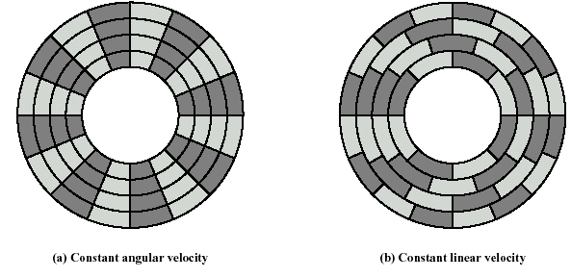
CAV vs. CLV

Slide 56
Capacity of CD-ROM
  Error correction
  20344 tracks, about 5.27Km
  Linear velocity is 1.2m/s, 75 sector/s
  73.2 minutes(maximum playing time of audio CD)
  Reading velocity is 176.4KB/s
  Capacity is 774.57MB, 550 3.25 inches disk

Slide 57
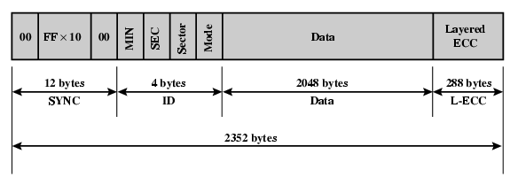
CD-ROM Block Format
  Mode 0=blank data field
  Mode 1=2048 byte data + error correction
  Mode 2=2336 byte data

Slide 58
Random Access on CD-ROM
  Difficult，because of CLV, according to track address
    Move head to rough position
    Set correct speed
    Read address
    Adjust to required location (minor adjustments, find and access sector)

Slide 59
CD-ROM pros& cons
  Large capacity
  Easy to mass produce
  Cheap
  Removable
  Robust
  Slow(<hard disk)
  Read only
  Vulnerable

Slide 60
WORM–CD recordable
  Write-once read-many CD
    Master disk is written by bursting the blisters
  Constant angular velocity, sacrifice some capacity
  Compatible with CD-ROM drives
  For archival storage of document and files

Slide 61
Erasable Optical Disk
  Can be repeatedly written and rewritten
  Use phase change material, different phase gives different reflectivity:
    Amorphous state, reflects light poorly
    Crystalline state, reflects light well
  The driver can give two sorts of laser, one is strong ,which can change the phase, used for write, and the other is weak, used for read
  500,000~1,000,000 erase cycles
  Constant angular velocity
  High capacity,650MB, removable, reliability

Slide 62


DVD
  Digital Video Disk
    Used for movies
      Only plays video disks
  Digital Versatile Disk
    Used for a computer drive
      Will read computer disks and play video disks
  7 times as much as CD-ROM
    Shorter wave length,0.4µm between pits,0.74µm between tracks
    A standard DVD holds 4.7GB per layer, with a dual-layer single-sided DVD holding 8.5GB
    With MPEG, a single layer DVD can hold 2.5h movies
  Present DVD
    100GB+

Slide 63
6.4 Magnetic Tape
Read and write in blocks, named physical records, separated by inter-record gaps
Newer tape uses 18/36 tracks
Serial access, slow
Very cheap
High capacity on small tape, previous tape
  4Gbyte uncompressed
  8Gbyte compressed
Present tape
  TB
Backup and archive

Slide 64
Vocabulary
Head：磁头
Track：磁道
Sector：扇区
Intratrack gap：道内间隙
Intersector gap：扇区间间隙
Floppy disk：软盘
Redundancy：冗余

Slide 65
Vocabulary
Queuing time: 排队时间
Transaction-oriented: 面向事务的
Exclusive-or calculation 异或运算
Mean time to repair (MTTR):平均修复时间
Erasable optic disk：可擦写光盘

Slide 66
Key points
  Organization of Disk System
  Disk Performance Parameters
  Common characteristics of RAID and different applications of different RAID levels
  Types of optical memory

