Slide 1


Computer Organization & Architecture
Chapter 7
Input/Output

Slide 2
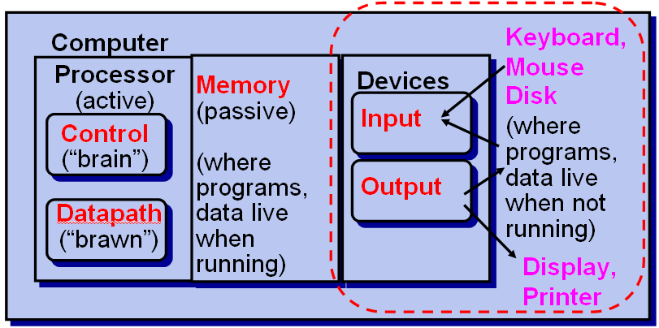
Motivation for Input/Output
5 Components of Any Computer

Slide 3
Motivation for Input/Output
Wide variety of peripherals
  Delivering different amounts of data
  At different speeds
  According to different timing sequence
  In different formats
All slower than CPU and RAM
Peripherals do not connect directly to system bus
Need I/O modules Computer

Slide 4
Motivation for Input/Output
Input/Output Module
  Interface to CPU and Memory
  Interface to one or more peripherals
  I/O modular architecture is designed to provide a systematic means of controlling interaction with outside world and provide the O.S with information to manage I/O activity effectively

Slide 5
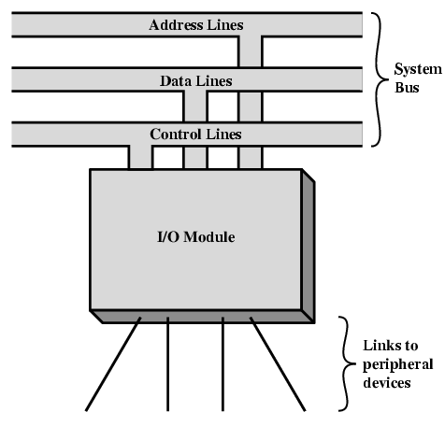
7.1 External Devices
Generic Model of I/O Modular

Slide 6
Human readable
  Screen, printer, keyboard
Machine readable
  Disk and monitoring and control
Communication
  Modem
  Network Interface Card (NIC)

Slide 7
I/O Device Examples and Speeds
  I/O Speed: bytes transferred per second
  (from mouse to display: 10-to-million)
Device Behavior Partner Data Rate
(KBytes/s)
Keyboard Input Human 0.01
Mouse Input Human 0.02
Voice output Output Human 5.00
Floppy disk Storage Machine 50.00
Laser printer Output Human 100.00
Magnetic disk Storage Machine 10,000.00
Network-LAN I or O Machine 10,000.00
Graphics display Output Human 30,000.00

Slide 8
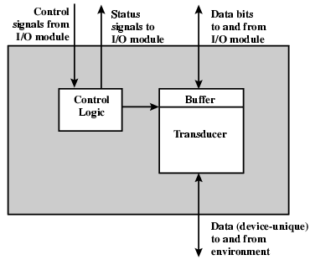
External Device Block Diagram

Slide 9
Keyboard and Monitor
  The most common means of computer/user is keyboard and monitor
  Keyboard working principle (A/D)
    A key → an electronic signal → bit pattern (transducer)
    Bit pattern → I/O modular
    Processed and stored as ASCⅡ in computer
  Monitor working as output (D/A)
    On the contrary

Slide 10
ASCⅡ
  ASCⅡ: American Standard Code for Information Interchange
  A character is represented by 7-bit binary code, total: 128 different characters
  DEL:1111111=127
  A: 1000001=65; a: 1100001=97
  1: 0110001=49;
  Others can see Table 7.1

Slide 11
Disk drive
  Contain two types of electronics
  One type for exchanging data, control and status signals with an I/O module
  The other for controlling the disk read/write mechanism

Slide 12
7.2 I/O Modules
Function of I/O Module
  Control & Timing
  CPU ~ I/O Communication
  Device ~I/O Communication
  Memory ~ I/O communication
  Data Buffering
  Error Detection

Slide 13
I/O Steps
  CPU checks I/O module and device status
  I/O module returns status
  If ready, CPU requests data transfer
  I/O module gets data from device
  I/O module transfers data to CPU
    Programmed-I/O
    Interrupt-Driven I/O
    DMA/Channel

Slide 14
I/O Communication
  Command decoding:
    Read sector, Seek track, Scan ID
    Which blocks can be read or written.
  Data exchange
    External data →I/O module buffer through local bus
    I/O module buffer →CPU/memory through system bus
  Status reporting
    Busy, ready, error, etc
  Address recognition
    Recognize each peripheral

Slide 15
Data Buffering
  An important role of I/O modular
  Adapt peripherals to CPU or main memory in their velocities
    CPU/DRAM ←→ I/O buffer
    I/O buffer ←→ peripherals

Slide 16
Error Detection
  An I/O modular is often responsible for error detection and reporting errors to CPU
  One class of errors is hardware failure
    Mechanical or electrical
    E.g.: paper jam, bad disk track
  Another class of errors is transmitting errors
    Bit errors
    Data losses

Slide 17
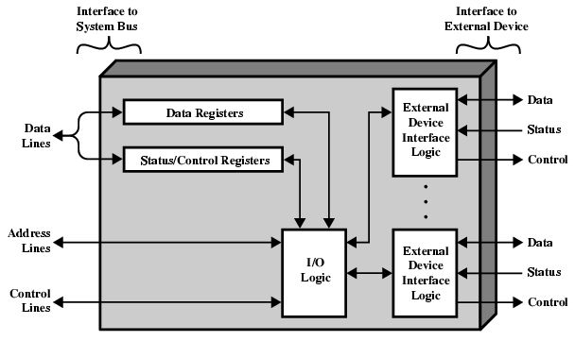
I/O Module Structure

Slide 18
I/O Module Decisions
  Support multiple or single device
  Hide or reveal device properties to CPU
  Control device functions or leave for CPU
  Also O/S decisions
    e.g. Unix treats everything it can as a file

Slide 19
Input Output Modes
  Programmed
  Interrupt driven
  Direct Memory Access (DMA)
  I/O Channel
  I/O processor

Slide 20
7.3 Programmed I/O
With programmed I/O, data are exchanged between the CPU and I/O modular
CPU has direct control over I/O in a program
  Sensing status
  Read/write commands
  Transferring data
CPU waits for I/O module to complete operation when it issues an I/O command
Wastes CPU time

Slide 21
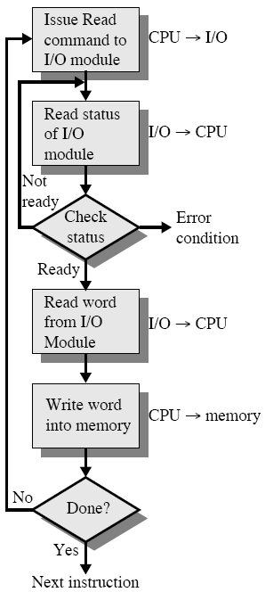
CPU encounters an I/O instruction
  It executes it, by sending a command to I/O modular, and waits for the I/O modular ready
  I/O modular performs the command and then set the appropriate bit in the I/O status register
  CPU periodically checks the status bit until it find the operation completed

Slide 22
I/O Commands
  CPU issues address
    Identifies module & device ( if >1 per module)
  CPU issues commands: 4 commands
    Control - telling module what to do
      e.g. rewind, open disk drive, etc
    Test - check status
      e.g. power? Error?
    Read/Write
      Module transfers data via buffer from/to device

Slide 23
Addressing I/O Devices
  Under programmed I/O data transfer is very like memory access (CPU viewpoint)
  Each device given unique identifier
  CPU commands contain identifier (address)

Slide 24
I/O Mapping
  Memory mapped I/O
    Devices and memory share an address space
      0xxxxxx, 1xxxxxx
    I/O looks just like memory read/write
    No special commands for I/O
      Large selection of devices available
  Isolated I/O
    Separate address spaces
    Need I/O or memory select lines
    Special commands for I/O
      Limited set

Slide 25
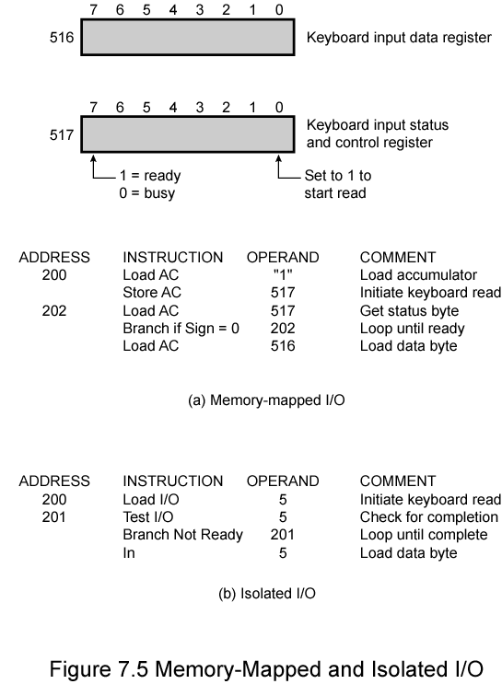
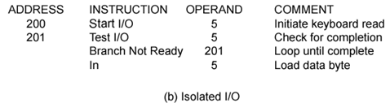
Memory Mapped and Isolated I/O

Slide 26
Summary
  Advantage:
    Simple: processor is totally in control and does all
  Disadvantage:
    Polling overhead can consume a lot of CPU time
  Solution: use exception mechanism to help I/O. Interrupt program when I/O ready, return when done with data transfer

Slide 27
7.4 Interrupt Driven I/O
Overcomes CPU waiting
No repeated CPU checking of device
I/O module interrupts when ready

Slide 28
Interrupt Driven I/O Basic Operation
  CPU issues read command, and then do other things
  I/O module gets data from peripheral whilst CPU does other work
  I/O module interrupts CPU
  CPU requests data
  I/O module transfers data through bus
  At last, CPU recover previous work

Slide 29
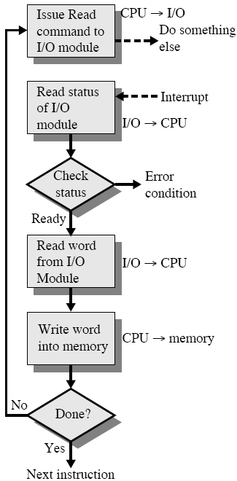
CPU Viewpoint
  Issue read command
  Do other work
  Check for interrupt at end of each instruction cycle
  If interrupted:-
    Save context (registers)
    Process interrupt
      Fetch data & store
    Restore context
  Continue previous work

Slide 30
I/O Module Viewpoint
  Receive a READ command from CPU
  Detect the state of the peripheral
  Read data from the peripheral, put it into registers
  Signal an interrupt to CPU
  Wait until its data are requested by CPU
  Place the data on the data bus

Slide 31
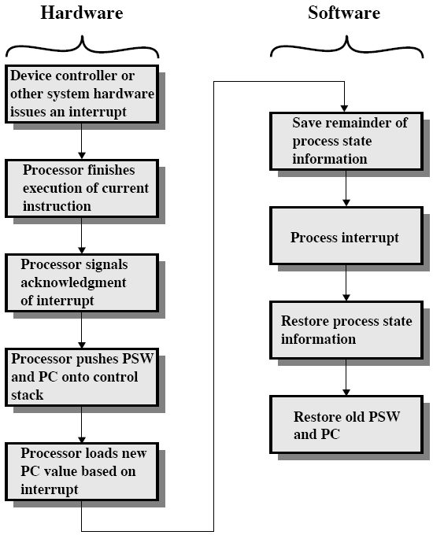
Simple interrupt processing

Slide 32
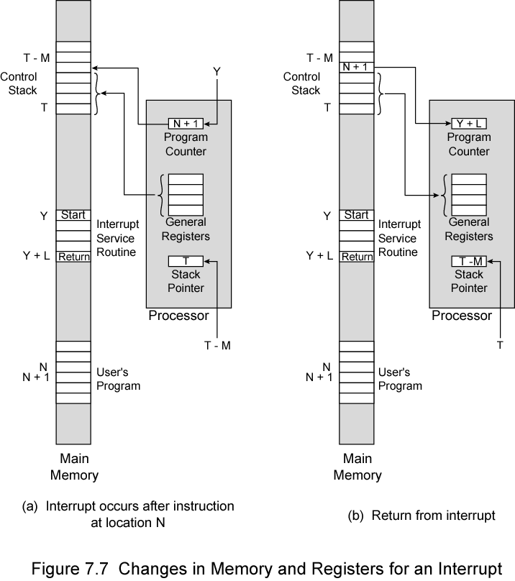
Changes in Memory and Registers for an Interrupt

Slide 33
Design Issues
  How do you identify the module issuing the interrupt?
  How do you deal with multiple interrupts?
    i.e. an interrupt handler being interrupted

Slide 34
Solutions
  Multiple interrupt lines
    Different line for each module, Limits number of devices
  Software poll
    CPU asks each module in turn through interrupt-service subroutine
      Command + address of I/O module
      Read addressable status register contained in each I/O module
      CPU branches to the device service routine
    Slow (time consuming)

Slide 35
  Daisy chain or Hardware poll Bus
    All I/O modules share a common interrupt request line
    Once CPU senses an interrupt, Interrupt Acknowledge sent down a chain
    Module responsible places vector (address, id) on bus
    CPU uses vector to point to an appropriate device-service routine
    Referred to as vectored interrupt
  Arbitration (vectored)
    Module must claim the bus before it can raise interrupt
    CPU detects the interrupt, respond it through interrupt acknowledge line.
    I/O module places vector on the data bus
    e.g. PCI & SCSI

Slide 36
Multiple Interrupts Processing
  With multiple lines, Each interrupt line has a priority
    Higher priority lines can interrupt lower priority lines
  With software polling, the order in which modules are polled determines their priority
  With daisy, the order of modules on the daisy determines their priority

Slide 37
Example—Intel 82C59A
  82C59A is a chip, interrupt controller, adaptive to Intel 80386 CPU
  80386 has one INTR pin and one INTA pin
  Devices←→82C59A←→CPU
  A single 82C59A can handle up to 8 devices, for more devices, cascade is used (see fig.7.9, pp.214)
  82C59A’s sole responsibility is the management of interrupt

Slide 38
Cascade of 82C59As
(IRQ 2)
82C59A
82C59A
80x86
IRQ0 (8)
IRQ0
IRQ1 (9)
IRQ1
IRQ2 (10)
IRQ2
IRQ3 (11)
IRQ3
INTR
IRQ4 (12)
IRQ4
IRQ5 (13)
IRQ5
IRQ6 (14)
IRQ6
IRQ7 (15)
IRQ7

Slide 39
Sequence of Events
  82C59A accepts interrupts from devices
  82C59A determines one with the highest priority
  82C59A signals 80386 (raises INTR line)
  CPU Acknowledges (INTA)
  82C59A puts correct vector on data bus
  CPU processes interrupt, communicate with I/O module

Slide 40
82C59A is programmable: by setting the control word in the 82C59A, CPU may determine the devices’priority
  Fully nested
    The interrupt requests are ordered in priority from IR0 to IR7 , all chips are same as this
  Rotating
    Equal priority, round robin
  Special mask
    Inhibit interrupts from some devices

Slide 41
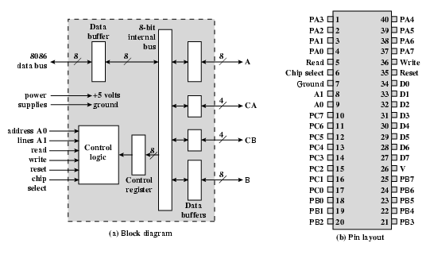
82C55A--Interface

Slide 42
Programmable peripheral interface,40 pins (24 I/O pins)
General I/O module used with 80386
Control register can be set by program
Three-8 bit I/O ports (A,C,B)
  C => C_{A}+C_{B} ,carrying control & status signals
  C_{A} may be used in conjunction with port A
  C_{B} may be used in conjunction with port B
8bit data lines,2 bit address lines, etc. Three major modes of operations
  Mode0: three 8-bit ports
  Mode1: two 12-bit ports
  Mode2: a strobed bi-directional bus configuration.

Slide 43
7.5 Direct Memory Access
Drawbacks of programmed and
interrupt-driven I/O
  Programmed I/O needs to occupy all CPU time
  Interrupt driven I/O still requires active CPU intervention, though more efficient CPU usage than Programmed I/O (transfer rate is lower)
  In both modes, data transfer must traverse CPU
    Transfer rate is limited
    CPU is tied up
  When large volumes of data are transferred, DMA is a more efficient technique

Slide 44
Ch.7-7.5
What is DMA
  External to the CPU
  Additional Module (hardware) on bus
  DMA controller takes over from CPU for I/O
    Transfer blocks of data to or from memory without CPU intervention
  In fact, DMA is also an I/O module
  Act as a maser on the bus
  Memory system acts like slave
  Manage byte-word conversion
  Priority: DMA > CPU

Slide 45
Three modes of data transfer between CPU and DMA:
  Block transfer mode (Monopolistic mode)
    An entire block of data is transferred in one contiguous sequence
    If DMA transfers data, CPU be disabled for a duration until DMA release bus
    Useful for loading an programs or data files into memory
  Cycle stealing mode
    DMA uses the bus only when CPU does not need it or forcing CPU to suspend operation temporarily
    DMA transfer one word of data, then release bus
    DMA interleaves instructions and data transfers
  Transparent mode (alternate mode)
    DMA and CPU use bus by division time multiplexing
    Require most time, but most efficient

Slide 46
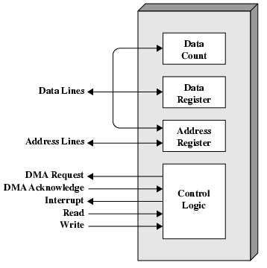
DMA Structure
Counter
Buffer
Address register
Control & status logic
Interrupt controller

Slide 47
DMA Operation
  Preprocessing: CPU tells DMA controller
    Read/Write
    Device address
    Starting address of memory block for data
    Amount of data to be transferred
    CPU carries on with other work
  Data transferring: DMA controller deals with transfer (word by word)
  Postprocessing: DMA controller sends interrupt when finished

Slide 48
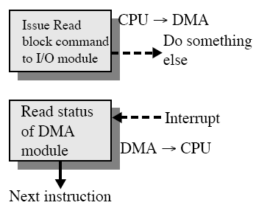
DMA transfer process
Thus, CPU is involved only at the starting and end of the transfer

Slide 49
DMA Transfer Cycle Stealing
  DMA controller takes over bus for a cycle
  Transfer of one word of data
  Not an interrupt
    CPU does not switch context
  CPU suspended just before it accesses bus
    i.e. before an operand or data fetch or a data write
  Slows down CPU but not as much as CPU doing transfer

Slide 50
Three modes of data transfer between CPU and DMA:
CPU:今天天气不错我要出去玩
DMA:大学课程难学
  Block transfer mode (Monopolistic mode)
  今天大学课程难学天气不错我要出去玩
  Cycle stealing mode
  今天大学天气课程不错难学我要出去玩
  Transparent mode (alternate mode)
  今天大学天气课程不错难学我要 出去 玩

Slide 51
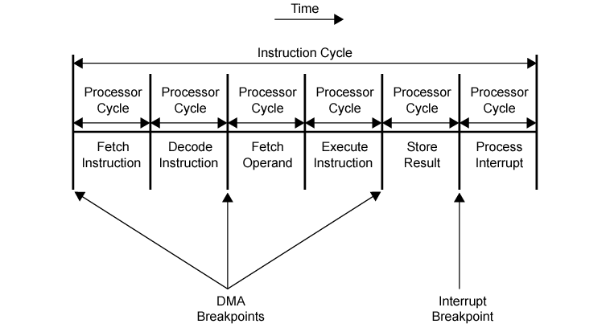
DMA and Interrupt Breakpoints During an Instruction Cycle

Slide 52
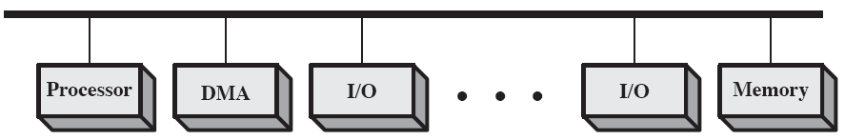
DMA Configurations
  Single Bus, detached DMA controller
    Each transfer uses bus twice
      I/O to DMA then DMA to memory
    CPU is suspended twice

Slide 53
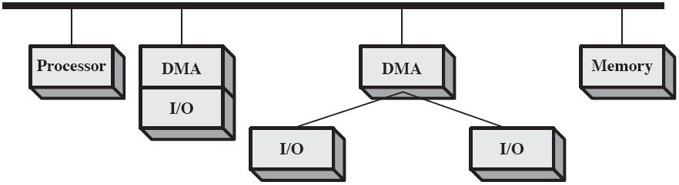
  Single Bus, Integrated DMA controller
    Controller may support >1 device
    Each transfer uses bus once
      DMA to memory
    CPU is suspended once

Slide 54
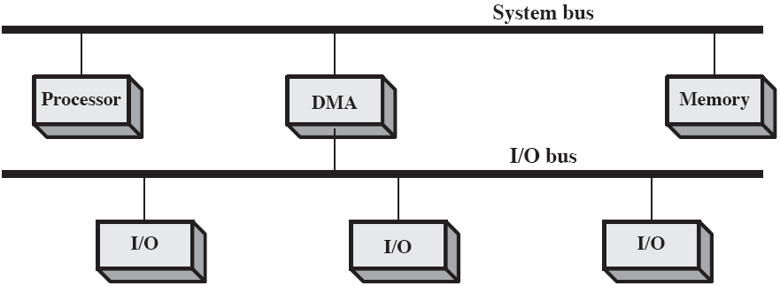
  Separate I/O Bus
    Bus supports all DMA enabled devices
    Each transfer uses bus once
      DMA to memory
    CPU is suspended once

Slide 55
Suppose that the CPU Clock frequency of a computer is 500 MHz and its CPI is 5 (means that it takes five clock cycles to executes an instruction on average). In the interrupt mode, the I/O device’s data transferring rate is 0.5 MB/s and the transferring unit is 32bit. The interrupt service routine contains 18 instructions, and other costs overhead of interrupt servicing is equivalent to the execution time of 2 instructions. Please answer:
  In the interrupt mode, how much is the ratio of time that CPU uses for I/O transferring to the total CPU running time?
  Assume that the data transferring rate of the device becomes 5 MB/s, and adapts the DMA mode to transfer data with 5000B block and the total cost of DMA pre-processing and post-processing is 500 clock cycles. How much is the ratio of time that CPU uses for I/O transferring to the total CPU running time? (assume that there is no memory access conflict between DMA and CPU).

Slide 56
  Solution:
  Interrupt mode
  In each interrupt, time that CPU uses for I/O transferring= 5×18+5×2=100 clock cycles.
  In one second,
  I/O device transfers 0.5MB data and
  need interrupt times=0.5MB/32=0.5MB/4B=0.125M.
  cost of interrupt=0.125M×100=12.5M clock cycles
  required ratio = 12.5M/500M=2.5%
  DMA mode
  In each DMA, time that CPU uses for I/O transferring=500 clock cycles.
  In one second,
  I/O device transfers 5MB data and
  need DMA processing times=5MB/5000B=1K.
  cost of DMA processing =1K×500=0.5M clock cycles
  required ratio = 0.5M /500M=0.1%

Slide 57
7.6 I/O Channels
I/O channel is an I/O module with its own processor which can execute I/O program
I/O program is located in main memory
In fact, the I/O channel represents an extension of the DMA concept
Thus, an I/O channel has the ability to execute I/O instructions and control the I/O operations

Slide 58
Functions of I/O Channels
  Receive command from CPU
    Micro command
  Load I/O program from memory, send commands to device
  Buffer, control and transfer data, provide path for transferring
  Report device status or interrupt

Slide 59
Working Principle
  Master CPU sends I/O command and waits channel and device ready
    the number of Channel
    the number of device
    Entry of channel program
    Size of data
  Master CPU starts the channel and returns to main program
  The channel executes I/O program to transfer data between memory and device
  When data transfer completed, interrupt CPU

Slide 60
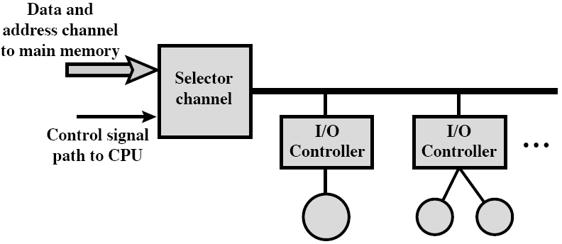
Types of I/O Channels
  Channel Capacity/data-transmission rate
    Maximum data transmitted per unit time of channel
  Selector channel
    At any one time, only one device is selected to transfer data
    High-speed devices

Slide 61
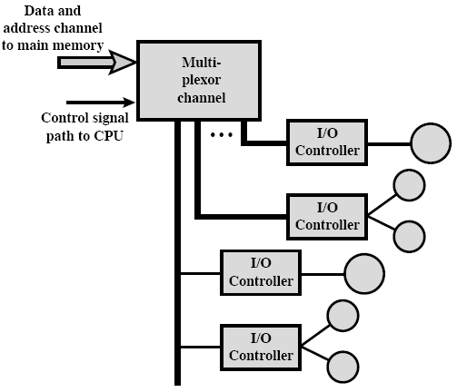
Multiplexor channel
  Byte multiplexor channel
    Round robin between devices
    For a device, only one byte data transferred
    For low speed devices
  Block multiplexor channel
    Round robin between devices
    For a device, K bytes data transferred

Slide 62
Evolution of the I/O Function
  CPU directly control a peripheral
  A control or I/O module is added
    programmed I/O
  Interrupt-driven I/O
  DMA
    Device--memory
  I/O channel
    I/O processor, no local memory
  I/O processor
    I/O processor + local memory

Slide 63
7.7 External Interface
Connecting devices together
  Point to point
    Dedicated line between I/O module and external devices
    E.g. keyboard, printer, modem, etc.
  Point to multi-point
    external buses
    External mass storage
    Multimedia devices (CD-ROMs, video, audio)
Serial or parallel
  Printer, mouse, keyboard, etc.
  Disk, tape, etc.

Slide 64
Write operation from I/O module to a peripheral
  I/O module sends a control signal requesting permission to send data
  The peripheral acknowledges the request
  The I/O module transfers data
  The peripheral acknowledges the receipt of the data

Slide 65
Small Computer Systems Interface (SCSI)
  Standard interface for CD-ROM drive, audio equipment, external mass storage devices
  Parallel interface
    8, 16, 32 bit data lines
  Daisy chained local bus, attached to PCI
  Devices are independent
  Devices can communicate with each other as well as host

Slide 66
SCSI Versions
  SCSI – 1
    Early 1980s,8 bit,5MHz,Data rate 5MBytes.s⁻¹
    Seven devices, daisy chained
  SCSI - 2
    1991,16 and 32 bit,10MHz,Data rate 20 or 40 Mbytes.s⁻¹
    8 devices
  SCSI-3:1995, 100MB/s, 32 devices supported

Slide 67
Signals & Phases
  Events in SCSI typically experience following phases:
    Bus free
    Arbitration - take control of bus
    Select target-a device,CPU,memory
    Reselection- Allows reconnection after suspension
    Command - target requesting from initiator
    Data request
    Status request
    Message request (both ways, e.g. disconnect, command complete)

Slide 68
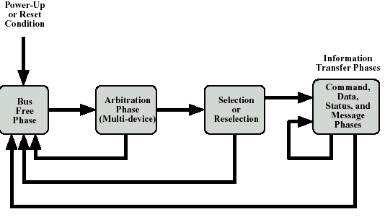
SCSI Phases

Slide 69
About SCSI
  Devices connected to SCSI：
    Direct access device, sequent access device
    Printer, processor
    Optic driver
    Scanner, media transforming devices
    Communication devices，etc.
  SCSI is a standard Specification and is very complicated
  All we know above are enough

Slide 70
About FireWire
  High performance serial bus, with a simple connector, up to 63 devices on single port
  Daisy chain or tree structure
  Hot plugging, automatic configuration
  Fast
  Low cost, easy to implement
  Also being used in digital cameras, VCR and TV

Slide 71
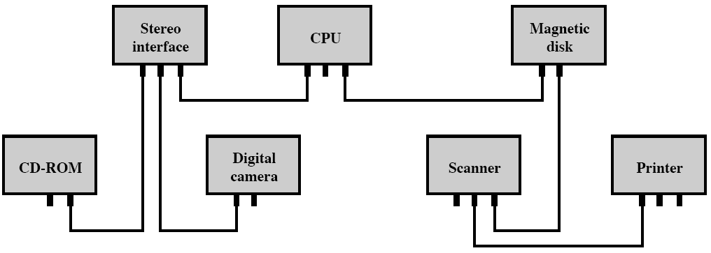
Simple FireWire Configuration

Slide 72
FireWire 3 Layer Protocols
  Physical
    Transmission medium, electrical and signaling characteristics
    Data rates from 25 to 400Mbps
    Arbitration: priority
  Link
    Transmission of data in packets
    Two transmission types:
      Asynchronous
      Isochronous
  Transaction
    Request-response protocol

Slide 73
InfiniBand
  I/O specification aimed at high end servers
    Merger of Future I/O (Cisco, HP, Compaq, IBM) and Next Generation I/O (Intel)
  Version 1 released early 2001
  Architecture and spec. for data flow between processor and intelligent I/O devices
  Intended to replace PCI in servers
  Increased capacity, expandability, flexibility

Slide 74
InfiniBand Architecture
  Remote storage, networking and connection between servers
  Attach servers, remote storage, network devices to central fabric of switches and links
  Greater server density
  Scalable data centre
  Independent nodes added as required
  I/O distance from server up to
    17m using copper
    300m multimode fibre optic
    10km single mode fibre
  Up to 30Gbps

Slide 75
InfiniBand Operation
  16 logical channels (virtual lanes) per physical link
  One lane for management, rest for data
  Data in stream of packets
  Virtual lane dedicated temporarily to end to end transfer
  Switch maps traffic from incoming to outgoing lane

Slide 76
Key points
Functions of I/O Module?
I/O module structure
Input Output Modes
What is 82c59a?
DMA &channel
SCSI
Firewire

Slide 77
Vocabulary
Cycle stealing: 周期窃取
Interrupt: 中断
Isolated I/O:分离式I/O
Memory-mapped I/O:存储映射式I/O
Multiplexor channel:多路转换通道
Parallel I/O:并行器I/O
Peripheral device : 外围设备
Selector channel:选择通道

Slide 78
Homework
7.3~7.5(7.3默认字长为1B)
Assume some I/O device send information to CPU with the maximum frequency of 4000 times per second, while the executing time of the corresponding interrupt handler routine is 40μs. Can this I/O device adopt Interrupt driven mode to work? And why?

Slide 79
Homework
3. Assume that a disk uses 32-bit word as the data transmission unit with transferring rate of 1MB/s, and CPU clock cycles is 50MHz. Please answer the following questions:
In programmed mode, suppose that it take 100 clock cycles to finish required operation. Please calculate the ratio of time that CPU uses for I/O inquiring (assume that there is enough inquiring operation to avoid data loss).
In Interrupt driven mode, the time consumption (including handling interrupt) for each transferring process is 80 clock cycles. Please calculate the ratio of time that CPU takes for data transferring of disk.
In DMA mode, assume that it takes 1000 clock cycles to start DMA, and 500 clock cycles to post-process when the DMA finished. If the length of the average transmission data is 4 KB, how much is the ratio of time that CPU use to finish I/O operation when disk working？Ignore the bus-request time of DMA.

