Slide 1


Computer Organization & Architecture
Chapter 9
Computer Arithmetic

Slide 2
9.1 Arithmetic & Logic Unit
Does the calculations
Everything else in the computer is there to serve this unit
  Controller, registers, memory, I/O
Handles integers, floating point (real) numbers
May be separate FPU (maths co-processor)
May be on chip separate FPU(486DX +)

Slide 3
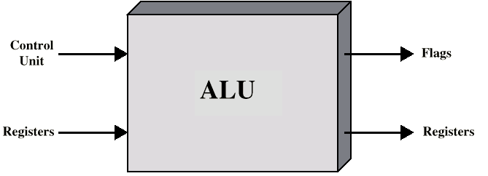
ALU Inputs and Outputs

Slide 4
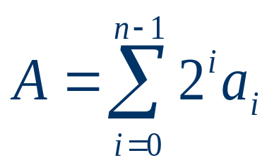
4.2 Integer Representation
Only have 0 & 1 to represent everything
Positive numbers stored in binary
  e.g. 41=00101001
No minus sign
No period (.)
n-bit binary digits a_{n-1}a_{n-2}….a₁a₀ denotes an unsigned integer A

Slide 5
Sign-Magnitude Representation
  Left most bit is sign bit
  0 means positive
  1 means negative
  +18 = 00010010
  -18 = 10010010
  Problems
    Need to consider both sign and magnitude in arithmetic
    Two representations of zero (+0 and -0)
  Rarely used

Slide 6
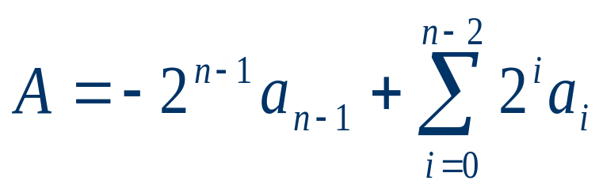
Two’s Complement Representation
  +3 = 00000011
  +2 = 00000010
  +1 = 00000001
  0 = 00000000
  -1 = 11111111
  -2 = 11111110
  -3 = 11111101
  Complement of positive number = unsigned number
  complement of negative number = bitwise not unsigned number +1

Slide 7
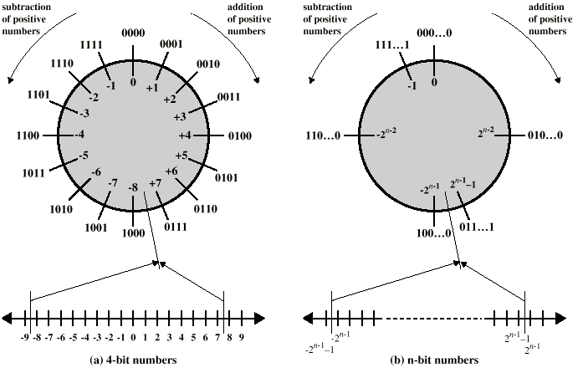
Geometric Depiction of Twos Complement Integers

Slide 8
Benefits
  One representation of zero
  Arithmetic works easily (see later)
  Negating is fairly easy
    3 = 00000011
    Boolean complement gives 11111100
    Add 1 to LSB

Slide 9
Negation Special Case 1
  0 = 00000000
  Bitwise not 11111111
  Add 1 to +1
  Result 1 00000000
  Overflow is ignored, so:
  0 = 0 √

Slide 10
Negation Special Case 2
  -128 = 10000000
  bitwise not 01111111
  Add 1 to LSB +1
  Result 10000000
  So:
  -(-128) = -128 X
  Monitor MSB (sign bit)
  It should change during negation

Slide 11
Range of Numbers
  8 bit 2’s complement
    +127 = 01111111 = 2⁷ -1
    -128 = 10000000= -2⁷
  16 bit 2s complement
    +32767 = 011111111 11111111 = 2¹⁵ - 1
    -32768 = 100000000 00000000 = -2¹⁵

Slide 12
Conversion Between Lengths
  Positive number pack with leading zeros
  +18 = 00010010
  +18 = 00000000 00010010
  Negative numbers pack with leading ones
  -18 = 11101110
  -18 = 11111111 11101110
  Extension rule of complement: left pack sign bit

Slide 13
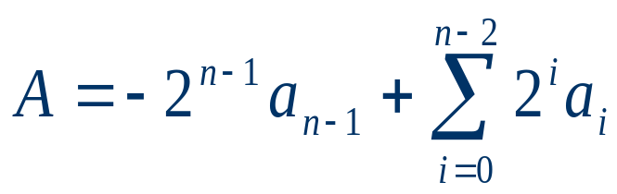
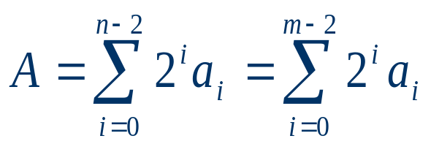
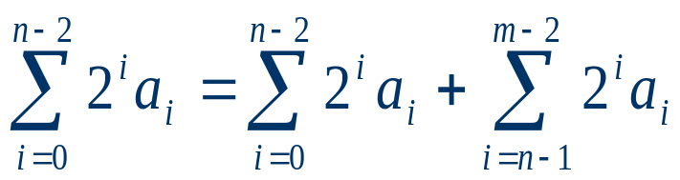
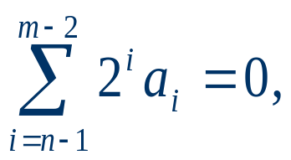
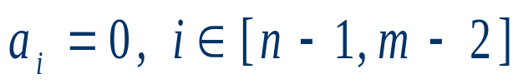
Proof
  For a binary number: A, a_{n-1}a_{n-2}….a₁a₀
  If A is positive, a _{n-1}=0, then：

Slide 14
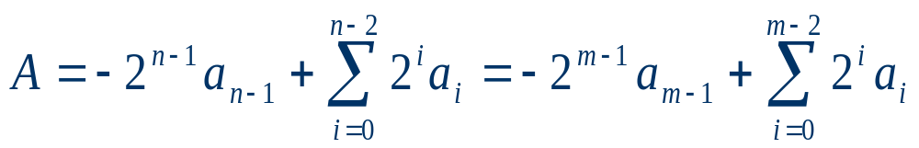
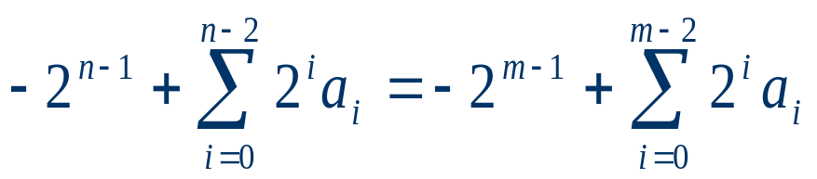
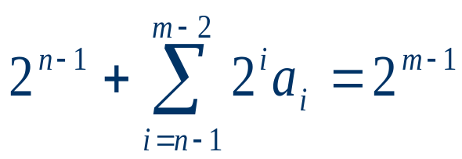
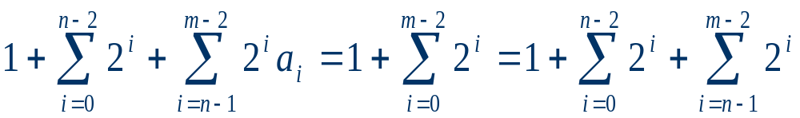
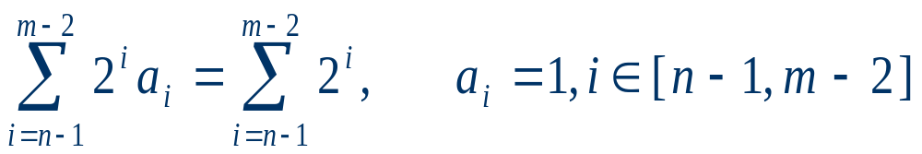
  If A is negative, a _{n-1}=1, then:

Slide 15
9.3 Integer Arithmetic
Negation
  Sign-magnitude: invert the sign bit
  Complement: bitwise not+1
    E.g. 18= 00010010
    11101101
    + 1
    11101110
    -18=11101110
    00010001
    + 1
    00010010
  A n-bit binary : [-2^{n-1}，2^{n-1}-1]

Slide 16
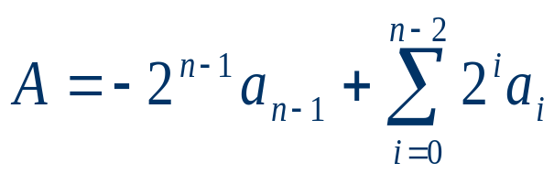
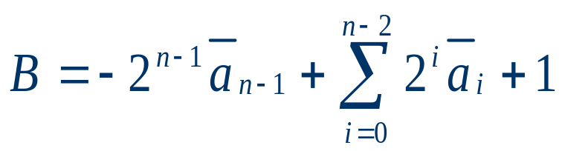
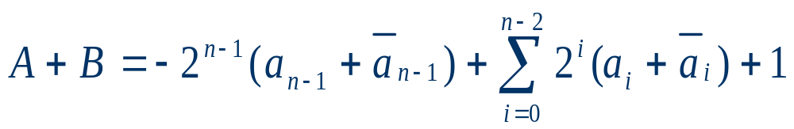
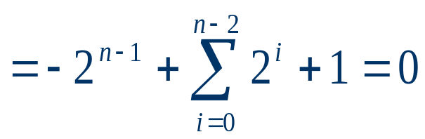
proof

Slide 17
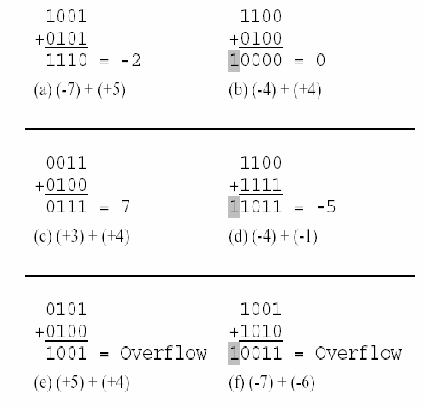
Addition & Subtraction

Slide 18
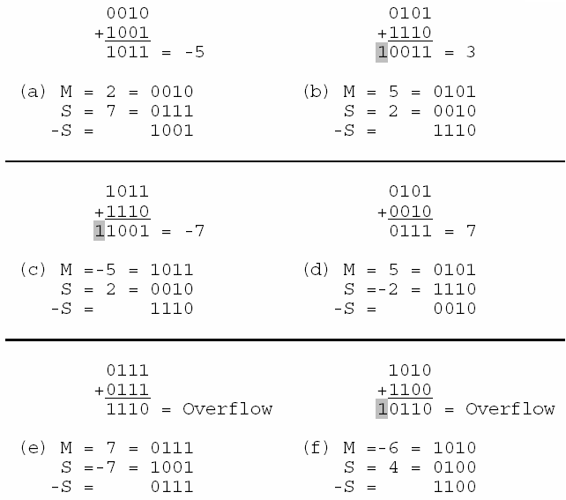

Slide 19
Comment on Addition and Subtraction
  Normal binary addition
  Monitor sign bit for overflow
    Overflow Rule: if two positive numbers or two negative numbers are added, iff the sign of result becomes inversion, overflow occurs.
  Subtraction Rule: Take complement of subtrahend and add to minuend
    i.e. a - b = a + (-b)
  No subtractor in a computer
  So we only need addition and complement circuits

Slide 20
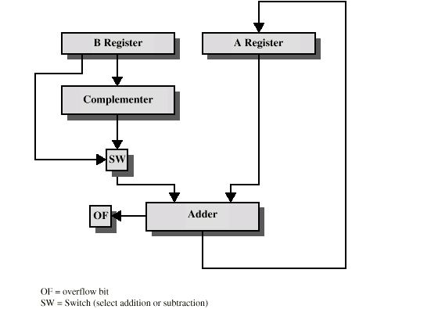
Hardware for Addition and Subtraction

Slide 21
Multiplication
  Unsigned integers by Pencil-and-paper
    1011 Multiplicand (11 dec)
    x 1101 Multiplier (13 dec)
    1011 Partial products
    0000 Note: if multiplier bit is 1 copy
    1011 multiplicand (place value)
    1011 otherwise zero
    10001111 Product (143 dec)
  Note: need double length result

Slide 22
M=1011 Q=1101=Q3Q2Q1Q0
M*Q
=M*1101
=M*(1000+100+0*10+1)
=M*2³+M*2²+M*2*0+M*2⁰
=M*2³+M*2²+2*(M*0+M*2⁻¹)
=M*2³+2²(M+2⁻¹(M*0+M*2⁻¹))
=2³(M+2⁻¹ (M+2⁻¹ (M*0+2⁻¹ (M+0))))
=2³(M*1+2⁻¹ (M*1+2⁻¹ (M*0+2⁻¹ (M*1+0))))
=2³(M*Q3+2⁻¹ (M*Q2+2⁻¹ (M*Q1+2⁻¹ (M*Q0+0))))
First partial products

Slide 23
  By computer
    More efficient
    Addition on partial product rather than waiting until the end
      No need for storage all the partial products, fewer registers are needed
      Save some time
    For each 1 on the multiplier, an addition and a shift operation are required, but for each 0, only a shift is required

Slide 24
M=1011 Q=1101=Q3Q2Q1Q0 Q3=1 Q2=1 Q1=0 Q0=1
A=0000, Q₀=1
M*1+0000=1011
② Shift right partial product
A=2⁻¹*(M+0)=0101,1
Q₁=0, directly shift right partial product
A=2⁻¹*(M*0+2⁻¹*(M+0))=0010,11
Q₂=1,
M+A= M+2⁻¹*(M*0+2⁻¹*(M+0))= 1011+0010,11=1101,11
⑤ Shift right partial product
A= 2⁻¹*(M*1+2⁻¹*(M*0+2⁻¹*(M+0)))= 0110,111
Q₃=1,
M+A=M*1+ 2⁻¹*(M*1+2⁻¹*(M*0+2⁻¹*(M*1+0)))
= 1011+0110,111=1,0001,111
⑦ Shift right partial product
A=1000,1111

Slide 25
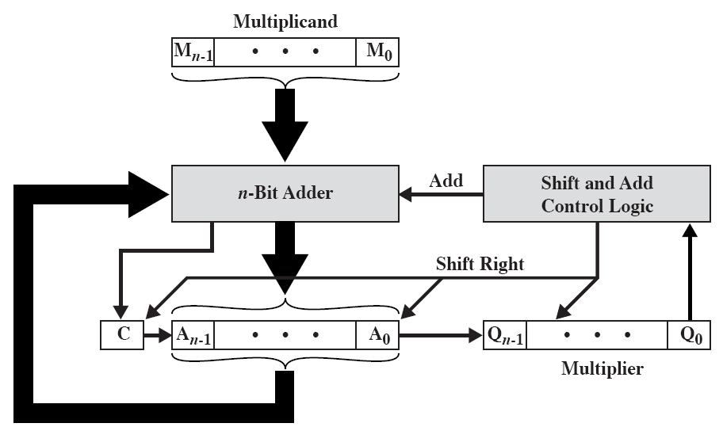
Block Diagram of Multiplier

Slide 26
Specification
  3 n-bit registers: Q,M,A; one 1-bit register: C; initially set A,C to 0
  Control logic reads the bits of the multiplier one at a time
  If Q₀=1, then the multiplicand is added to the A and the results is stored in the A
  Then, all of the bits of C, A and Q are shifted right one bit, Q₀ is lost
  If Q₀=0, just right shift
  The resulting 2n-bit product is in the A and Q

Slide 27
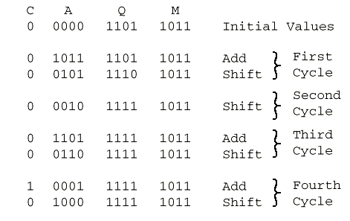
Execution of Example

Slide 28
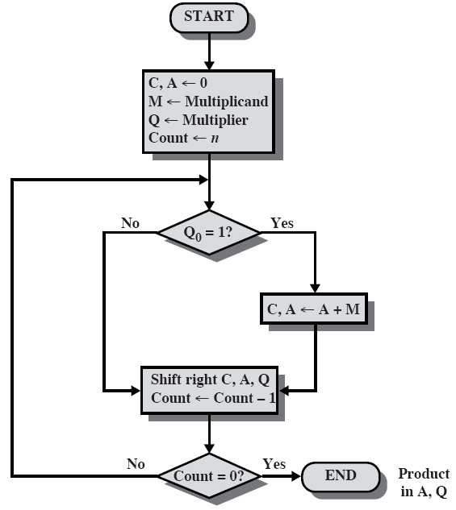
Flowchart for Unsigned Binary Multiplication

Slide 29
Multiplying Negative Numbers
  Straightforward multiplication does not work!
      1001 (-7)
      x 0011 ( 3)
      1001
      1001
      11011 (27) (-5) X
  Solution 1
    Convert to positive if required
    Multiply as above
    If signs were different, negate answer
  Solution 2
    Booth’s algorithm

Slide 30
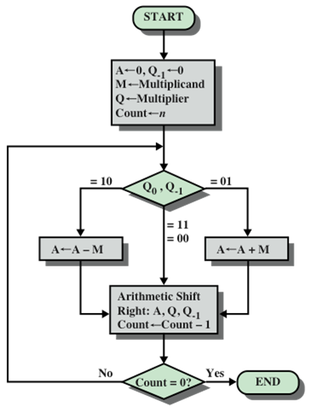
Booth’s Algorithm

Slide 31
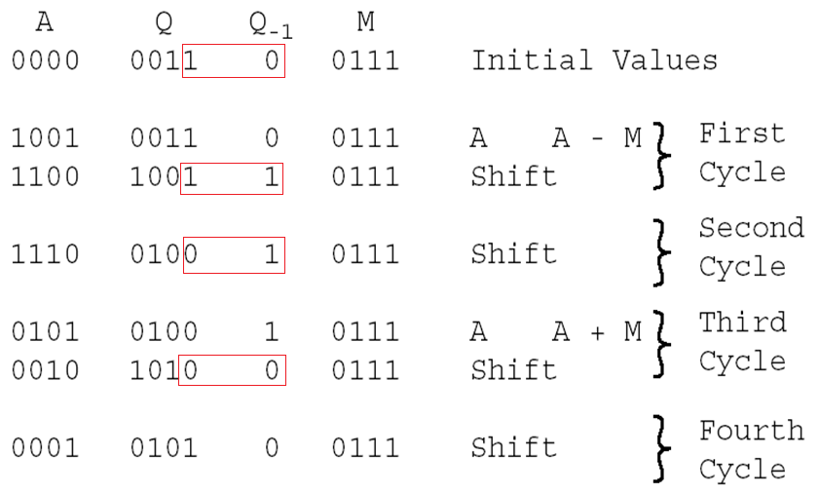
Example of Booth’s Algorithm <-

Slide 32
Example of Booth’s Algorithm
A Q Q₋₁ M
0000 0011 0 1001 Initial Values
0111 0011 0 1001 A=A-M
0011 1001 1 1001 Shift Right
0001 1100 1 1001 Shift Right
1010 1100 1 1001 A=A+M
1101 0110 0 1001 Shift Right
1110 1011 0 1001 Shift Right

Slide 33
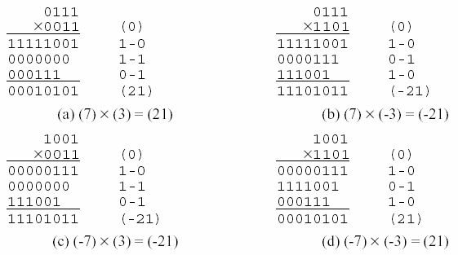
Example of Booth’s Algorithm (3)

Slide 34
Division
  More complex than multiplication
  Negative numbers are really bad!
  Based on long division

Slide 35
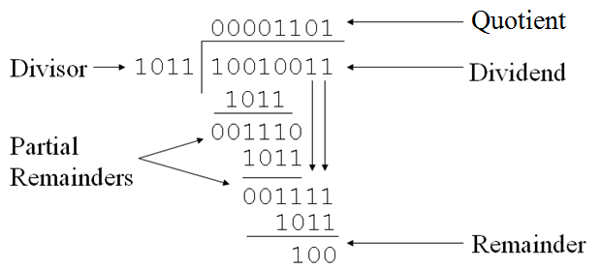
Division of Unsigned Binary Integers
147/11=13…4

Slide 36
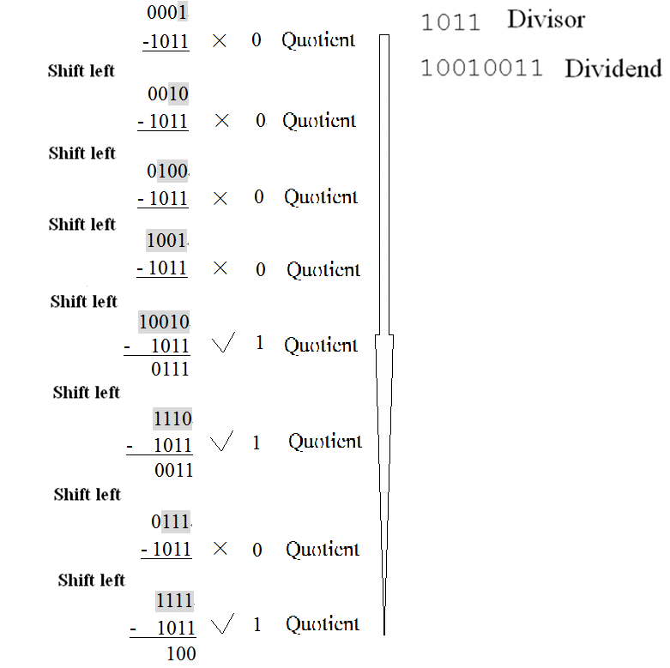
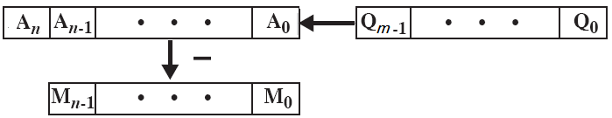

Slide 37
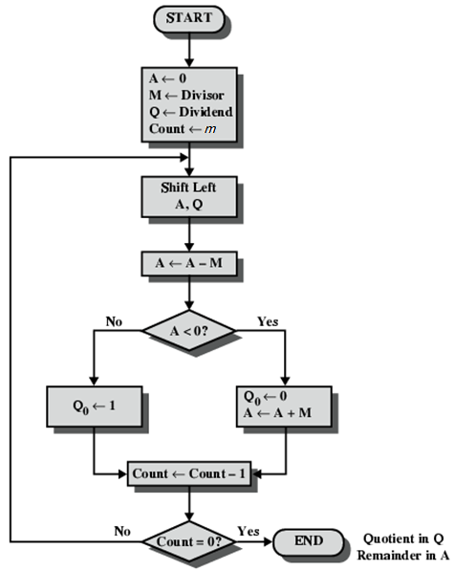
Flowchart for Unsigned Binary Division

Slide 38
Negative Numbers Division
  The method given in our book is too troublesome
  A simple scheme
    Convert to positive if required
    division as above
    If signs were different, negate answer

Slide 39
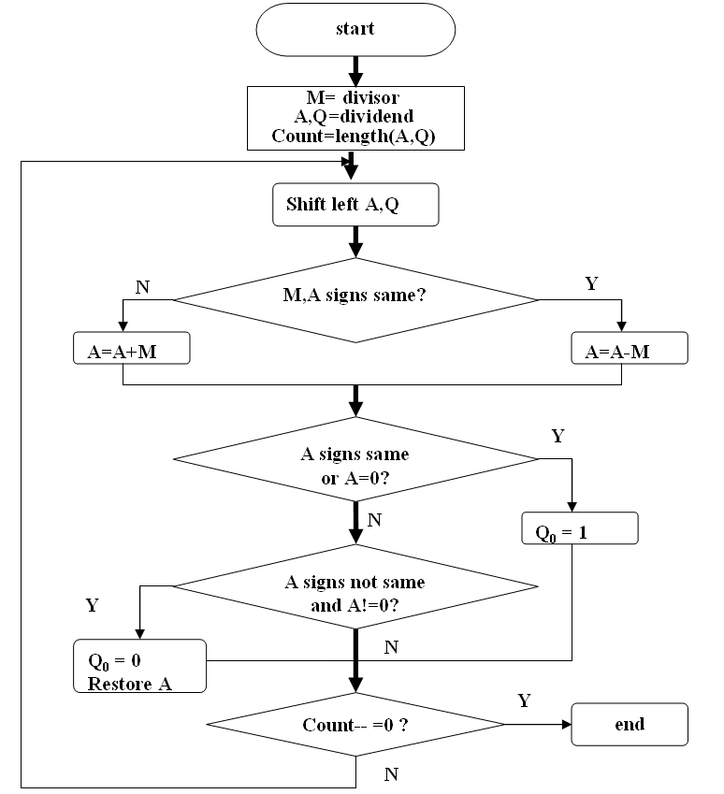
Sign Integer division

Slide 40
9.4 Floating Point Representation
Real Numbers
  Numbers with fractions
  Could be done in pure binary
    1001.1010 = 2⁴ + 2⁰ +2⁻¹ + 2⁻³ =9.625
  Where is the binary point?
  Fixed?
    Very limited
  Moving?
    How do you show where it is?

Slide 41
Principles
  ±S×B ^{±E}
    ±: Sign
    S: significand
    E: exponent, in computer, usually biased representation
        ±S×B ^{E‘}
    B: base is implicit, need not be stored
    Typically, the bias=2^{k-1}-1
      k: number of bits of exponent
        E.g. 8-bit field, the bias is 127
        True exponent values :[-127,128]
      Exponent value= true exponent + bias
      Thus, stored exponent value is unsigned

Slide 42
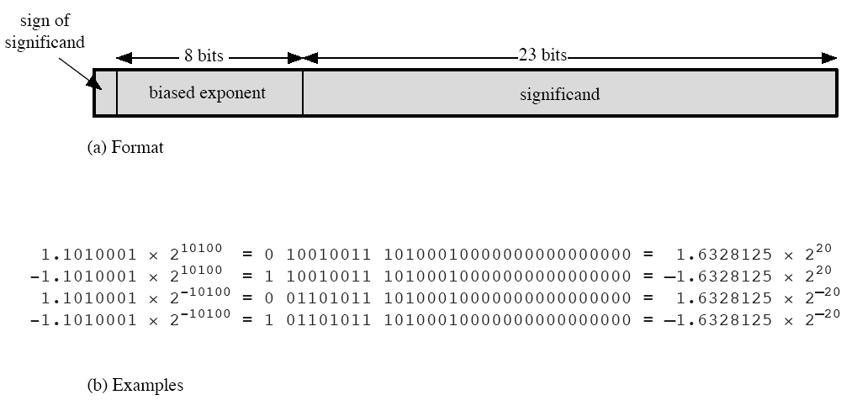
Typical 32-bit Float-point Format

Slide 43
Signs for Exponent
  Exponent is in excess or biased notation
    e.g. Excess (bias) 127 means
    8 bit exponent field
    Pure value range 0-255
    Subtract 127 to get correct value
    Range -127 to +128

Slide 44
Normalization
  FP numbers are usually normalized
  i.e. exponent is adjusted so that leading bit (MSB) of significand is 1
  Since it is always 1 there is no need to store it
  c.f. Scientific notation where numbers are normalized to give a single digit before the decimal point
  e.g. 3.123 x 10³

Slide 45
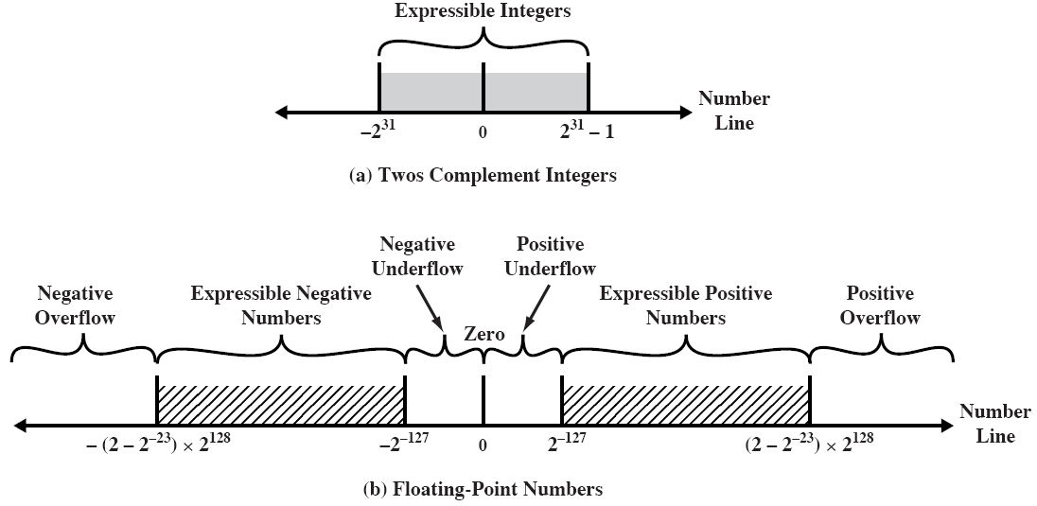
FP Ranges

Slide 46
FP Ranges
  For a 32 bit number
    8 bit exponent
    +/- 2¹²⁸ ≈ 3.4 x 10³⁸
  Accuracy
    The effect of changing lsb of mantissa
    23 bit mantissa 2⁻²³ ≈ 1.2 x 10⁻⁷
    About 6 decimal places
  Relation: when bits of E are increased, we expand the range of expressible data, but result in reduction of precision (E larger, mantissa smaller, scope larger, precision smaller)
  Trade-off between range and precision

Slide 47
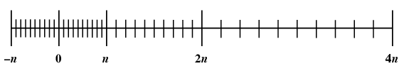
Density of Floating Point Numbers

Slide 48
9.5 Floating-point arithmetic
For addition and subtraction, we must ensure that both operands have the same exponent value, while multiplication and division are more simple.
  X=X_{S} × B^{Xe}, Y=Y_{S} × B^{ye} (X_{e}< Y_{e})
    X+Y=(X_{S}×B^{Xe-Ye} + Y_{S}) × B^{Ye}
    X-Y=(X_{S}×B^{Xe-Ye} -Y_{S}) × B^{Ye}
    X × Y= (X_{S}×Y_{S} ) × B^{Xe +Ye}
    X/Y=(X_{S}×Y_{S} ) × B^{Xe-Ye}

Slide 49
Floating-point operation may cause some problems:
  Exponent overflow
  Exponent underflow
  Significant underflow
  Significant overflow

Slide 50
FP Arithmetic +/-
  Check for zeros
  Align significands (adjusting exponents)
    Shifting the radix point on the smaller operand
    Once the overflow occurs, the influence is smaller
  Add or subtract significands
  Normalize result

Slide 51
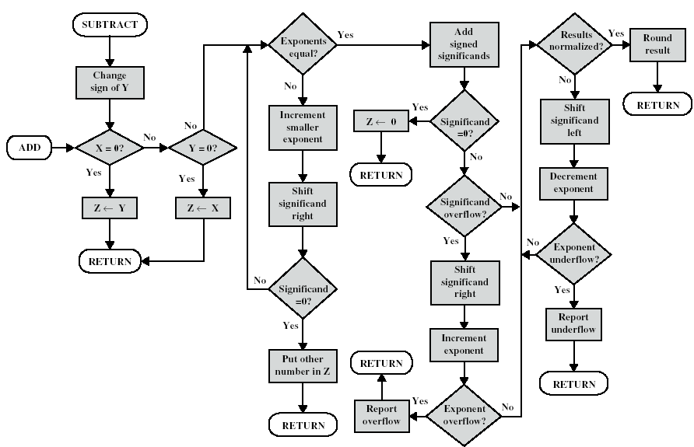
FP Add & Sub

Slide 52
By 32-bit IEEE 754 Format, X and Y have been Normalized,
X= 0 1000 0001 1101 1011 0000 0000 0000 000
Y= 1 1000 0011 1101 1011 0000 0000 0000 000
Please the result of X+Y by normalized format

Slide 53
Solution:
X＝+1.1101 1011×2^{(1000 0001－0111 1111)}
＝1.1101 1011×2²
Y＝-1.1101 1011×2^{(1000 0011－0111 1111)}
＝-1.1101 1011×2⁴
X+Y
= 0.0111 0110 11×2⁴-1.1101 1011×2⁴
= -1.0110 010001×2⁴
=1 1000 0011 0110 0100 0100 0000 0000 000

Slide 54
FP Arithmetic x/÷
  Check for zero
  Add/subtract exponents
    SUB, ADD Bias
  Multiply/divide significands
  Normalize
  Round
  All intermediate results should be in double length storage

Slide 55
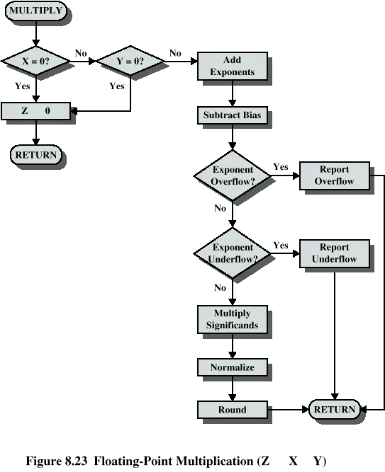
Flowchart of FP Multiplication

Slide 56
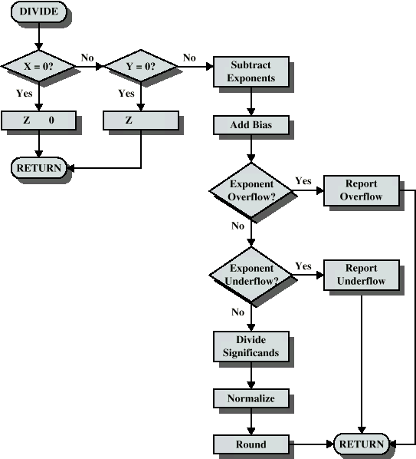
Flowchart of FP Division

Slide 57
IEEE 754
  Standard for floating point storage
  32 and 64 bit standards
  8 and 11 bit exponent respectively
  Extended formats (both mantissa and exponent) for intermediate results

Slide 58
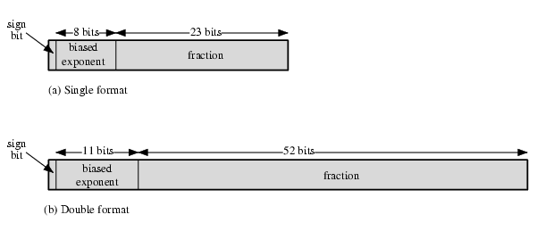
IEEE 754 Formats

Slide 59
Key points
Complement representation and arithmetic of signed binary
Negatee
+-x/ of integer
Float point representation and arithmetic

Slide 60
Vocabulary
Base: 基数
Biased representation: 偏值表示法
Dividend: 被除数
Divisor: 除数
Exponent: 指数
Guard bits: 保护位
Minuend: 被减数
Multiplicand: 被乘数
Multiplier: 乘数

Slide 61
Vocabulary
Overflow: 溢出
Product: 积
Quotient: 商
Radix point: 小数点
Remainder: 余数
Rounding: 舍入
Significand: 有效数
Subtrahend: 减数
Sign bit: 符号位

Slide 62
Homework
1. 将（20.59375）₁₀转换成为754标准的32位浮点数二进制存储格式。
2. 若浮点数X的754的标准存储格式为（41360000）₁₆，求其浮点数的十进制数值。
3. 假定在一个8位字长的计算机中运行如下C语言程序段：
unsigned int x=134;
unsigned int y=246;
int m=x;
int n=y;
unsigned int z1=x-y;
unsigned int z2=x+y;

Slide 63
Homework
int k1=m-n;
int k2=m+n;
若编译器编译时将8个8位寄存器R1-R8分别分配给变量x,y,m,n,z1,z2,k1,k2. 请回答以下问题：
1）执行上述程序后，寄存器R1，R5和R6的内容分别是多少？
2）执行上述程序后，变量m和k1的值分别是多少？
3）上述程序段中，哪些带符号的整数运算会发生溢出？

