Slide 1
DOES AI NEED MORE INNATE MACHINERY?
Topic #2
Rahul Basu
Indira Nouduri

Slide 2
Presentation Overview
Brief Bio of Yann LeCun
Brief Bio of Gary Marcus
Aspects of the debate that both agree on
Points of disagreement in the debate

Slide 3
Parallel debates in nearby fields
Psychology : nature vs nurture
Philosophy : Innatism vs Constructism with Chompsky vs Piaget
Now in AI….. Gary vs Yann

Slide 4
Yann LeCun
Became interested in AI via the nature vs nurture theories of Jean Piaget and Noam Chomsky
Was one of the first people to propose a form of backpropagation, alongside Geoffrey Hinton
Developed LeNet 1 while working with Hinton at ATnT Bell Labs
LeNet 1 was a precursor to what would eventually become Convolutional Neural Nets (ConvoNets)
His team also developed DjVu after ATnT broke up.
Currently the director of Facebook AI Research and director of NYU Center for Data Science

Slide 5
Gary Marcus
Comes from a cognitive science background and began studying human reasoning in college
Much of Marcus’s research work is centered around theories of language and the mind, as well as, the meeting point of biology and psychology
One of the contemporaries of Innatism, unlike Locke, he believes that that the mind is not a blank state
Co-founded the company Geometric Intelligence. It was one of the first ‘algorithmic support as a service’ companies to utilize machine learning and use Gary’s nativist perspective
He published a paper in 2017 critiquing Deep Learning, giving rise to this particular question

Slide 6
What both LeCun and Marcus agree on
AI is in its infancy
ML is fundamentally necessary in reaching strong AI
Deep Learning is not sufficient on its own for cognition
Model-free RL is not the answer
AI systems still need better internal forward models
Common sense reasoning remains fundamentally unsolved

Slide 7
Differing point #1 :Starting point
What types of innate machinery should be present at the very beginning of the learning process?
Gary - more complex and detailed
Yann – simplistic but versatile
Where to draw the line of inbuilt knowledge and acquired knowledge?
Resources that would be spent on learning vs resources spent on including the most ‘intelligent’ machinery

Slide 8
Starting points…..Yann
Believes in minimizing the amount of structure a system depends on
That said, he believes at least some structure is a ‘necessary evil’
Structures require us to make certain assumptions, which are invariably wrong for at least some portion of the data
Claims that most papers are specifically about structures and the different ways of connecting the layers
Key Claim - what we’re missing is a good predictive model of the world, an agent that would allow for better learning

Slide 9
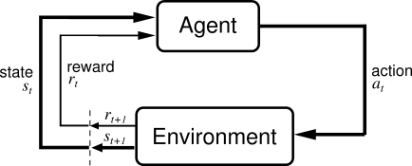
A Learning Agent

Slide 10
Starting Points …. Gary
Innate Machinery in intelligent living beings is the reason they’re intelligent
- Our ancestors evolved machinery for representing things meaningfully
Strong starting points in biological beginnings
Predicts that ML will work much better once similar innate machinery is incorporated into it
Key Claim: Unsupervised Learning can perform better with a richer system of primitives and representations.

Slide 11
Differing point #2: Integration of Cognitive human-like abilities
Equipping AI with: Common sense, logical reasoning, planning, etc
How much of these should be “in-built”
Gary – lots of complex abilities should be part of the machinery
How much should be part of the “learning”
Yann – learning algorithms can be improved and ConvoNets can be optimized

Slide 12
Integration of Cognitive….Yann
Best used when its fine tuned to that specific environment/problem
But first…..What is common sense?
The ability to fill in the blanks
infer the state of the world from partial information
Infer the past from the present
Infer the future from the present and the past
Humans don’t need that many trials because have a good predictive model in our brain
Something outside the model ….Surprises promotes heightened sensitivity
Reinforcement of model….”I knew it!” promotes reprioritizing

Slide 13
Integration of Cognitive….Gary
Nature is what causes nurture
= intelligent machinery causes intelligent learning
- Example : Toddlers consistently outperform deep learning algorithms today
Deep Learning: Initial approximations are largely random, but the human brain doesn’t function that way.
This gap could be in part due to the lack of detailed innate machinery
Sheer bottom up statistics hasn’t got us very far on language, reasoning, planning and common sense
“We need to start over” – Geoffrey Hinton

Slide 14
Human cognitive capabilities that a learning agent would benefit from (Gary Marcus)
Representation of objects
Structured, algebraic representations
Operations over variables
A type-token distinction
A capacity to represent sets, locations, paths, trajectories and enduring individuals
A way of representing the affordances of objects
Spatiotemporal contiguity / conservation of mass
Causality
Translational invariance
Capacity for cost-benefit analysis

Slide 15
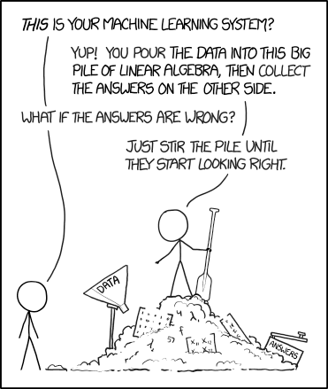

Slide 16
Key Areas of difference (A summary)
Gary believes that cleverer and more detailed innate machinery is needed for strong AI, whereas Yann has spent his entire career trying to achieve better results with as little machinery as possible
Yann imagines good predictive models capable of inferring based on existing information available in an environment is the answer, whereas Gary believes that can be better achieved by intelligent machines that have mechanisms to match human cognitive capabilities.
Their backgrounds may also play a part
Gary: studied language as an expression of human reasoning/intelligance
Yann: developed the supporting hidden layer needed to prove Backpropagation

Slide 17
Conclusion
There isn’t a single correct approach, and neither of these people in the field of psychology and AI can provide empirical evidence of exactly why their approach is better (quantitatively)
The most AI efficiency can be expected from using both aspects, advanced innate machinery paired with comprehensive learning
“The formulation of the problem is often more essential than its solution, which may be merely a matter of mathematical or experimental skill.”
- Albert Einstein

