Slide 1
CMPE 281 BURGER ORDERING SYSTEM
By,
Indira bOBburi
Manasa Yedire
Aman Ojha
Kalikalyan dash
VIRaj nilakh

Slide 2
AKF SCALING
X Scaling
X-axis scaling consists of running multiple copies of an application behind a load balancer. If there are N copies then each copy handles 1/N of the load.
In our application, we have multiple GO back end servers behind the load balancer to distribute data load.
Also, we have deployed our front end in Heroku which handles X scaling.

Slide 3
AKF SCALING
Y Scaling
Y-axis axis scaling splits the application into multiple, different services. Each service is responsible for one or more closely related functions.
In our application, we have multiple micro-services independent of each other. There are different services for handling orders, menu, restaurant or user data.
Amazon API gateway will route to different micro services (APIs) based on the URL.

Slide 4
AKF SCALING
Z Scaling (Sharding)
Sharding is a type of database partitioning that separates very large databases the into smaller, faster, more easily managed parts called data shards.
In our application, we have created two shards (RIAK clusters).
If the username has odd number of characters, it will be stored in the first shard.
If the username has even number of characters, it will be stored in the second shard.

Slide 5
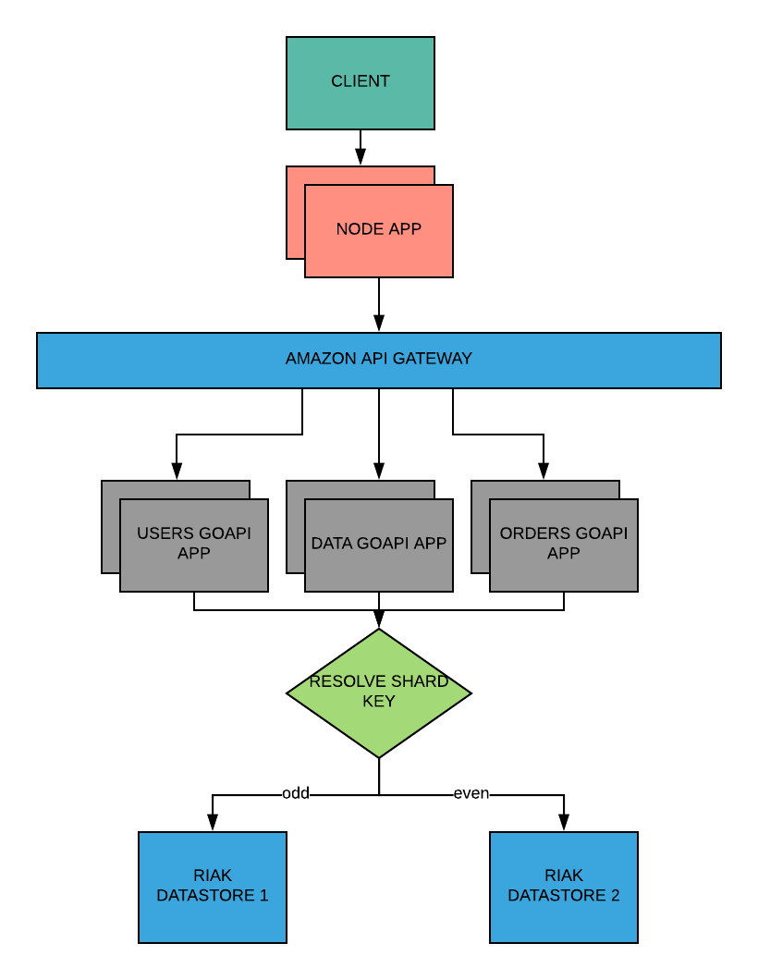
ARCHITECTURE

Slide 6
PARTITION TOLERANCE IN RIAK
Each node is fully capable of serving any client request. There is no “master”.
This uniformity provides the basis for Riak’s fault-tolerance and scalability.
http://dataconomy.com/2014/08/distributed-nosql-riak/

Slide 7
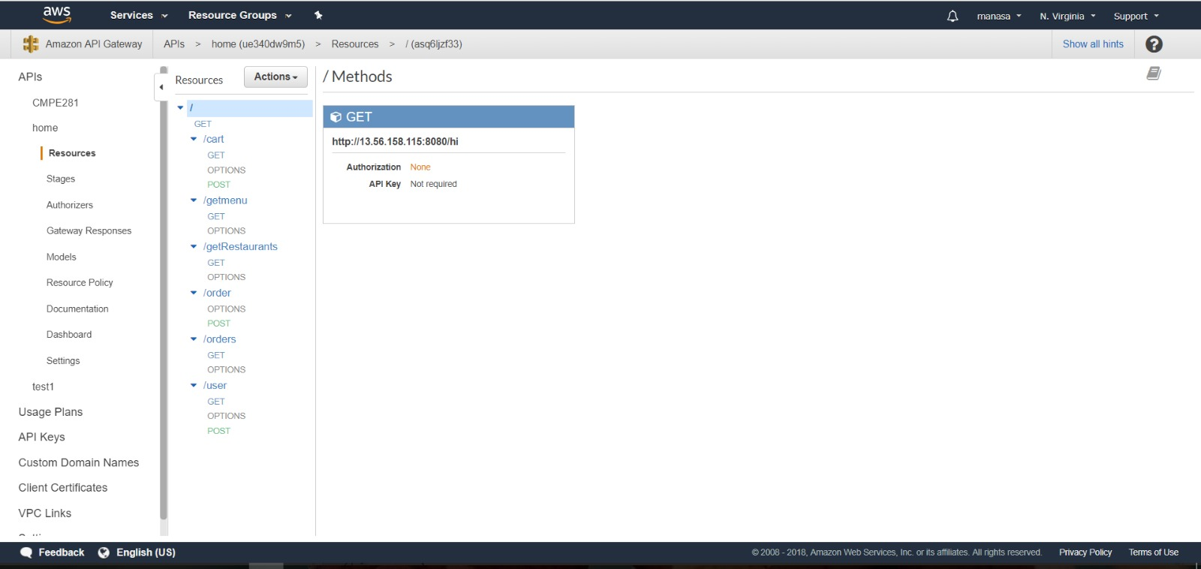
AMAZON API GATEWAY

Slide 8
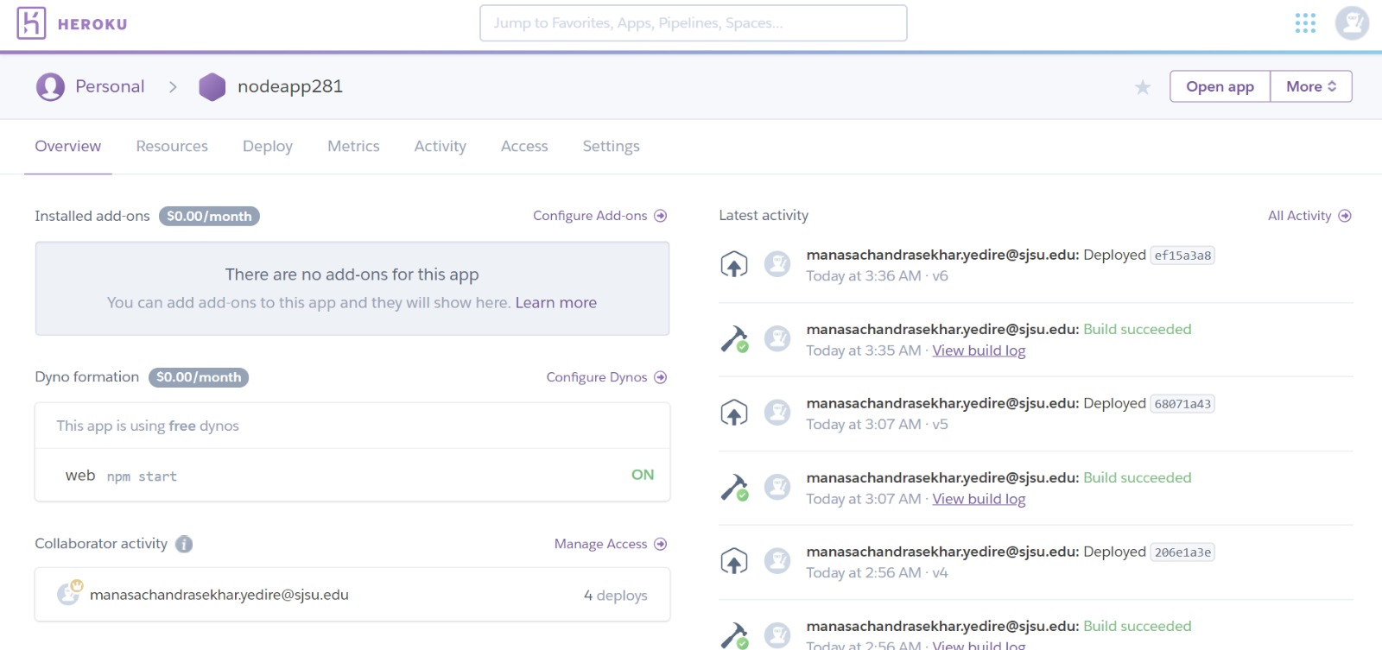
HEROKU

