Slide 1
DATA ANALYST INTERNSHIP
Name: I.Varshith
Task 4: Dashboard Design
PPT summary

Slide 2
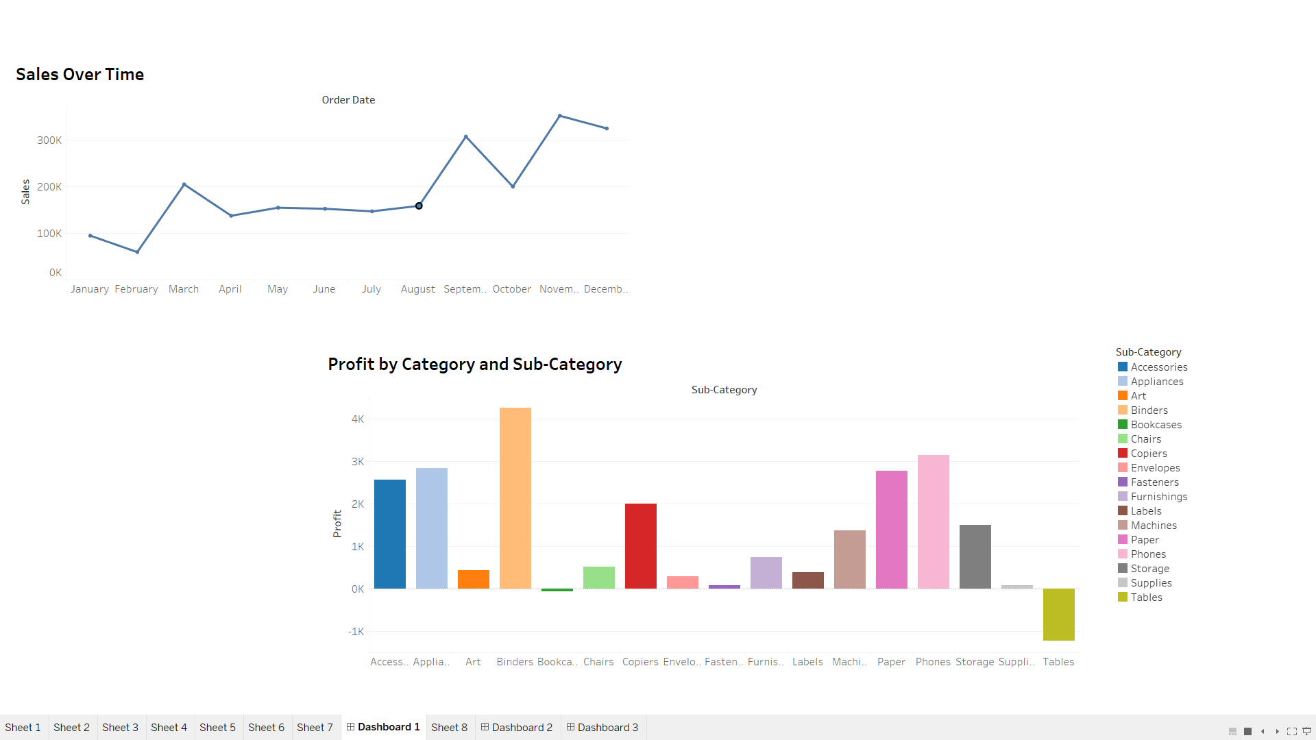
Title: Sales Analysis Dashboard
Interactive Business Insights for Stakeholders

Slide 3
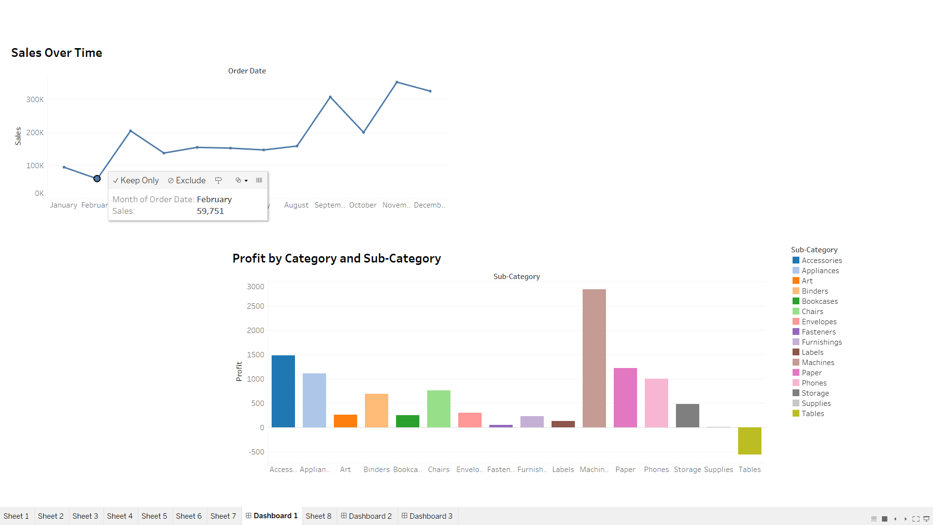
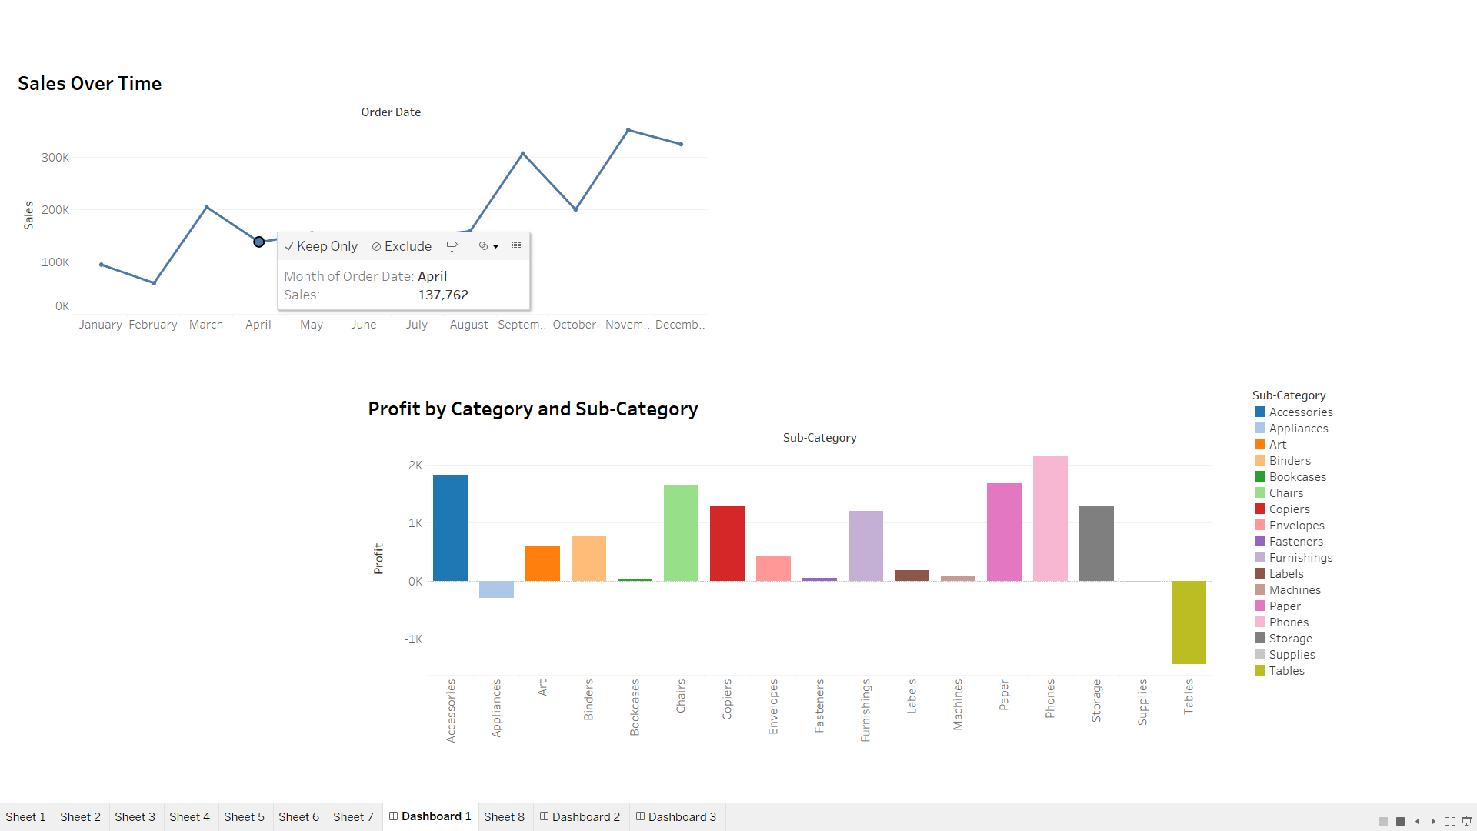

Slide 4
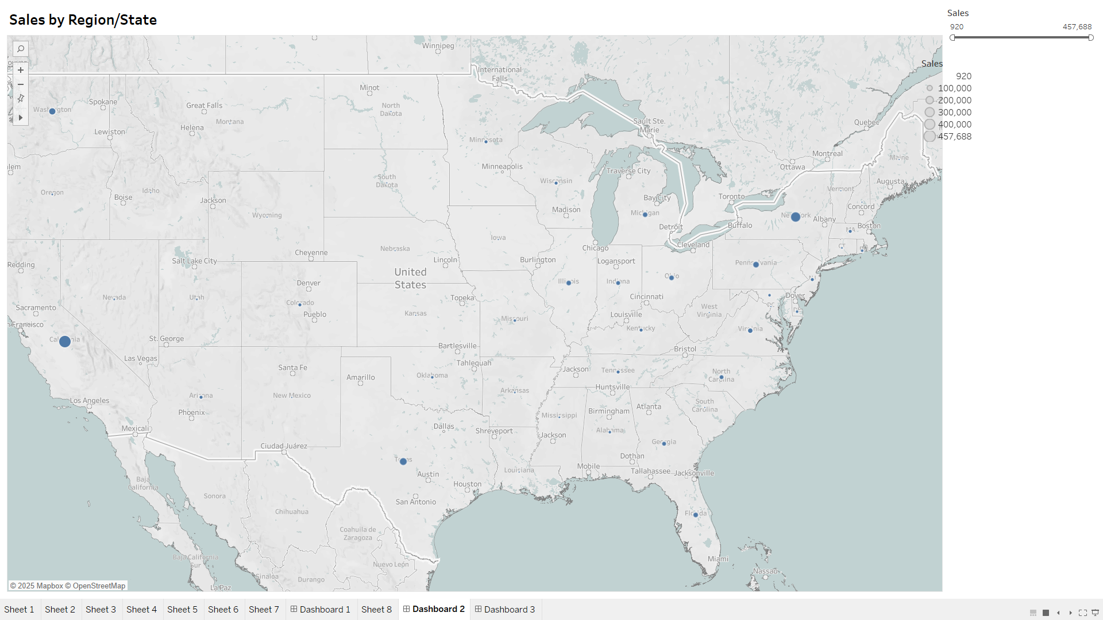
Project Objective
Design an interactive dashboard using Tableau.
Provide quick insights into Sales, Profit, and Growth.
Enable data-driven decisions through visualization.

Slide 5
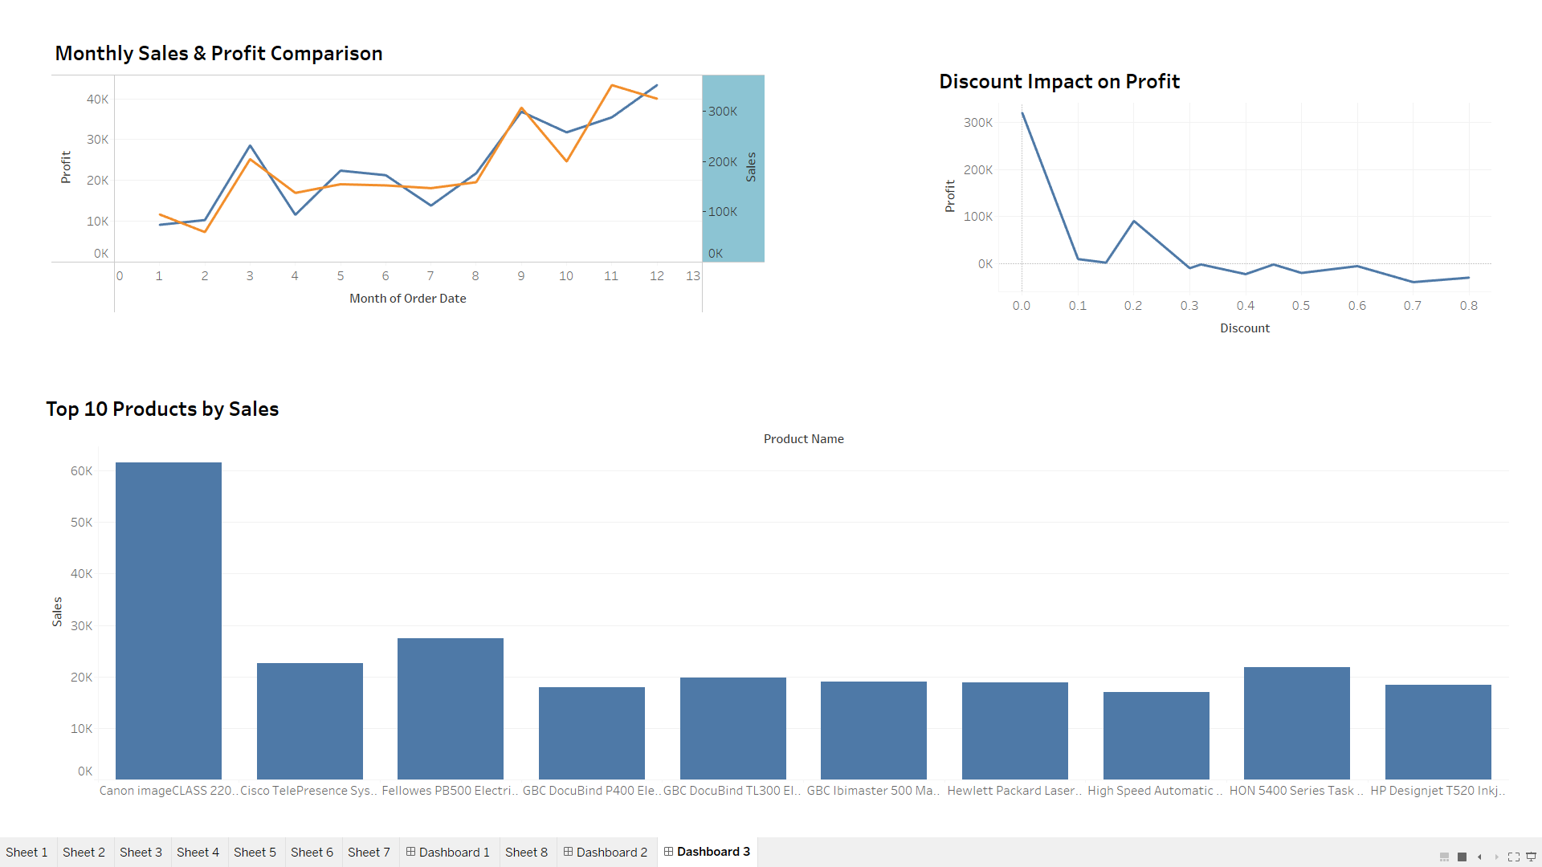
Total Sales
Total Profit
Total Orders
Profit Margin
Sales Growth (%)

Slide 6
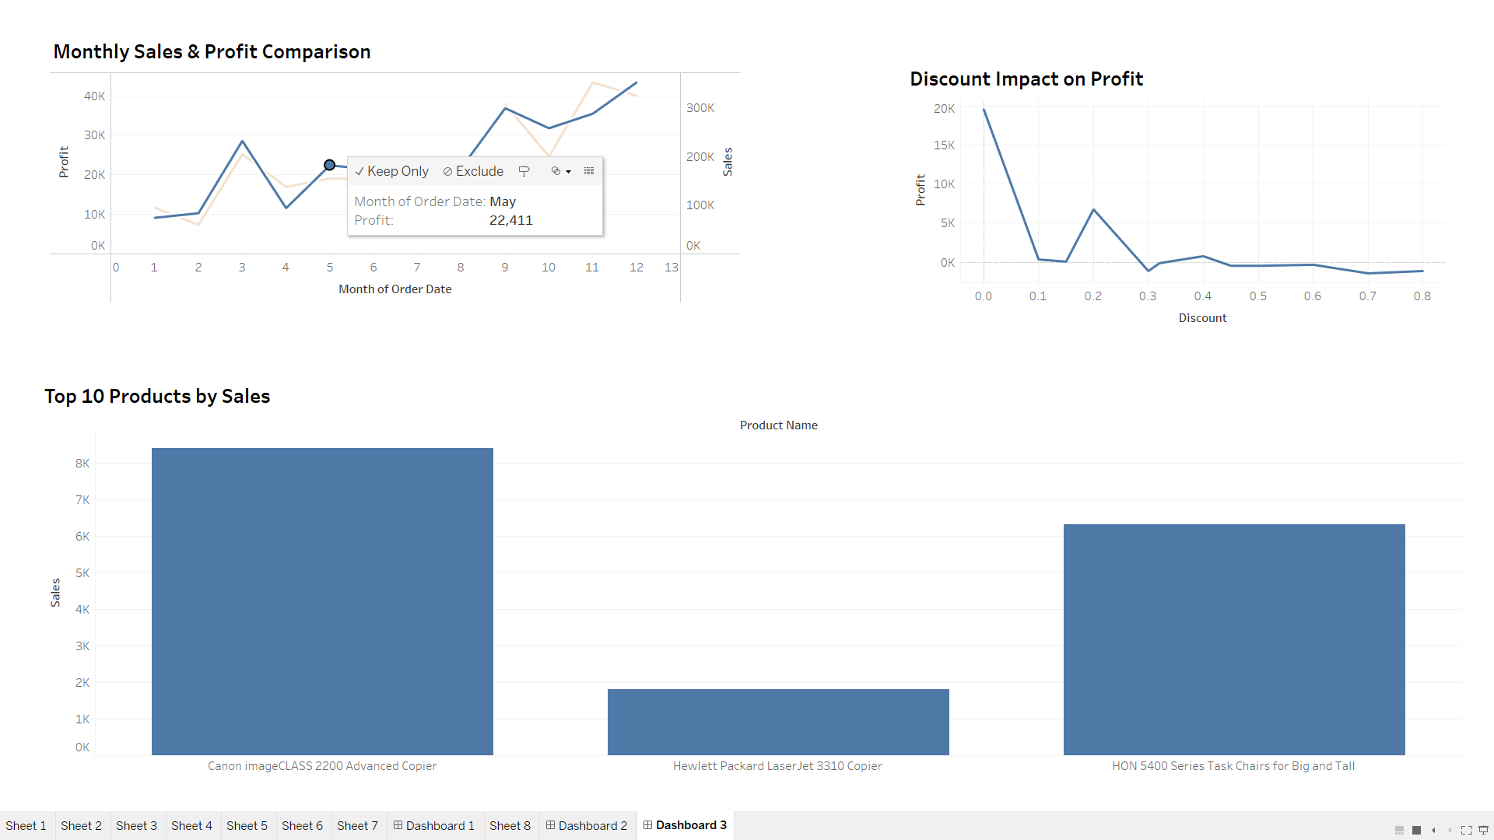
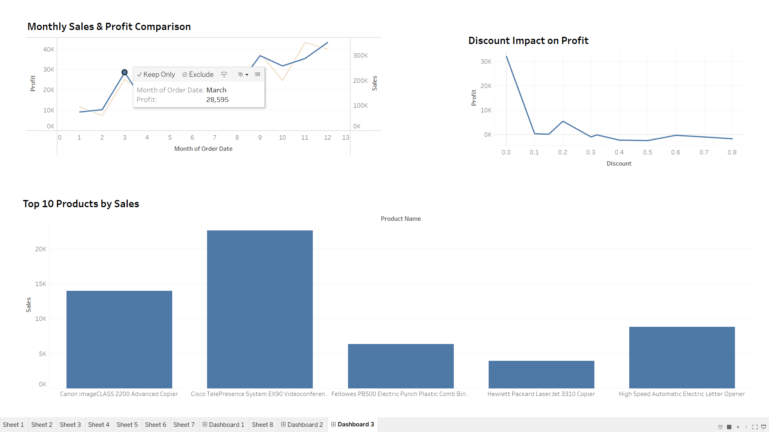
Interactive Features
Date Filters (to choose specific periods).
Region/Segment Filters (for detailed view).
Dynamic Filtering (click on bar/map to filter others).
Navigation Buttons (if added for smooth dashboard).

Slide 7
CONCLUSION:
"Through this project, we successfully designed an interactive and dynamic sales dashboard using Tableau. By focusing on key performance indicators such as Sales, Profit, and Growth, we provided stakeholders with clear, actionable insights.
The dashboard not only highlights important business trends but also allows users to explore the data through intuitive filters and visualizations.
This approach empowers faster, data-driven decision-making, improves operational visibility, and sets a strong foundation for continuous business analysis and strategy planning."

