Slide 1

Financial Systems And Banking Software

Slide 2
Project Description
The Financial Systems and Banking Software project is aimed at developing a secure and robust application for processing transactions, managing account data, and ensuring reliable communication between financial institutions. The application will leverage transport protocols, specifically TCP, to provide reliable, high-performance, and secure data transfer across the banking network. UDP protocol used for fast, unreliable data transmission without error-checking or flow control, The design focuses on creating a stable environment for high-stakes data transfer, ensuring compliance with security standards, and optimizing transaction handling.
This system will encompass critical features such as transaction processing, data security, and error handling. Financial transactions will be managed efficiently with precise data integrity checks, utilizing encryption techniques to protect sensitive information. The banking software will connect with external financial entities via secure protocols, facilitating the exchange of data such as payment requests, account updates, and fund transfers.

Slide 3

Transaction Processing: Handles the execution of financial transactions, ensuring they are processed reliably and accurately. This module is crucial for maintaining the integrity and consistency of account data.
User Side: Initiates transactions like transfers, payments, or withdrawals through a banking interface.
Server Side: Processes transactions by updating account balances and ensuring ACID properties, logging each transaction for consistency.
User Authentication and Access Control:
Manages the verification of user identities using passwords.
User Side: Logs in using passwords to access banking services.
Server Side: Verifies user credentials, assigns roles, and grants access based on user permissions.

Slide 4
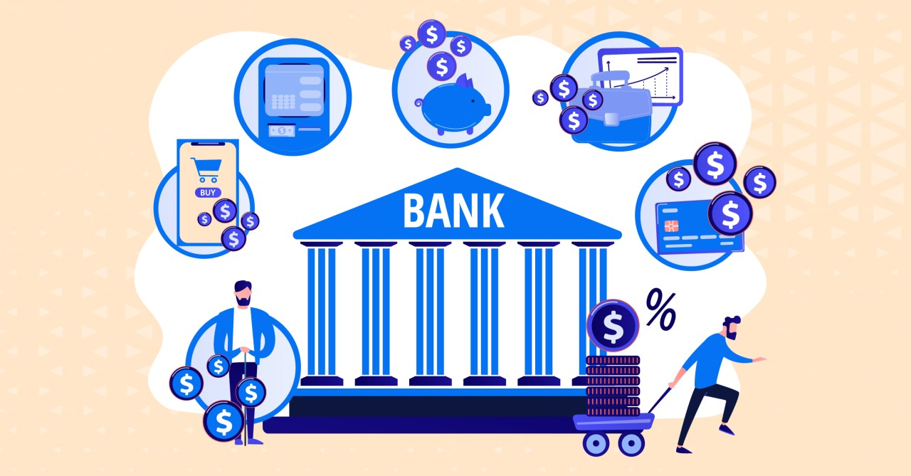
Account Management: Manages user accounts, including data retrieval and updates, ensuring only authorized access is granted.
User Side: Accesses account information, create and delete accounts .
Server Side: Retrieves and updates account data from the database, enforcing access controls to ensure only authorized changes are made.
Communication with External Systems: This module is responsiblefor allowing clients to check the status of the server using UDP
User Side: sends “status_check” message to servers UDP port and waits for the response
Server Side: listens for “status_check”request and responds with a message.

Slide 5
Error Handling and Logging:Monitors transactions and system operations, providing error detection and logging capabilities for troubleshooting and auditing.
User Side: Receives notifications or alerts in case of errors during transactions.
Server Side: Detects and logs errors during transactions, triggering retry mechanisms or notifying administrators
The architecture relies heavily on TCP connections to guarantee reliable data transfer, with an emphasis on minimizing latency and ensuring message delivery. Minimal use of UDP will be made for non-critical data that requires lower latency but not reliability.

Slide 6
Requirement | Description
Reliable Data Transfer | Uses TCP to ensure that all messages are delivered accurately and in sequence, crucial for transaction integrity.
Timing | Guarantees timely delivery of messages, managing timeout and retransmission strategies to reduce delays. Application responds promptly to user actions.
Throughput | Manages data flow to ensure efficient use of network resources, balancing speed with system capabilities and must handle users without degrading performance.
Security | Implements encrypted communication protocols, passwords for data security, protecting sensitive information

Slide 7
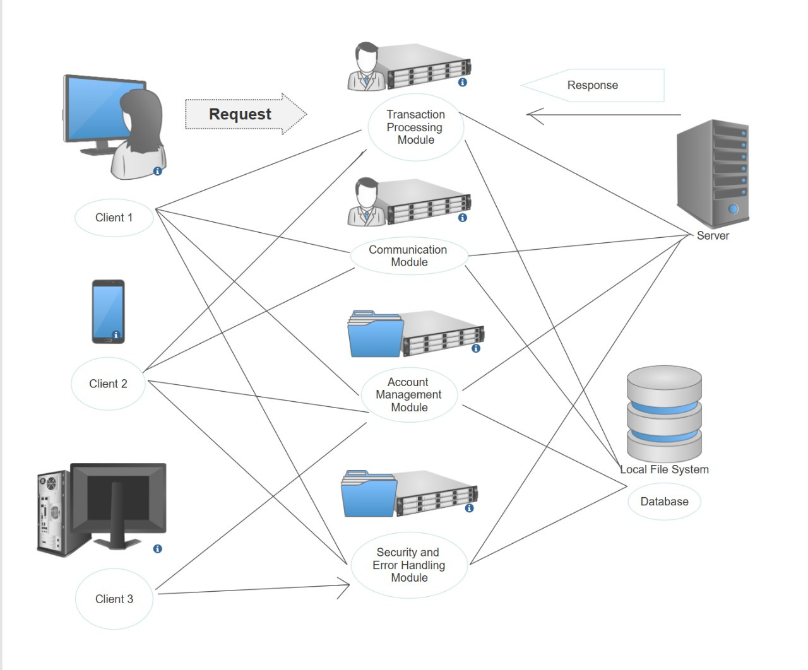
Architecture Diagram

Slide 8
Account Processing Module
FUNCTIONALITY | Type of transport protocol | Number of connections per client
CREATE ACCOUNT | TCP | 1
CLOSE ACCOUNT | TCP | 1

Slide 9
Transaction Processing Module
FUNCTIONALITY | Type of transport protocol | Number of connections per client
DEPOSIT | TCP | 1
WITHDRAWL | TCP | 1
BALANCE ENQUIRY | TCP | 1
LOAN REQUEST | TCP | 1

Slide 10
User Authentication Module
FUNCTIONALITY | Type of transport protocol | Number of connections per client
LOGIN (Authenticate User) | TCP | 1
PASSWORD VALIDATION | TCP | 1

Slide 11
Communications with External Systems Module
FUNCTIONALITY | Type of transport protocol | Number of connections per client
CHECK “SERVER_STATUS” | UDP | 1
Error Handling Module
FUNCTIONALITY | Type of transport protocol | Number of connections per client
HANDLE CONNECTION ERRORS & WRONG ENTRIES | TCP | 1

Slide 12
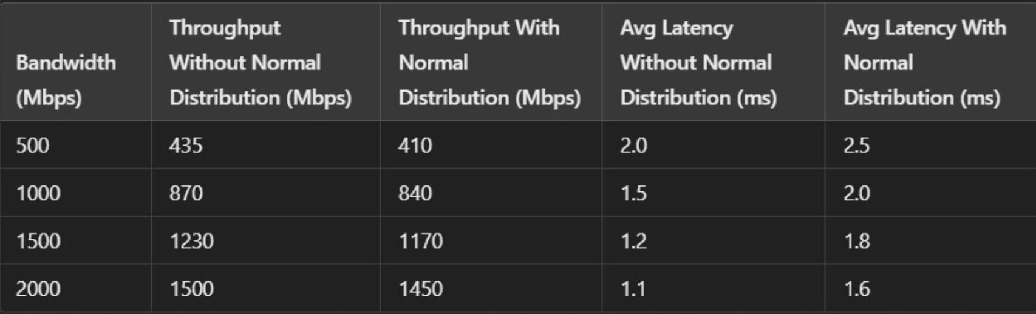
Perfomance Analysis Values

Slide 13
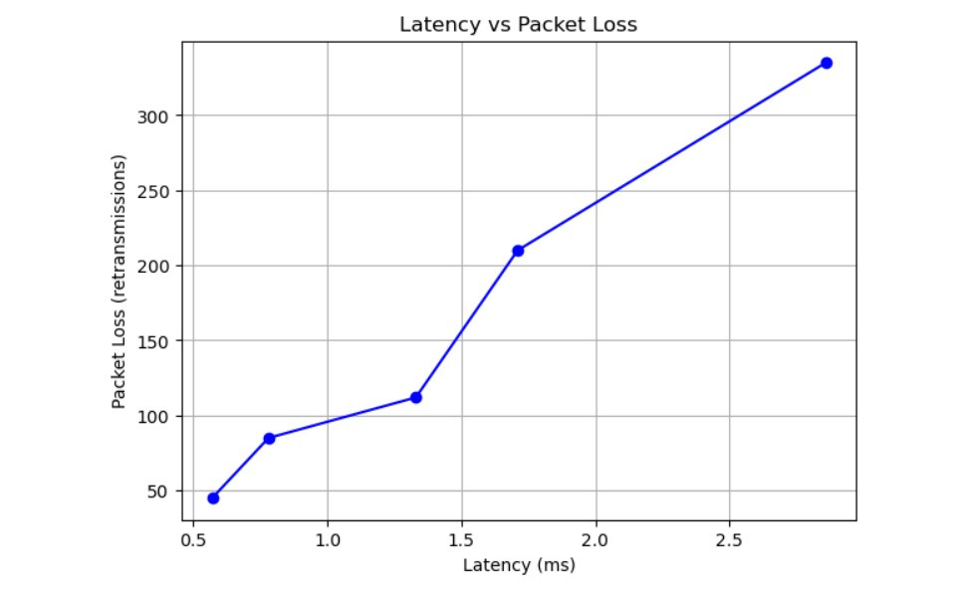
PERFOMANCE ANALYSIS

Slide 14
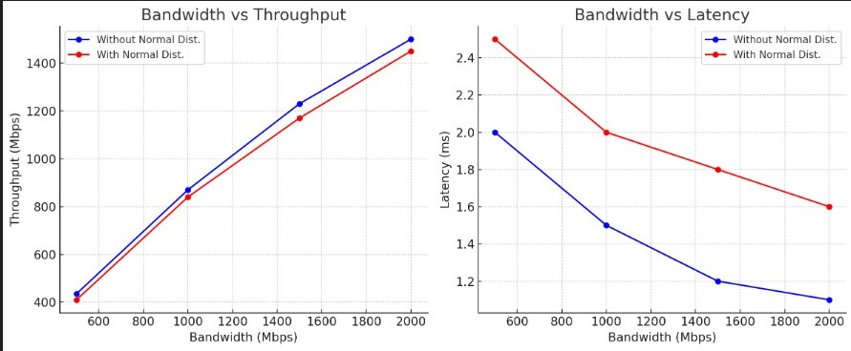

Slide 15
THANK YOU

