Slide 1
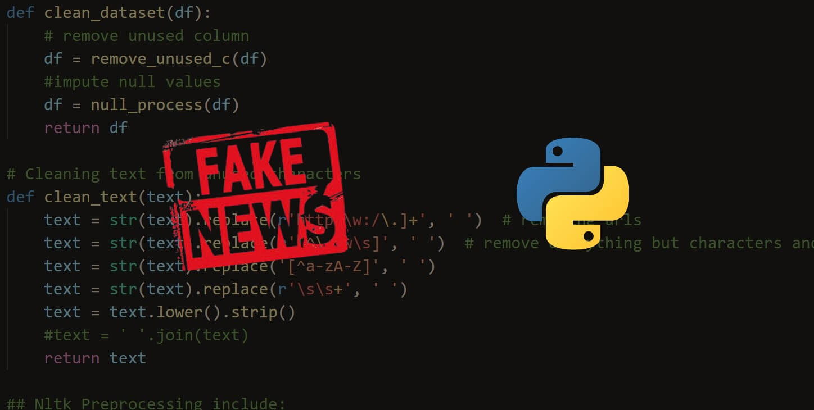
FAKE NEWS DETECTION USING MACHINE LEARNING

Slide 2

ABSTRACT
A double-edged sword is social media for news consumption. On the one hand, its low cost, convenient access, and rapid information sharing lead people to search for and consume social media content. On the other hand, it allows "fake news" to spread widely, i.e. low-quality news with purposely misleading facts.
The wide spread distribution of fake news has the potential to have highly negative effects on people and culture. Fake news identification on social media, therefore, has recently become an evolving study that attracts immense interest. Fake social media identification of news poses specific features and obstacles that make conventional news media detection algorithms ineffective.

Slide 3

INTRODUCTION
As more and more of our lives are spent communicating online across social networking channels, more and more individuals prefer to search for and absorb social media news instead of conventional news organisations. The essence of these social media sites is implicit in the reasons for this shift in consumption behaviour. The widespread distribution of false news can have a significant advene effect on people and society. Second, fake news will break the news ecosystem's balance of credibility. For instance, it is obvious that during the US presidential election of 2016, the most popular fake news was much more frequently circulated on Facebook than the most popular authentic mainstream news

Slide 4

OBJECTIVES
* Fake news can help further an enterprise's marketing goals. For example, if the information presented on the web pages associated with such news is one that favours the goods supplied by a business, despite the fact that the content of the web page is far from accurate, more customers grow an interest in the same.
*These are news articles that are purposely created, with lies and Misinformation, with the main purpose of spreading misinformation in a country or nation, or causing conflict. The widespread distribution of fake news will impact eple, culture as a whole, and in general, doubt the authenticity of journalism as well. Fake news also aims to force users to follow preconceived ideas.

Slide 5
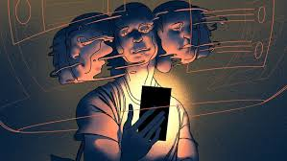
PROBLEM STATEMENT
In order to help users avoid being attracted by click baits, the project aims to find a solution that could be used to identify and filter out pages containing fake news. It is important to recognize such solutions as they will prove to be beneficial to both readers and tech companies involved in the problem.
In this project, we propose a solution to the fake news detection problem using the machine learning ensemble approach.

Slide 6
LITERATURE REVIEW/SURVEY
Yuzi Mahmud, Noor Sakinah Shaeeali, Sofianita Mutalib | Comparison of Machine Learning Algorithms for Sentiment Classification on Fake News Detection | The aim of this paper is to develop an automation of sentiment classifier model that could help individuals, or readers to understand the sentiment of the fake news immediately. The Cross-Industry Standard Process for Data Mining (CRISP-DM) process model has been applied for the research methodology. The dataset on fake news detection were collected from Kaggle website. The dataset was trained, tested, and validated with cross-validation and sampling methods.
Description
Author
Tittle

Slide 7
 |  | The main goal of fake news websites is to affect public opinion on certain matters. Our aim is to find a reliable and accurate model that classifies a given news article as either fake or true.
Fake News Detection using Machine Learning
and Natural Language Processing
Aphiwongsophon
, Supanya, and
Prabhas
Chongstitvatana
Kushal Agarwalla, Shubham Nandan, Varun Anil Nair, D. Deva Hema
Uma Sharma, Sidarth Saran, Shankar M. Patil
In this paper, we aim to perform binary classification of various news articles available online with the help of concepts pertaining to Artificial Intelligence, Natural Language Processing and Machine Learning.
Fake News Detection using Machine Learning
Algorithms

Slide 8
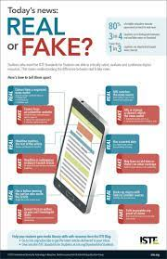

There are two categories of important researches in automatic classification of real and fake
news up to now:
In the first category, approaches are at conceptual level, distinction among fake news is
done for three types: serious lies (which means news is about wrong and unreal events or
information like famous rumors), tricks (e.g. providing wrong information) and comics (e.g.
funny news which is an imitation of real news but contain bizarre contents).
In the second category, linguistic approaches and reality considerations techniques are
used at a practical level to compare the real and fake contents. Linguistic approaches try to detect text features like writing styles and contents that can help in distinguishing fake news. The main idea behind this technique is that linguistic behaviors like using marks, choosing various types of words or adding labels for parts of a lecture are rather unintentional, so they are beyond the author’s attention. Therefore, an appropriate intuition and evaluation of using linguistic techniques can reveal hoping results in detecting fake news.

Slide 9
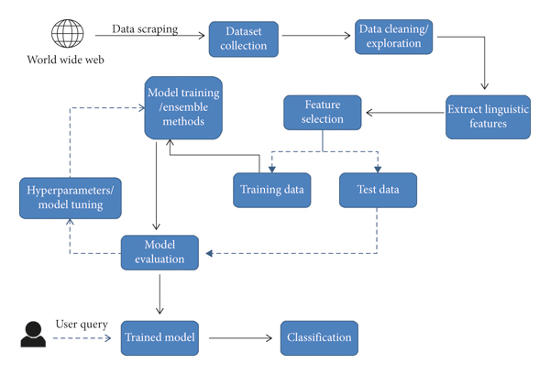
PROPOSED SYSTEM
The proposed system contains a Word2Vec model for finding the relationship between the words and with the obtained information of the existing relations , the new articles are categorized into fake and real news.

Slide 10


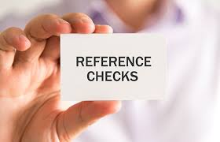
REFERENCES
Yuzi Mahmud, Noor Sakinah Shaeeali, Sofianita Mutalib.
“Comparison of Machine Learning Algorithms for
Sentiment Classification on Fake News Detection” (IJACSA) Vol. 12, No. 10, 2021
Kushal Agarwalla, Shubham Nandan, Varun Anil Nair, D. Deva Hema. “Fake News Detection using Machine Learning
and Natural Language Processing” (IJRTE)
ISSN: 2277-3878 (Online), Volume-7, Issue-6, March 2019
Uma Sharma, Sidarth Saran, Shankar M. Patil. ”Fake News Detection using Machine Learning Algorithms” (IJERT)
ISSN: 2278-0181
Liu, Yang, and Yi-Fang Brook Wu. "Early detection of fake news on social media through propagation path classification with recurrent and convolutional networks." Thirty-Second AAAI Conference on Artificial Intelligence. 2018.

Slide 11
THANK YOU .

