Slide 1




Notes:
Open: this is the white-labeled Comax AI Analytics Platform — verified analytics AI built end to end, from the Comax database all the way to WhatsApp.

Slide 2
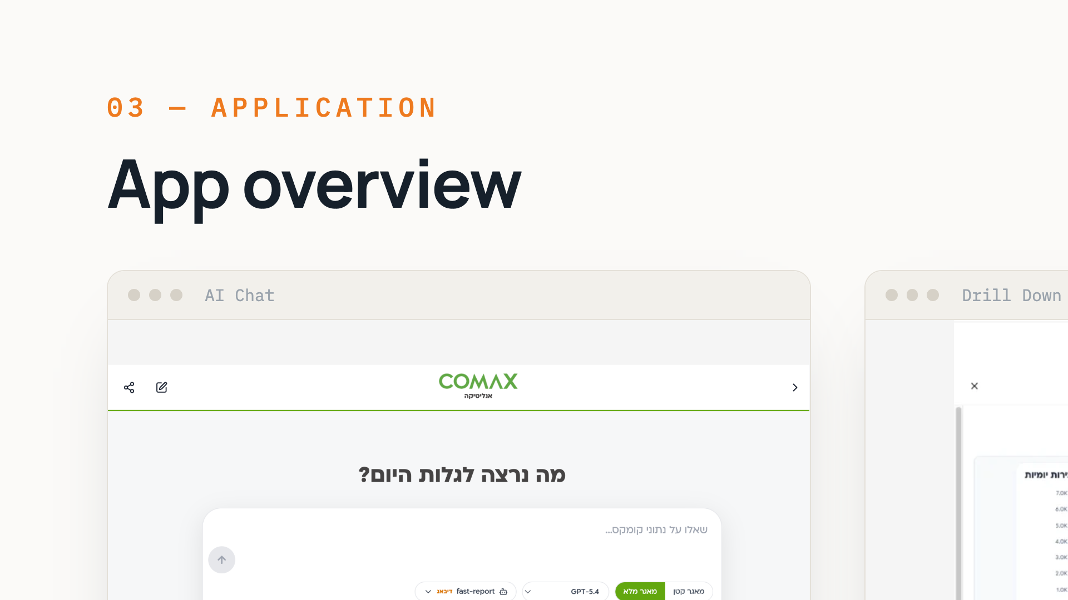
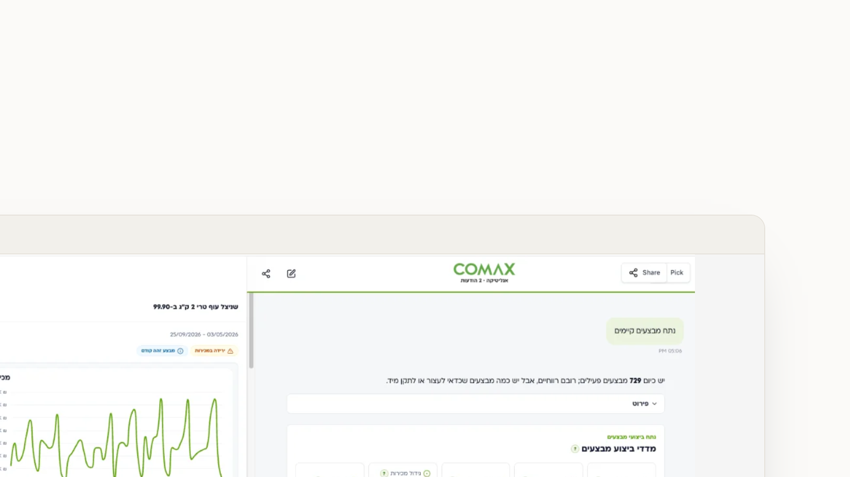
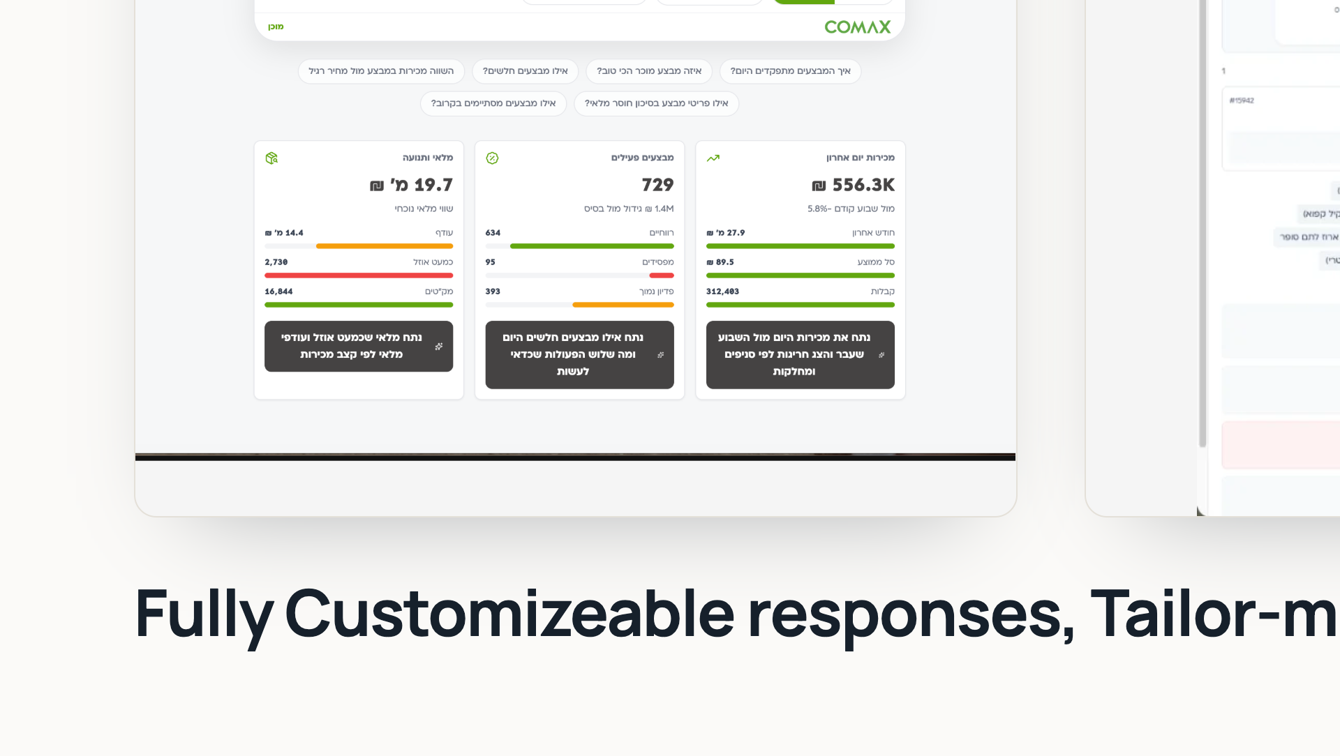
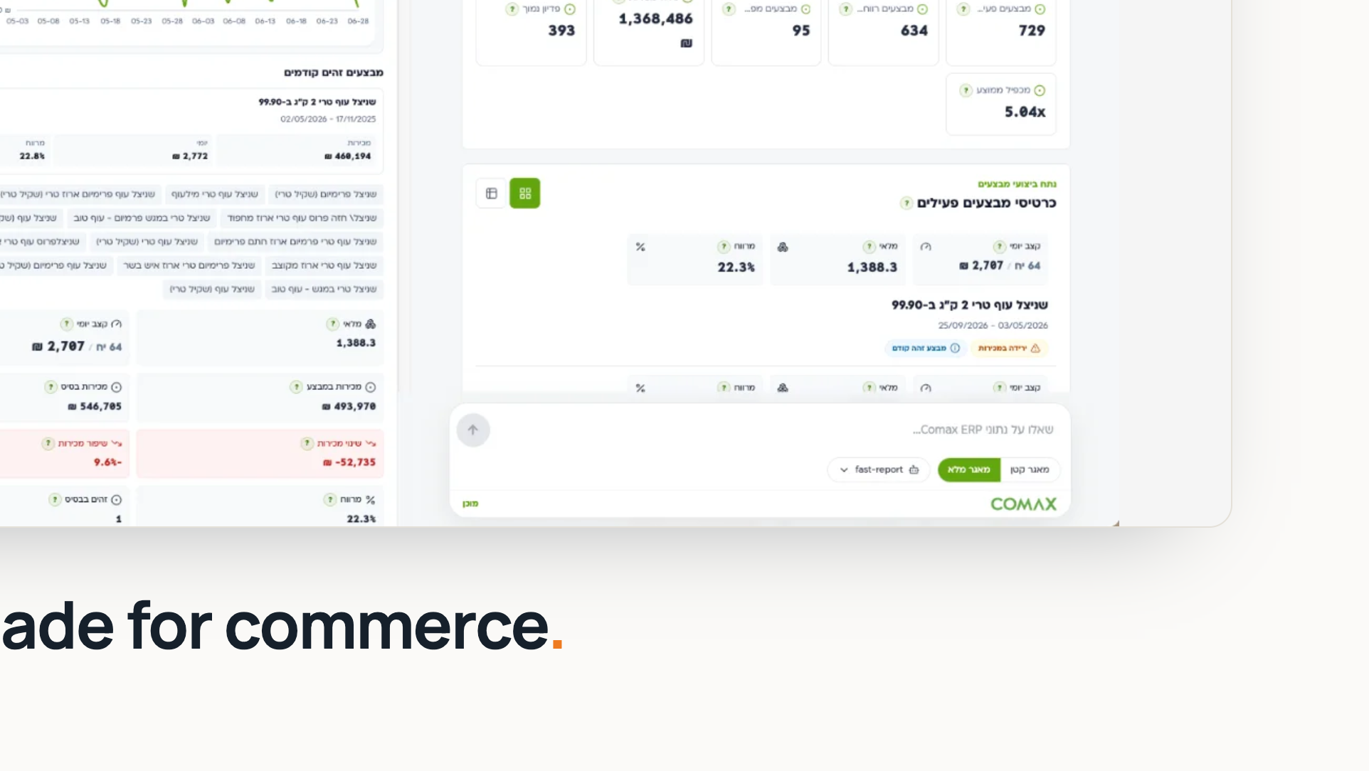
Notes:
Two surfaces, one system: the AI chat can pull up any dashboard, and every dashboard has AI that can summarize it. Everything stays fully customizable.

Slide 3
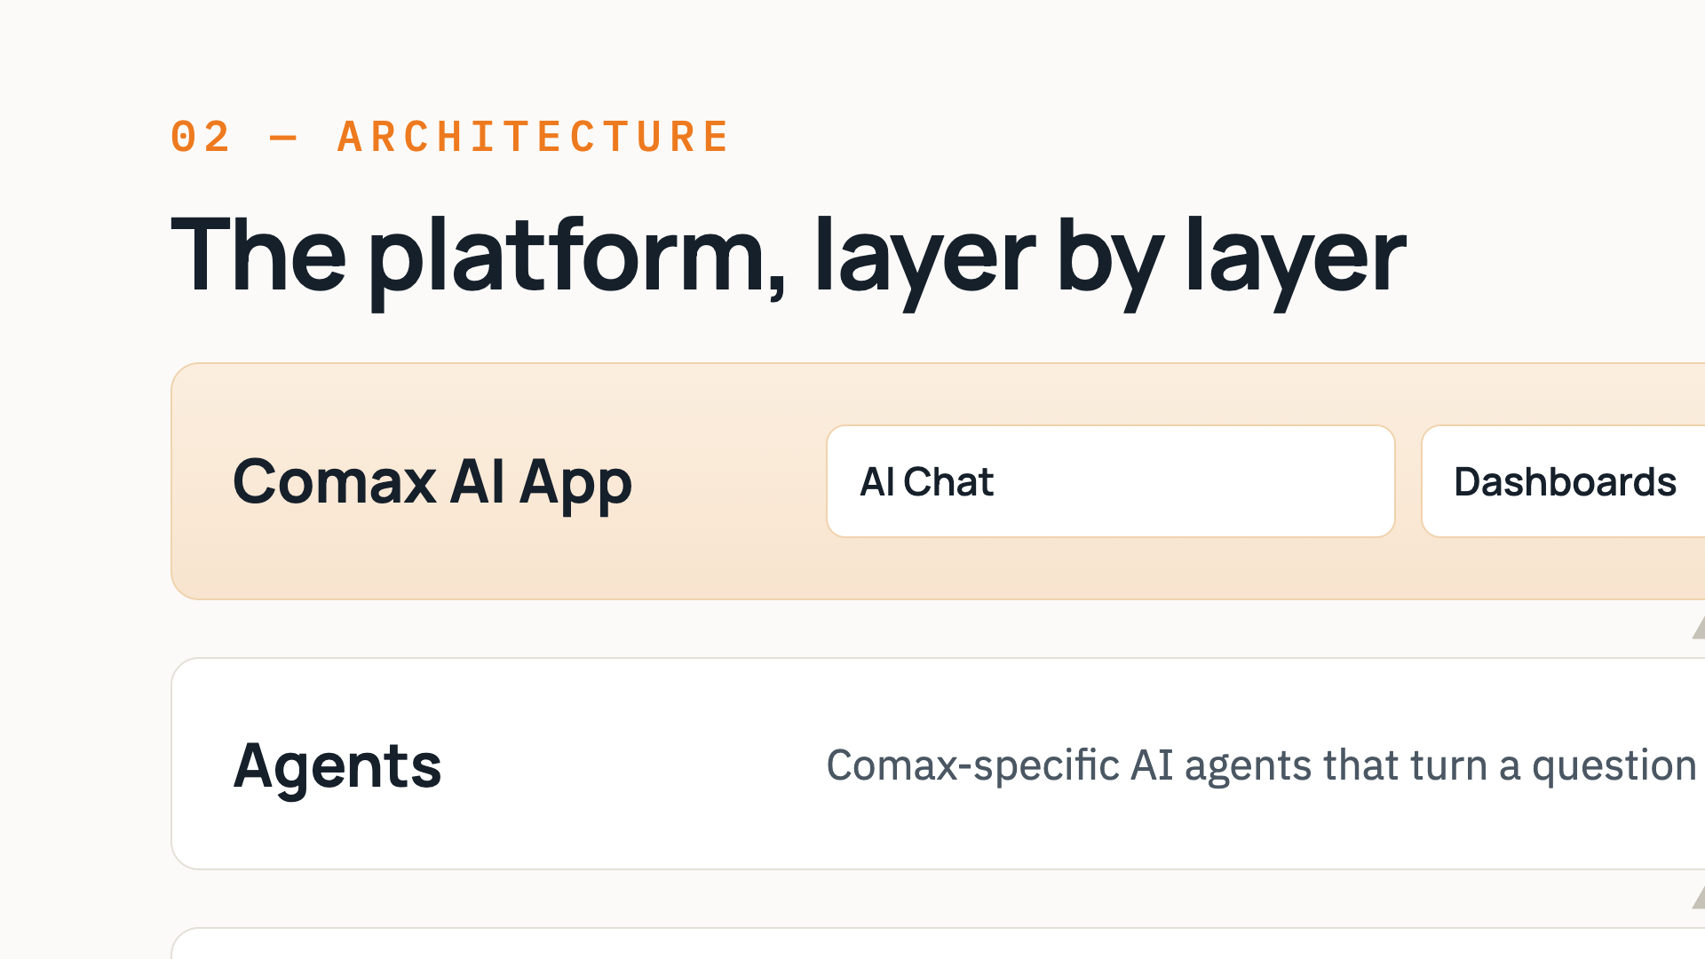
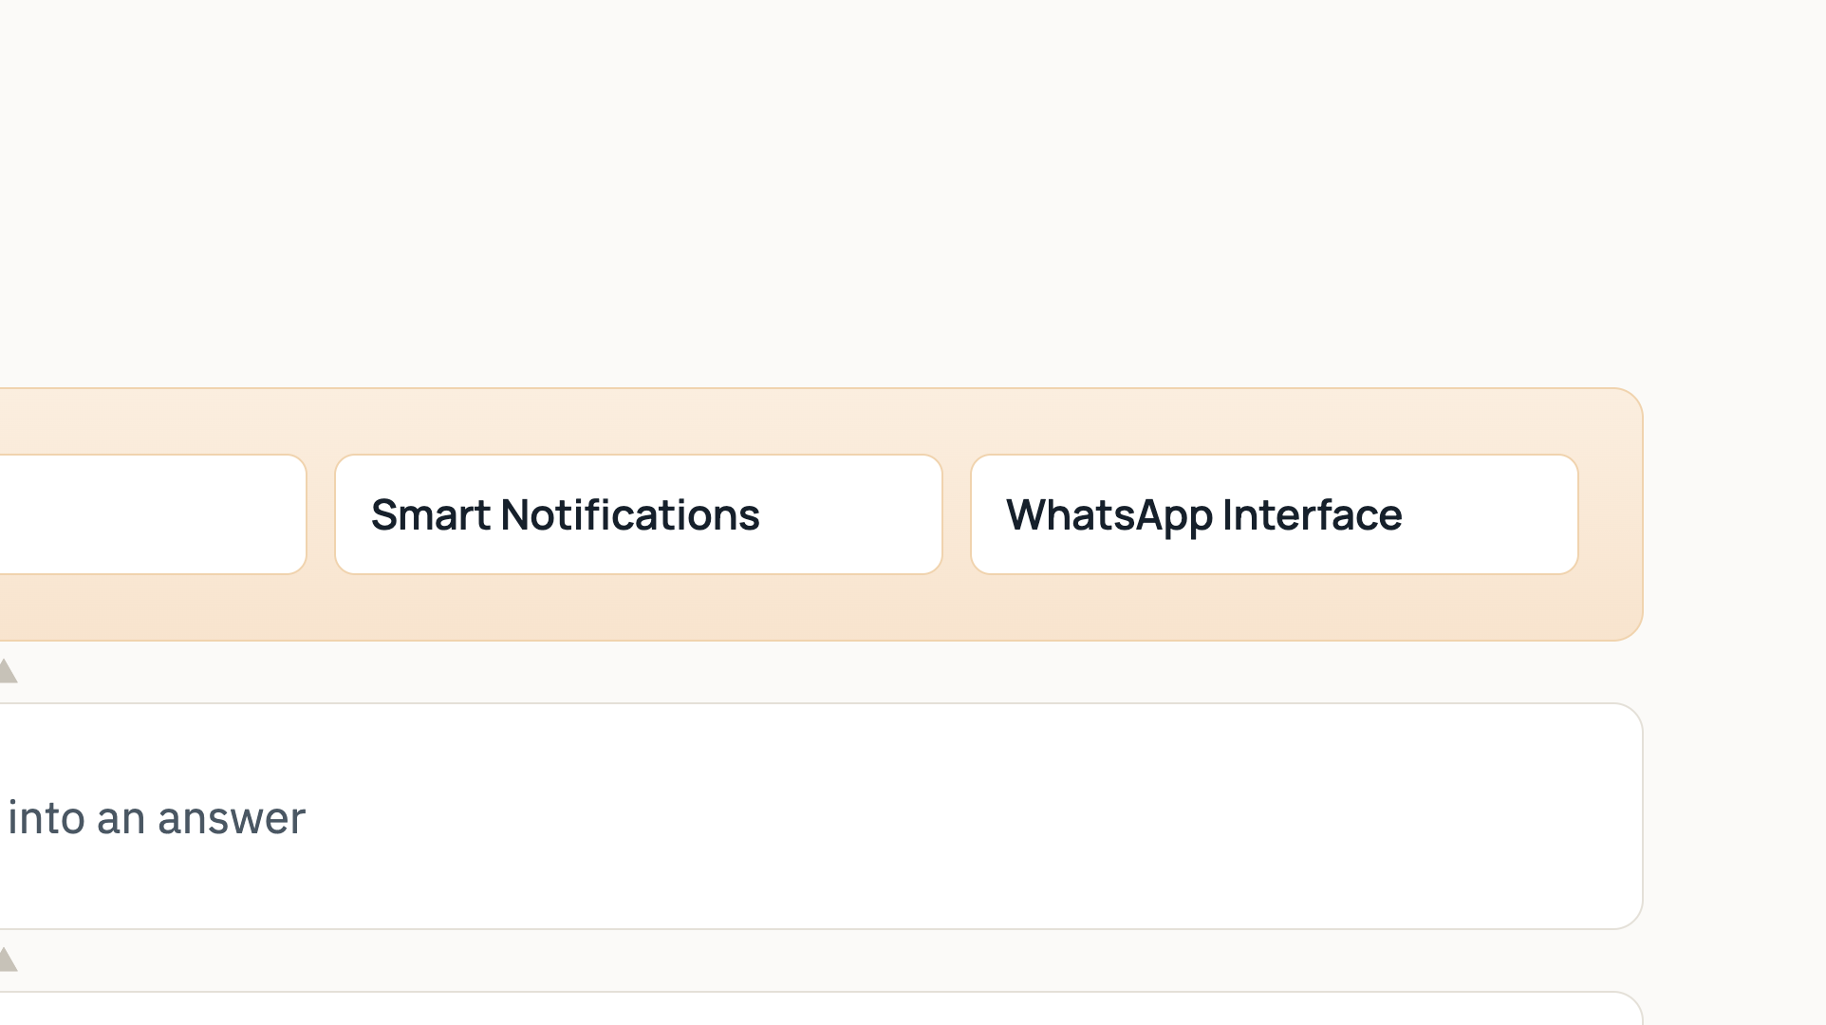
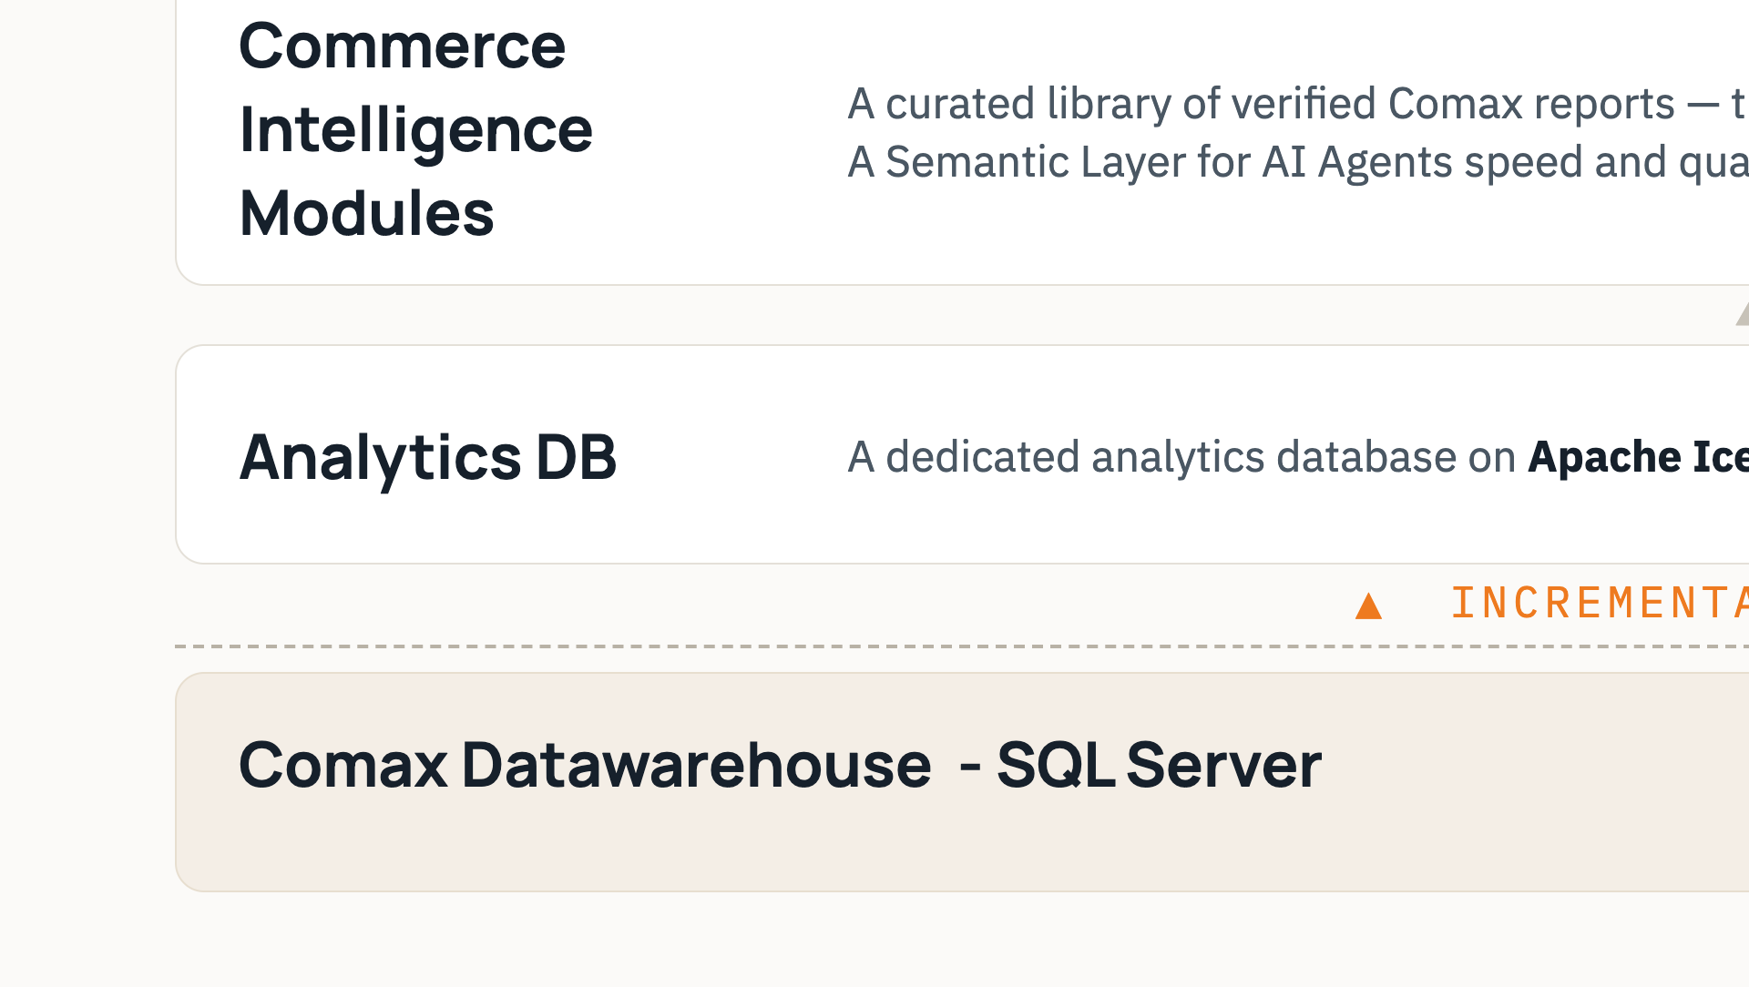
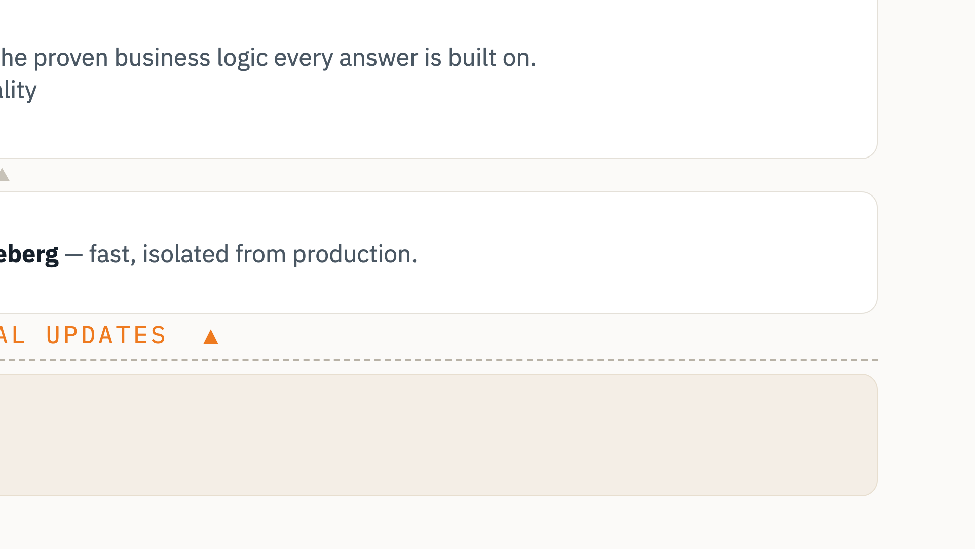
Notes:
The architecture, bottom to top. Your operational database streams changes via CDC into a dedicated analytics database on Iceberg. On top sits a library of verified reports, then the AI agents, and finally the Comax AI app with its four surfaces.

Slide 4
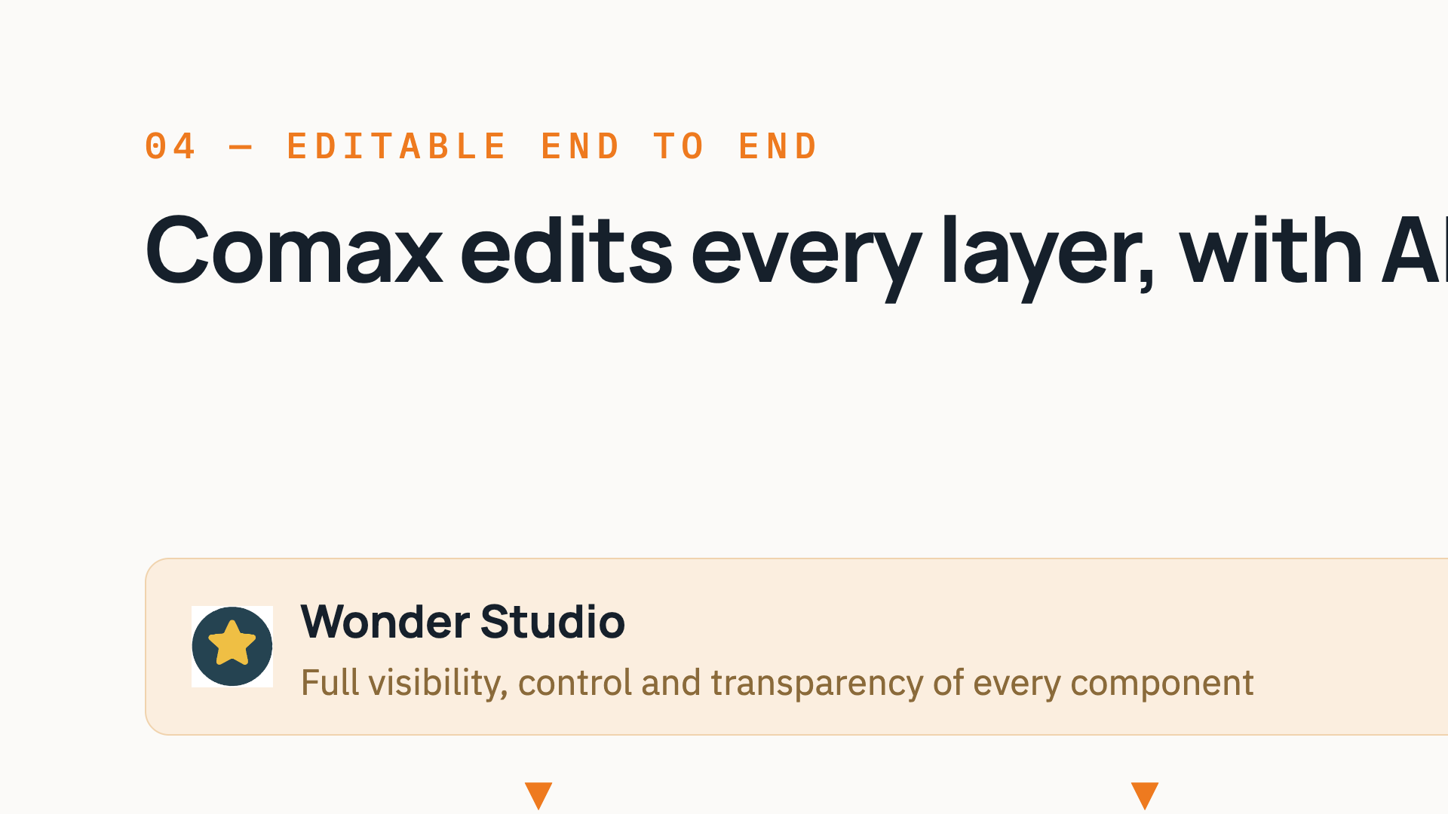
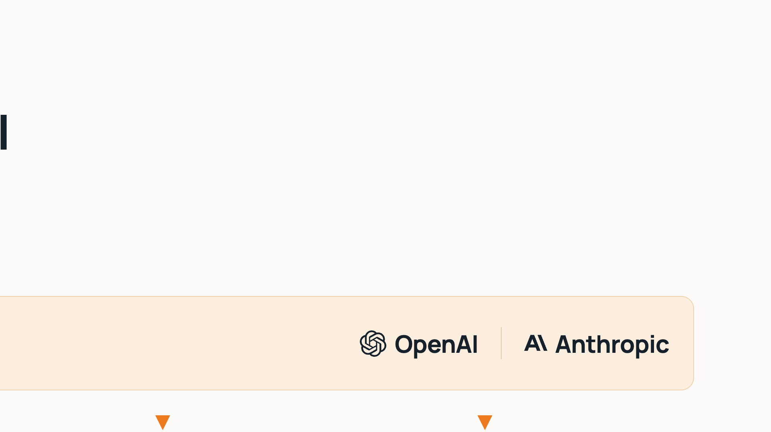
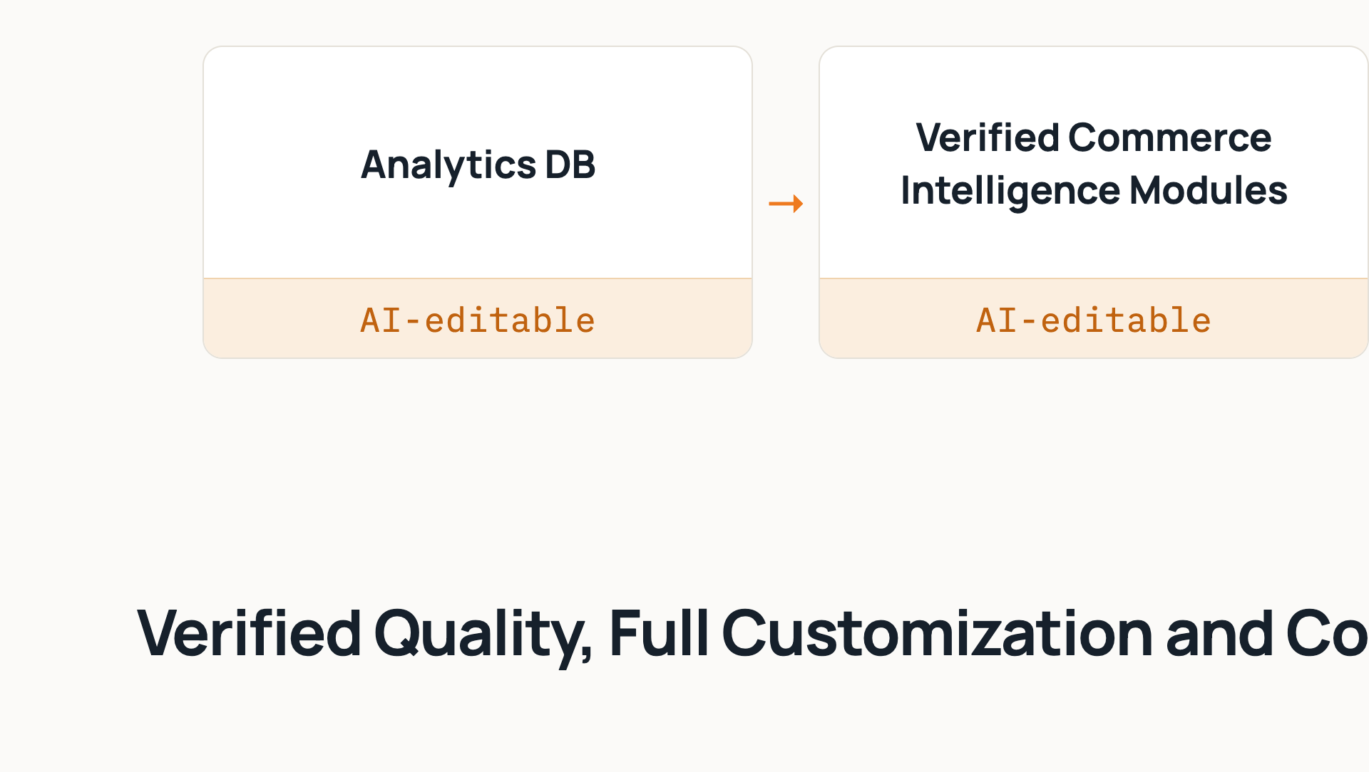
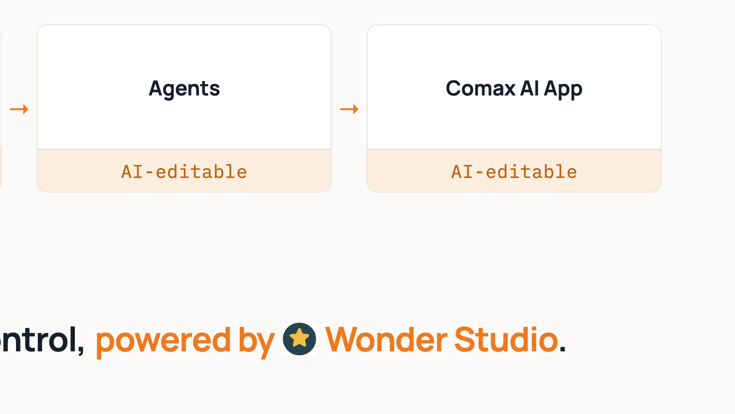
Notes:
Every layer — from the database up to the app — is editable with AI by Comax, in Wonder Studio, using leading models from OpenAI and Anthropic. That means verified quality with full customization and control.

Slide 5
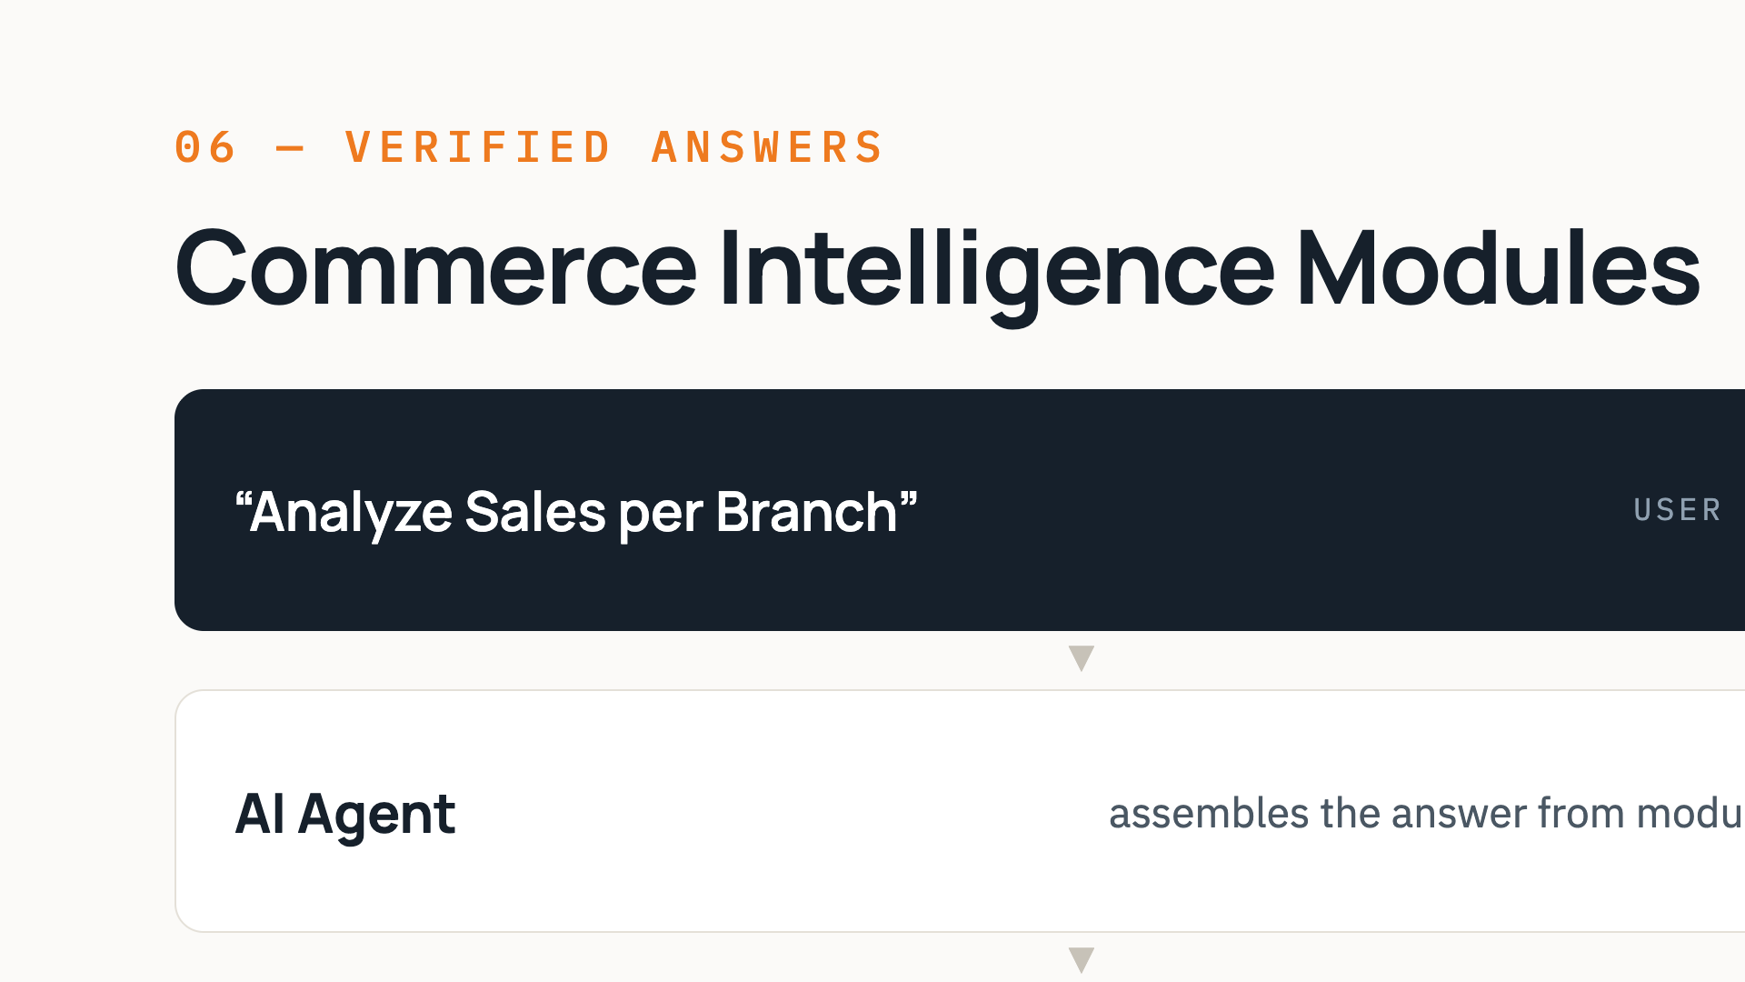
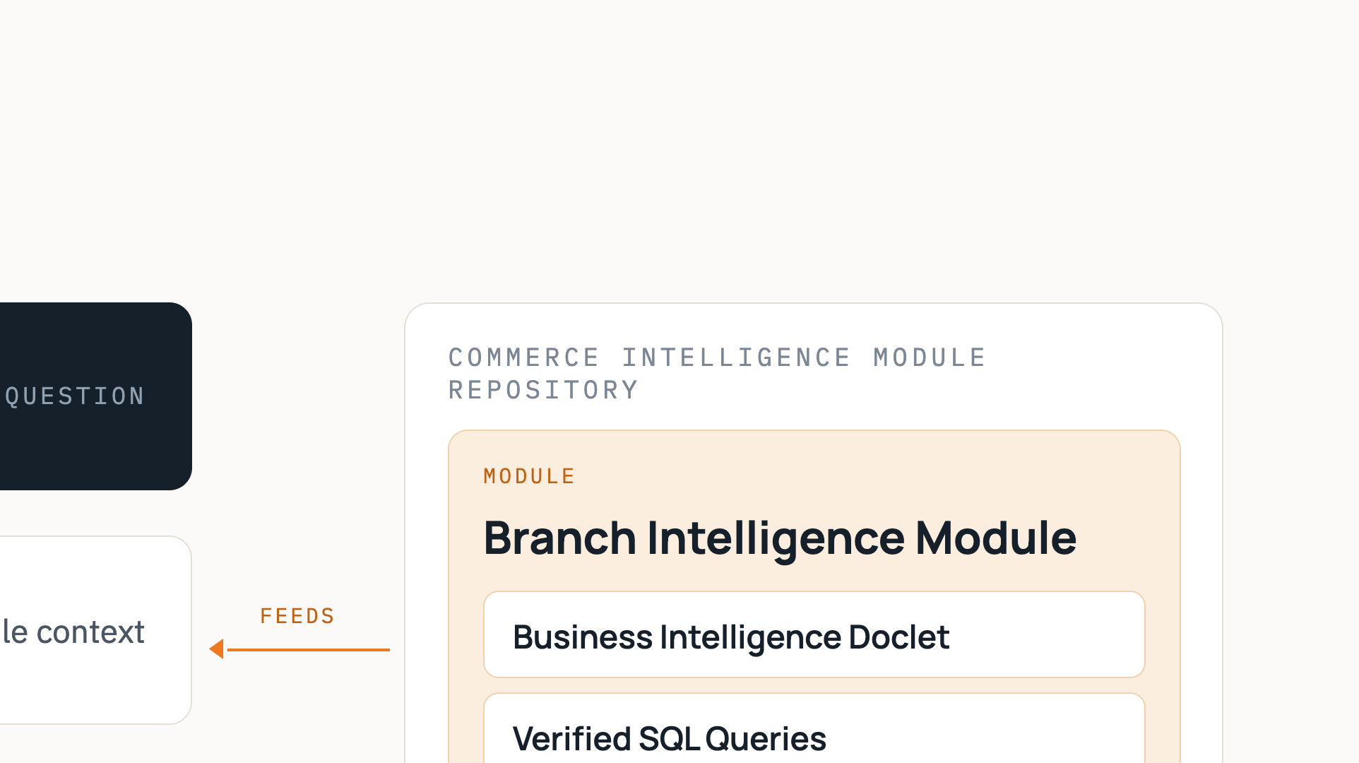
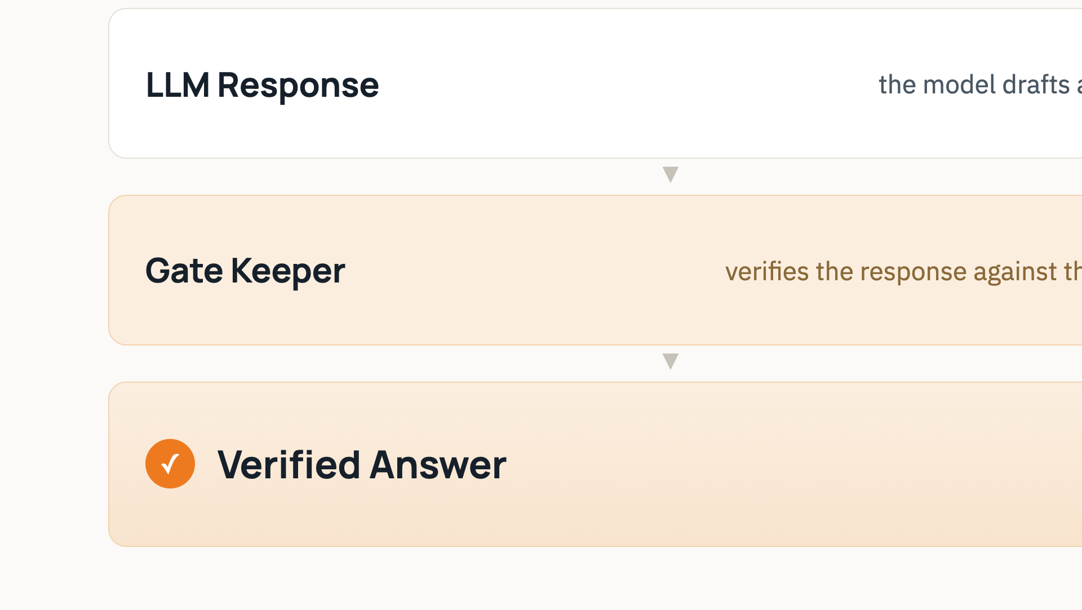
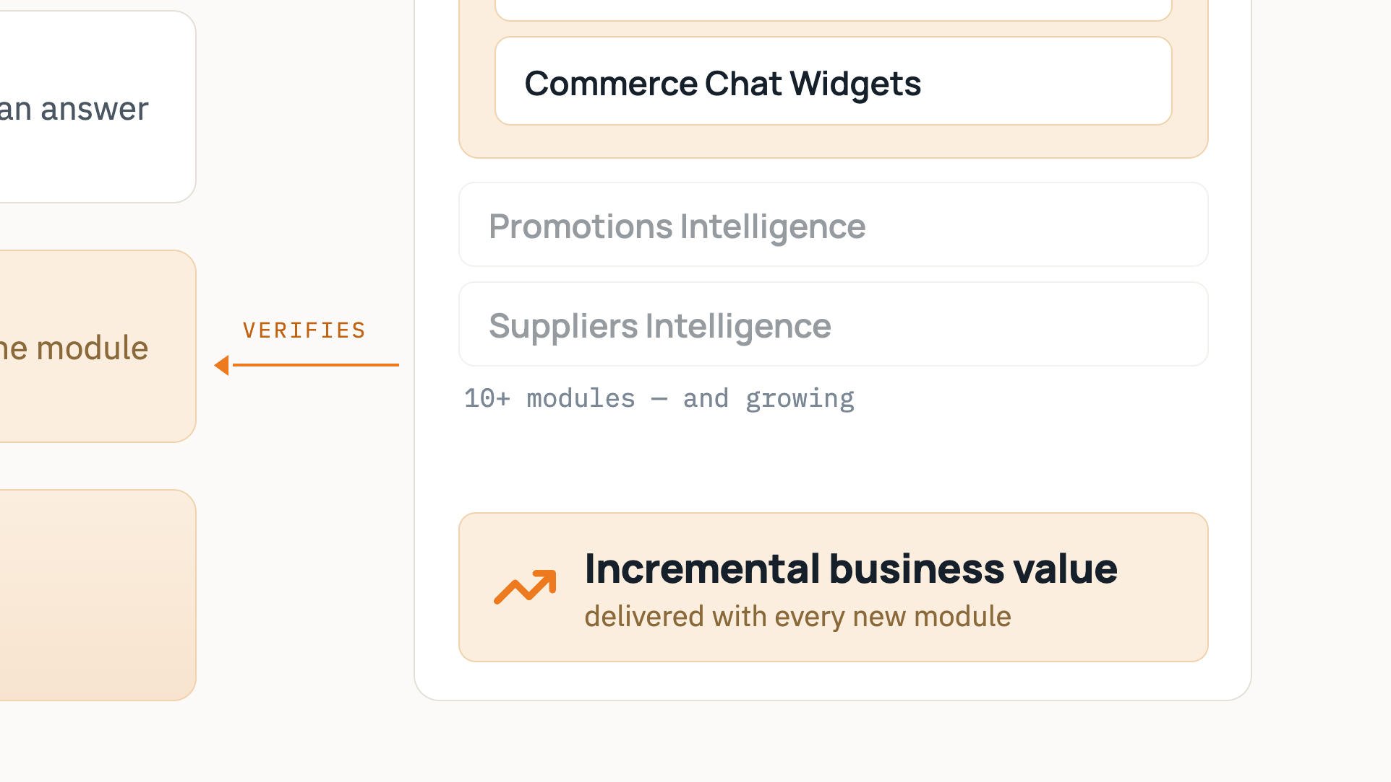
Notes:
How an answer gets verified, end to end: the user asks, the AI agent pulls context from the Branch Intelligence module — prompts, verified SQL, chat widgets — the LLM drafts a response, and a gate keeper verifies that response against the same module before the answer is delivered.

Slide 6
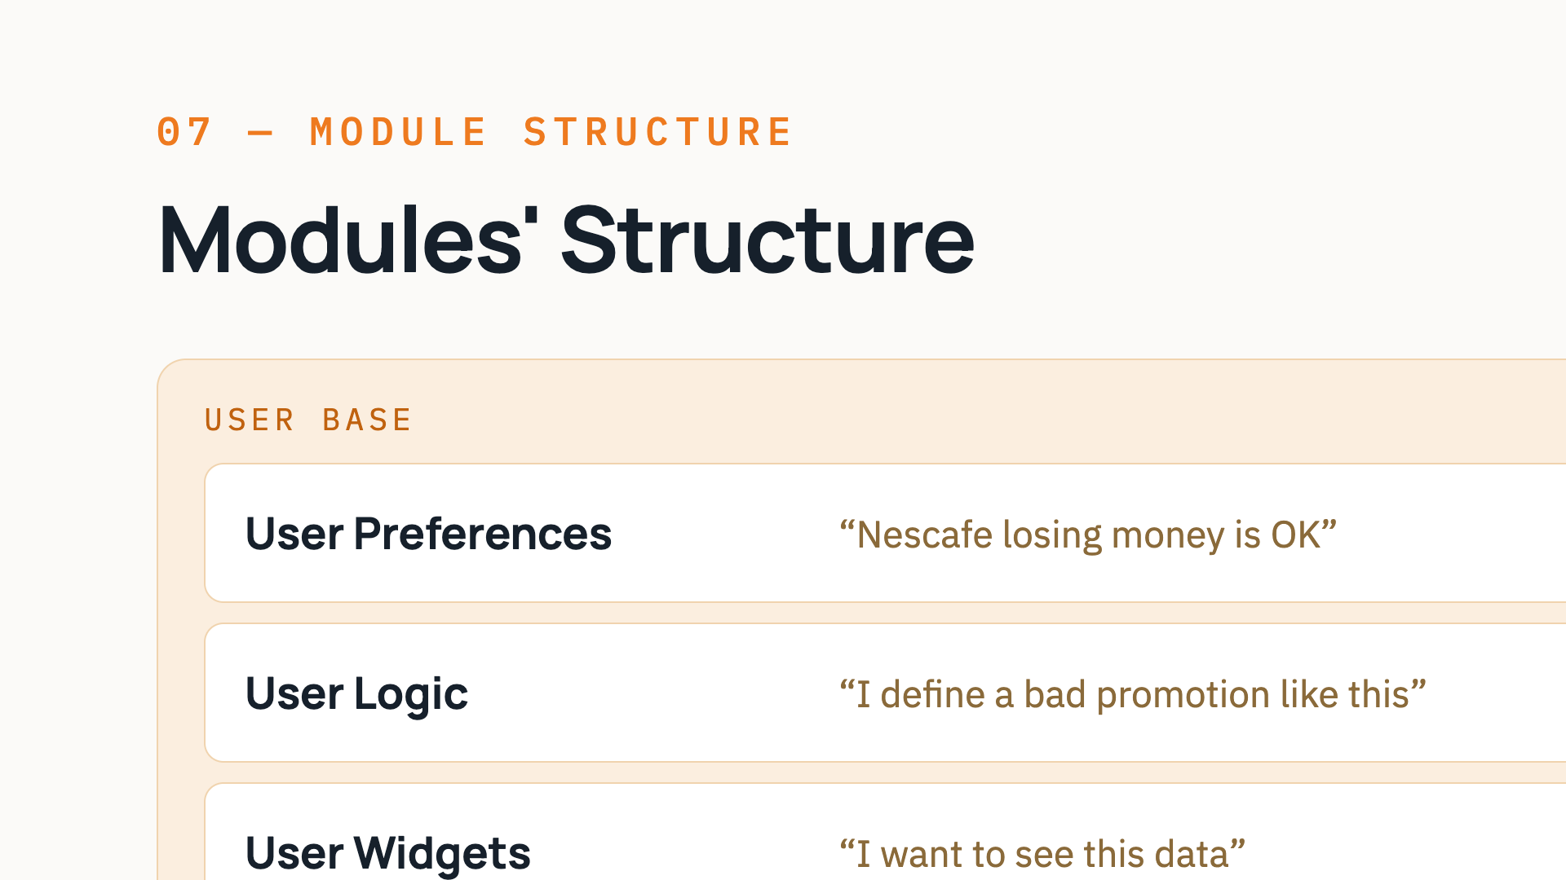
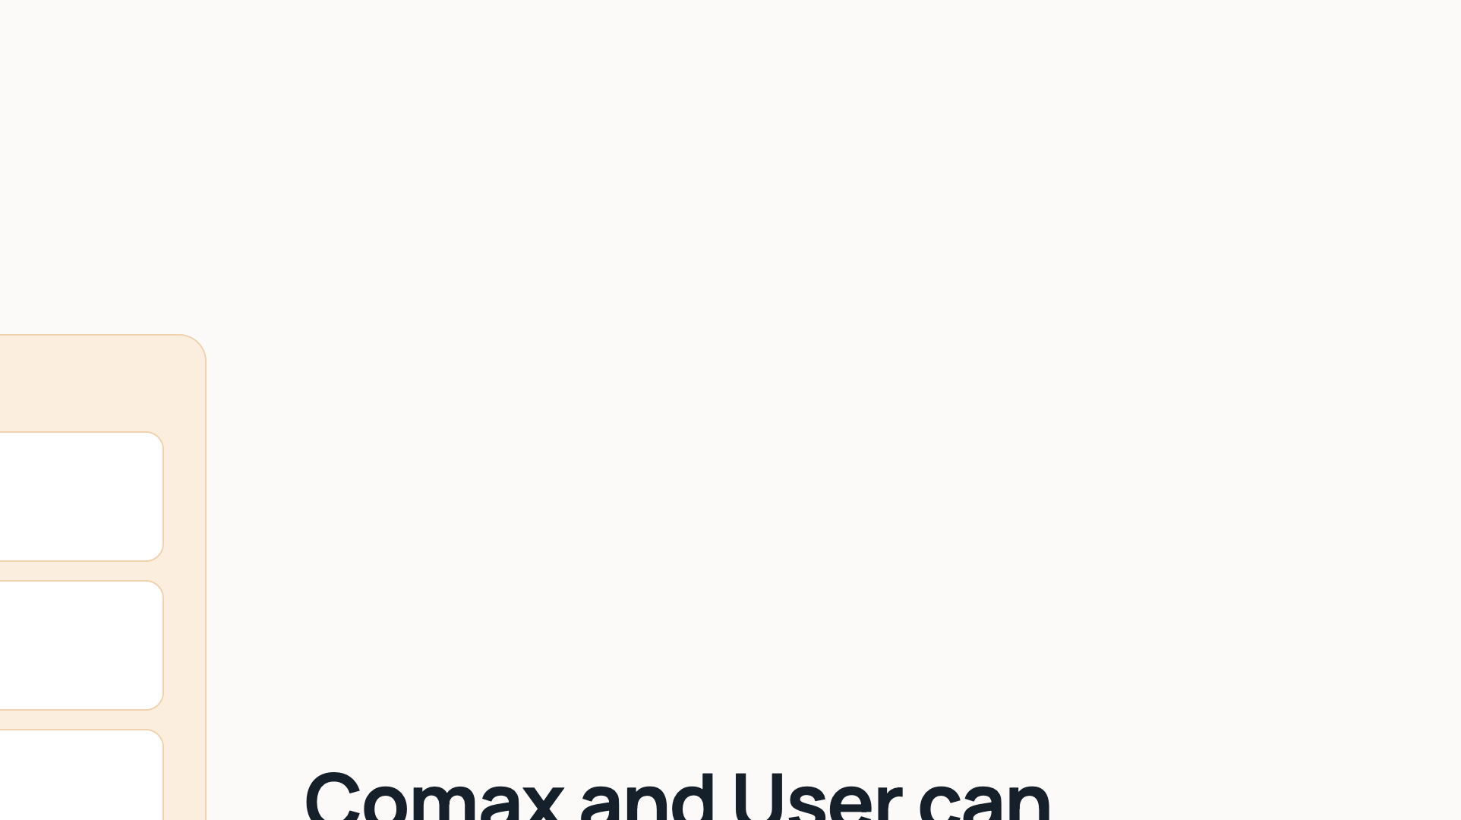
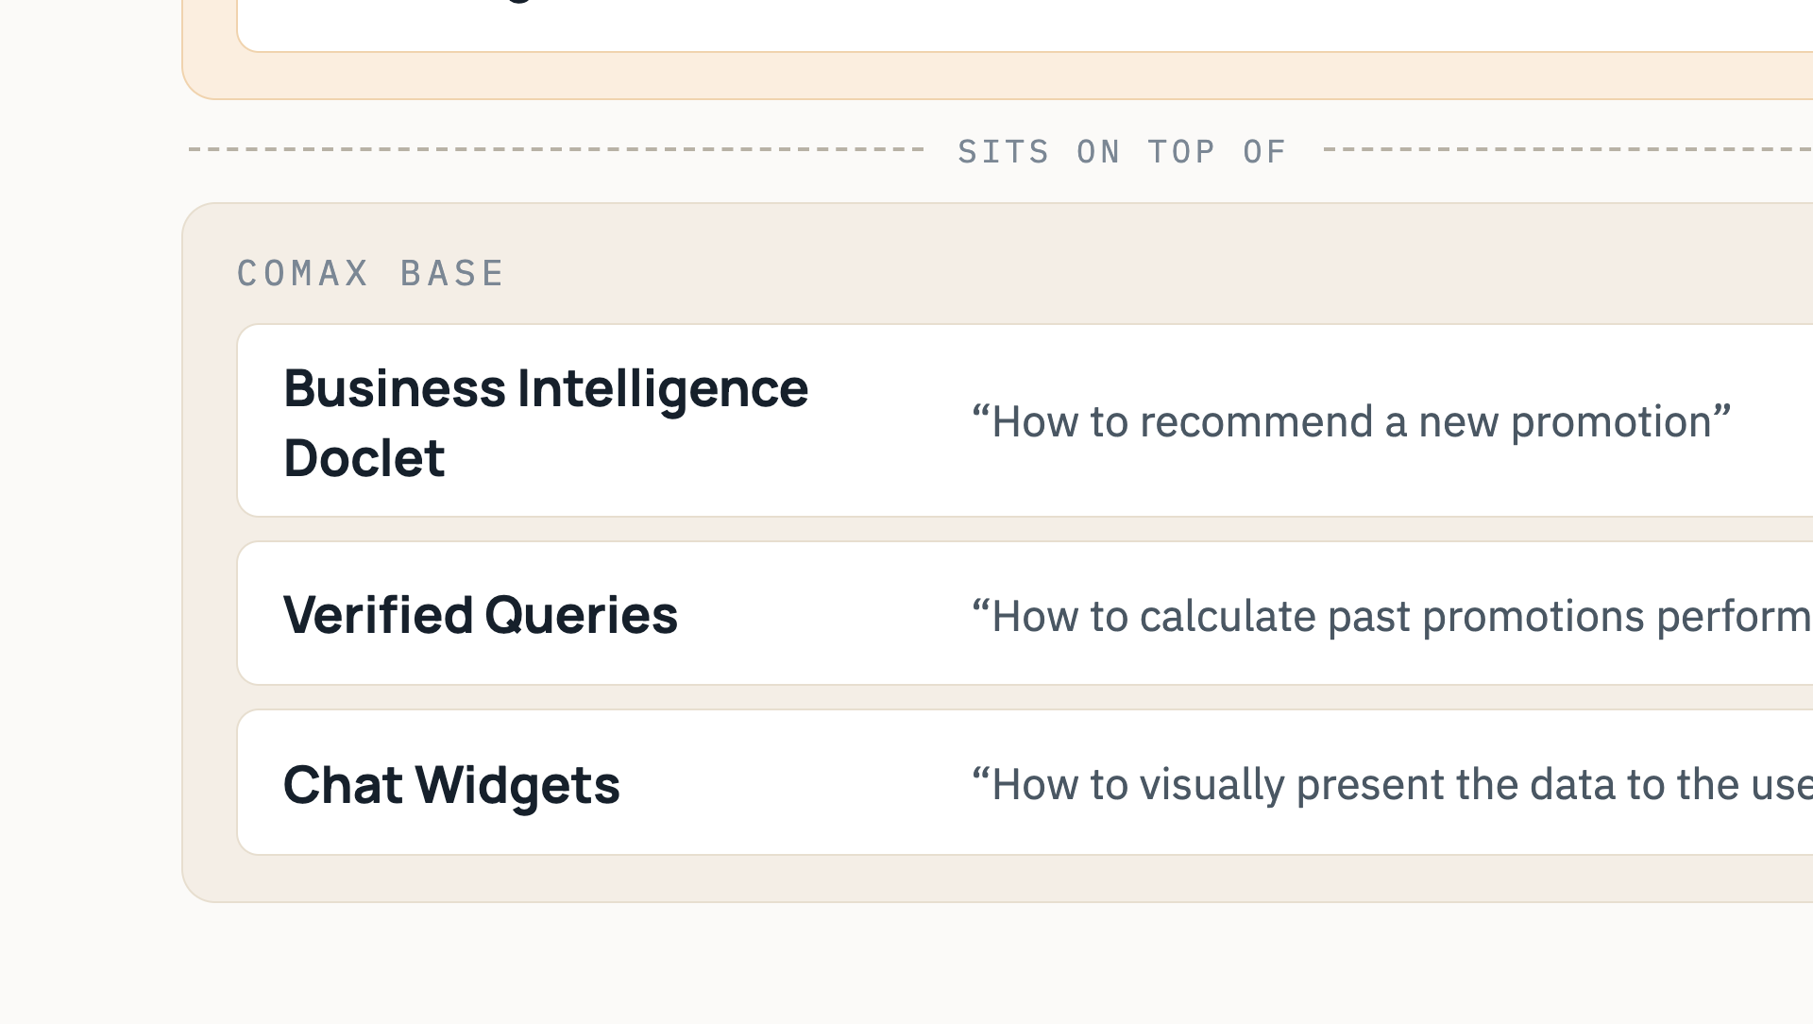
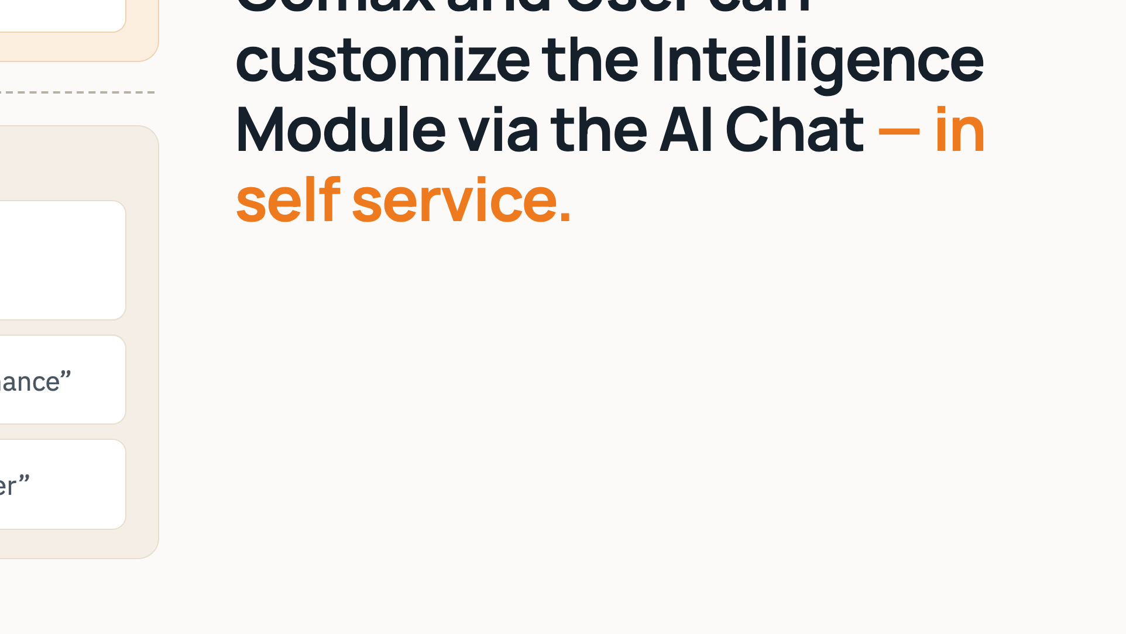
Notes:
Every intelligence module is two layers. The Comax base — the business intelligence doclet, verified queries and chat widgets — is built and verified by Comax. On top sits the user base: each user's own preferences, logic and widgets. Both layers are customized in plain language through the AI chat, fully self-service.

Slide 7
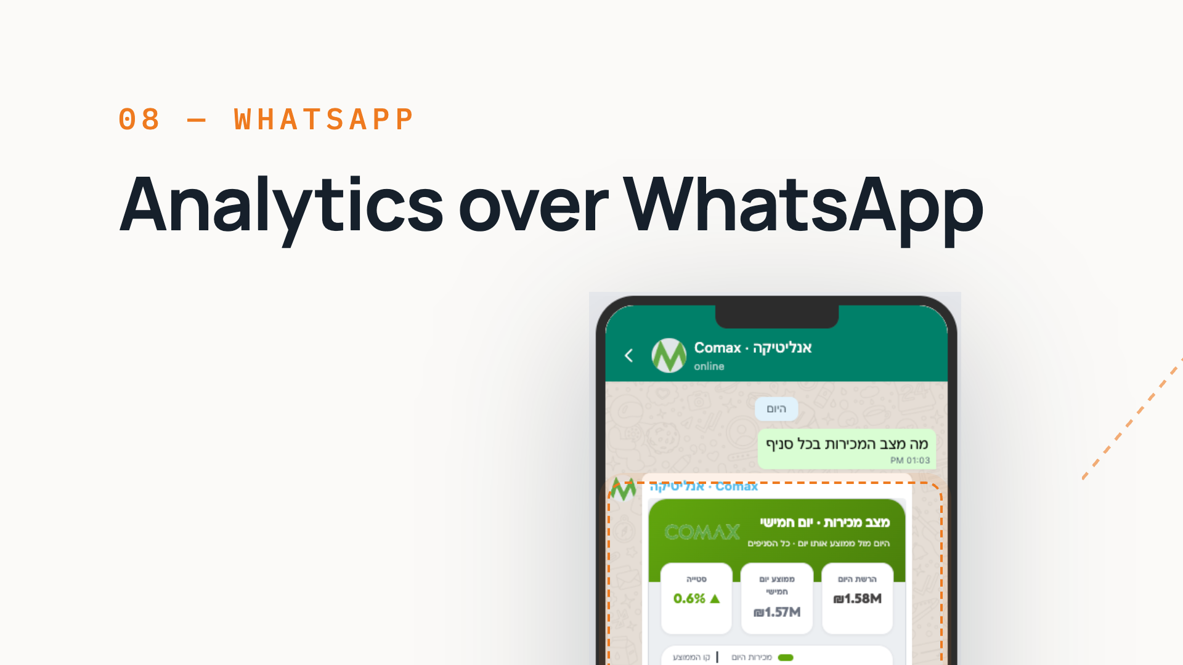
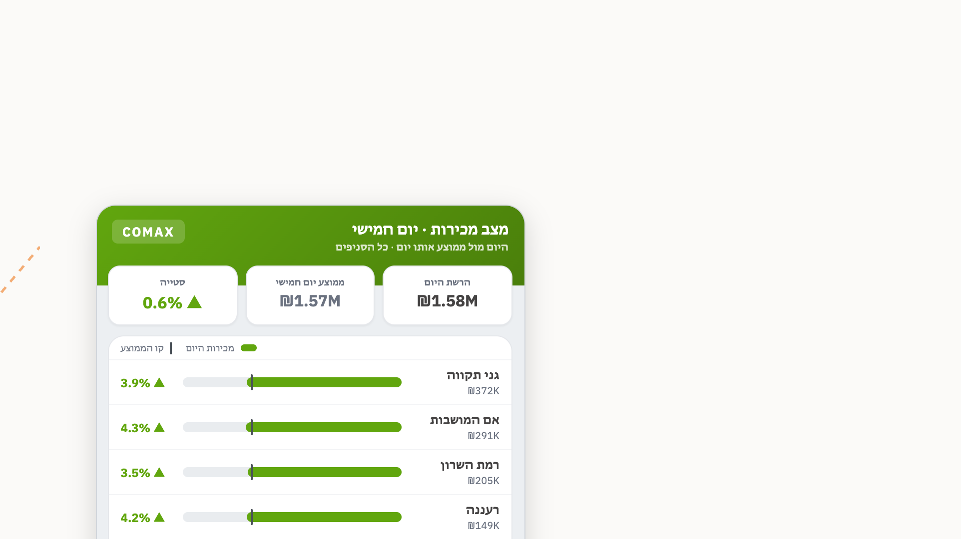
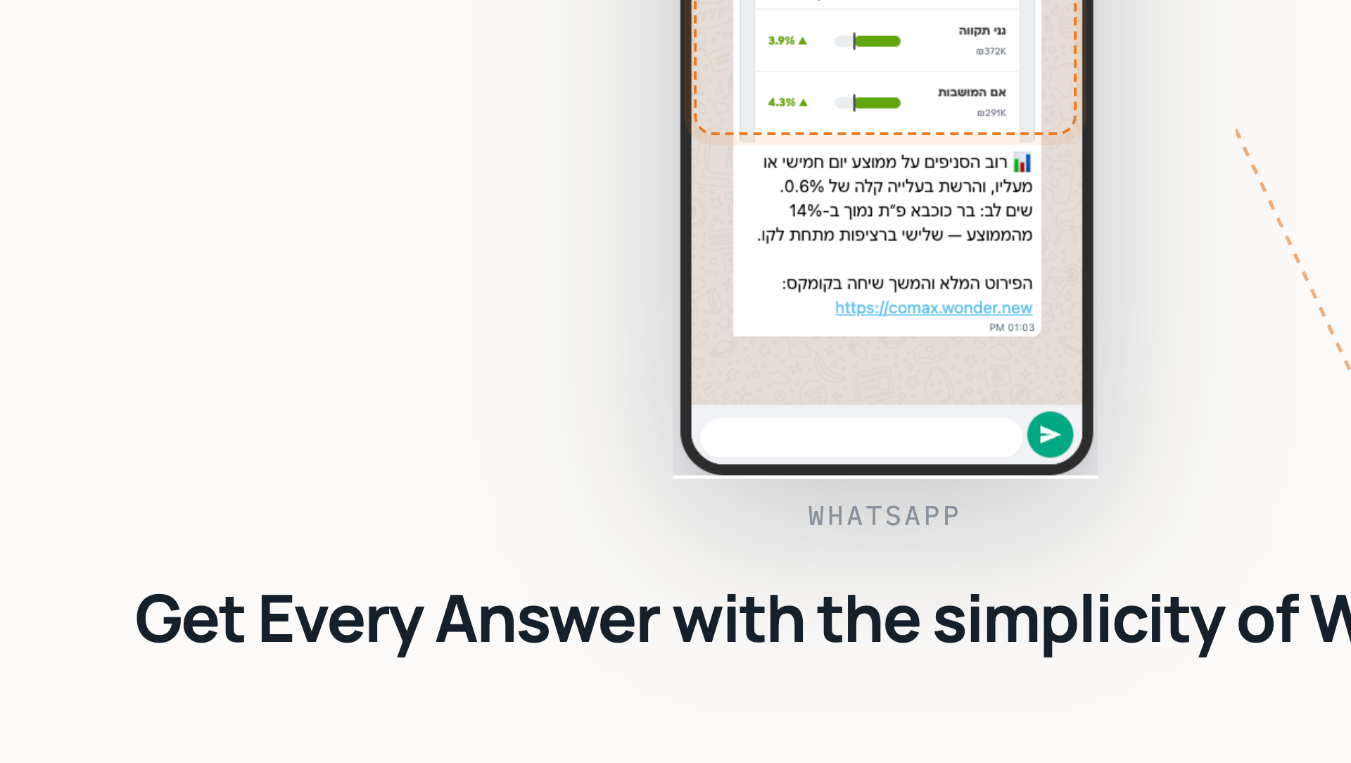
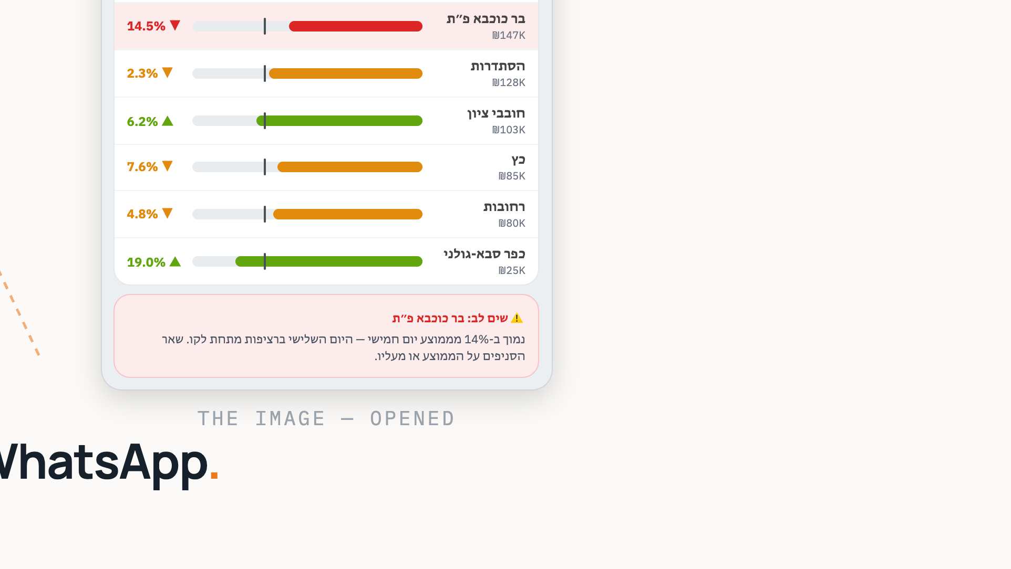
Notes:
Ask in WhatsApp, get a verified answer: the daily branch status arrives as a chart image plus a short summary, with the exception flagged. On the right — the same image opened: every branch against its own day-of-week average. The link continues the conversation in the Comax app.

Slide 8
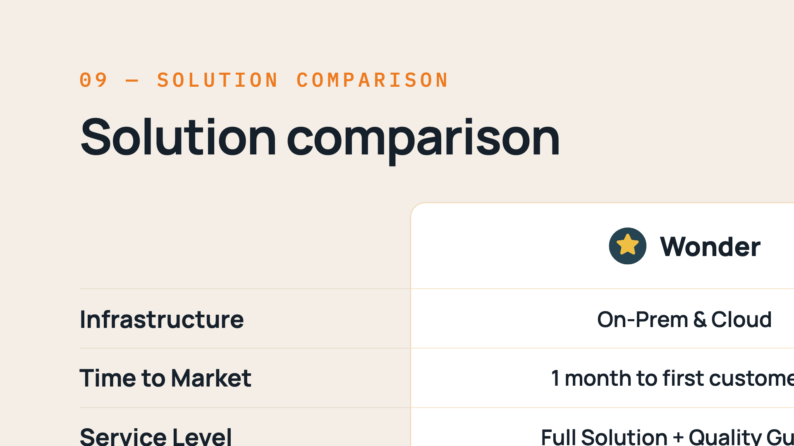
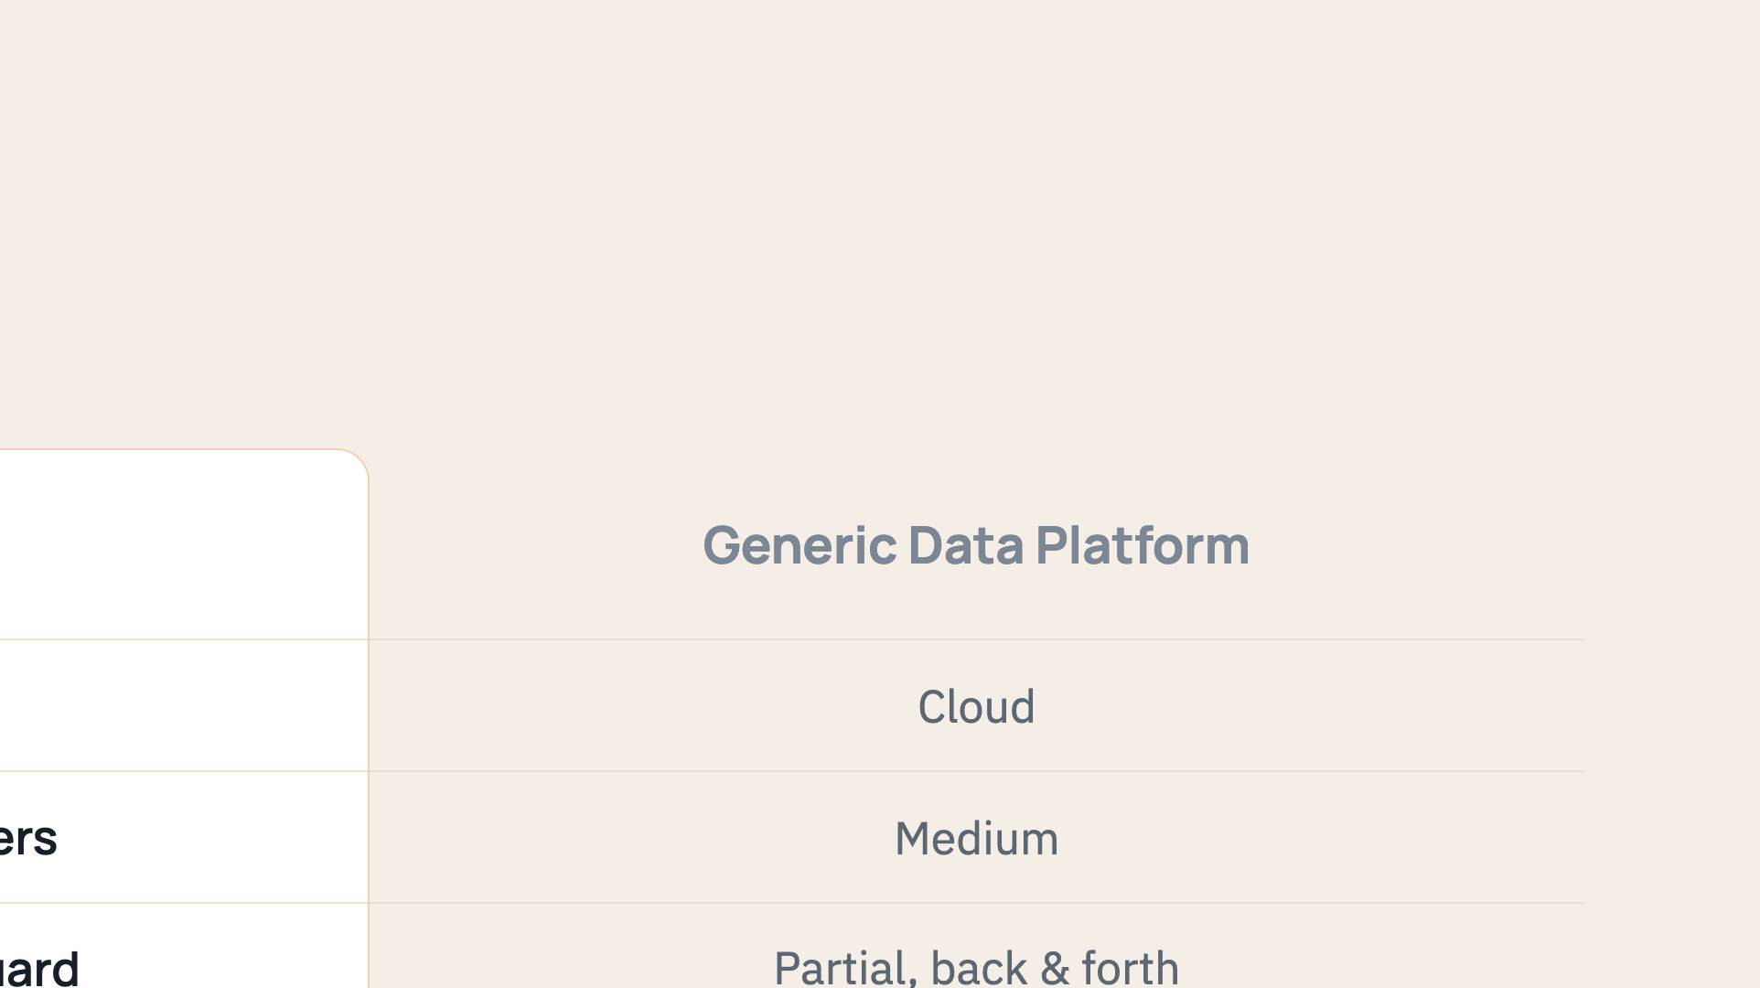
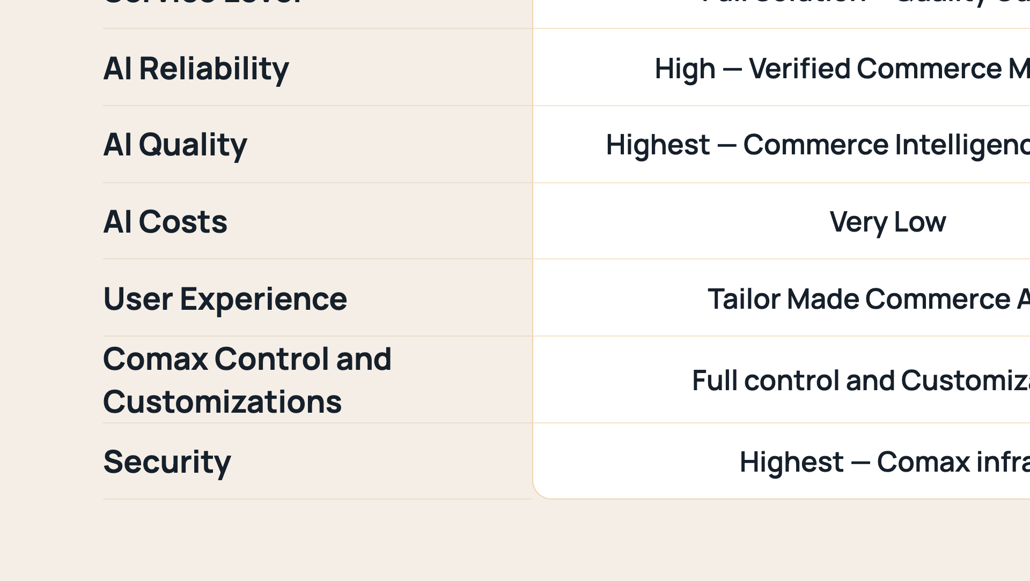
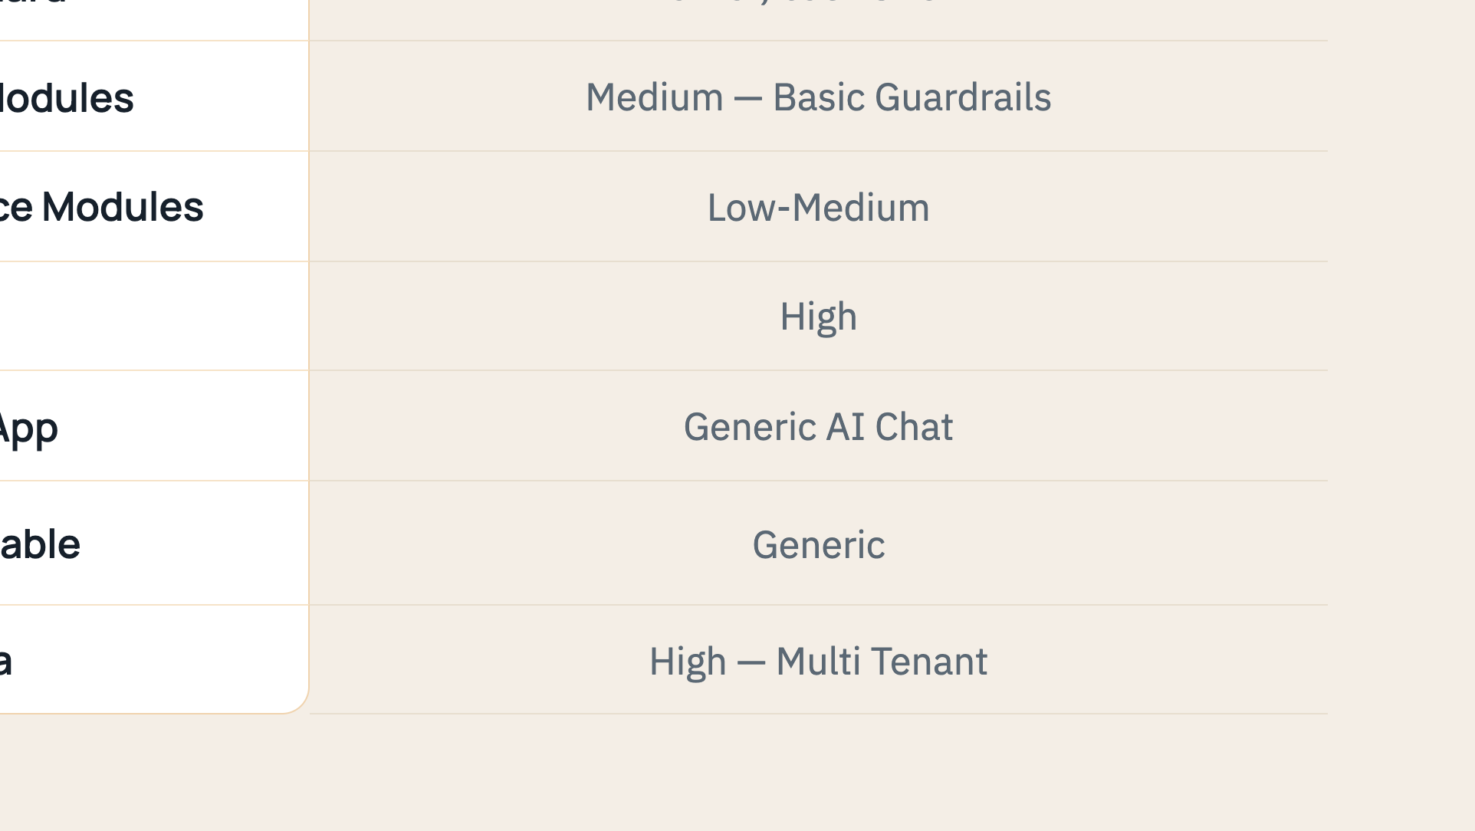
Notes:
Side by side against a generic data platform: Wonder deploys on-prem or in the cloud, ships fastest, comes as a full solution with Quality Guard, and its verified commerce modules give high AI reliability at very low AI cost — with a tailor-made commerce experience running on Comax infrastructure.

Slide 9
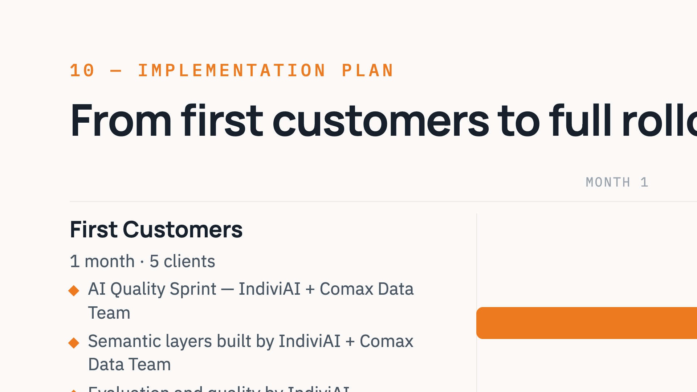
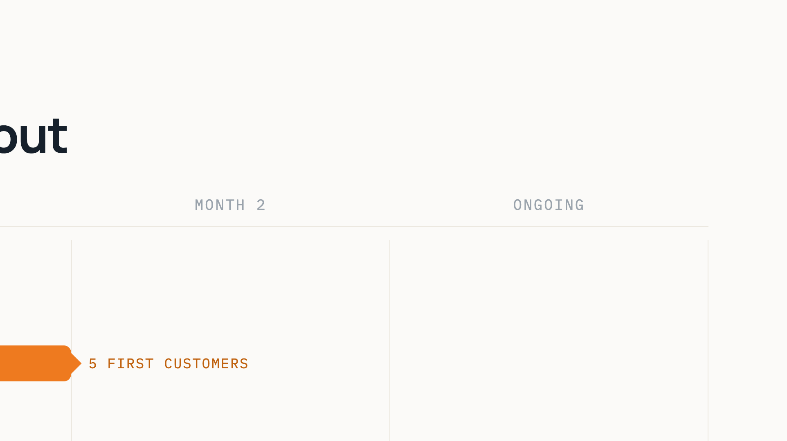
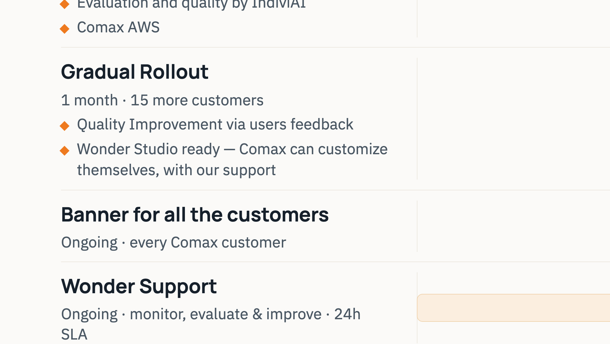
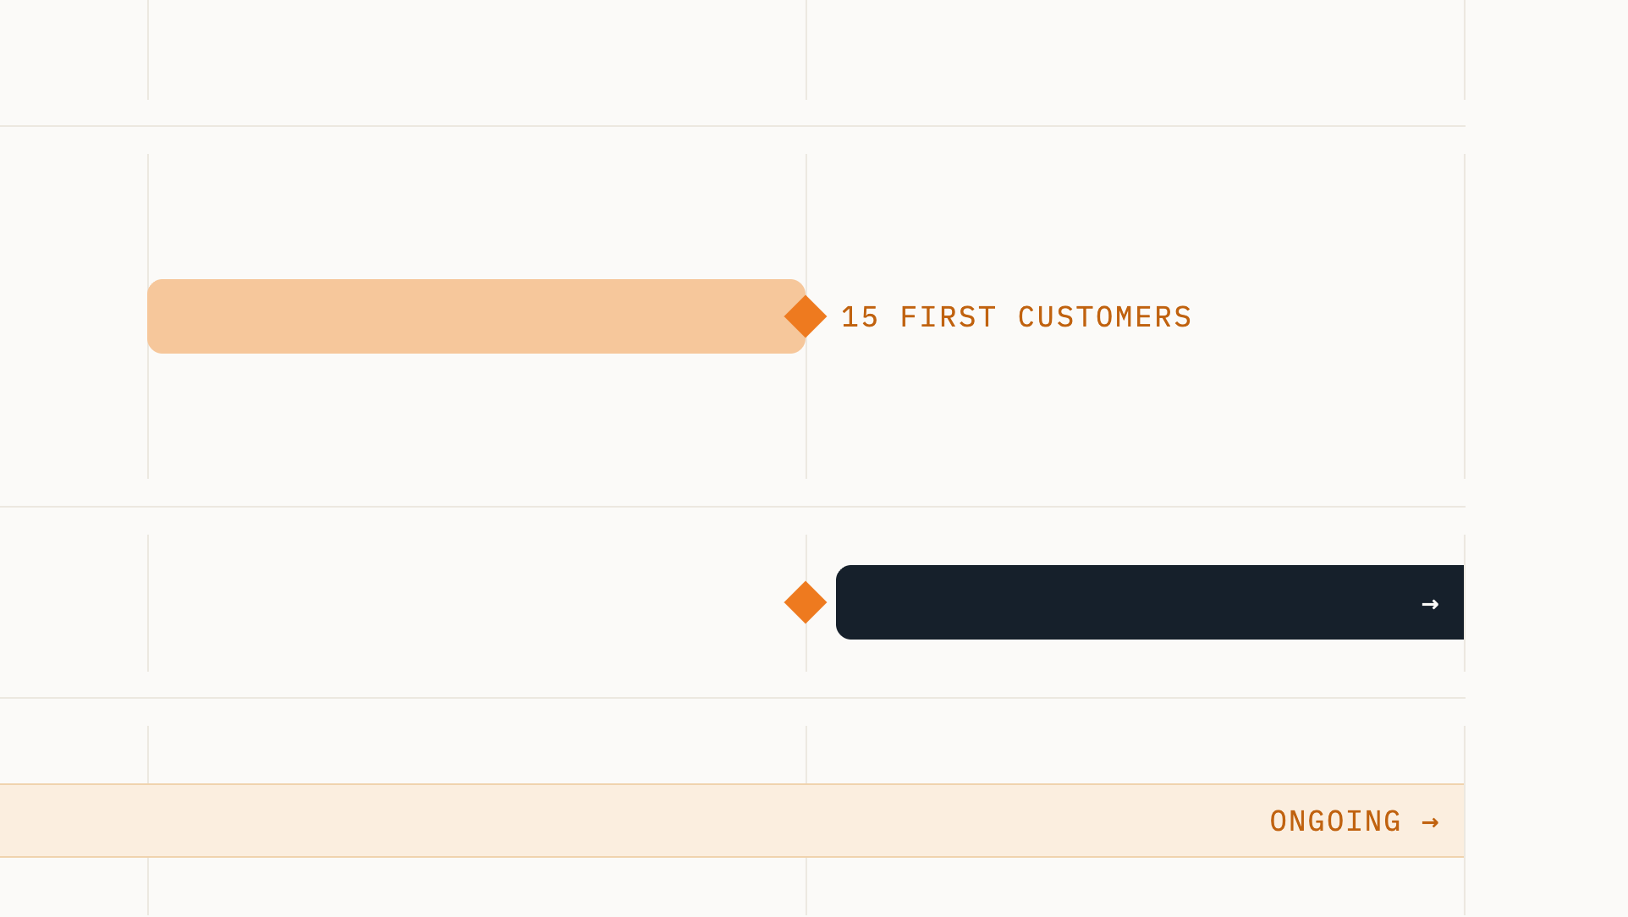
Notes:
Gantt view. Month one, First Customers: five clients live — the AI quality sprint and semantic layers built by IndiviAI together with the Comax data team, evaluation and quality owned by IndiviAI, all on Comax AWS. Month two, Gradual Rollout: fifteen more customers, and Wonder Studio ready so Comax can customize themselves with our support. Then the banner goes out to all customers and rollout continues as ongoing. Wonder Support runs ongoing from day one — monitoring, evaluation and improvement with a 24-hour SLA.

