Slide 1
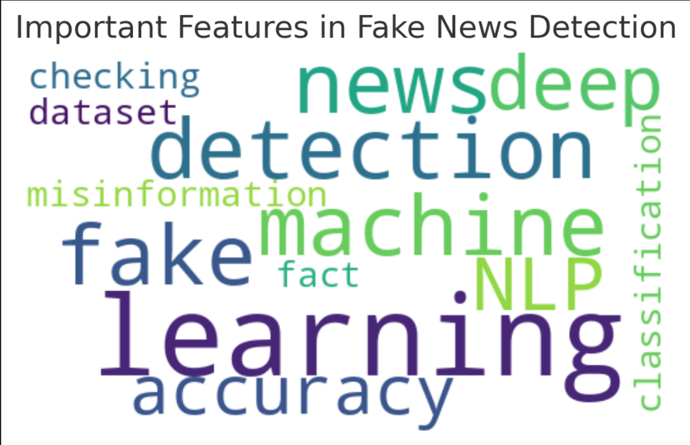
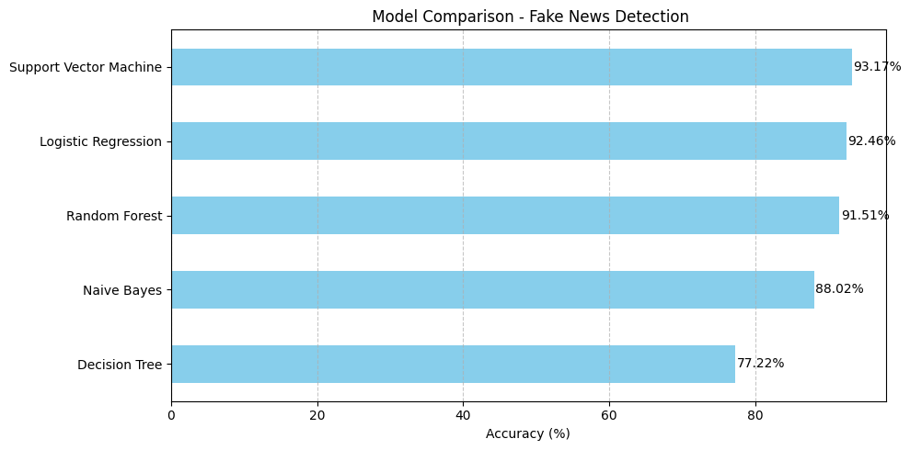
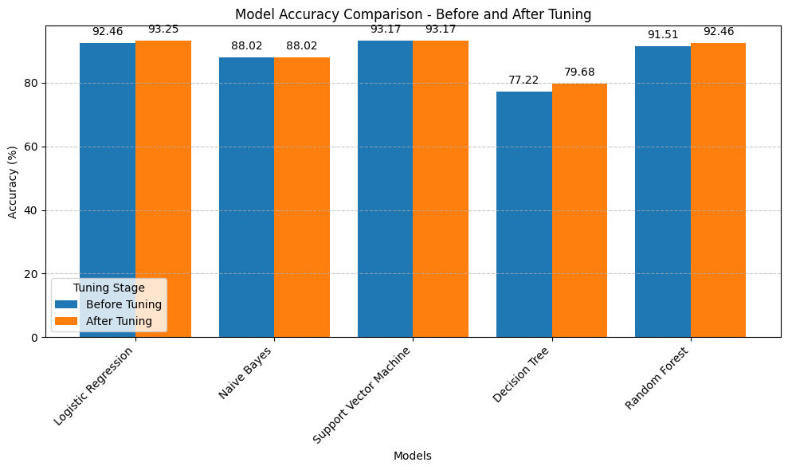
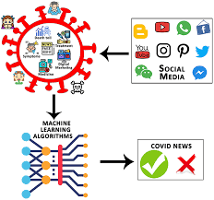

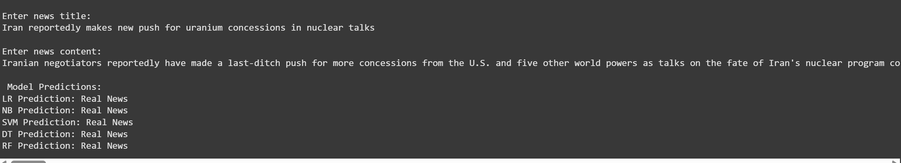
Fake News Detection
Kollapudi Jeevan Kumar, Indla Harshitha, Naga Sruthi Chidipothu, Tejeswar Gadey
jkh6r@umkc.edu, hiv9d@umkc.edu, ncbkg@umsystem.edu, tgdhp@umsystem.edu
Computer Science Engineering, Computer Science Engineering, Computer Science Engineering, Computer Science Engineering
Abstract
Materials
Results
Conclusion
The rise of misinformation and fake news on digital platforms has necessitated the development of automated detection systems. This project explores the use of Data Science and Machine Learning techniques to classify news articles as real or fake. Various models, including Logistic Regression, Naive Bayes, and Deep Learning-based approaches, are compared to determine the most effective method for identifying fake news.
Dataset: Kaggle’s Fake News dataset (includes real and fake news articles)
Tools & Libraries: Python, Scikit-Learn, TensorFlow, Pandas, NLTK
Evaluation Metrics: Accuracy, Precision, Recall, F1-score
Logistic Regression achieved an accuracy of 92%
Naive Bayes performed well with 88% accuracy
LSTM-based deep learning model outperformed traditional ML with 95% accuracy
Machine Learning provides an effective approach to detecting fake news. Deep learning models, particularly LSTMs, offer superior accuracy due to their ability to capture contextual dependencies in text. Future work includes improving performance with transformer-based models like BERT.
Methodology
Data Collection & Preprocessing:
Removal of stopwords, tokenization, and lemmatization
Feature extraction using TF-IDF and Word Embeddings
Model Training:
Implementing Logistic Regression, Naive Bayes, Random Forest, and LSTM
Hyperparameter tuning for optimal performance
Model Evaluation:
Comparing models using evaluation metrics
Visualizing results with confusion matrices and classification reports
Recommendations
Introduction
Incorporate fact-checking sources for improved accuracy
Utilize ensemble models to enhance prediction reliability
Implement real-time detection for social media applications
Fake news has become a critical issue, influencing public opinion and decision-making. Traditional fact-checking methods are insufficient to handle the vast amount of data generated daily. Machine Learning offers an efficient way to analyze and classify news articles based on linguistic and contextual patterns.
Acknowledgements
We acknowledge Professor Syed Jawad Hussain Shah for their guidance and support in this research.

