Slide 1

Travelling Salesman Problem using Branch and Bound
The Traveling Salesman Problem (TSP) is a classic combinational optimization challenge that seeks to find the shortest possible route that visits a set of cities exactly once and returns to the starting city. This approach plays a pivotal role in optimizing logistics, transportation, and route planning in various real-world scenarios.

Slide 2
Introduction
Travelling Salesman Problem
Branch and Bound Algorithm
Optimal Solution
Finding the optimal solution to minimize travel distance and time is crucial for reducing costs, improving time efficiency, lowering environmental impact, optimizing resources, gaining a competitive edge, enhancing urban planning, saving personal time, and advancing mathematical and algorithmic techniques, all of which contribute to economic, environmental, and societal well-being.
The Traveling Salesman Problem (TSP) is a computational problem that involves finding the shortest possible route that visits a set of given locations (usually cities) exactly once and returns to the starting point. It is a classic optimization challenge with applications in logistics, transportation, and various fields where efficient route planning is crucial. The goal is to minimize the total distance or cost of the route while visiting all locations.
Branch and Bound is an algorithm for solving optimization problems. It breaks the problem into smaller parts, estimates their best possible outcomes, and eliminates unpromising paths. This process continues until the best solution is found or proven to be unreachable. It's used for efficiently solving complex problems like the Traveling Salesman Problem.

Slide 3
Branch and Bound Algorithm
1
Approach Overview
Explanation of the step-by-step approach of the branch and bound algorithm.
Branching and Pruning
2
Detail the techniques used to create subproblems and eliminate unpromising paths.
3
Lower Bounds Calculation
Discuss how to calculate lower bounds to estimate the best possible solution.
Promising Subproblems
4
Describe the process of selecting subproblems that have the potential to lead to the optimal solution.

Slide 4

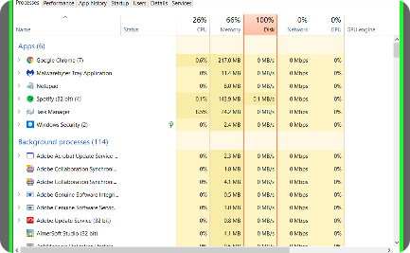
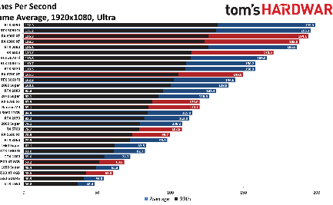
Implementation and Analysis
Algorithm Implementation
Time and Space Complexity
Performance Evaluation
Evaluate the performance of the algorithm and compare it to other optimization techniques.
Steps to implement the branch and bound algorithm in code. Visual representation and visualization techniques.
Analysis of the computational complexity and resources required for the algorithm.

Slide 5
Case Study
1
Real-world Application
Explore a practical application of the algorithm in a specific industry or domain.
Example Problem and Solution
2
Present a detailed example problem and the corresponding solution using the branch and bound algorithm.
3
Results Analysis
Analyze the results obtained from the case study and discuss their implications and benefits.

Slide 6
Advantages and Limitations
Benefits of Branch and Bound
Limitations and Challenges
Outline the advantages and strengths of using the branch and bound algorithm for optimization problems.
Discuss the limitations and challenges faced when applying the branch and bound algorithm.
Problem Size and Complexity
Enhancements and Alternatives
Considerations for problem size and complexity when using the branch and bound algorithm.
Explore potential enhancements and alternative approaches to improve the algorithm's performance.

Slide 7

Conclusion
1
Recap of Key Points
Summarize the main concepts discussed throughout the presentation.
2
Importance of Branch and Bound
Highlight the significance of the branch and bound algorithm in solving optimization problems.
3
Inspiration for Further Research
Encourage further research and improvements on the branch and bound algorithm.
4
Closing Remarks and References
Closing remarks and references to acknowledge the sources of information.

Slide 8
Initialization: Begin with the entire problem space. This means considering the full set of possibilities for solving the problem. For example, in the Traveling Salesman Problem (TSP), you start with all possible routes that can be taken to visit cities.
Branching: Divide the problem into smaller, more manageable subproblems. In the context of TSP, this could involve selecting a city as the next destination. Each branch represents a different choice or decision point.
Bounding: Estimate the best possible outcome (usually a lower bound) for each subproblem. In TSP, this could be finding the minimum possible distance if a specific city is visited next. If this estimate is worse than the best solution found so far, prune (discard) that branch, as it cannot lead to an optimal solution.
Backtracking: Systematically explore the branches, going deeper into promising paths. When exploring a branch, keep track of the best solution found so far. If a branch cannot lead to a better solution than the best one found, prune it. This recursive process continues until all branches have been explored.
Termination: The algorithm either terminates when all branches have been explored or when it can prove that no better solution exists than the best one found. The best solution found is the optimal solution to the problem.
Optimal Solution: The optimal solution is the best one among all possible solutions considered, and it represents the most efficient and effective way to solve the given optimization problem.
SLIDE 3

