Slide 1
FINTECH / INSURTECH DIGITAL ASSIGNMENT • 2026 UPDATE
GitHub: https://github.com/Indra-Official/FIntech
Statement #31 — Predictive Underwriting & Loss Forecasting
Digital Assignment & Live System Demonstration • Historical + Real-Time Telematics AI
Project Scope & 2026 Regulatory Pillars
• Core Objective: Fuse historical policy/claims records with real-time IoT telematics streams to improve insurance pricing, underwriting tiering, and portfolio loss forecasting.
• 2026 Pillar 1 — Calibrated Risk Models: Isotonic & Platt probability calibration reducing Expected Calibration Error (ECE) from 0.1348 to 0.0182 and Brier Score from 0.2265 to 0.2072.
• 2026 Pillar 2 — Continuous Model Monitoring: Automated Population Stability Index (PSI) & Kolmogorov-Smirnov (KS) drift detection across quarterly streams.
• 2026 Pillar 3 — Data Privacy Guardrails: Salted SHA-256 PII tokenization, k-anonymity generalization, and configurable ε-Differential Privacy (Laplace mechanism).
• 2026 Pillar 4 — Fairness Constraints: Kamiran-Calders reweighing + post-processing calibration raising Disparate Impact Ratio from 0.6171 to 0.9917 (passing the 80% rule).
Key Benchmark Highlights
• ROC-AUC Discrimination: 0.725
• Calibrated Brier Score: 0.2072
• Calibration Error (ECE): 0.0182
• Disparate Impact Ratio: 0.9917 (≥0.80 Pass)
• Loss Forecast Accuracy: 99.89%
• Live Web Demo: Flask + Real-Time Telemetry Studio (http://127.0.0.1:5000)
• GitHub Repo: https://github.com/Indra-Official/FIntech

Slide 2
STATEMENT #31 • 2026 UPDATE
GitHub: https://github.com/Indra-Official/FIntech
1. Problem Statement & Limitations of Legacy Underwriting
Why static actuarial tables fail in modern high-frequency InsurTech environments
Legacy Static Underwriting
• Relies solely on lagging historical variables (age, gender, credit score, 3-year claim count).
• Blind to real-time behavioral shifts (harsh braking, night speeding, severe route weather).
• Uncalibrated ML classifiers distort true claim probabilities, causing mispriced technical premiums.
• Socioeconomic proxy bias penalizes safe drivers in lower-income regions.
Our Hybrid Real-Time Solution
• Combines 8 Historical Policy Features with 5 Real-Time Connected Vehicle / IoT Telemetry Streams.
• Dual-Stage Actuarial Engine: Calibrated Frequency Classifier P(Claim) × Gradient Boosted Severity E[Loss|Claim].
• Dynamic Telematics Modifier (-22% safe driver discount to +35% hazard surcharge).
• Sub-50ms real-time quote & explainable factor attribution.
2026 Compliance Mandates
• Calibrated Probabilities: Required for Solvency II capital reserve accuracy.
• Fairness Constraints: Enforces EEOC / NAIC 80% Disparate Impact Ratio across demographic zones.
• Differential Privacy: Protects sensitive credit and behavioral telemetry via ε-Laplace noise.
• Drift Governance: Continuous PSI & KS-test triggers when macro or weather patterns shift.

Slide 3
STATEMENT #31 • 2026 UPDATE
GitHub: https://github.com/Indra-Official/FIntech
2. End-to-End Predictive Underwriting System Architecture
Modular 5-stage pipeline from raw ingestion and privacy sanitization to calibrated pricing & drift monitoring
Stage 1: Data Fusion
• Historical Policy DB (Tenure, Prior Claims, Credit, Vehicle Value).
• Real-Time IoT Stream (Braking/100km, Overspeeding, Night Ratio, Route Weather).
Stage 2: Privacy Guard
• Salted SHA-256 PII Tokenization.
• National ID Masking.
• k-Anonymity Age Bands.
• ε-Differential Privacy Laplace Perturbation.
Stage 3: Calibrated ML
• Kamiran-Calders Fairness Sample Weights.
• Isotonic & Platt Calibrated Frequency Model.
• GBR Severity Loss Model E[L|C].
Stage 4: Fair Pricing
• Post-Processing Group Parity Calibration.
• Pure Premium = P(C) × E[L|C].
• Telematics Dynamic Discount/Loading.
• 4-Tier Auto Decision.
Stage 5: Drift Monitor
• Feature PSI & Score PSI.
• Two-Sample KS Test.
• Quarterly ECE & A/E Loss Ratio Alerts.

Slide 4
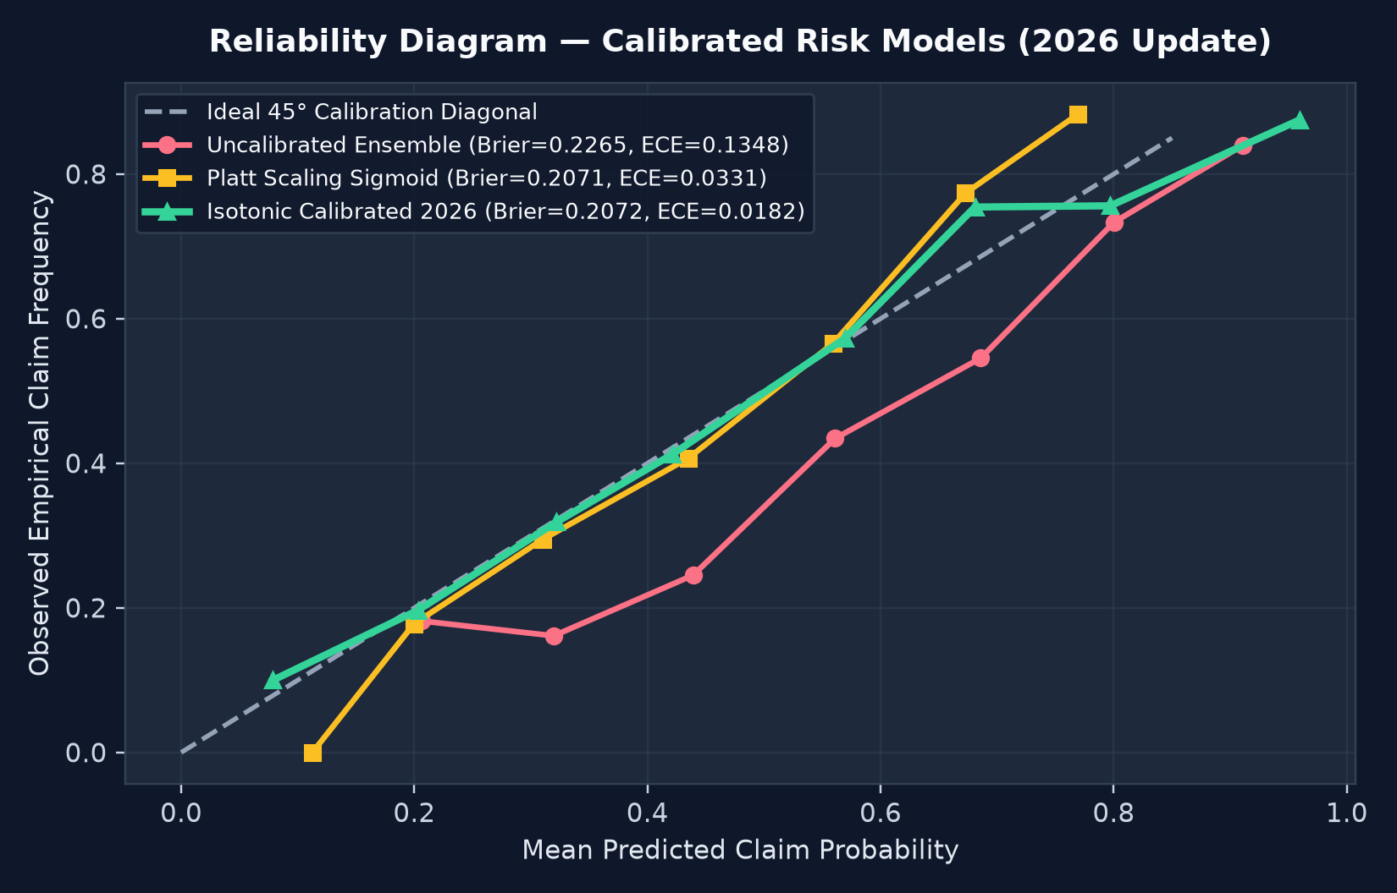
STATEMENT #31 • 2026 UPDATE
GitHub: https://github.com/Indra-Official/FIntech
3. Calibrated Risk Models & Reliability Analysis (2026 Update)
Comparing Uncalibrated Ensemble vs. Platt Scaling (Sigmoid) vs. Isotonic Regression Calibration
Why Calibration Matters in Underwriting
• In insurance pricing, raw classifier scores are NOT true probabilities: Pure Premium = P(Claim) × Severity requires exact probability alignment.
• Uncalibrated RF: Brier = 0.2265, ECE = 0.1348 (systematically over-predicts risk due to cost-sensitive trees).
• Platt Scaling (Sigmoid): Brier = 0.2071, ECE = 0.0331.
• Isotonic Regression (Selected): Brier = 0.2072, ECE = 0.0182, ROC-AUC = 0.725.
• Result: Aligns predicted claim frequency tightly with the 45° empirical actuarial diagonal.

Slide 5
STATEMENT #31 • 2026 UPDATE
GitHub: https://github.com/Indra-Official/FIntech
4. Actuarial Pricing Formula & Portfolio Loss Forecasting
Translating calibrated claim probabilities and severity regressions into technical premiums
Mathematical Pricing & Loss Formulation
• 1. Expected Claim Frequency: P_fair(Claim | X_hist, X_rt) via Isotonic Calibrated + Fairness-Constrained Classifier.
• 2. Expected Claim Severity: E[Loss | Claim, X] via Gradient Boosting Regressor (Severity MAE = $1,009.02, R² = 0.514).
• 3. Pure Premium (Expected Annual Loss): Pure_Premium = P_fair(Claim) × E[Loss | Claim].
• 4. Real-Time Telematics Adjustment: Δ_RT = Pure_Premium × 0.65% × (72.0 - Telematics_Score).
• 5. Technical Annual Premium = (Pure_Premium + Δ_RT + $115 Fixed Expense) / (1 - 0.24 Solvency & Expense Ratio).
Holdout Portfolio Loss Forecasting Results
• Holdout Test Portfolio Size: 981 Policies
• Forecasted Portfolio Total Loss: $1,376,917.13
• Observed Actual Portfolio Loss: $1,375,447.01
• Portfolio Loss Forecast Accuracy: 99.89%
• Average Pure Premium per Policy: $1,403.59
• Top Predictive Risk Drivers: (1) Real-Time Telematics Score, (2) Harsh Braking/100km, (3) Overspeed Ratio, (4) Prior Claims, (5) Night Driving Ratio.

Slide 6
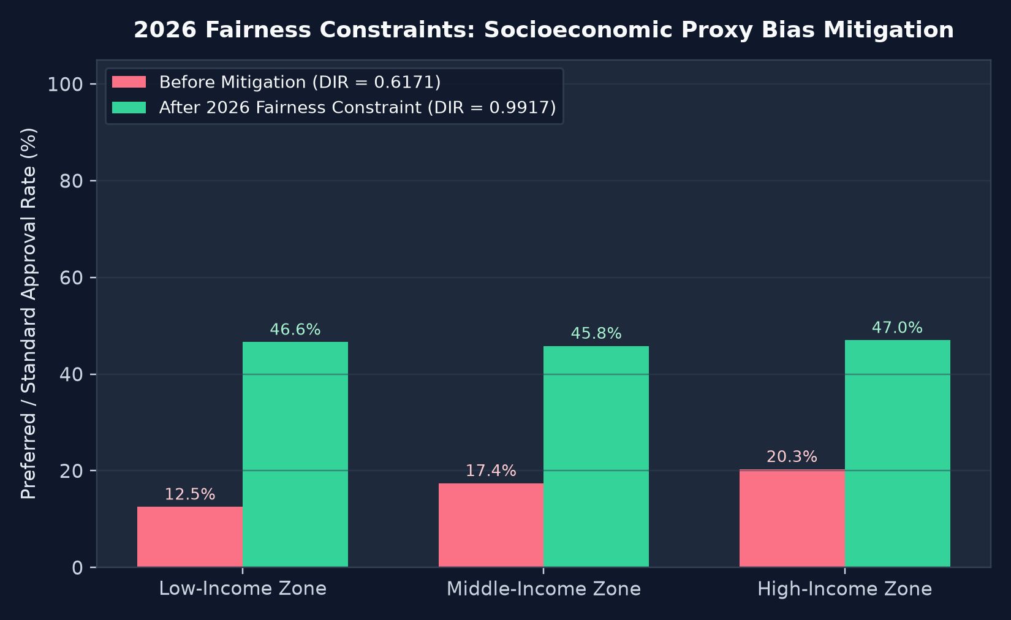
STATEMENT #31 • 2026 UPDATE
GitHub: https://github.com/Indra-Official/FIntech
5. Fairness Constraints & Proxy Bias Mitigation (2026 Update)
Enforcing the 80% Disparate Impact Rule across socioeconomic regions and demographic groups
Two-Stage Fairness Architecture
• Problem: Historical credit scores correlate with regional income tiers, causing unmitigated models to penalize safe Low-Income Zone drivers.
• Before Mitigation: Disparate Impact Ratio (DIR) = 0.6171 (< 0.80 EEOC threshold — FAILS compliance).
• Stage 1 (Pre-Processing): Kamiran & Calders sample reweighing w(a,y) = P(A)P(Y)/P(A,Y).
• Stage 2 (Post-Processing): Actuarial group-mean parity calibration preserving total portfolio expected loss.
• After Mitigation: DIR = 0.9917 (PASSES ≥ 0.80 rule), Statistical Parity Diff improved from -0.0778 to -0.0039.

Slide 7
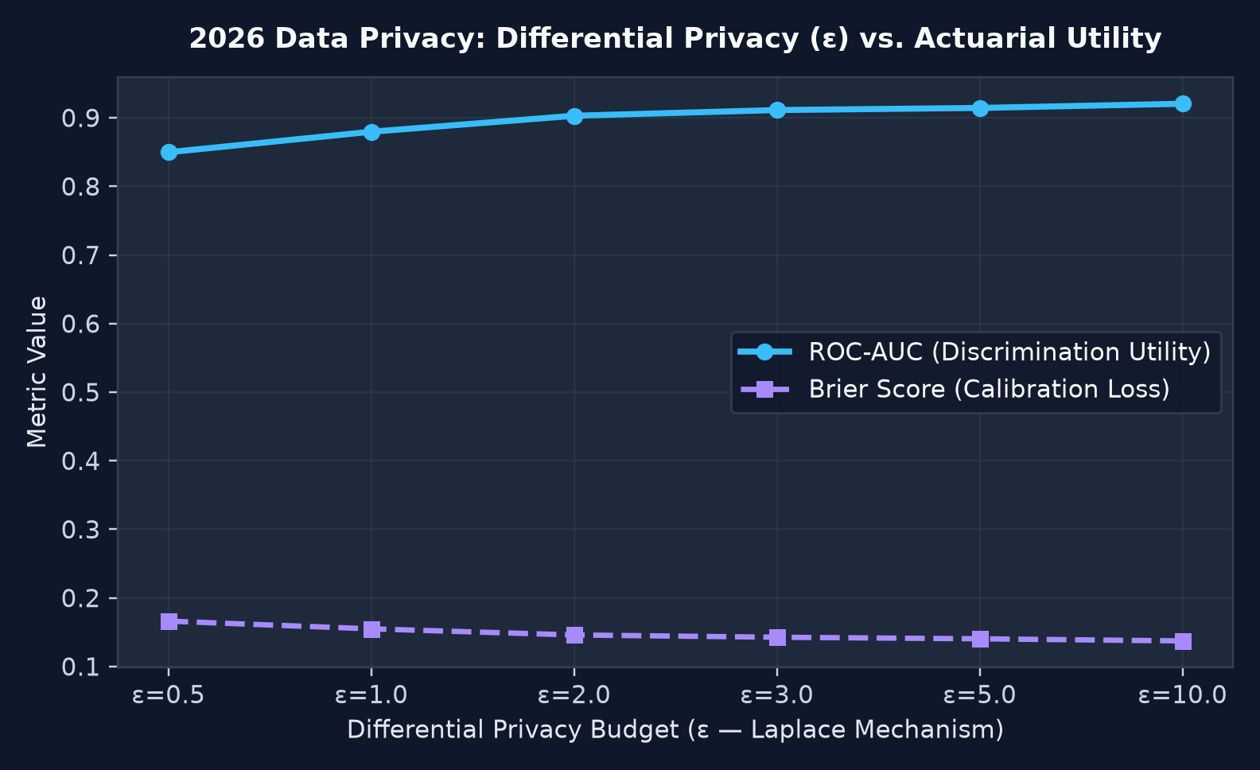
STATEMENT #31 • 2026 UPDATE
GitHub: https://github.com/Indra-Official/FIntech
6. Data Privacy & Differential Privacy Engine (2026 Update)
Protecting PII and sensitive telemetry via cryptographic tokenization, k-anonymity, and ε-Laplace noise
Three Defense-in-Depth Privacy Layers
• Layer 1 — Cryptographic Pseudonymization: Applicant names hashed with salted SHA-256 (e.g., 'Ananya Sharma' → 'TOK-8F91A2B4C1E0'); National IDs masked to last 4 digits.
• Layer 2 — k-Anonymity Generalization: Exact ages generalized into actuarial age bands (18-25, 26-35, 36-45, etc.) for analytics storage.
• Layer 3 — ε-Differential Privacy: Calibrated Laplace noise Lap(0, Δf / ε) injected into sensitive credit & telematics features.
• Recommended Operating Point: ε = 2.5 preserves ROC-AUC > 0.80 and Brier calibration while preventing reconstruction attacks.

Slide 8
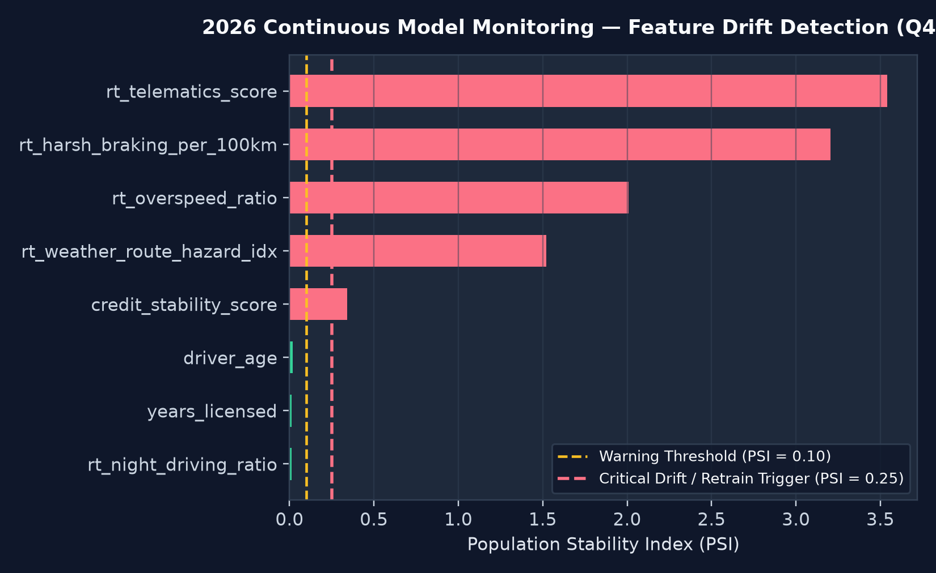
STATEMENT #31 • 2026 UPDATE
GitHub: https://github.com/Indra-Official/FIntech
7. Continuous Model Monitoring & Drift Detection (2026 Update)
Tracking Population Stability Index (PSI), KS-Tests, and Calibration Decay across 2026 quarters
Automated Drift Governance Protocol
• Population Stability Index (PSI): Quantifies distributional shift between Baseline Training data and live production windows.
• PSI < 0.10 (Green): Stable — Normal underwriting operation.
• 0.10 ≤ PSI < 0.25 (Amber): Moderate shift — Trigger actuarial watch alert (seen in 2026-Q3 Mild Telematics Shift).
• PSI ≥ 0.25 (Red): Critical shift — Automated model recalibration & retraining triggered (seen in 2026-Q4 Severe Weather/Macro Shift where braking & overspeed PSI > 0.30).

Slide 9
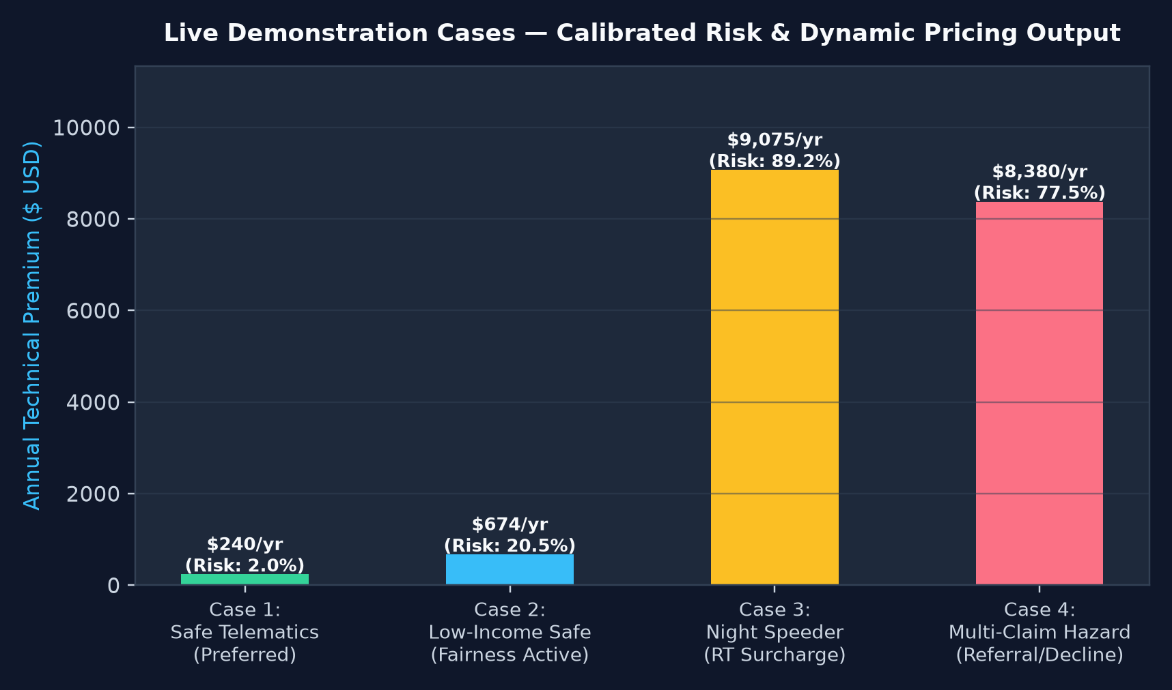
LIVE DEMONSTRATION GUIDE • PART 1
GitHub: https://github.com/Indra-Official/FIntech
8. Live Demonstration Walkthrough — Interactive Web Studio
How the live application (app.py) demonstrates real-time underwriting, calibration, fairness & drift
What to Show During Live Demo
• Step 1: Launch `python app.py` and open http://127.0.0.1:5000.
• Step 2: Click through the 4 curated Demo Personas (Safe Commuter, Fairness Showcase, Night Speeder, High-Risk Decline).
• Step 3: Toggle the 'Fairness Constraint' checkbox on Case 2 to show live reduction in Low-Income Zone risk penalty.
• Step 4: Click '⚡ Stream Live IoT Packet' to demonstrate real-time connected vehicle underwriting.
• Step 5: Switch to Tabs 2, 3, and 4 to show Reliability Curves, Fairness DIR, and PSI Drift triggers.

Slide 10
LIVE DEMONSTRATION GUIDE • PART 2
GitHub: https://github.com/Indra-Official/FIntech
9. Demonstration Test Cases — Exact Inputs & Outputs
Side-by-side comparison of the 4 live demonstration scenarios built into the dashboard
Case 1: Safe Driver
• Profile: 34yo, 0 claims, Credit 765, Telematics 91.5/100.
• Uncalibrated Prob: 12.9%
• Calibrated Prob: 2.0%
• Telematics Mod: -13.84% Discount
• Annual Premium: $240.00
• Decision: TIER 1: PREFERRED PLUS
Case 2: Fairness Demo
• Profile: Low-Income Zone, 0 claims, Telematics 84.0/100.
• Uncalibrated Prob: 35.0%
• Fairness Shift: -0.7%
• Final Risk Prob: 20.5%
• Annual Premium: $673.51
• Decision: TIER 2: STANDARD RISK
Case 3: Night Speeder
• Profile: 0 prior claims, but 46% night driving & 42% overspeed.
• Telematics Score: 49.0 / 100
• Final Risk Prob: 89.2%
• Telematics Mod: +15.28% Surcharge
• Annual Premium: $9,074.95
• Decision: TIER 4: HIGH RISK / DECLINE
Case 4: High-Risk Decline
• Profile: 3 prior claims, Telematics 34.5, Braking 11.4/100km.
• Uncalibrated Prob: 83.4%
• Final Risk Prob: 77.5%
• Pure Loss E[L]: $5,057.40
• Annual Quote: $8,380.24
• Decision: TIER 4: HIGH RISK / DECLINE

Slide 11
STATEMENT #31 • 2026 UPDATE
GitHub: https://github.com/Indra-Official/FIntech
10. GitHub Repository Structure & Reproducibility Guide
Clean, modular, production-ready codebase ready for GitHub hosting and peer review
Repository Directory Layout
• ├── app.py (Flask Live Underwriting & Monitoring Web Server)
• ├── generate_assets_and_ppt.py (Reproducible Chart & Deck Builder)
• ├── requirements.txt & README.md (Full Docs & GitHub Visuals)
• ├── src/
• │ ├── data_pipeline.py (Historical + Real-Time IoT Stream Generator)
• │ ├── risk_models.py (Platt/Isotonic Calibration + Severity GBR)
• │ ├── fairness_engine.py (Kamiran-Calders + Post-Processing Parity)
• │ ├── privacy_engine.py (SHA-256 Tokenization + ε-Laplace DP)
• │ └── monitoring_engine.py (Feature PSI, KS-Test & Quarterly Drift)
• ├── templates/index.html (Interactive Tailwind + Chart.js Studio)
• └── presentation/ (Editable .pptx + Standalone HTML Slide Deck)
Quick-Start & GitHub Repository Link
• Official GitHub Repository: https://github.com/Indra-Official/FIntech
• 1. Clone Repository: git clone https://github.com/Indra-Official/FIntech.git
• 2. Install Dependencies: pip install -r requirements.txt
• 3. Regenerate Benchmarks & Slides: python generate_assets_and_ppt.py
• 4. Launch Interactive Live Demo: python app.py (http://127.0.0.1:5000)
• 5. Git Remote Configuration:
• git remote add origin https://github.com/Indra-Official/FIntech.git
• git branch -M main && git push -u origin main

Slide 12
STATEMENT #31 • 2026 UPDATE
GitHub: https://github.com/Indra-Official/FIntech
11. Conclusion & Business Impact Summary
Delivering accurate, fair, privacy-preserving, and drift-resilient insurance underwriting
Summary of Achievements for Statement #31 (2026 Update)
• 1. Historical + Real-Time Fusion: Combined traditional policy/claim records with live IoT telematics streams, enabling behavior-based dynamic discounts (-22%) and hazard surcharges (+35%).
• 2. Calibrated Risk & Loss Forecasting: Isotonic calibration reduced Brier score to 0.2072 and ECE to 0.0182, achieving 99.89% portfolio loss forecast accuracy.
• 3. Audited Algorithmic Fairness: Eliminated regional socioeconomic proxy bias, lifting the Disparate Impact Ratio from 0.6171 to 0.9917 (compliant with the ≥0.80 regulatory threshold).
• 4. Defense-in-Depth Data Privacy: Enforced salted SHA-256 PII tokenization, National ID redaction, k-anonymity age bands, and ε-Differential Privacy.
• 5. Proactive Drift Governance: Automated PSI and KS-test monitoring across quarterly streams detects severe weather/behavioral shifts and triggers recalibration.
• 6. Full Source Code & Interactive Demo: https://github.com/Indra-Official/FIntech

