Slide 1
Hungarian Helper
Indra Narayan Dutta(NSN8A7)

Slide 2

Objectives
Create a model that acts as an OCR (Optical Character Recognition) for Hungarian characters – the OCR will be used for translation apps
A lot of work has been done for English natural scene character recognition but hardly any models are available for Hungarian text

Slide 3
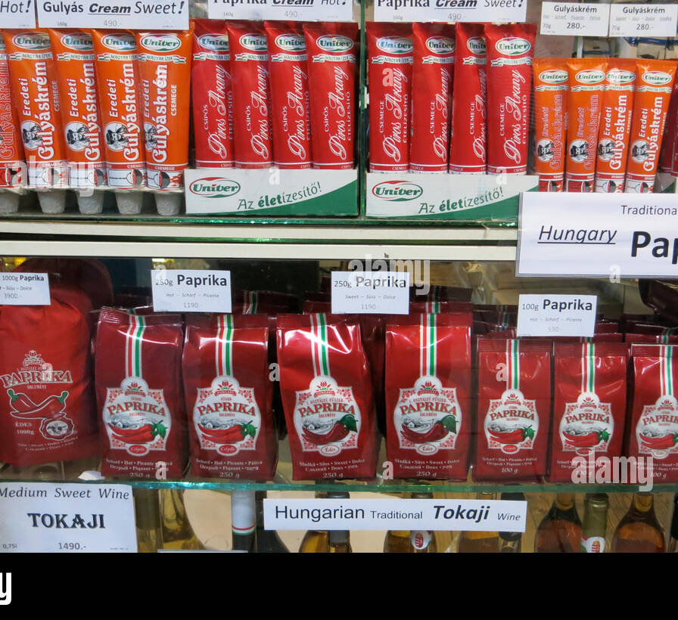
Challenges
Dataset Unavailability: Unlike English, not a lot of datasets are available for Hungarian natural scene characters
Model size: An OCR forms the last step in any scene text recognition pipeline and must therefore be light enough to allow bigger prior model pipelines

Slide 4



Dataset Preparation
How the dataset challenge was solved:
Since Hungarian and English share the same Latin script and only differ in the Hungarian special characters, I combined pre-existing English scene text images with Hungarian Characters from a different domain
English Scene Text from ICDAR Challenges
Hungarian special characters from handwritten text recognition

Slide 5
Dataset Split
The following datasets were considered:
ICDAR 2003 Challenge for English Natural Scene Text Images
ICDAR Robust Reading Challenge for more difficult English Scene Text
Bartosgye’s Handwritten character dataset: Handwritten characters for both English and Hungarian special characters
Training Images | Validation Images | Test Images
98, 717 | 32,919 | 32,915

Slide 6
Model Pipeline
Data Preparation
Train
Validation
Data Augmentation
Grey-scaling
Rotation
Data Loaders
Train Loader
Val Loader
Test
Only on train data
Test Loader
Model
Embedding Layer
Convolution Blocks
Convolution 2D
RELU Activation
Average Pool
Batch Normalization
FCNN 1
FCNN 2
Softmax
Validation
Testing
Hyper Parameter Tuning
A CNN was used with two Fully connected layers at the end
Data augmentation was done on the training data using:
Random Greyscaling of image
Random rotation of +22.5 to -22.5 degrees
Fine Tuning

Slide 7
Model Hyperparameters to consider
Embedding depth: Initial Embedding depth gets doubled and the dimensions of the input channels get halved at every layer, so the embedding depth determines model size
Image size: Since multiple sources of images are used, image size becomes vital
Batch Norm or not: Should batch norm be used or not?
Learning Rate
Batch size

