Slide 1


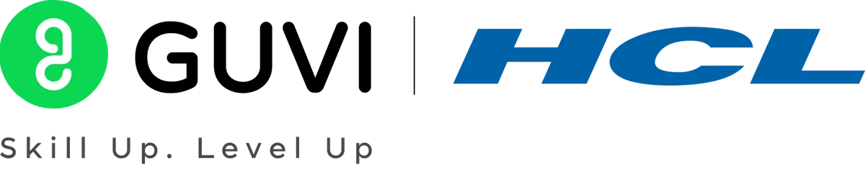

GUVI - Naan Mudhalvan
Engineering Hackathon 2025
www.guvi.in

Slide 2
PROBLEM STATEMENT:
VOICE-BASED AUTHENTICATION FOR HEALTHCARE PORTALS
TEAM MEMBERS:
1.B.INDRA DEVI (III-CSE)
2.V.ABINAYAPRIYA (III-CSE)
3.M.AISHWARYA (III-CSE)
4.M.DEVA THARSHINI (III-CSE)
5.S.MONIKA (III-CSE)
A.V.C COLLEGE OF ENGINEERING,MANNAMPANDAL
MAYILADUTHURAI.
Learning Programs
www.guvi.in

Slide 3
INTRODUCTION:
As healthcare systems increasingly adopt digital technologies, securing access to sensitive patient data has become more critical than ever. Traditional authentication methods such as passwords, PINs, or security questions are often vulnerable to breaches, forgotten credentials, or unauthorized access. To address these challenges, voice-based authentication is emerging as a secure and convenient solution for healthcare portals. This biometric technology uses an individual’s unique voice characteristics to verify identity, offering a fast, reliable, and user-friendly alternative. By analyzing vocal features like pitch, tone, and speech patterns, voice authentication not only enhances data security but also improves the overall user experience—especially for patients and healthcare professionals who require remote and secure access to health information.
ABSTRACT:
Voice-based authentication is an emerging biometric security method that utilizes the unique characteristics of a person's voice to verify identity. In healthcare portals, where protecting sensitive patient data is critical, this technology offers a secure and user-friendly alternative to traditional authentication methods such as passwords or security questions. By analyzing vocal features like pitch, tone, and speech patterns, the system creates a distinct voiceprint for each user. During subsequent login attempts, the spoken input is matched against the stored voiceprint to grant or deny access. Voice authentication enhances security, improves accessibility, and supports compliance with healthcare regulations like HIPAA. Its remote usability makes it particularly valuable in telehealth and patient self-service scenarios.
Learning Programs
www.guvi.in

Slide 4
Proposed Solution:
1. System Architecture Overview Components:
Voice Biometric Engine:
Core system that creates and verifies voiceprints.
User Enrollment Module:
Collects initial voice samples securely.
Authentication API:
Interface between the portal and the biometric engine.
Healthcare Portal Integration:
EHR (Electronic Health Records) system or patient access portal.
Security Layer:
Encryption, token-based authentication, and secure storage.
2. Security Features
Voiceprint Encryption:
All stored voiceprints are encrypted.
Liveness Detection:
System ensures the voice is live (not a recording).
Fallback Authentication:
Allows use of passwords/OTP in case of voice issues.
Audit Logs:
Logs all authentication attempts for compliance and monitoring.
Learning Programs
www.guvi.in

Slide 5
3. Deployment Model
Cloud-Based API (e.g., Microsoft Azure, AWS VoiceID)
Easily integrates with web/mobile portals.
On-Premises OptionFor hospitals needing full control over patient data and security policies.
4. Compliance and Standards
HIPAA(Health Insurance Portability and Accountability Act) -Compliant Architecture
Ensures all data handling meets privacy laws
Integration with Existing IAM Systems
Works with current identity and access management (IAM) systems used in hospitals.
5. Benefits
Strong security without remembering passwords
Remote access for telemedicine
Faster, user-friendly logins
Reduces risk of impersonation or fraud
Learning Programs
www.guvi.in

Slide 6
TECHNOLOGIES USED :
Automatic Speaker Recognition (ASR) This is the main technology that listens to a person’s voice and recognizes who they are.It extracts unique voice features (like pitch, rhythm, tone) and creates a voiceprint.
Machine Learning (ML) & Artificial Intelligence (AI) AI algorithms train on voice data to learn the unique vocal patterns of users. ML models improve accuracy over time by adapting to changes in a person's voice (e.g., aging, sickness).
Natural Language Processing (NLP) Understands what the person is saying, especially if the system is using passphrases or spoken commands. Helps the system handle different accents, dialects, and languages.
Voice Biometrics Engine This is a dedicated engine or software platform that compares a spoken voice with a stored voiceprint. Examples: Nuance Gatekeeper, Verint Voice Biometrics,VoiceTrust, Phonexia, Pindrop, Auraya EVA.
Encryption & Secure Data Storage Ensures that voiceprints and recordings are securely stored and encrypted to comply with HIPAA and other regulations. Uses technologies like TLS/SSL encryption, tokenization, and secure cloud storage.
Learning Programs
www.guvi.in

Slide 7
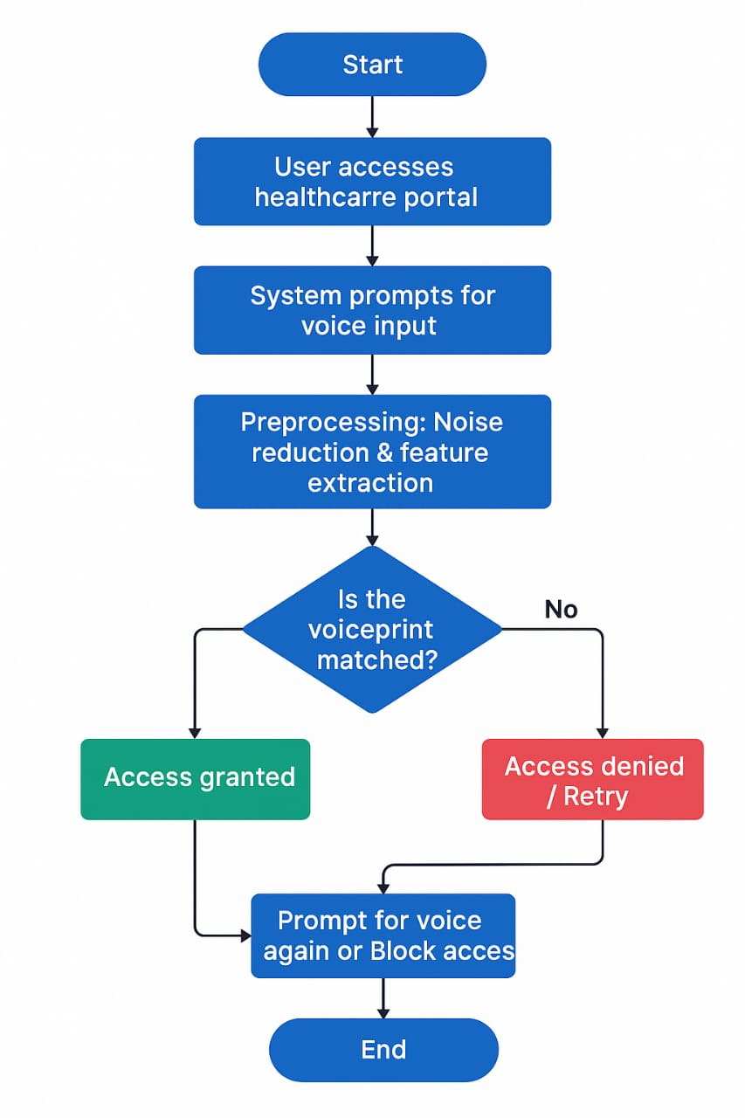
Learning Programs
www.guvi.in

Slide 8
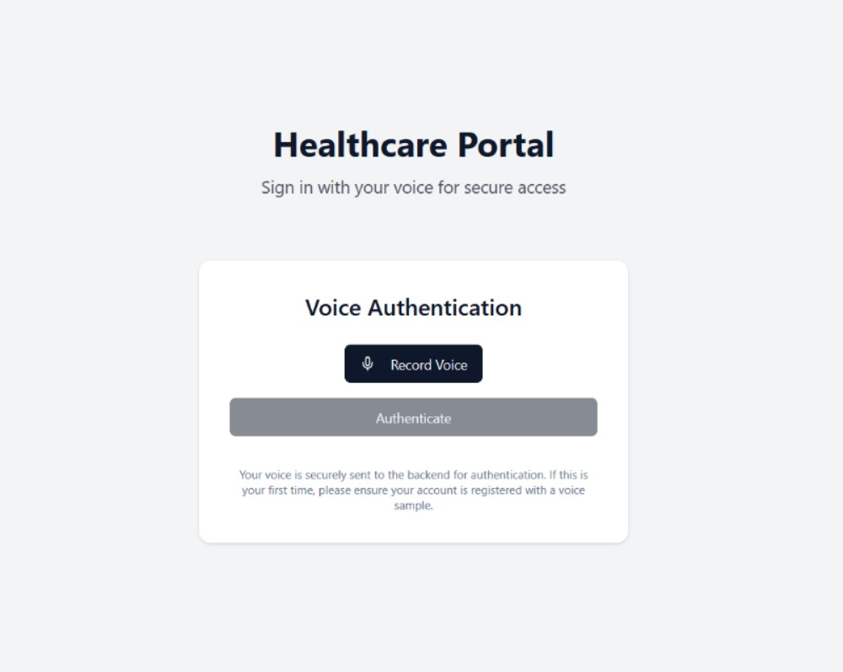
EXECUTION:
Learning Programs
www.guvi.in

Slide 9
Conclusion:
Voice-based authentication offers a balanced combination of security, convenience, and compliance for healthcare portals. By using each person’s unique voiceprint, it ensures that only authorized users can access sensitive medical data, reducing the risk of fraud or impersonation. This method enhances the user experience by enabling quick, password-free access, which is especially valuable in remote healthcare and telemedicine. It also supports HIPAA compliance, audit logging, and integration with existing healthcare systems. Whether deployed via cloud services or on-premises, voice authentication is a forward-looking solution that strengthens data protection while making healthcare access simpler and more secure.
Learning Programs
www.guvi.in

Slide 10
Thank You
www.guvi.in

