Slide 1
A PROJECT PRESENTATION ON
“Website For
Anudeep Industries”

Slide 2

“Website For
Anudeep Industries”
PRESENTED BY
Yashraj Ranjeet Shitole
Aniket Vilas Shelake
Vinayak Avinash Murkute
Indrajeet Amarsinh Shinde
GUIDED BY
Mrs. V. A. Jujare
COMPUTER SCIENCE AND ENGINEERING
SHARAD INSTITUTE OF TECHNOLOGY COLLEGE OF ENGINEERING YADRAV.
2023-24

Slide 3
CONTENT
Introduction
Motivation
Literature survey
Problem statement
Objective
Requirements
Diagrams
Output
Conclusion
Future Scope
References

Slide 4
Introduction
The project features on building a website for an Engineering, Agriculture and Consultant Services company in order to increase their online presence and make their services easily accessible for the customers.

Slide 5
Motivation
The motivation behind the development of a website for Anudeep Industries is to help the company connect with potential clients and showcase its services effectively. A professional and user-friendly website can help to establish credibility and make a positive impression on visitors, leading to new business opportunities.

Slide 6
Literature Survey
Sr. No | Title | Author | Objective
1 | User Interface and User Experience UIUX Design | 1. Robert E. Roth | user experience design, user interface design, interactive maps, interaction primitives, interaction operators
2 | Website Developmemt Technologies: A Review | Pratiksha D Dutonde Shivani S Mamidwar Prof. Dhiraj D Shirbhate | Web Applications design issues and implementation of pc code that runs on internet servers

Slide 7
Problem Statement
Anudeep Industries faces the challenge of connecting with potential clients and showcasing its services effectively. Without a professional and user-friendly website, it may be challenging to attract new clients and demonstrate the value of its services.

Slide 8
Objective
Provide detailed information about the agriculture services, engineering services, and consultant services offered by Anudeep Industries
Showcase the company's expertise and past projects through a portfolio section.
Enable potential clients to contact Anudeep Industries for inquiries and consultations.
Improve the company's online visibility and brand recognition.
Enhance user experience through responsive design and intuitive navigation.

Slide 9
Requirements
Hardware Requirements:
System : Pentium i3 Processor
Hard Disk : 512 GB
Ram : 8 GB
Software Requirements :
Operating System : Windows 10 or 11.
Coding Language : HTML, CSS, JavaScript
Database : MongoDB
Editor : VS Code

Slide 10
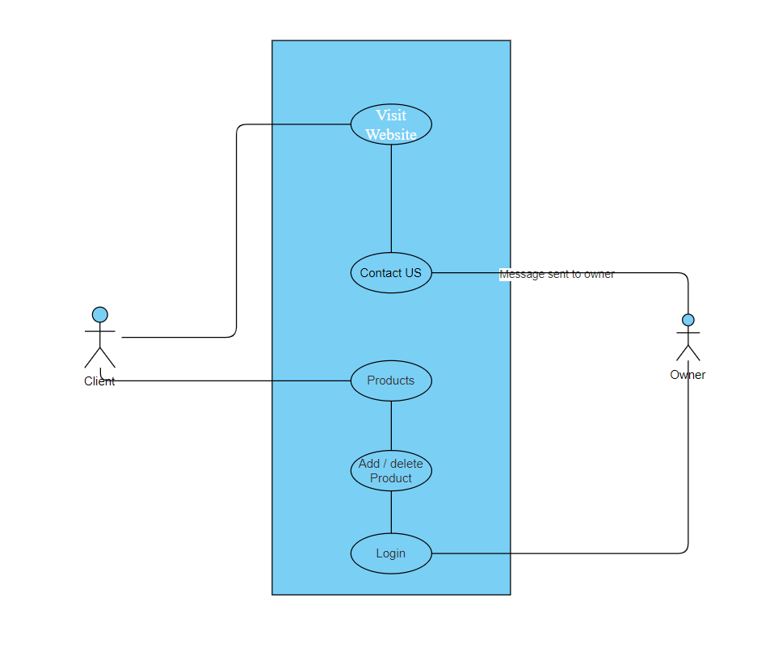
Use case Diagram
Fig. 1 Use case Diagram

Slide 11
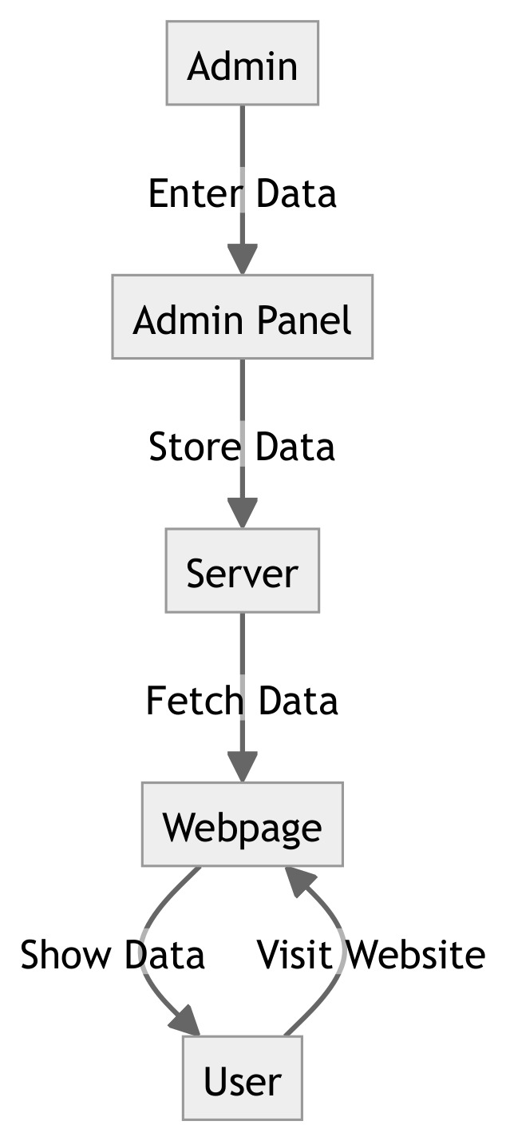
Block Diagram
Fig. 2 Block Diagram – Website For Anudeep Industries

Slide 12
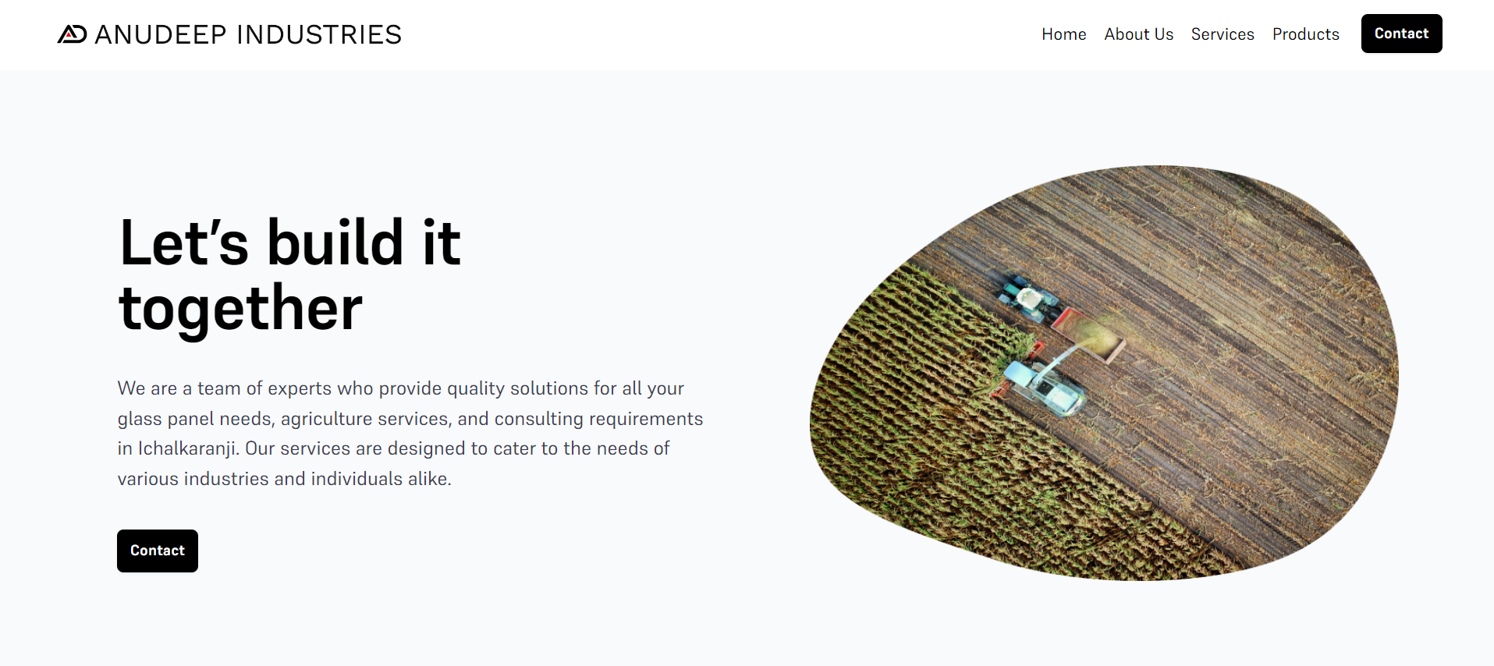
Work Samples

Slide 13
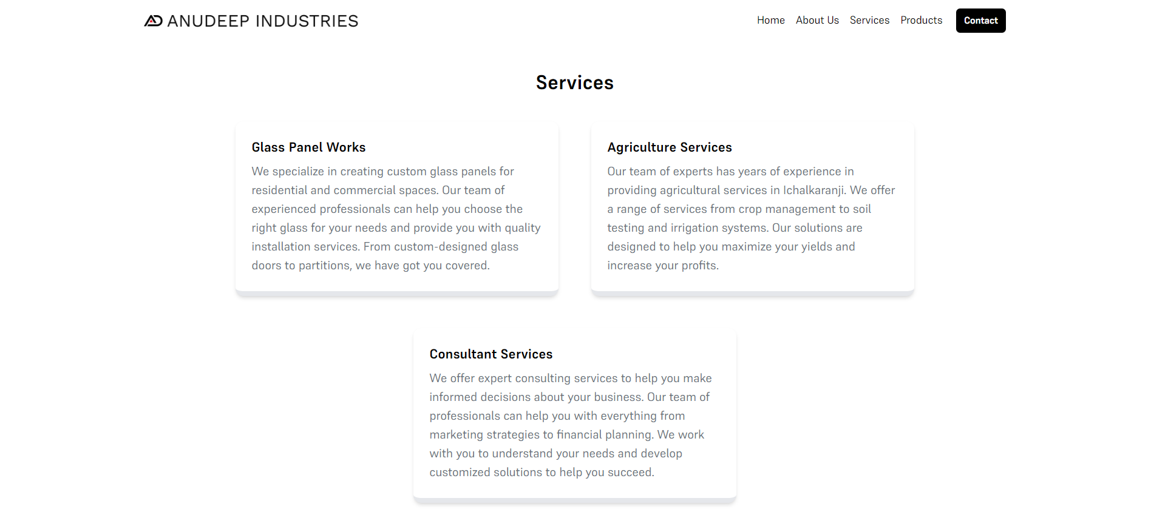

Slide 14
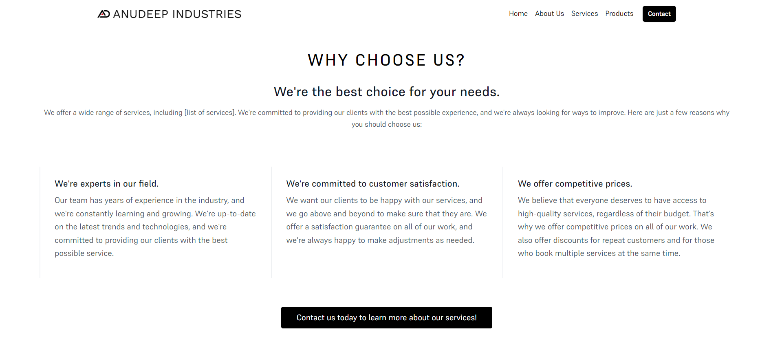

Slide 15
Conclusion
In conclusion, the development of a website for Anudeep Industries is a critical step in connecting with potential clients and showcasing its services effectively. A well-designed website can help to establish credibility and make a positive impression on visitors, leading to new business opportunities and future growth.

Slide 16
Future Scope
In the future, Anudeep Industries may look to expand its services or target new markets. The website will be designed with scalability in mind, allowing for easy updates and additions as needed.
This project will be hosted on internet for Anudeep Industries.

Slide 17
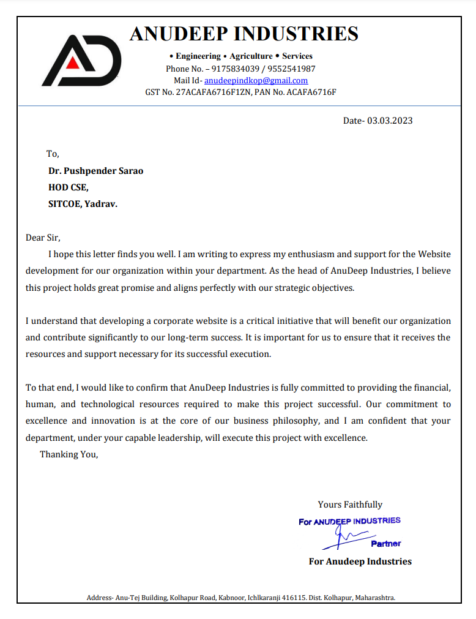
Sponsorship Letter

Slide 18
References
https://www.wikipedia.org/
https://www.ripublication.com/ijaer17/ijaerv12n20_96.pdf
https://www.researchgate.net/publication/317660257_User_Interface_and_User_Experience_UIUX_Design
https://www.ijraset.com/research-paper/website-development-technologies
https://www.ijert.org/research/a-survey-on-current-technologies-for-web-development-IJERTV9IS060267.pdf

Slide 19
THANK YOU

