Slide 1
Library Management system

Slide 2
Introduction
Library management systems are designed to manage the movement of books and maintain records of the members in a library. The main desire of this system is to have a perfect record of the issued books and the members. And all these will be done through this automated system.

Slide 3
Acknowledgement
I would like to express my profound gratitude to our Mr. Sofikul Mallick of Ardent Computech Pvt. Ltd. for their contributions to the completion of my project “Library Management System”. We are immensely thankful to them for their valuable ideas on improvement of the project.

Slide 4
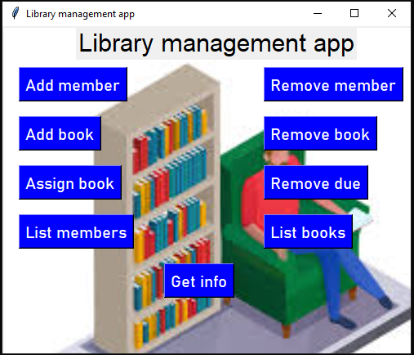
The Systen
Features :
User-friendly interface .
Add books in the system.
Display out books
Remove the books
Add members
Remove the members
Issue books for members
Returning of books

Slide 5
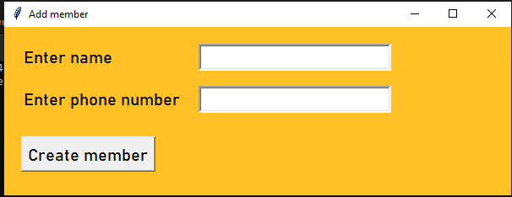
Add Member
Enter the name of the new member
Enter the number of the new member

Slide 6
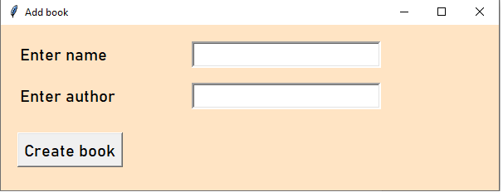
Add Book
Enter the name of the new book
Enter the name of the author

Slide 7
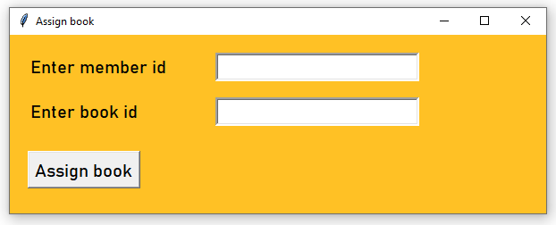
Asign book
Enter the proper data whatever needed otherwise you can have error.

Slide 8
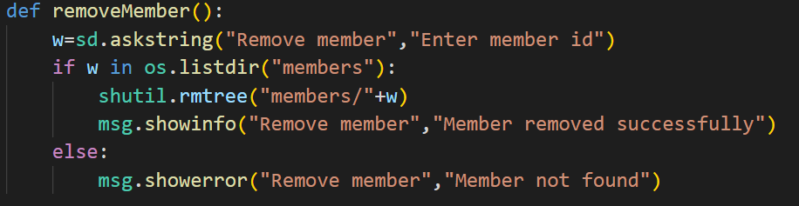
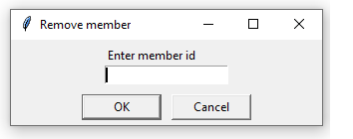
Remove member
Used to remove any record of a member

Slide 9
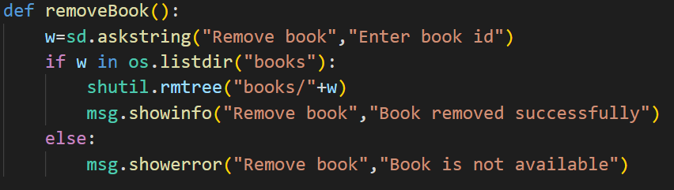
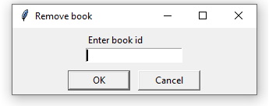
Remove Book
Used to remove any record of a lost book

Slide 10
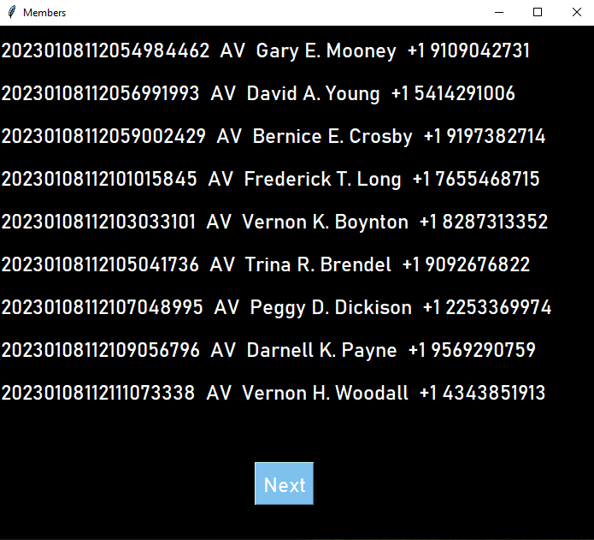
Record

Slide 11
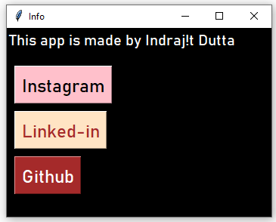
Get Info
open("https://www.instagram.com/indrajit7074/")
open("https://www.linkedin.com/in/indrajit-dutta-70bab0204/")
open("https://github.com/70744034000")

Slide 12
Conclusion:-
From this project we have learnt a lot about “Basics of Python and It’s Application". We have used tkinter, webbrowser, os, datetime, shutil these modules. This project has enhanced our knowledge in the field of industrial work of python.

Slide 13
Thank You

