Slide 1
Lecture Overview
Motivation – why do clustering? Examples from research papers
Choosing (dis)similarity measures – a critical step in clustering
  Euclidean distance
  Pearson Linear Correlation
Clustering algorithms
  Hierarchical agglomerative clustering
  K-means clustering and quality measures
  Self-organizing maps (if time)

Slide 2
What is clustering?
A way of grouping together data samples that are similar in some way - according to some criteria that you pick
A form of unsupervised learning – you generally don’t have examples demonstrating how the data should be grouped together
So, it’s a method of data exploration – a way of looking for patterns or structure in the data that are of interest

Slide 3
Why cluster?
Cluster genes = rows
  Measure expression at multiple time-points, different conditions, etc.
  Similar expression patterns may suggest similar functions of genes (is this always true?)
Cluster samples = columns
  e.g., expression levels of thousands of genes for each tumor sample
  Similar expression patterns may suggest biological relationship among samples

Slide 4
Example 1: clustering genes
P. Tamayo et al., Interpreting patterns of gene expression with self-organizing maps: methods and application to hematopoietic differentiation, PNAS 96: 2907-12, 1999.
  Treatment of HL-60 cells (myeloid leukemia cell line) with PMA leads to differentiation into macrophages
  Measured expression of genes at 0, 0.5, 4 and 24 hours after PMA treatment

Slide 5
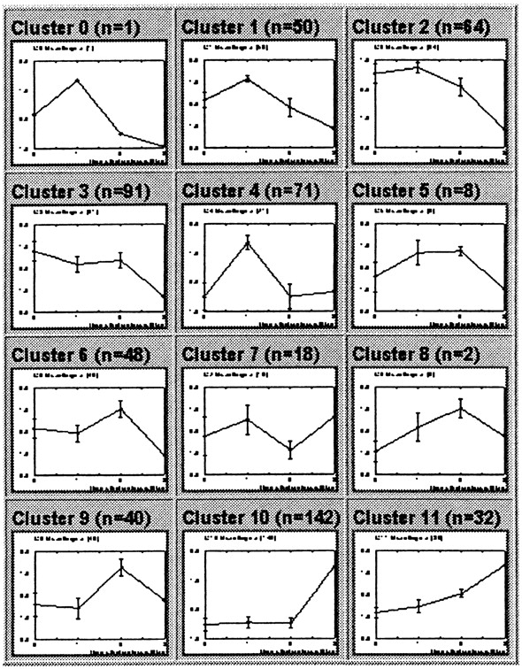
Used SOM technique; shown are cluster averages
Clusters contain a number of known related genes involved in macrophage differentiation
e.g., late induction cytokines, cell-cycle genes (down-regulated since PMA induces terminal differentiation), etc.

Slide 6
Example 2: clustering genes
E. Furlong et al., Patterns of Gene Expression During Drosophila Development, Science 293: 1629-33, 2001.
Use clustering to look for patterns of gene expression change in wild-type vs. mutants
Collect data on gene expression in Drosophila wild-type and mutants (twist and Toll) at three stages of development
twist is critical in mesoderm and subsequent muscle development; mutants have no mesoderm
Toll mutants over-express twist
Take ratio of mutant over wt expression levels at corresponding stages

Slide 7
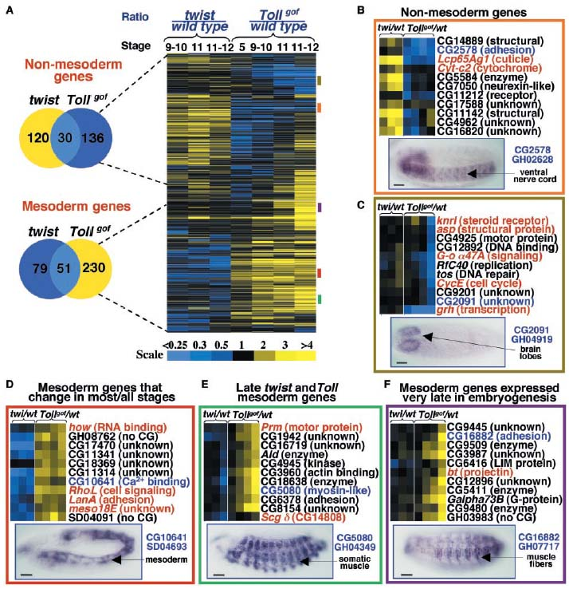
Find general trends in the data – e.g., a group of genes with high expression in twist mutants and not elevated in Toll mutants contains many known neuro-ectodermal genes (presumably over-expression of twist suppresses ectoderm)

Slide 8
Example 3: clustering samples
A. Alizadeh et al., Distinct types of diffuse large B-cell lymphoma identified by gene expression profiling, Nature 403: 503-11, 2000.
Response to treatment of patients w/ diffuse large B-cell lymphoma (DLBCL) is heterogeneous
Try to use expression data to discover finer distinctions among tumor types
Collected gene expression data for 42 DLBCL tumor samples + normal B-cells in various stages of differentiation + various controls

Slide 9
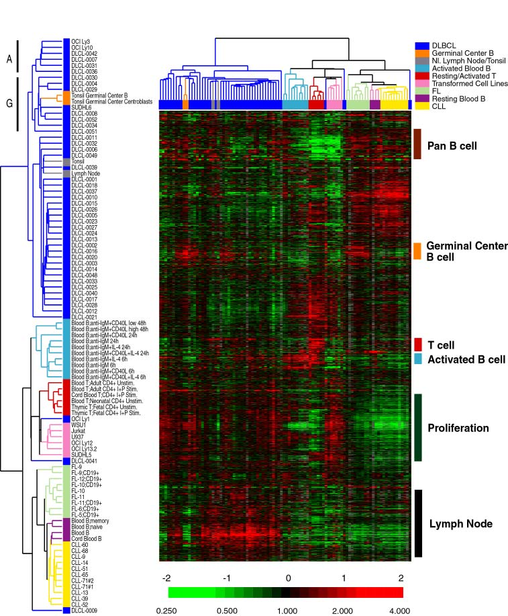
Found some tumor samples have expression more similar to germinal center B-cells and others to peripheral blood activated B-cells
Patients with “germinal center type” DLBCL generally had higher five-year survival rates

Slide 10
Lecture Overview
Motivation – why do clustering? Examples from research papers
Choosing (dis)similarity measures – a critical step in clustering
  Euclidean distance
  Pearson Linear Correlation
Clustering algorithms
  Hierarchical agglomerative clustering
  K-means clustering and quality measures
  Self-Organizing Maps (if time)

Slide 11
How do we define “similarity”?
Recall that the goal is to group together “similar” data – but what does this mean?
No single answer – it depends on what we want to find or emphasize in the data; this is one reason why clustering is an “art”
The similarity measure is often more important than the clustering algorithm used – don’t overlook this choice!

Slide 12
(Dis)similarity measures
Instead of talking about similarity measures, we often equivalently refer to dissimilarity measures (I’ll give an example of how to convert between them in a few slides…)
Jagota defines a dissimilarity measure as a function f(x,y) such that f(x,y) > f(w,z) if and only if x is less similar to y than w is to z
This is always a pair-wise measure
Think of x, y, w, and z as gene expression profiles (rows or columns)

Slide 13
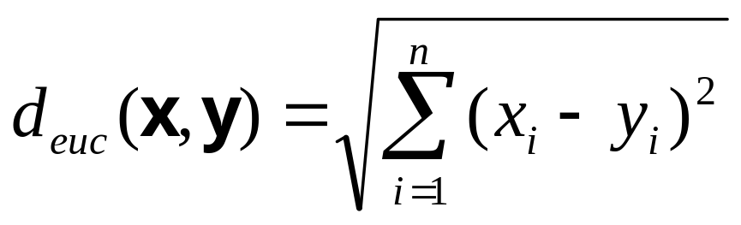
Euclidean distance
Here n is the number of dimensions in the data vector. For instance:
  Number of time-points/conditions (when clustering genes)
  Number of genes (when clustering samples)

Slide 14
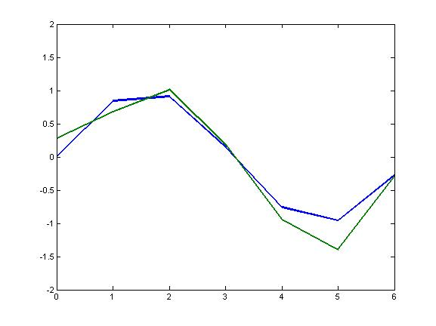
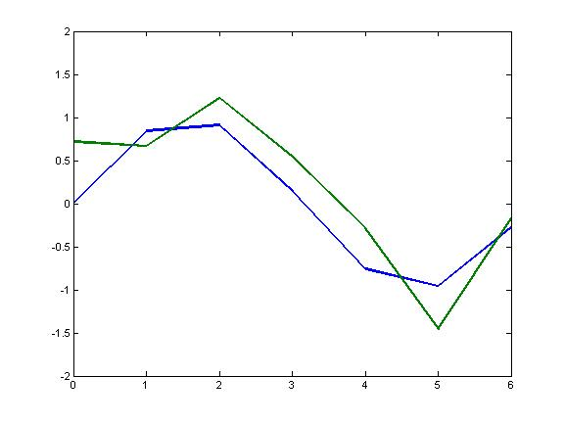
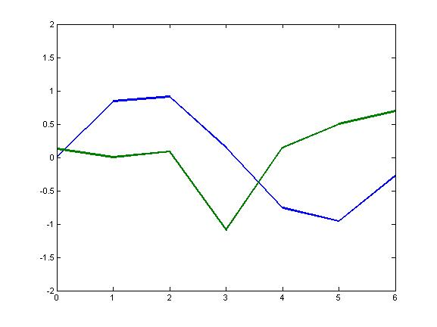
d_{euc}=0.5846
d_{euc}=1.1345
d_{euc}=2.6115
These examples of Euclidean distance match our intuition of dissimilarity pretty well…

Slide 15
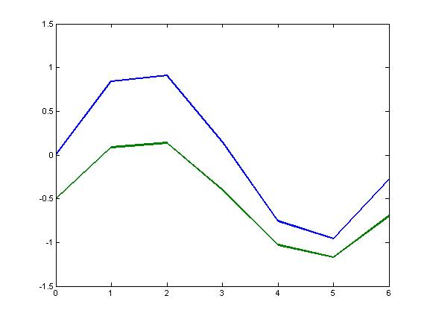
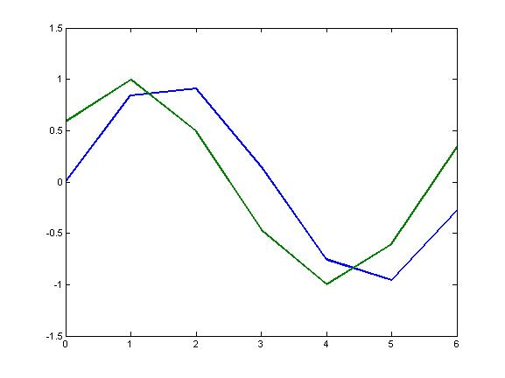
d_{euc}=1.41
d_{euc}=1.22
…But what about these?
What might be going on with the expression profiles on the left? On the right?

Slide 16
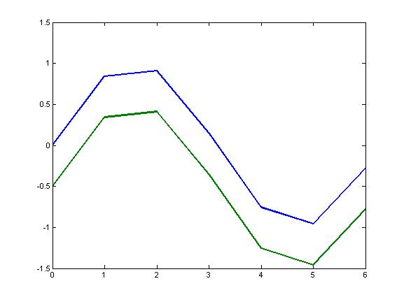
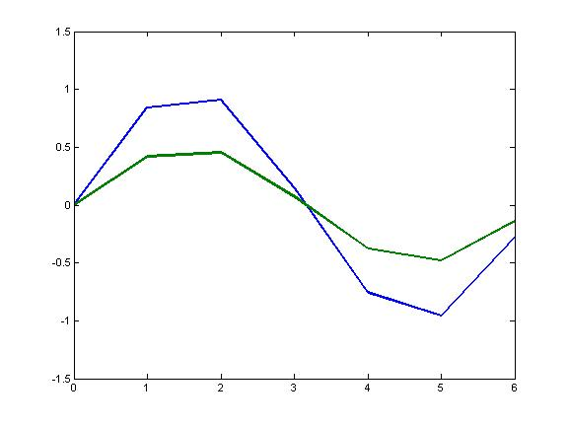
Correlation
We might care more about the overall shape of expression profiles rather than the actual magnitudes
That is, we might want to consider genes similar when they are “up” and “down” together
When might we want this kind of measure? What experimental issues might make this appropriate?

Slide 17
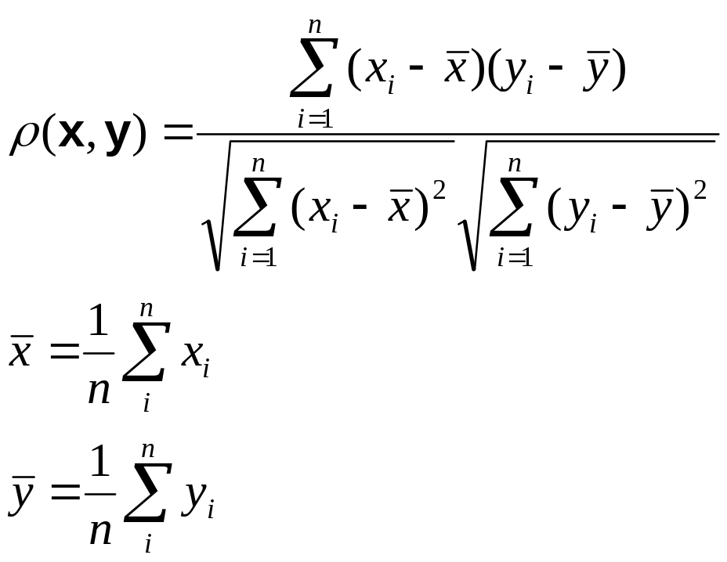
Pearson Linear Correlation
We’re shifting the expression profiles down (subtracting the means) and scaling by the standard deviations (i.e., making the data have mean = 0 and std = 1)

Slide 18
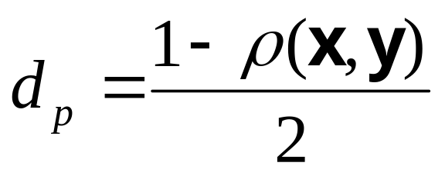
Pearson Linear Correlation
Pearson linear correlation (PLC) is a measure that is invariant to scaling and shifting (vertically) of the expression values
Always between –1 and +1 (perfectly anti-correlated and perfectly correlated)
This is a similarity measure, but we can easily make it into a dissimilarity measure:

Slide 19
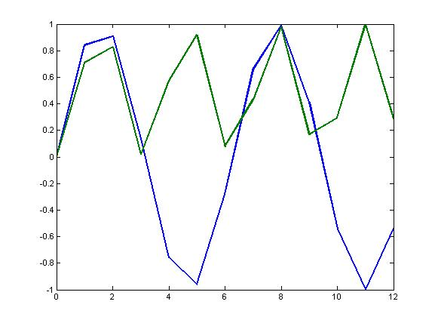
PLC (cont.)
PLC only measures the degree of a linear relationship between two expression profiles!
If you want to measure other relationships, there are many other possible measures (see Jagota book and project #3 for more examples)
ρ = 0.0249, so d_{p} = 0.4876
The green curve is the square of the blue curve – this relationship is not captured with PLC

Slide 20
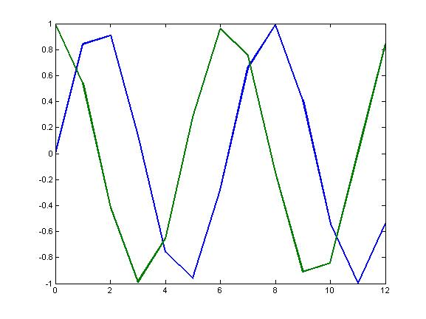
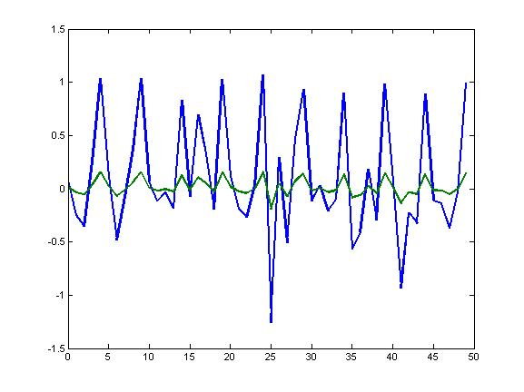
More correlation examples
What do you think the correlation is here? Is this what we want?
How about here? Is this what we want?

Slide 21
Missing Values
A common problem w/ microarray data
One approach with Euclidean distance or PLC is just to ignore missing values (i.e., pretend the data has fewer dimensions)
There are more sophisticated approaches that use information such as continuity of a time series or related genes to estimate missing values – better to use these if possible

Slide 22
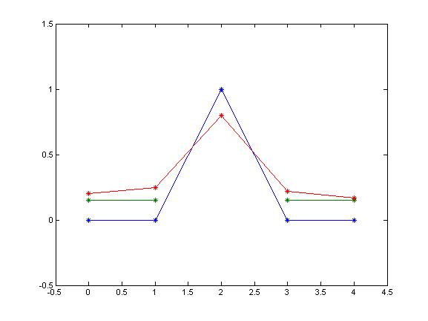
Missing Values (cont.)
The green profile is missing the point in the middle
If we just ignore the missing point, the green and blue profiles will be perfectly correlated (also smaller Euclidean distance than between the red and blue profiles)

Slide 23
Lecture Overview
Motivation – why do clustering? Examples from research papers
Choosing (dis)similarity measures – a critical step in clustering
  Euclidean distance
  Pearson Linear Correlation
Clustering algorithms
  Hierarchical agglomerative clustering
  K-means clustering and quality measures
  Self-Organizing Maps (if time)

Slide 24
Hierarchical Agglomerative Clustering
We start with every data point in a separate cluster
We keep merging the most similar pairs of data points/clusters until we have one big cluster left
This is called a bottom-up or agglomerative method

Slide 25
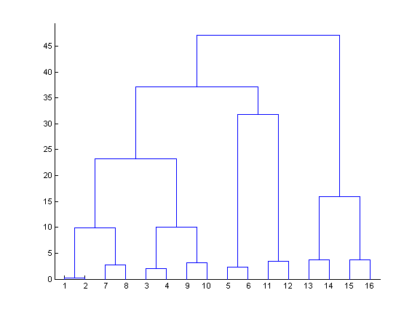
Hierarchical Clustering (cont.)
This produces a binary tree or dendrogram
The final cluster is the root and each data item is a leaf
The height of the bars indicate how close the items are

Slide 26
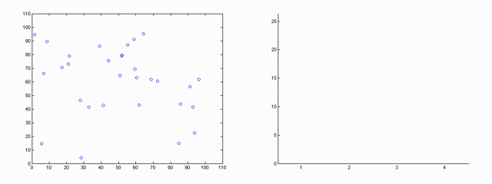
Hierarchical Clustering Demo

Slide 27
Linkage in Hierarchical Clustering
We already know about distance measures between data items, but what about between a data item and a cluster or between two clusters?
We just treat a data point as a cluster with a single item, so our only problem is to define a linkage method between clusters
As usual, there are lots of choices…

Slide 28
Average Linkage
Eisen’s cluster program defines average linkage as follows:
  Each cluster c_{i} is associated with a mean vector μ_{i} which is the mean of all the data items in the cluster
  The distance between two clusters c_{i} and c_{j} is then just d(μ_{i} , μ_{j} )
This is somewhat non-standard – this method is usually referred to as centroid linkage and average linkage is defined as the average of all pairwise distances between points in the two clusters

Slide 29
Single Linkage
The minimum of all pairwise distances between points in the two clusters
Tends to produce long, “loose” clusters

Slide 30
Complete Linkage
The maximum of all pairwise distances between points in the two clusters
Tends to produce very tight clusters

Slide 31
Hierarchical Clustering Issues
Distinct clusters are not produced – sometimes this can be good, if the data has a hierarchical structure w/o clear boundaries
There are methods for producing distinct clusters, but these usually involve specifying somewhat arbitrary cutoff values
What if data doesn’t have a hierarchical structure? Is HC appropriate?

Slide 32
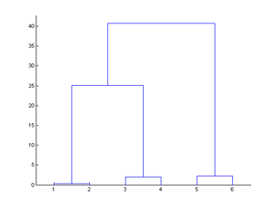
Leaf Ordering in HC
The order of the leaves (data points) is arbitrary in Eisen’s implementation
If we have n data points, this leads to 2^{n-1} possible orderings
Eisen claims that computing an optimal ordering is impractical, but he is wrong…

Slide 33
Optimal Leaf Ordering
Z. Bar-Joseph et al., Fast optimal leaf ordering for hierarchical clustering, ISMB 2001.
Idea is to arrange leaves so that the most similar ones are next to each other
Algorithm is practical (runs in minutes to a few hours on large expression data sets)

Slide 34
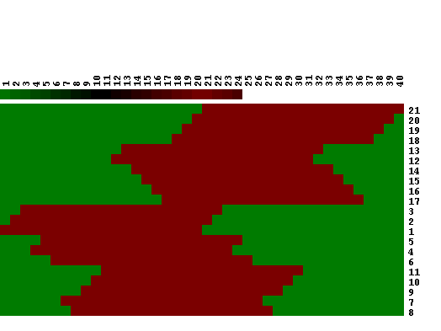
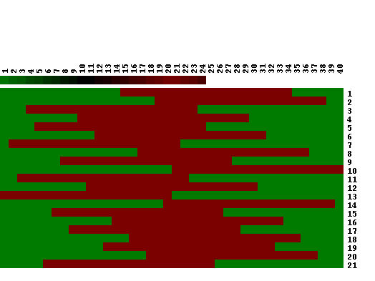
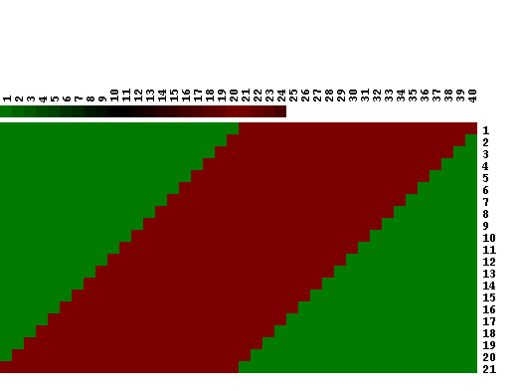
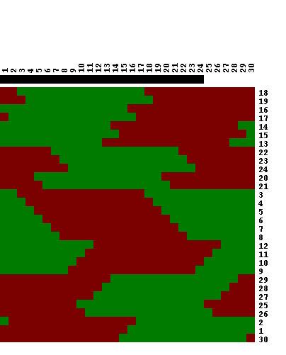
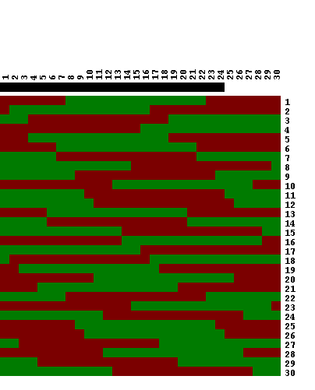
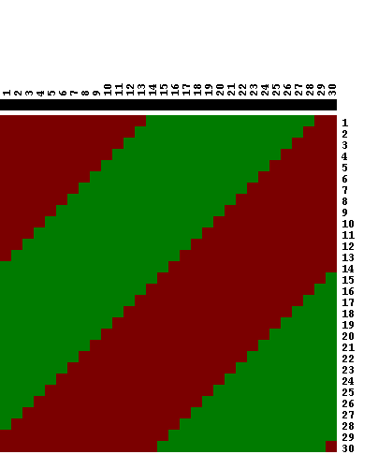
Optimal Ordering Results
Hierarchical clustering
Input
Optimal ordering
Hierarchical clustering
Input
Optimal ordering

Slide 35
K-means Clustering
Choose a number of clusters k
Initialize cluster centers μ₁,… μ_{k}
  Could pick k data points and set cluster centers to these points
  Or could randomly assign points to clusters and take means of clusters
For each data point, compute the cluster center it is closest to (using some distance measure) and assign the data point to this cluster
Re-compute cluster centers (mean of data points in cluster)
Stop when there are no new re-assignments

Slide 36
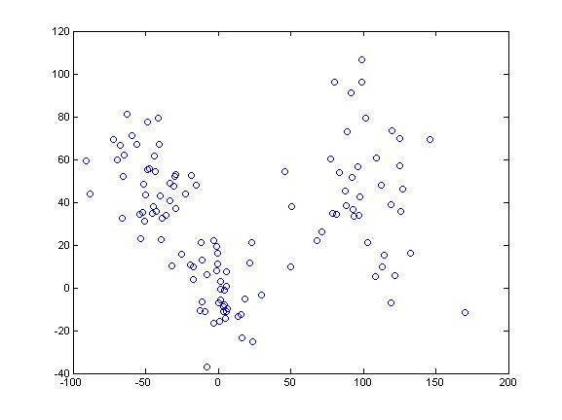
K-means Clustering (cont.)
How many clusters do you think there are in this data? How might it have been generated?

Slide 37
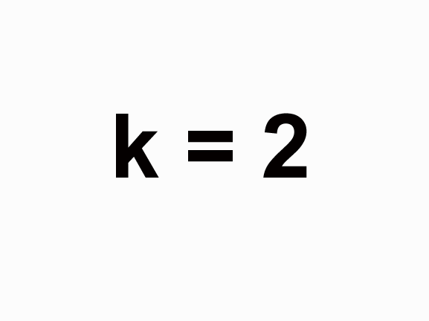
K-means Clustering Demo

Slide 38
K-means Clustering Issues
Random initialization means that you may get different clusters each time
Data points are assigned to only one cluster (hard assignment)
Implicit assumptions about the “shapes” of clusters (more about this in project #3)
You have to pick the number of clusters…

Slide 39
Determining the “correct” number of clusters
We’d like to have a measure of cluster quality Q and then try different values of k until we get an optimal value for Q
But, since clustering is an unsupervised learning method, we can’t really expect to find a “correct” measure Q…
So, once again there are different choices of Q and our decision will depend on what dissimilarity measure we’re using and what types of clusters we want

Slide 40
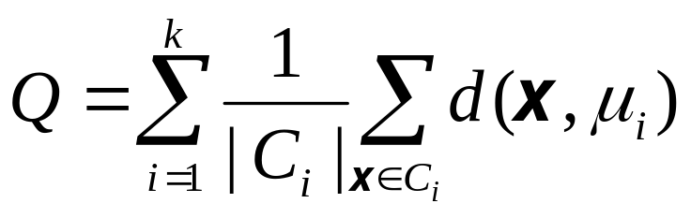
Cluster Quality Measures
Jagota (p.36) suggests a measure that emphasizes cluster tightness or homogeneity:
|C_{i} | is the number of data points in cluster i
Q will be small if (on average) the data points in each cluster are close

Slide 41
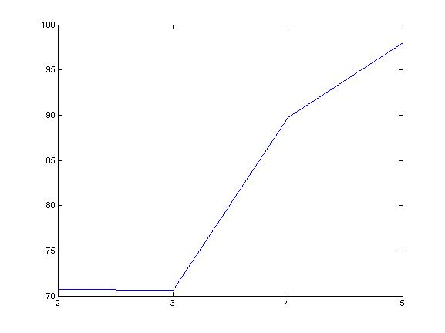
Cluster Quality (cont.)
This is a plot of the Q measure as given in Jagota for k-means clustering on the data shown earlier
How many clusters do you think there actually are?
Q
k

Slide 42
Cluster Quality (cont.)
The Q measure given in Jagota takes into account homogeneity within clusters, but not separation between clusters
Other measures try to combine these two characteristics (i.e., the Davies-Bouldin measure)
An alternate approach is to look at cluster stability:
  Add random noise to the data many times and count how many pairs of data points no longer cluster together
  How much noise to add? Should reflect estimated variance in the data

Slide 43
Self-Organizing Maps
Based on work of Kohonen on learning/memory in the human brain
As with k-means, we specify the number of clusters
However, we also specify a topology – a 2D grid that gives the geometric relationships between the clusters (i.e., which clusters should be near or distant from each other)
The algorithm learns a mapping from the high dimensional space of the data points onto the points of the 2D grid (there is one grid point for each cluster)

Slide 44
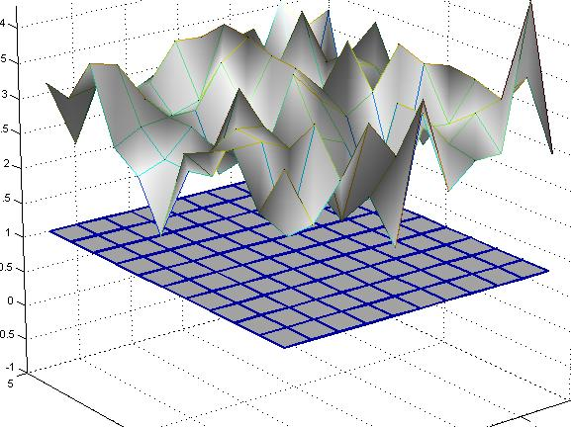
Self-Organizing Maps (cont.)
μ_{10,10}
Grid points map to cluster means in high dimensional space (the space of the data points)
μ_{11,11}
Each grid point corresponds to a cluster (11x11 = 121 clusters in this example)

Slide 45
Self-Organizing Maps (cont.)
Suppose we have a r x s grid with each grid point associated with a cluster mean μ_{1,1},… μ_{r,s}
SOM algorithm moves the cluster means around in the high dimensional space, maintaining the topology specified by the 2D grid (think of a rubber sheet)
A data point is put into the cluster with the closest mean
The effect is that nearby data points tend to map to nearby clusters (grid points)

Slide 46
Self-Organizing Map Example
We already saw this in the context of the macrophage differentiation data…
This is a 4 x 3 SOM and the mean of each cluster is displayed

Slide 47
SOM Issues
The algorithm is complicated and there are a lot of parameters (such as the “learning rate”) - these settings will affect the results
The idea of a topology in high dimensional gene expression spaces is not exactly obvious
  How do we know what topologies are appropriate?
  In practice people often choose nearly square grids for no particularly good reason
As with k-means, we still have to worry about how many clusters to specify…

Slide 48
Other Clustering Algorithms
Clustering is a very popular method of microarray analysis and also a well established statistical technique – huge literature out there
Many variations on k-means, including algorithms in which clusters can be split and merged or that allow for soft assignments (multiple clusters can contribute)
Semi-supervised clustering methods, in which some examples are assigned by hand to clusters and then other membership information is inferred

