Slide 1


SMART INDIA HACKATHON 2025
Problem Statement ID – SIH25033
Problem Statement Title- Al-Based Smart
Allocation Engine for PM Internship Scheme
Theme- Smart Automation
PS Category- Software
Team ID-
Team Name - AlgoArmy

Slide 2
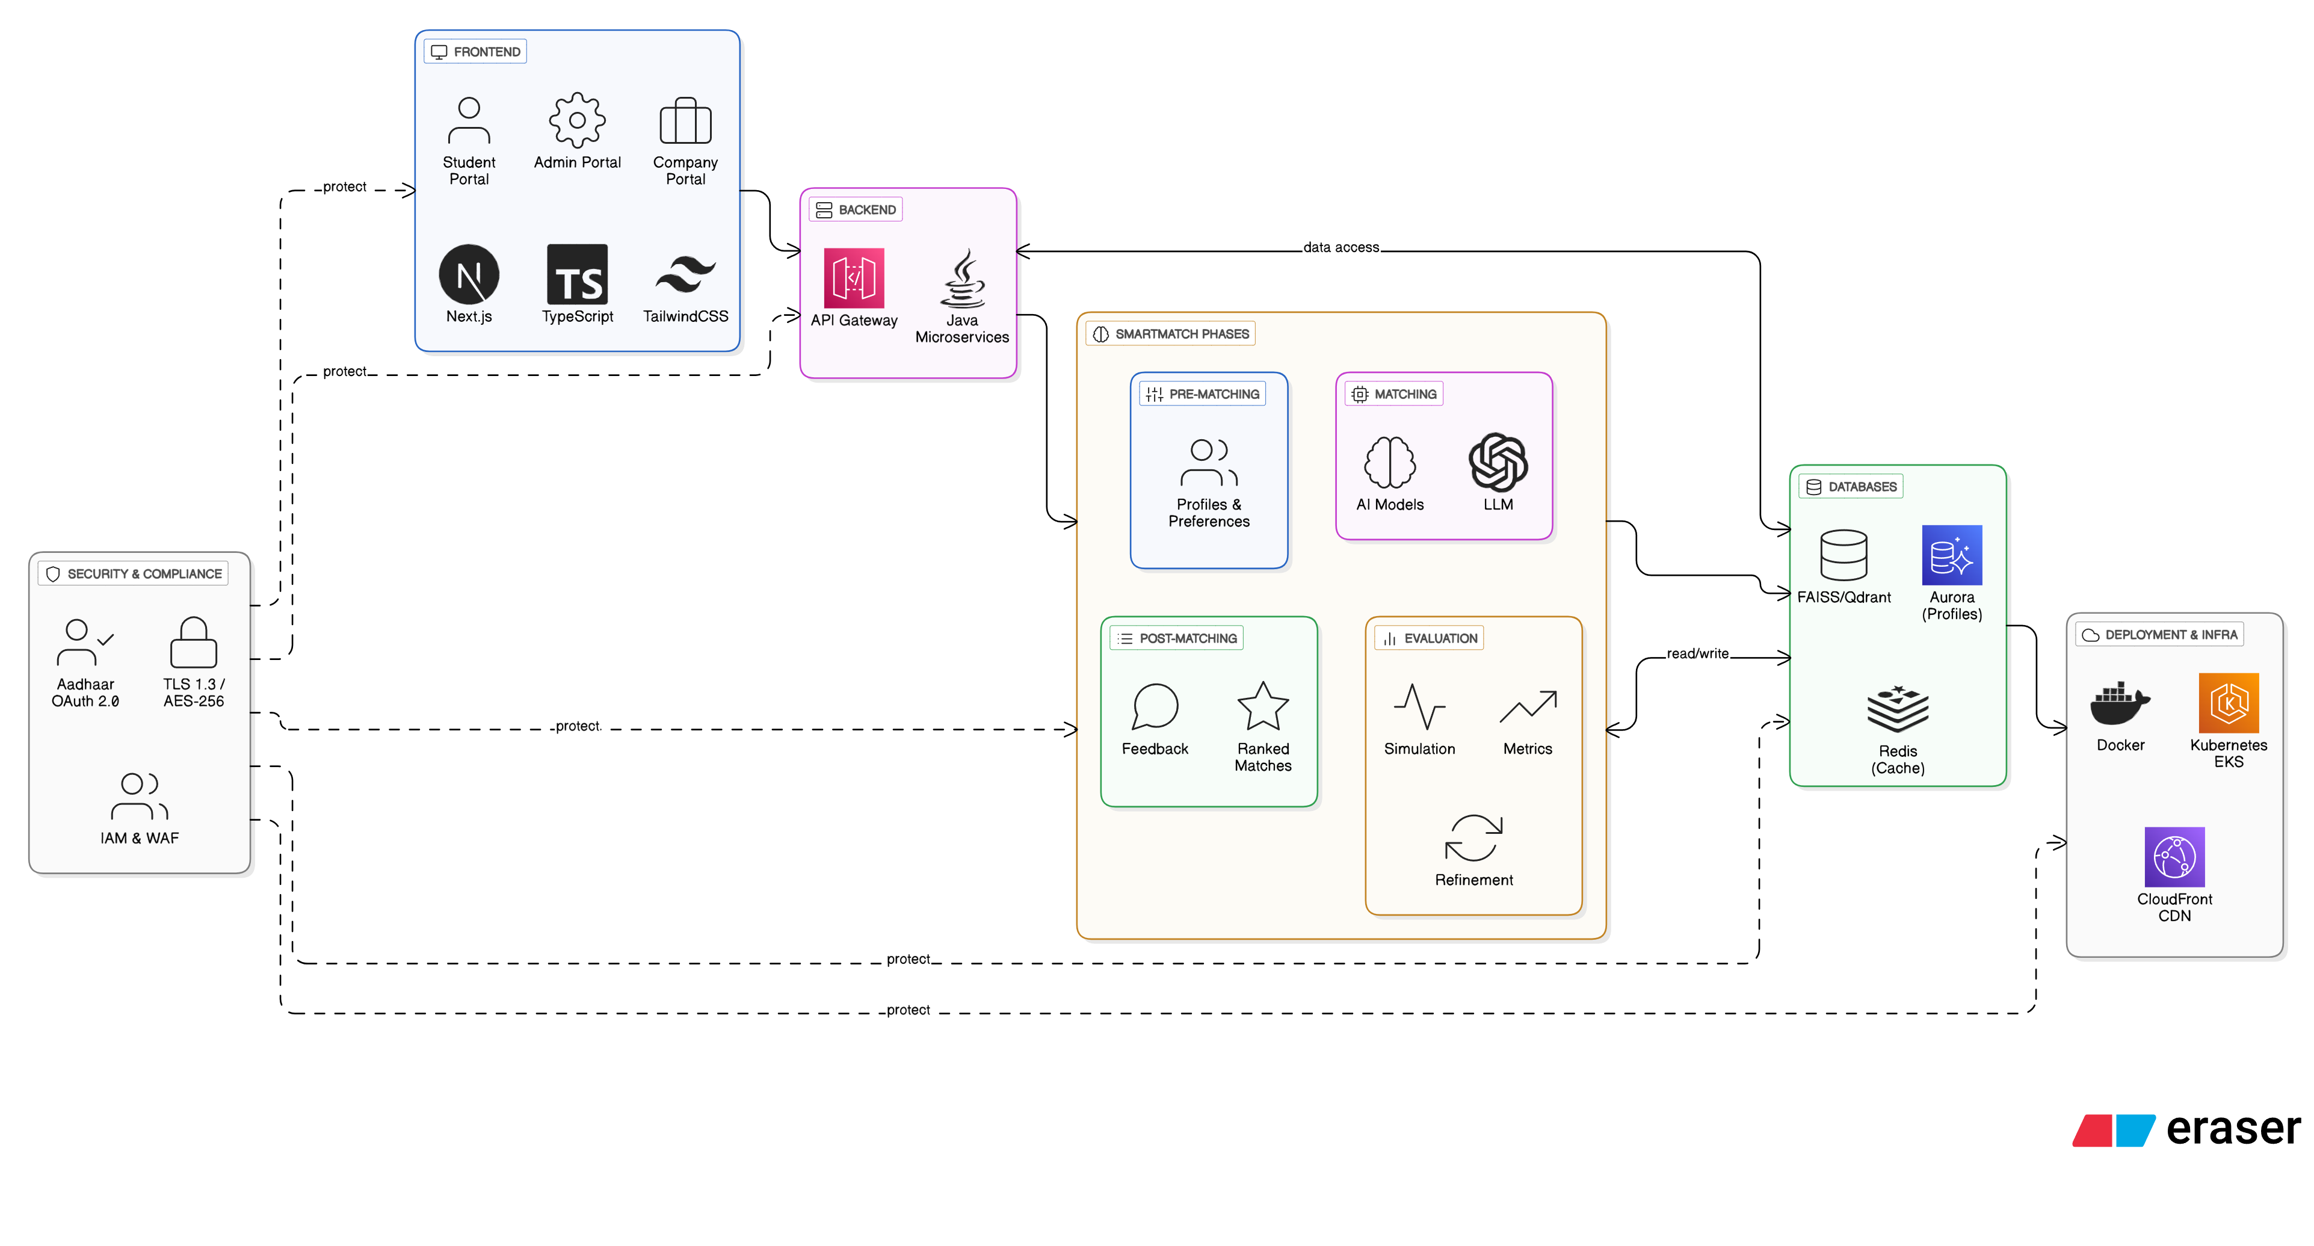
SmartMatch “Fair, transparent and scalable automated matching of students to industry internships.”
Algo
Army
Need
The PM Internship Scheme requires a fair, transparent, and scalable platform to match millions of students with companies.
Current allocation models fail to ensure equity, leaving aspirational district students overlooked.
Problem
Existing systems are manual/keyword-based with limited fairness.
10M+ student applications create a massive scalability challenge.
Industries face inefficiency and bias in talent discovery.
SmartMatch
An AI-driven allocation platform that ensures equity, scalability, and explainability.
Designed to handle 10 million+ nationwide applicants while meeting Govt affirmative action policies.
Provides intuitive dashboards for students, companies, and administrators.
Key Features
AI-Powered Allocation:
Uses Sentence Transformers + Gale–Shapley Algorithm + Multi-Objective Optimization for stable and fair matching.
Weighted Scoring Model:
Balances Core Factors (70%) with Affirmative Action (30%) for inclusive allocations.
Transparent Dashboards:
Companies configure role capacity & diversity preferences with real-time insights.
Explainable AI:
Every allocation is accompanied by “Why was I matched?” reasoning to build trust.
Architecture

Slide 3
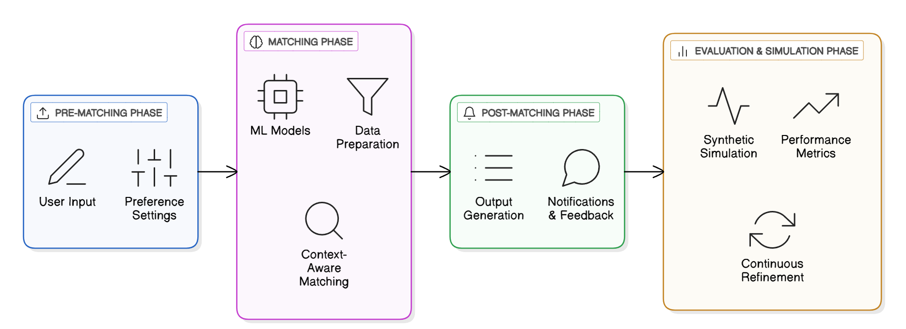
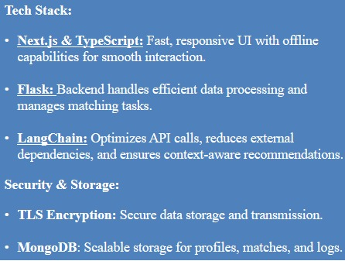
TECHNICAL APPROACH
Algo
Army
METHODOLOGY
Pre-Matching Phase:
User Input: Students upload academic, skill, and experience profiles; companies upload internship requirements and preferences.
Preference Settings: Students and companies can set priorities such as location, stipend, duration, role type, and skill focus.
Matching Phase:
Data Preparation: Clean, normalize, and label datasets for model training.
ML Models: Use embeddings and classification models to compute compatibility scores.
Context-Aware Matching: Fine-tuned LLMs analyze skills, experience, and preferences for optimal, personalized matches.
Post-Matching Phase:
Output Generation: Generate ranked lists of matches for both students and companies.
Notifications & Feedback: Alerts and recommendations sent to students and companies; feedback collected to improve future matches.
Evaluation & Simulation Phase:
Synthetic Simulation: Generate synthetic student-company interaction data to test fairness and robustness.
Performance Metrics: Evaluate using Precision, Recall, Match Satisfaction Score, and fairness metrics.
Continuous Refinement: Incorporate user feedback to enhance matching accuracy and equity.
Tech Stack:
Next.js & TypeScript: Fast, responsive UI with offline capabilities for smooth interaction.
Flask: Backend handles efficient data processing and manages matching tasks.
LangChain: Optimizes API calls, reduces external dependencies, and ensures context-aware recommendations.
Security & Storage:
TLS Encryption: Secure data storage and transmission.
SIH IDEA SUBMISSION

Slide 4
FEASIBILITY AND VIABILITY
Algo
Army
Feasibility
Technical:
Built on proven AI/ML frameworks (BERT, LangChain, SentenceTransformers) and stack (Next.js, Flask, MongoDB). Scalable and integration-ready.
Financial:
Open-source + cloud-native → cost-effective development and deployment.
Market:
Strong demand for transparent, fair internship allocation platforms. Early adoption possible through government + universities + industry partners.
Operational:
Works across portals, offline-ready UI for low-connectivity regions.
Potential Challenges & Risks:
Data Bias:
Historical data may reinforce existing biases (e.g., favoring certain regions, institutions, or demographics).
Algorithm Explainability:
Companies and students may hesitate to trust results if they see it as a “black box.”
User Adoption:
Convincing companies and institutions to onboard and actively use a new platform.
Infrastructure Load:
Handling large-scale, simultaneous applications across multiple districts or states.
Strategies to Overcome Challenges:
Bias Mitigation:
Regular auditing of algorithms to detect and minimize bias.
Introduce adjustable weightages for affirmative action (AA) factors.
Transparency & Trust:
Provide a clear “Why was I matched?” explanation with every recommendation.
Visual dashboards showing compatibility factors.
Phased Roll-out:
Launch pilot programs with government initiatives and partner institutions.
Collect early feedback and refine before large-scale deployment.
Adoption Support:
Offer onboarding workshops, help guides, and dedicated support for companies and universities.
Highlight success stories to boost credibility.
Viability
Can scale to handle millions of student applications & company postings .
Ensures fair, bias-reduced matching with continuous refinement.
Backed by Digital India vision & govt. compliance, ensuring long-term adoption.
Transparency + feedback loop builds trust among students, companies, and institutions.

Slide 5
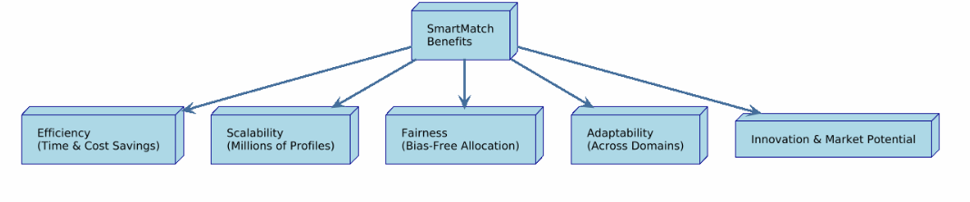
IMPACT AND BENEFITS
Algo
Army
Potential Impact
Benefits
Efficiency: Saves time and cost for companies, universities, and administrators by automating allocation.
Scalability: Handles millions of student and company profiles seamlessly across regions.
Fairness:Reduces bias with context-aware allocation models and adjustable preference settings.
Adaptability:Works across diverse domains, streams, and internship types with minimal customization.
Innovation & Market Potential: Opens pathways for adoption by corporates, universities, and government agencies nationwide.
Social Equity: Equal opportunities for rural & underserved students, bridging the urban–rural gap.
Educational Transformation: Enables universities to track student skills and align curriculum with real industry needs.
Government Support: Strengthens national internship programs through transparent, auditable AI-based allocation.
Trust & Transparency: Builds confidence among students and companies with explainable AI that reduces bias.
Workforce Development: Improves employability by connecting the right talent to the right opportunities.
Scalability at National Level: Handles millions of profiles seamlessly.
Faster Processes: Reduces manual effort in allocation, ensuring quick turnaround.
Evidence and statistics
A centralized AI allocation system could save billions in administrative costs annually.
Automated allocation reduces manual processing errors by up to 40%.
Pilot AI-based internship systems reported a 30% improvement in matching accuracy and 20% faster placements.
At scale, SmartMatch can manage 10M+ student applications, ensuring transparency and inclusion.
Nationwide adoption could support 2M+ students annually with fair and efficient internship allocation

Slide 6
RESEARCH AND REFERENCES
Algo
Army
1. Stable Matching Theory: Gale-Shapley Stable Matching Algorithm: The core theory for two-sided matching markets (e.g., medical residencies).
Gale, D., & Shapley, L. S. (1962). College Admissions and the Stability of Marriage. The American Mathematical Monthly.
2. Modern Matching Systems: Research on large-scale, real-world applications of matching algorithms.
Nobel Prize in Economics 2012 – Advanced Information.
https://www.nobelprize.org/uploads/2012/06/advanced-economicsciences2012.pdf
3. Fair ML – Bias & Equity in Algorithms: Techniques to identify and mitigate bias in algorithmic decision-making.
Mehrabi, N., et al. (2021). A Survey on Bias and Fairness in Machine Learning. ACM Computing Surveys.
https://fairmlbook.org/
4. Explainable AI (XAI) Tools: Techniques for explaining difficult models – essential for transparency in SmartMatch.
Lundberg, S. M., & Lee, S. I. (2017). A Unified Approach to Interpreting Model Predictions. NeurIPS (SHAP).
Ribeiro, M. T., Singh, S., & Guestrin, C. (2016). “Why Should I Trust You?”: Explaining the Predictions of Any Classifier. ACM SIGKDD (LIME).
https://github.com/slundberg/shap
5. Education & Policy Frameworks: National Education Policy (NEP) 2020: Focus on holistic education, skill integration, and technology use.
https://www.education.gov.in/sites/upload_files/mhrd/files/NEP_Final_English_0.pdf
Government of India initiative for transformative development of underserved districts. https://aspirationaldistricts.niti.gov.in/
Prototype demo link : DEMO LINK

