Slide 1
Red Wine Quality Prediction

Slide 2
Objective
Data Set
Histograms
Univariate Analysis
Multivariate Analysis
Algorithms
Conclusion

Slide 3
Objective
To test the quality of red wine considering several attributes of wine data set and use them against three machine learning algorithms to predict the best accuracy.
The algorithms that are being used in this project are
1. Random Forest
2. K-nearest neighbors
3. Decision tree

Slide 4
Data Set
The data set contains 12 attributes :-
1. Fixed acid 7. Total sulfur dioxide
2. Volatile acid 8. Free sulfur dioxide
3. Citric acid 9. Chlorides
4. Residual acid 10. Density
5. Sulphates 11.Alcohol
6. Quality 12. PH

Slide 5

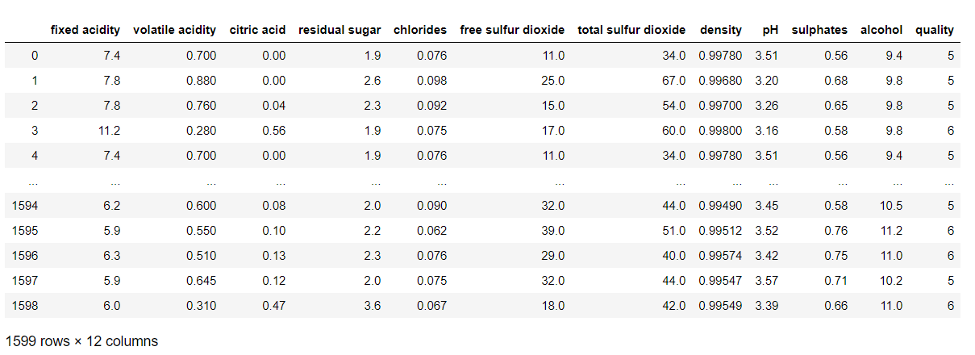
Data Reading

Slide 6
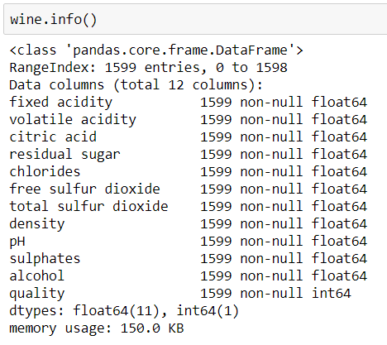
Data Information

Slide 7
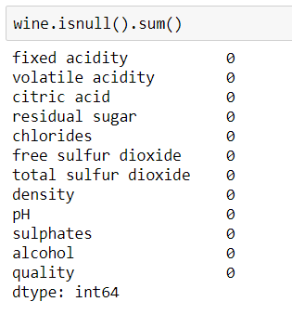
Null Value Checking

Slide 8

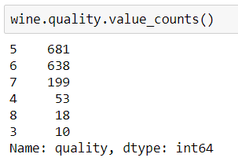
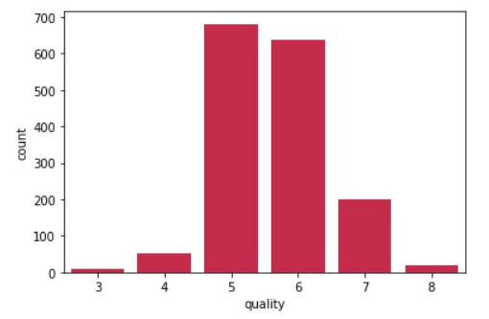
Histogram (Quality)

Slide 9
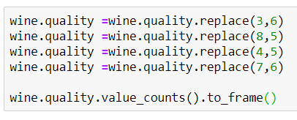

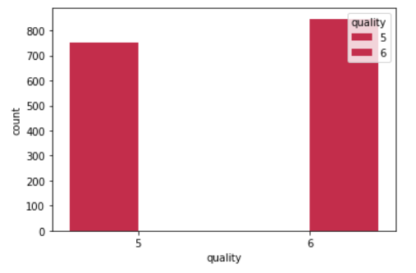
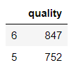
Adjusting Quality Attributes

Slide 10
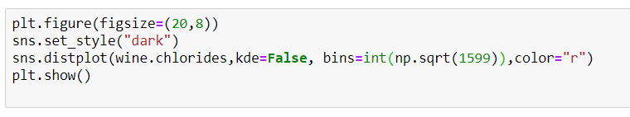
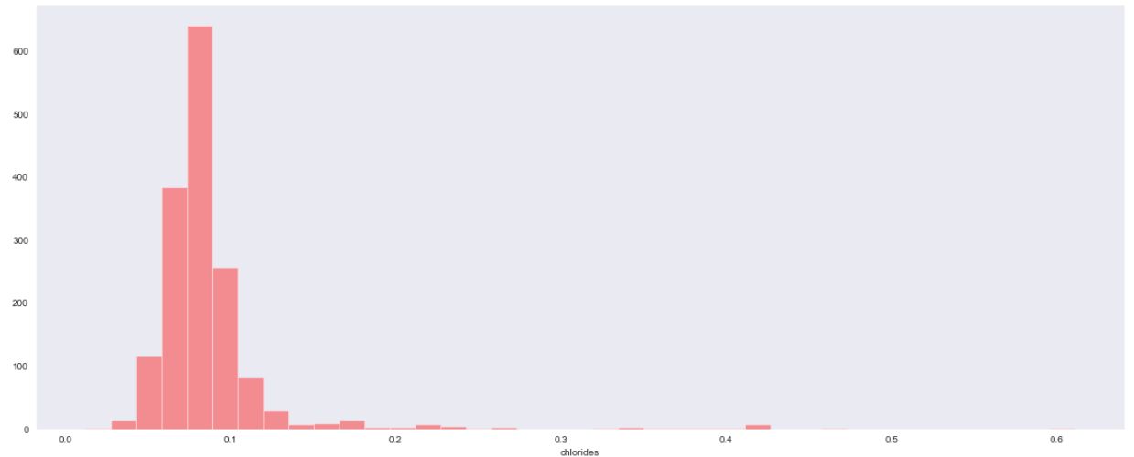
Univariate Analysis

Slide 11
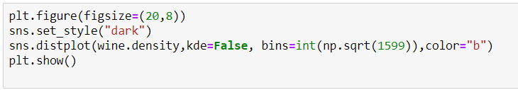
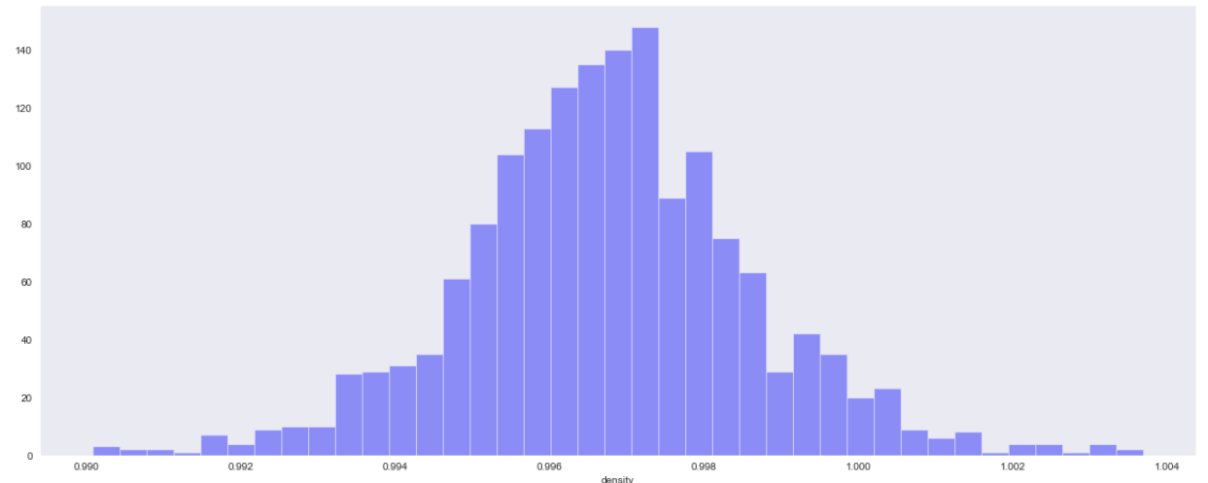
Univariate Analysis

Slide 12
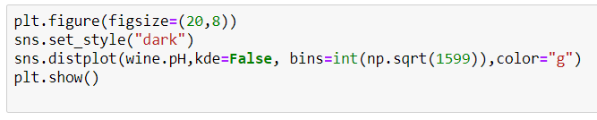
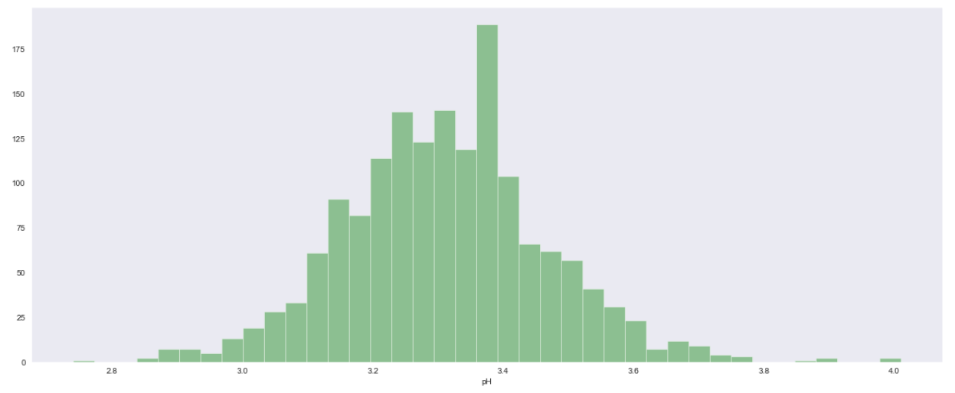
Univariate Analysis

Slide 13
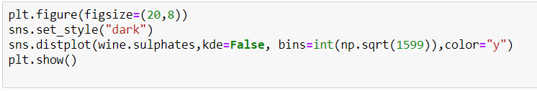
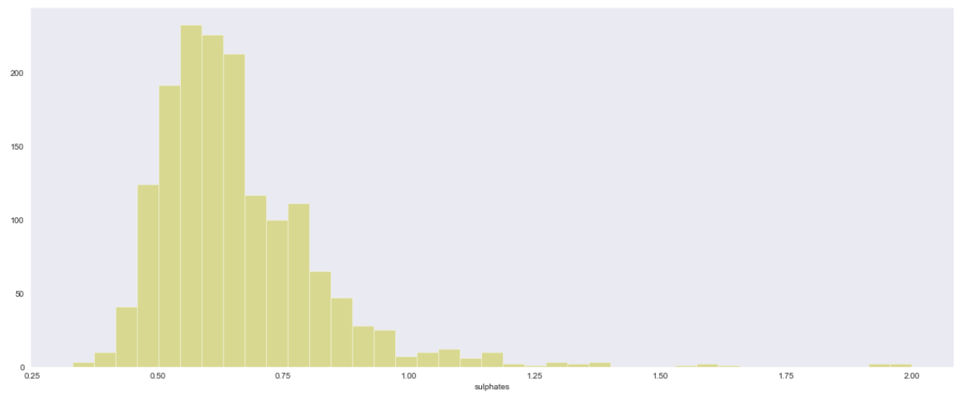
Univariate Analysis

Slide 14
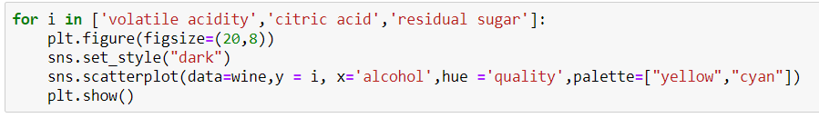
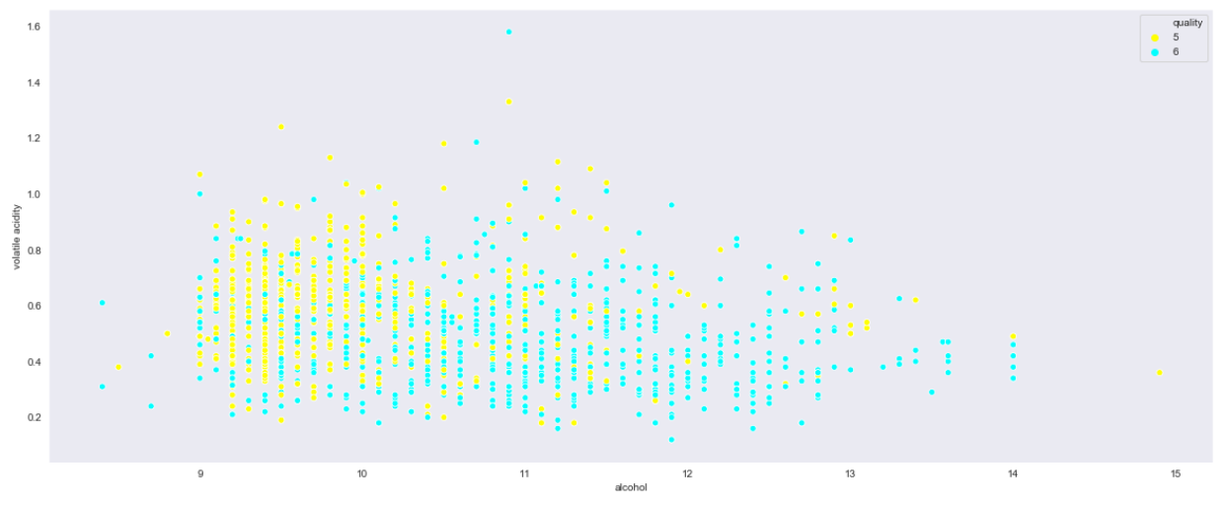
Multivariate Analysis

Slide 15
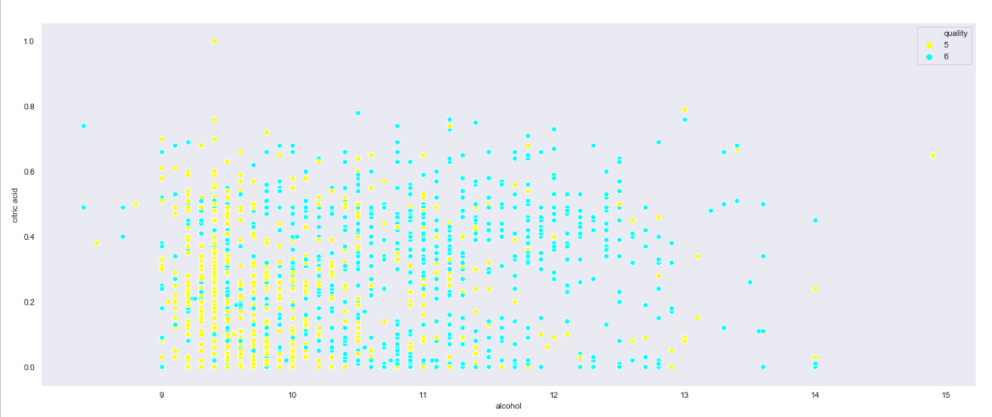
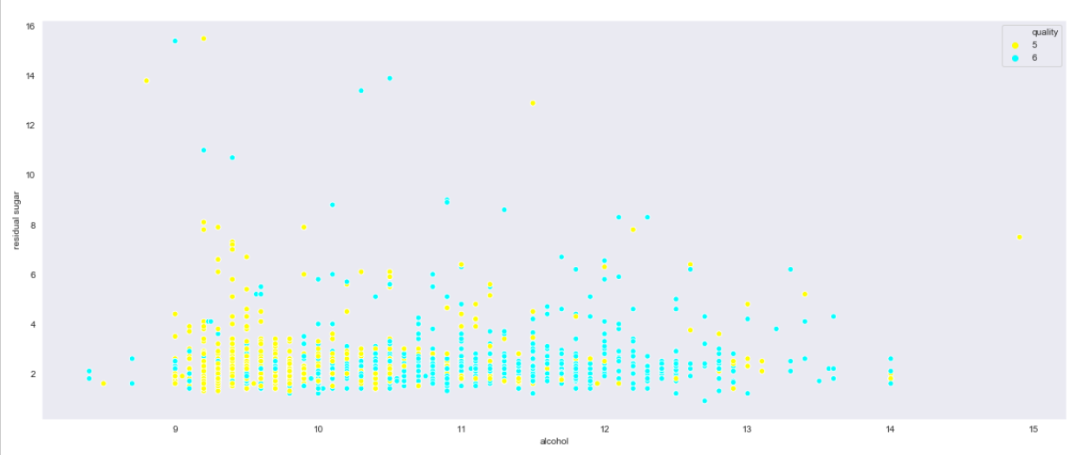

Slide 16
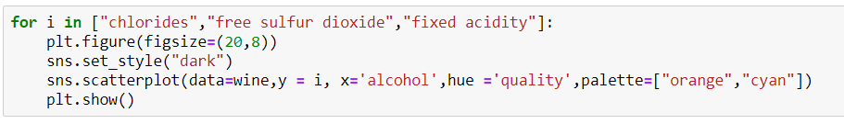
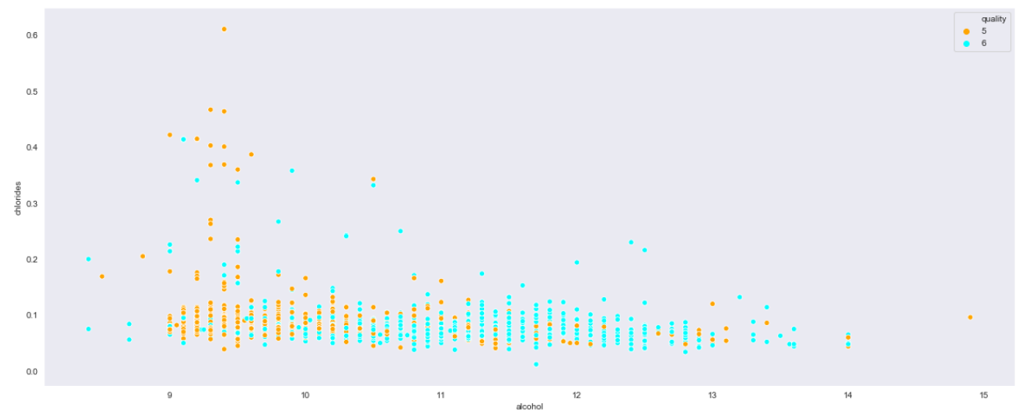
Multivariate Analysis

Slide 17
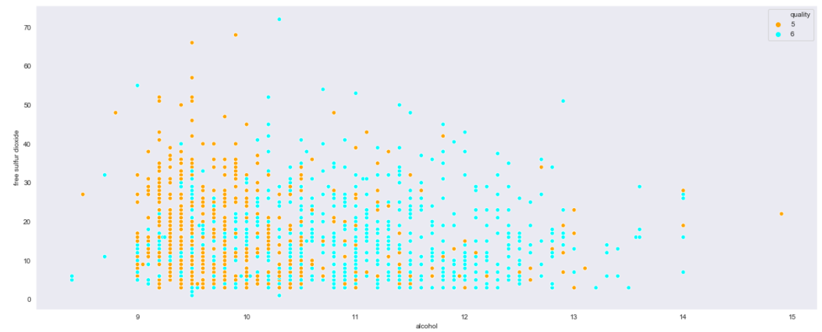
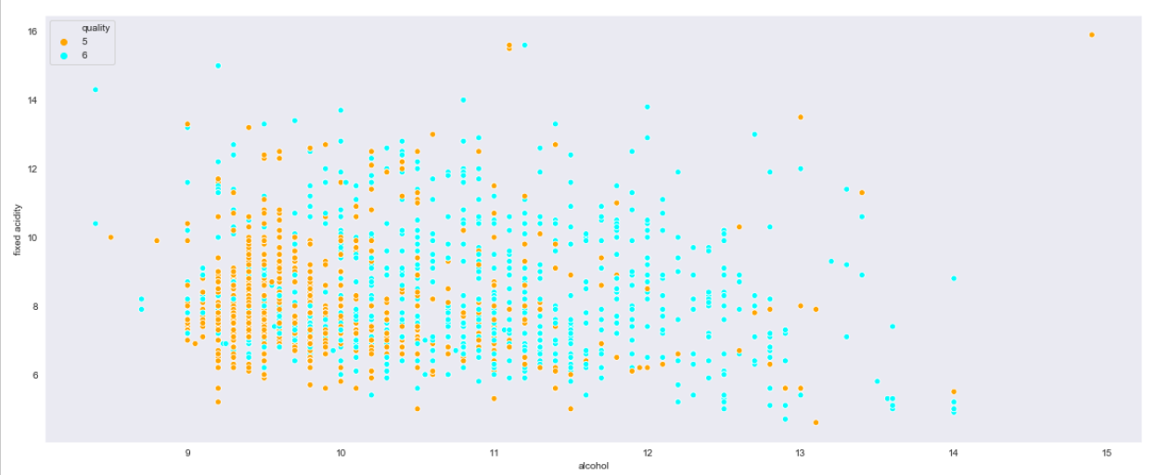

Slide 18

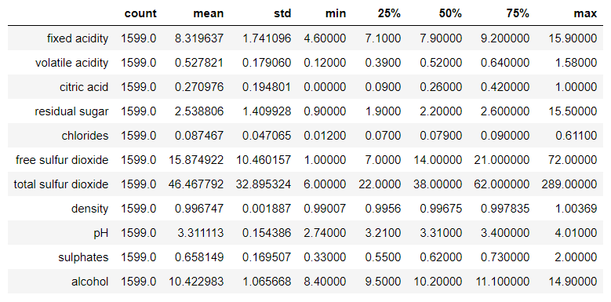
Numeric Data Description

Slide 19
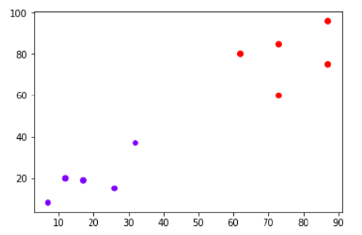
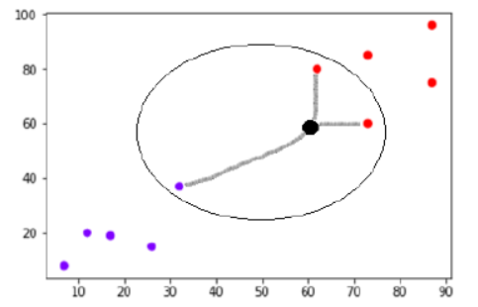
Knn Algorithm
Knn is a type of supervised learning.
It is also Known as
1. Lazy learning algorithm
2. Non parametric learning algorithm

Slide 20

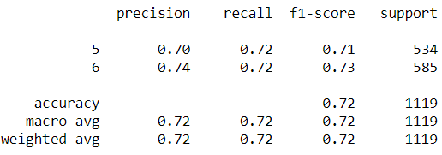
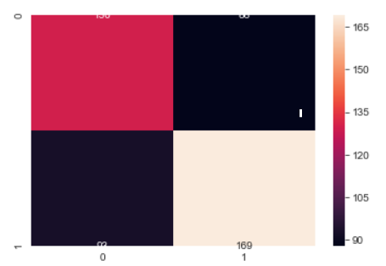
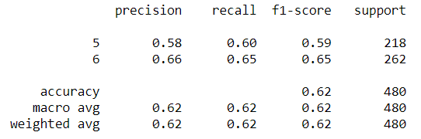
Knn Algorithm
Confusion matrix
Training set
Testing set

Slide 21
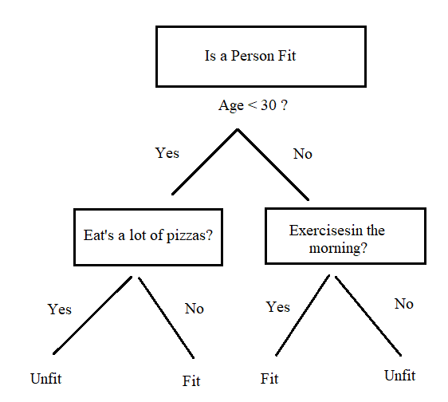
Decision Tree Algorithm
Decision tree is a type of supervised learning.
It is used to predict a class based on simple decision rules.
Based on conditions it moves from one node to another.

Slide 22

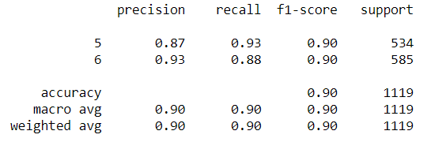
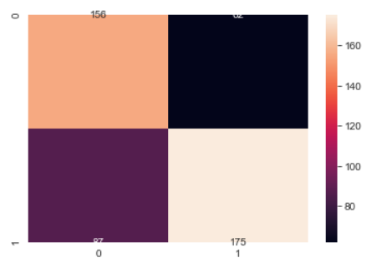
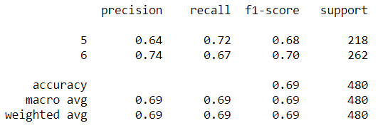
Decision Tree Algorithm
Confusion matrix
Training set
Testing set

Slide 23
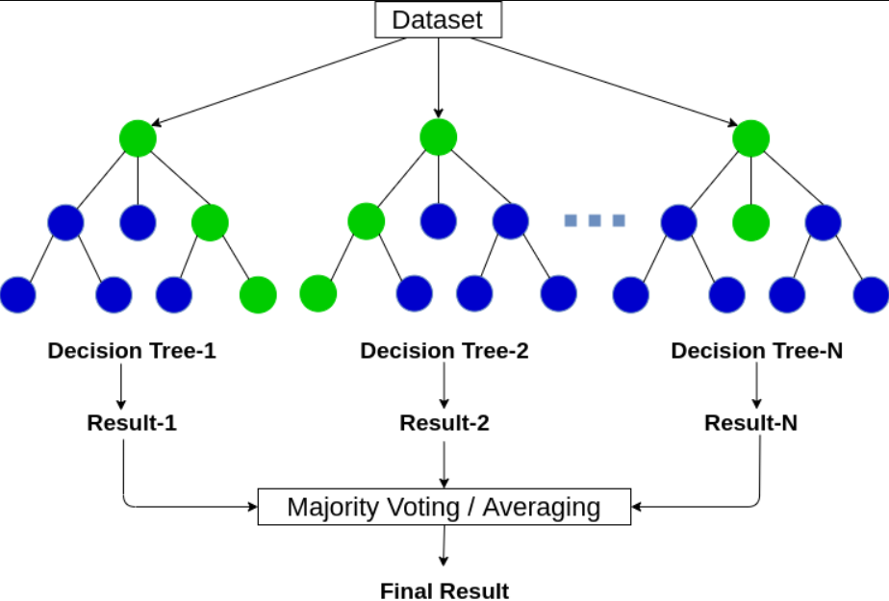
Random Forest Algorithm
Random forest is a type of supervised learning.
Basic idea is to use multiple decision trees to predict the result.
The multiple algorithms can be same or different.
It reduces over fitting by averaging the result.

Slide 24

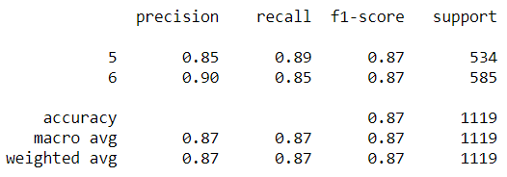
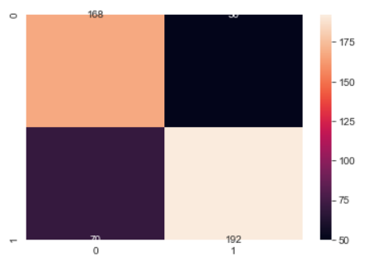
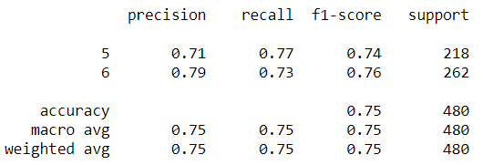
Random Forest Algorithm
Confusion matrix
Training set
Testing set

Slide 25
Conclusion
Firstly, the data set used for this project has been acquired from “kaggle” website.
Secondly, several packages like numpy, pandas, seaborn, matplotlib have been used in order to perform the statistical analysis, visualization and data splitting.
Thirdly, the data set has been split in the ratio of 7:3 using which three machine learning algorithms Decision Tree, Random Forest and KNN have been trained and tested.
Based on the results it is concluded that Random Forest is the most suitable algorithm for predicting the quality of red wine with an accuracy of “0.75”.

Slide 26
Thank you

