Slide 1

Vel Tech Rangarajan Dr. Sagunthala R&D Institute of Science and Technology
School of Computing
Department of Computer Science and Engineering
10211CS224 / FULL STACK APPLICATION DEVELOPMENT (JAVA)
PROJECT REVIEW : MILESTONE PROJECT – 1
Date: 25-03-2026
Relational Inventory Control & Stock Tracking System
SDG: 9 – Industry,Innovation,and infrastructure
Presented By:
TIRUMANI INDRANI– VTU24820 – 23UECS0902
Courses Handling Faculty:
Dr.S.Hemamalini-M.E.,PH.D,
Assistant Professor

Slide 2
INTRODUCTION
1
BACKGROUND: Most small businesses still track their shop items using old paper notebooks which is very slow and hard to maintain.
It is easy to make mistakes in counting items by hand, leading to confusion in the total stock.
IMPORTANCE: This project is important because it makes the shop management 100% digital and much more accurate.
It helps the owner save time every day and focus more on selling products to customers rather than paperwork.
RELEVANCE: This tool is perfect for small electronics stores that need to track items like mobile phones and accessories.
it allows people who are not computer experts to manage a professional database easily without any special training.
SYSTEM OVERVIEW: StockPro is a simple web-based system that records every single item in the shop inventory securely.
It tracks product names, categories, prices, and stock levels in a clear digital table that is easy to read.
2
3
4
5
6
7
8
9

Slide 3
PROBLEM STATEMENT
MANUAL WORK: Tracking stock by hand is very disorganized and takes a lot of time to update every single day.
DATA LOSS: Shop owners often lose records because paper can get damaged, wet, or lost in a busy shop environment.
SEARCHING: It is extremely difficult to find one specific item quickly when you have to look through many pages of a book.
STOCK ALERTS: There is no automatic warning system to tell the owner when a product is running low or finished.
CALCULATION: Figuring out the total value or total quantity of all stock in the shop takes a very long time by hand.
HUMAN ERROR: Writing down wrong numbers in a ledger leads to incorrect business reports and loss of money.
COMPLEXITY: Most existing business software is too hard and too expensive for small shop owners to understand.
SECURITY: Paper books are not safe as anyone can open them and see private business data and profit margins.
1
2
3
4
5
6
7
8
9

Slide 4
OBJECTIVE(S)
1
DESIGN AND DEVELOPMENT :
To create a simple "Web Dashboard" that tracks all shop items like Laptops and Phones in one digital list.
To provide a fast "Search Tool" so the owner can find any product information in less than a second.
To implement a "Low Stock Alert" system that warns the owner when items are finishing soon.
SECURITY AND DATA ACCURACY :
To build a "Secure Login" page that protects private shop records from unauthorized people.
To ensure "100% Data Accuracy" by removing the risk of human counting mistakes found in paper books.
To store all business data safely in a "MySQL Database" so it never gets lost or damaged.
2
3
4
5
6
7
8
9

Slide 5
PROPOSED SYSTEM
1
SOLUTION: A digital website built using PHP language and a safe MySQL database to store all product information.
DIGITAL RECORDS: This system replaces old paper books with a fast and modern system running on your own laptop.
DATA SECURITY: It solves the problem of missing data by saving every entry permanently on the local computer server.
EASY EDITING: The owner can add, edit, or delete any product from the list with just one simple mouse click.
AUTO NUMBERING: The system automatically gives every new item a unique ID number to keep the list organized.
LOW STOCK ALERT: It shows a visual warning in red color whenever the stock of an item falls below ten units.
USER FRIENDLY: The design is very clean and simple so that any beginner can understand it in just a few minutes.
PERFORMANCE: It runs on a private "3307 Port" to stay fast and ensure the system never crashes during work.
2
3
4
5
6
7
8
9

Slide 6
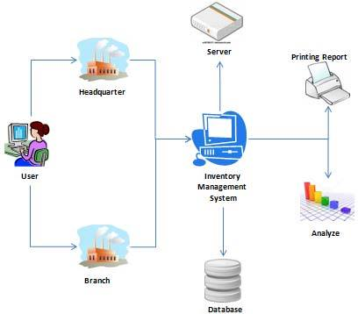
PROPOSED SYSTEM ARCHITECTURE
1
2
3
4
5
6
7
8
9

Slide 7
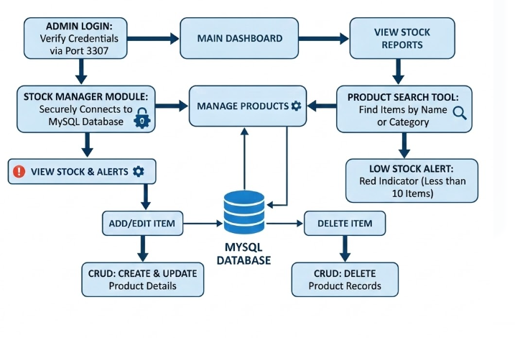
WORKFLOW
1
2
3
4
5
6
7
8
9

Slide 8
TECHNOLOGIES USED
1
FRONTEND: We used HTML5 and CSS3 to design a clean and professional-looking website interface for the shop owner.
We also used the CSS framework to make the "Dashboard" and "Buttons" look modern and easy to click.
BACKEND: The main logic of the system is built using PHP, which handles adding and deleting products from the list.
PHP ensures that when you click "Add New Product," the information is processed quickly and correctly.
DATABASE: We used MySQL to store all the shop data safely, including product names, prices, and stock quantities.
The database is connected using a private 3307 Port to ensure the connection stays fast and secure.
TOOLS: We used the XAMPP Control Panel to run our local server so the website can work on any laptop.
REQUIREMENTS: The system runs smoothly on any basic Windows Laptop with at least 4GB of RAM and a modern web browser.
2
3
4
5
6
7
8
9

Slide 9
MODULE DESCRIPTION
1
ADMIN LOGIN: A secure entry door to the system that protects all your private shop records from outsiders.
AUTHENTICATION: This module ensures that only the authorized admin "rani" can enter and change the information.
MAIN DASHBOARD: The home page of the project that shows a clear summary of every item currently in the shop.
LIVE STATUS: It tells the owner exactly how many total items are in the inventory at this exact moment.
STOCK MANAGER: The core section of the software where you can add new items like Laptops and Phones easily.
ITEM CONTROL: You can update the prices or the quantity of items whenever new deliveries arrive at the shop.
SEARCH ENGINE: A very fast search bar used to find any product instantly just by typing the first few letters.
QUICK ALERTS: It helps the owner answer customers quickly about what is available and what needs to be ordered.
2
3
4
5
6
7
8
9

Slide 10
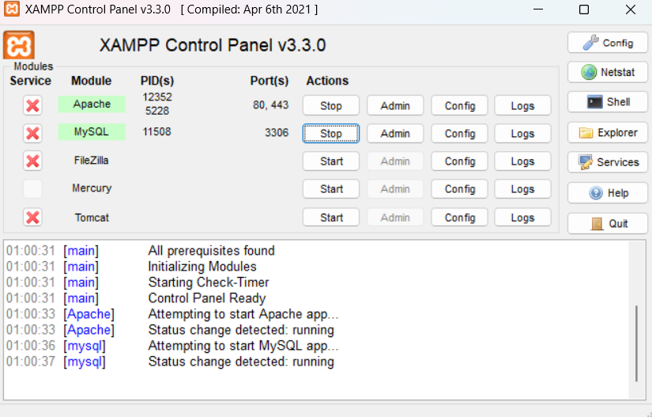
IMPLEMENTATION SCREENSHOTS
1
The system foundation relies on XAMPP, utilizing a local Apache server and a MySQL database connected via a private port for secure data management.
2
3
4
5
6
7
8
9

Slide 11
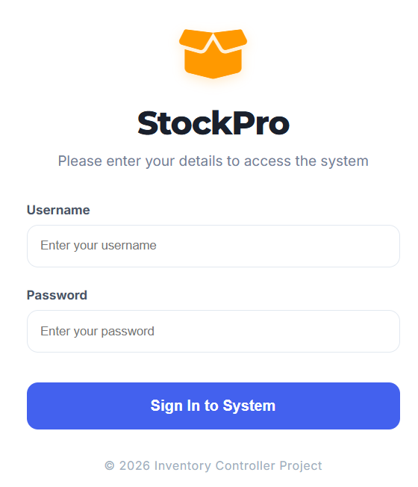
IMPLEMENTATION SCREENSHOTS
1
The secure login module provides a gateway to the system, ensuring that only the authorized administrator can access and modify inventory records.
2
3
4
5
6
7
8(A)
9

Slide 12
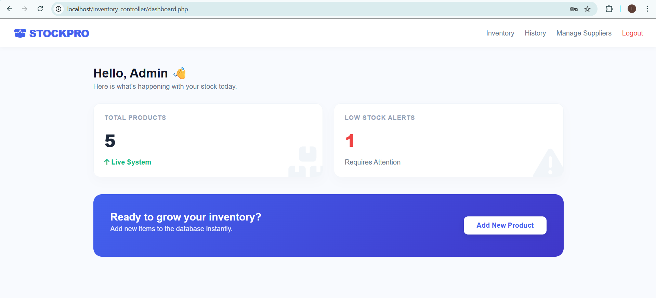
IMPLEMENTATION SCREENSHOTS
The main “dashboard “provides a real-time summary of the entire inventory, including quick-action buttons to add products and manage supplier information.
1
2
3
4
5
6
7
8(B)
9

Slide 13
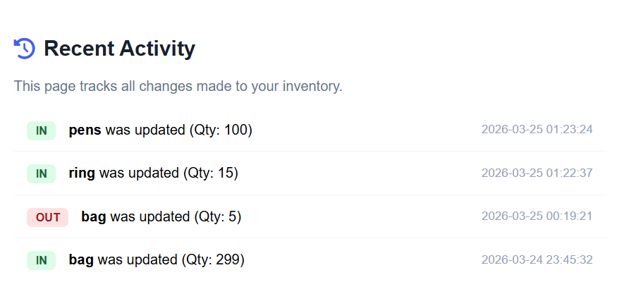
IMPLEMENTATION SCREENSHOTS
1
The Output Page features a dynamic audit log that tracks all inventory movements, displaying linked product updates and timestamps directly from the transactions table.
2
3
4
5
6
7
8(C)
9

Slide 14
ADVANTAGES & LIMITATIONS
EASY TO USE: The system is built with very simple logic so anyone can learn how to use it in 5 minutes.
ACCURACY: It provides 100% correct data every time and removes all human counting or writing errors.
SPEED: Searching for any product in the inventory takes less than one second using the built-in search tool.
COST EFFECTIVE: It is free to use for any shop because it uses open-source tools like XAMPP, PHP, and MySQL.
REQUIREMENT: You must keep the XAMPP control panel running on the laptop for the website to be accessible.
LOCAL ACCESS: It works only on the shop's laptop and is not connected to the public internet for better privacy.
BACKUP: If the computer is lost or formatted, you need a backup copy of the database to get your data back.
SINGLE USER: Currently, the system only supports one admin user to manage the entire shop inventory at a time.
1
2
3
4
5
6
7
8
9

Slide 15
Thank you

