Slide 1
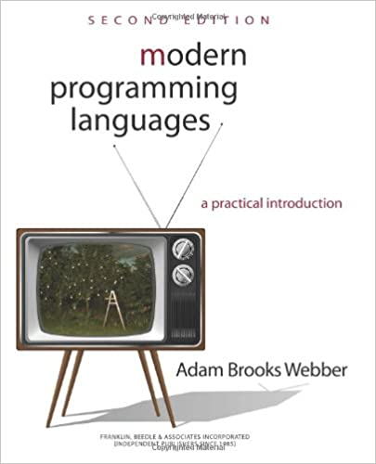
Welcome - CSC 301
CSC 301- Foundations of Programming
Languages
Instructor: Indrani Mandal
Email: indrani_mandal@uri.edu
Office: Tyler 130
Class Meetings: no fixed meeting time
Office Hours: T TR 12:00-1:00pm
WebEx: https://rhody.webex.com/meet/indrani_mandaluri.edu
TA: Madhukara Kekulandara
Email: mkekulandara@uri.edu

Slide 2
Why Study Programming Languages?
Amazing variety
  One of the moderated email lists counted ~2300 different programming languages (comp.lang.*)
“Strange” controversies
  Should a programming language have a ‘goto’ statement?
  Should an OO language allow for global functions?
  Terminology: argument vs. actual parameter.
Many connections
  Programming languages touch upon virtually all areas of computer science: from the mathematical theory of formal languages and automata to the implementation of operating systems.
Intriguing evolution
  Programming languages change!
    New ideas and experiences trigger new languages.
    New languages trigger new ideas, etc.

Slide 3
Programming Language Classes
There are many different programming language classes, but four classes or paradigms stand out:
  Imperative Languages
  Functional Languages
  Logic/Rule Based Languages
  Object-Oriented Languages

Slide 4
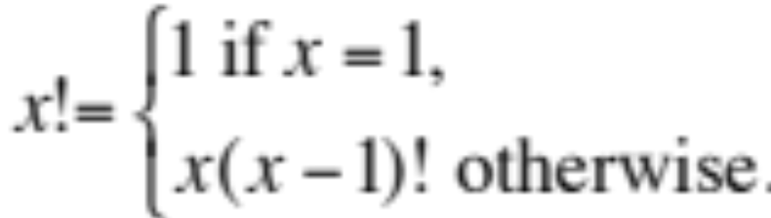
Example Computation
Recursive definition of the factorial operator
for all x > 0.

Slide 5
Imperative Languages
Hallmarks: assignment and iteration
Examples: C, FORTRAN, COBOL
Example Program: factorial program in C
int fact(int n) {
int sofar;
sofar = 1;
while (n > 1) {
sofar = sofar*n;
n--;
}
return sofar;
}
iteration
assignment

Slide 6
Imperative Languages
Observations:
  The program text determines the order of execution of the statements.
  We have the notion of a ‘current value’ of a variable – accessible state of variable.
This is not always true in other languages.

Slide 7
Functional Languages
Hallmarks: recursion and single valued variables.
Examples: ML, Lisp, Haskell
Example Program: factorial program in ML
fun fact x = if x = 1 then 1
else x*fact(x-1);
recursion

Slide 8
Functional Languages
Observations:
  There are no explicit assignments.
  The name stems from the fact that programs consist of recursive definitions of functions.

Slide 9
Logic Programming Languages
Hallmarks: programs consist of rules that specify the problem solution.
Examples: Prolog, Maude
Example Program: factorial program written in Prolog
fact(1,1).
fact(X,F) :-
X > 1,
X1 is X-1,
fact(X1,F1),
F is X*F1.
fact(in,out)
‘and’
rules
assignment

Slide 10
Logic Programming Languages
Observations:
  Rules do not appear in the order of execution in the program text.
  No specific order of execution is given – rules ‘fire’ when necessary.

Slide 11
Object-Oriented Languages
Hallmarks: bundle data with the allowed operations  Objects
Examples: Java, C++, Smalltalk
Example Program: factorial program in Java
class FactInt {
private int val;
public FactInt(int x) {
val = fact(x);
}
public int getVal() {
return val;
}
private int fact(int n) {
int sofar = 1;
while (n>1) {
sofar = sofar*n;
n--;
}
return sofar;
}
}
data
Public
operations
allowed
operations
Operation
only allowed
by the object
itself
(or subobjects)

Slide 12
Programming Language Classes
General Observations:
  Programming languages guide programmers towards a particular programming style:
    Functional → mathematical functions
    OO → objects
    Logic → rules
  Programming itself guides the developer towards new language ideas:
    Recursion was introduced by John McCarthy in the 1950’s with the programming language Lisp to solve problems in AI.
    Classes and objects were developed by Nygaard and Dahl in the 1960’s and 70’s for the language Simula in order to solve problem in simulations.

Slide 13
Take Away
There exist many programming languages today (> 2000)
In order to understand the similarities and differences ⇒ sort into classes
  Imperative
    assignment and iteration
  Functional
    Recursion, single valued variables
  Logic/rule based
    programs consist of rules
  Object-oriented
    bundle data with the allowed operations

Slide 14
Assignments
Read Chapters 1&2

