Slide 1
ML
ML is a functional programming language
the ML environment runs in an interactive mode
$ sml
Standard ML of New Jersey v110.78 [built: Tue Sep 8 14:59:55 2015]-
-
At the prompt the system expects a valid sentence in ML
ML System Prompt
Read Chap 5

Slide 2
ML – Constant Exressions
The simplest sentence in the ML language is a constant expression
Standard ML...
- 1234;
val it = 1234 : int
-
Sentence Delimiter
Other Constants:
real 123.4
bool true/false
string “Susan”
char #”Q”
Internal
Variable
Type of
the Value
Value

Slide 3
ML – Operators and Simple Expressions
Example:
- ~ 1 + 2 – 3;
val it = ~2 : int
string concatenation;
“abc” ^ “def”
~ is the unary -,
here -2.
Precedence | Operators
High | not ~
 | * / div mod
 | + - ^
 | < > <= >= = <>
 | andalso (logical and)
Low | orelse (logical or)
- (4 > 0) andalso (4 mod 2 = 0);
val it = true : bool

Slide 4
ML – Conditional Expressions
if – then – else
or
if – then
if 1 < 2 then #”x” else #”y”;
val it = #”x” : char

Slide 5
ML – Type Conversions
Most programming languages we are used to allow
for mixed-type expressions such as
3.0 * 2
real
int
ML does not allow mixed-type expressions.
3.0 * 2;
Error: operator and operand don't agree
operator domain: real * real
operand: real * int
in expression:
3.0 * 2
-

Slide 6
ML – Type Conversions
However, we can use type conversions to manipulate the types
of an expression.
Example:
real: int → real
conversion function
from integers to reals
function
name
signature
Other conversion functions:
floor: real → int (round down)
ceil: real → int (round up)
round: real → int (round to nearest int)

Slide 7
ML – Type Conversions
We can now rewrite our illegal expression from before:
- 3.0 * real(2);
val it = 6.0 : real
Convert 2 into 2.0
or
- floor(3.0) * 2;
val it = 6 : int

Slide 8
ML – Variable Definitions
Very simple syntax:
- val x = 1 + 2 * floor(3.0);
val x = 7 : int
In ML you do not need
to declare the type of a variable;
ML will determine its type through
type inference.
No longer the
default variable
Of course we can use the values of variables:
- x + 1;
val it = 8 : int

Slide 9
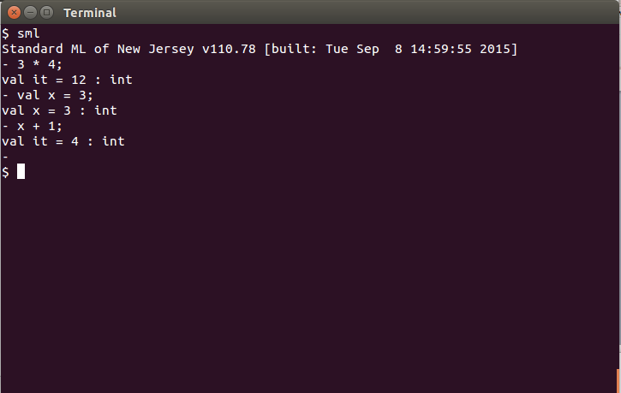
Try it yourself
type Cntrl-D to exit
Log into UbuntuBox
account: csc301 password: csc301$is$fun
start a terminal
run sml (see above)

