Slide 1
Parameters
We have discussed different classes of variables so far:
_x0010_Global/static variables
Function local or automatic variables
Dynamic, heap allocated variables
However, one important class of variables is still missing ⇒ parameters
Chap 18
Terminology: Example: Java, C, C++
int plus (int a, int b)
{
return a + b;
}
…
int x = plus(1,2);
…
Formal Parameters
Function
Definition
Observation: in function
definitions formal parameters
act as placeholders for the
values of actual parameters.
Function Body
Actual Parameters
Function
Call

Slide 2
Two Fundamental Questions
How is the correspondence between actual and formal parameters established?
How is the value of an actual parameter transmitted to a formal parameter?

Slide 3
Correspondence
Most programming languages use positional parameters; the first actual
parameter is assigned to the first formal parameter, the second actual
parameter is assigned to the second formal parameters, etc.
1
2
int x = plus(1,2);
int plus (int a, int b)
{
return a + b;
}
1
2

Slide 4
Correspondence
Some languages such as Ada provide keyword parameters.
Example: Ada
FUNCTION Divide(Dividend:Float, Divisor:Float) RETURN Float IS
BEGIN
RETURN Dividend/Divisor;
END
...
Foo = Divide(Divisor => 2.0, Dividend => 4.0);
...
2nd formal
parameter
becomes 2.0
1st formal
Parameter
Becomes 4.0

Slide 5
Parameter Value Transmission
We look at three different techniques
  By value
  By value-result
  By reference

Slide 6
I. By Value
For by-value parameter passing, the formal parameter is just like a local variable in the activation record of the called method, with one important difference: it is initialized using the value of the corresponding actual parameter, before the called method begins executing.
Also called ‘copy-in’
Simplest method
Widely used
The only method in Java

Slide 7
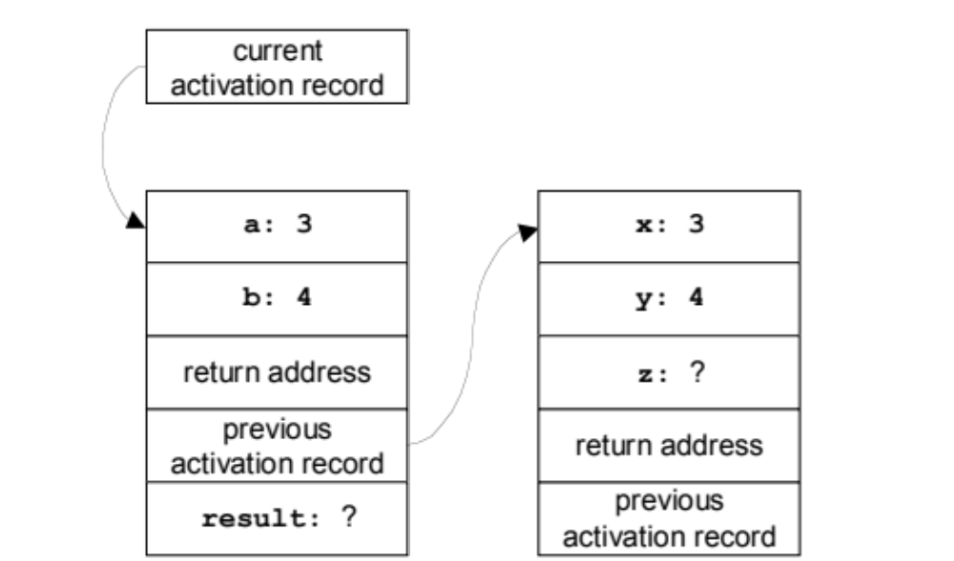
By Value - Example
int plus(int a, int b) {
a += b;
return a;
}
void f() {
int x = 3;
int y = 4;
int z = plus(x, y);
}
When plus is starting

Slide 8
II. By Value-Result
For passing parameters by value-result, the formal parameter is just like a local variable in the activation record of the called method. It is initialized using the value of the corresponding actual parameter, before the called method begins executing. Then, after the called method finishes executing, the final value of the formal parameter is assigned to the actual parameter.
Also called ‘copy-in/copy-out’
Actual must have an lvalue
Lvalues are values that have addresses, meaning they
are variables or dereferenced references to a certain place.

Slide 9
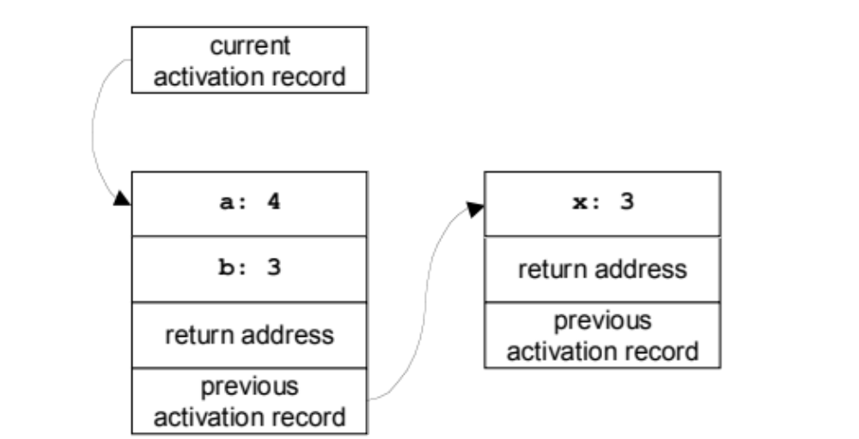
By Value-Result - Example
void plus(int a, by-value-result int b) {
b += a;
}
void f() {
int x = 3;
plus(4, x);
}
When plus is starting

Slide 10

By Value-Result - Example
void plus(int a, by-value-result int b) {
b += a;
}
void f() {
int x = 3;
plus(4, x);
}
When plus is ready to return

Slide 11
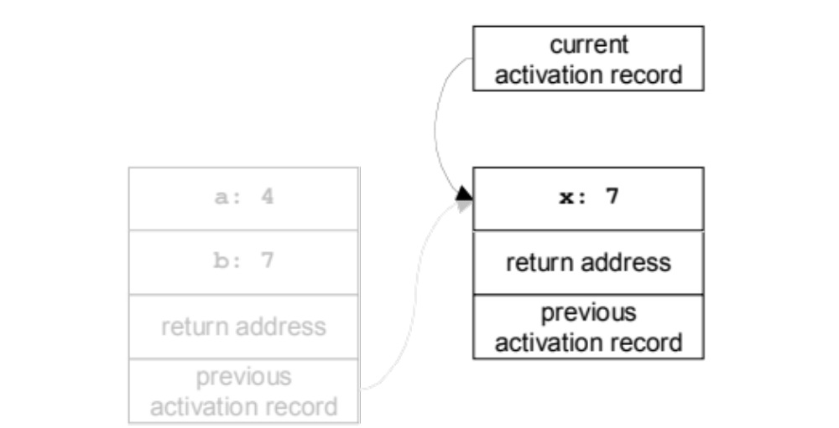
By Value-Result - Example
void plus(int a, by-value-result int b) {
b += a;
}
void f() {
int x = 3;
plus(4, x);
}
When plus has returned

Slide 12
III. By Reference
For passing parameters by reference, the lvalue of the actual parameter is computed before the called method executes. Inside the called method, that lvalue is used as the lvalue of the corresponding formal parameter. In effect, the formal parameter is an alias for the actual parameter—another name for the same memory location.
One of the earliest methods: Fortran
Most efficient for large objects
Still frequently used; C++ allows you define calls by reference

Slide 13
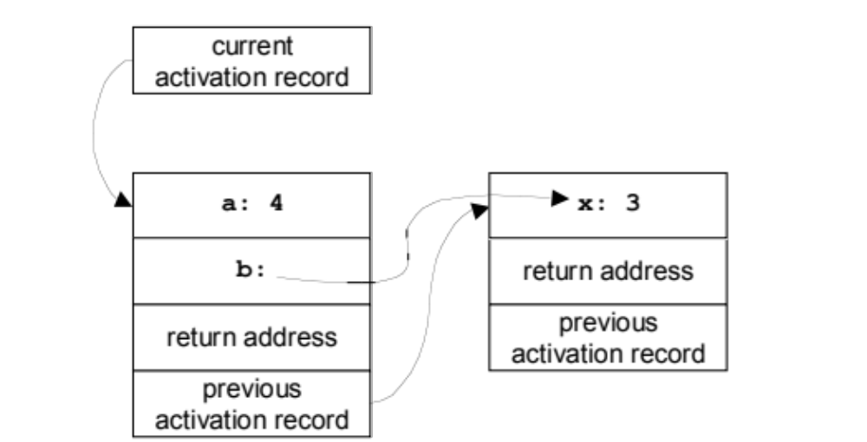
By Reference - Example
void plus(int a, by-reference int b) {
b += a;
}
void f() {
int x = 3;
plus(4, x);
}
When plus is starting

Slide 14

By Reference - Example
void plus(int a, by-reference int b) {
b += a;
}
void f() {
int x = 3;
plus(4, x);
}
When plus has made the assignment

Slide 15
Homework
HW#9 – see website
Notes:
HW #9 Problems 18.6 a,b,c

